Slide 1
IT Strategic Plan
Todd Simpson, Chief Information Officer, FDA
May 16, 2017

Slide 2
Welcome!
2017
2nd Annual OIMT Outreach & Technology Day
Notes:
Hello, I am Todd Simpson, FDA’s Chief Information Officer. As I look out across the audience, I see familiar faces from last year’s event as well as many new faces joining us this year. I want to extend my appreciation and a very warm welcome to all of you for attending our 2nd Annual Technology and Outreach Day!
We had such a great turn out and exchange last year during our Inaugural Event that we decided we needed to do this every year! We hope that you find it beneficial and look forward to seeing you in the years to come.
As I did last year, I would like to highlight FDA’s public health mission for those of you that may not be familiar with the breadth and depth of FDA responsibilities. I will also discuss our implementation progress of the IT Strategic plan and the priorities that we are focusing on over the next 2 years.

Slide 3
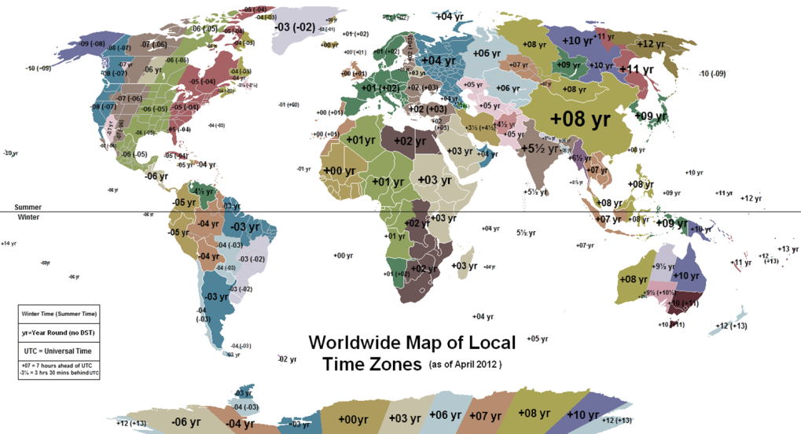
GLOBAL PUBLIC HEALTH MISSION
The United States Food and Drug Administration (FDA) is a science-based Federal Regulatory Agency responsible for protecting and promoting public health through the regulation and supervision of food safety, tobacco products, dietary supplements, prescription and over-the-counter pharmaceutical drugs (medications), vaccines, biopharmaceuticals, blood transfusions, medical devices, electromagnetic radiation emitting devices, and veterinary products.
It is estimated that more the 25% of the nation’s gross domestic product is regulated by the FDA. Those regulated products are submitted, reviewed, coordinated, supported and approved through our information technology systems and data repositories.
FDA Fast Facts
Science-Based Regulatory Agency
Organized by Product Area
Field Offices and Labs throughout U.S.
Field Offices in other countries.
Approximately 22,000 Employees
Notes:
FDA
Science-based Federal Regulatory Agency
Responsible for protecting and promoting the public health
Regulation and supervision of
Food safety
Tobacco products
Dietary supplements
Prescription and over-the-counter pharmaceutical drugs
Vaccines
Biopharmaceuticals
Blood transfusions
Medical devices
Veterinary products
Estimated 25% of nation’s gross domestic product is regulated by the FDA
FDA has offices and labs throughout the US.
In today's world, other countries produce significant portions of the food and medical products that U.S. consumers and patients use in their daily lives.
In fact 300,000 foreign facilities from more than 150 countries export FDA-regulated products to the United States.
Therefore, in 2008 to address this globalization, FDA established foreign offices in China, Europe, India and Latin America.
These FDA offices overseas work closely with foreign governments, industry and other stakeholders to enable FDA to more effectively protect U.S. consumers.

Slide 4


OIMT | Office of Information Management and Technology
Information Technology Strategic Plan
2015-2018
Update 2016
Notes:
For those of you that may not have attended last year’s Outreach and Technology Day…
In 2015, OIMT developed an IT Strategic Plan in concert with our colleagues across the Agency.
Coupled with the IT Strategic Plan, we developed an annual update process to ensure our strategic plan remains aligned with agency priorities and agile to address emerging FDA business needs.
Since the fall of 2016 and into early 2017, we have updated our Plan to:
Account for the activities that have been completed over the last year,
Ensure alignment with overall FDA strategic priorities and Office/Center activities and;
Ensure clarity and consistency in the level of detail of the strategic plan content.

Slide 5
Implementation Progress
2018
January 2017: ~ 40%
April 2016: ~ 25%
September 2015
Notes:
As we worked through the update process, we felt good about the progress we’ve made in information technology across the Agency since the posting of our strategic plan in October 2015.
We had completed approximately 40% of the strategic milestones and have reduced central OIMT costs per IT user by 23.2% since 2014.
But we also know that there is still much work to be done.
I will now walk through our updated strategic plan, upcoming priorities and the outcomes we hope to realize upon completion of these activities. For many of you that attended last year, this will be familiar. But it is important to review for our new attendees and to share how we have adjusted to our evolving mission and the rapidly changing information ecosystem to support and enable our customers, to more efficiently perform their mission critical work through use of information technology.

Slide 6
Major Accomplishments
Enhanced Service Offerings |  |  | Governance, Communication & Transparency
Choose Your Own Device Program | Systems Management Center (SMC) | Electronic Submissions Gateway (ESG) Upgrade | Enterprise Portfolio Management Office | OIMT Communication Council
Multiple Cloud Services | Chief Technology Officer (CTO) | ServiceNow & ITIL | Balanced Scorecard Methodology | Quarterly Field and Center/Office Meetings
Cybersecurity Task Force and GAO Remediation | Collaboration Pilots | Network Upgrades & Internet 2 | Governance Sub-Committees | High Performance Computing (HPC) Governance Board
eNSpect | ACE Customs Interface | Infrastructure & Application Monitoring | Portfolio of Projects, Project Reviews & Standard Reporting | Intake Process
Notes:
A few of our notable accomplishments include but are not limited to
(note metrics as of the Jan 2017 Strategic Plan Update):
<<Enhanced Service Offerings - 1st row (left to right) >>
We have implemented the choose your own device (CYOD) program in April 2016.
We have embraced new technologies and adapted to the new trends by introducing a variety of mobile platforms such as the iPhones 5 and 6, Samsung Note and Galaxy along with a series of Blackberry models bringing the total mobile unit count to 9069.
And the number of mobile devices is continuing to grow at a rapid rate
Implemented FDA Systems Management Center (SMC) to unify Network and Security Operations Centers, to afford network, systems, application, and cybersecurity threat management activities and operations.
The SMC is formally U.S Food and Drug Administration central command and control center for the monitoring, triaging, troubleshooting, and restoral and the escalation of all detected or reported or potential security incidents, performance issues, enterprise services, and infrastructure operations.
Completed an ESG upgrade in April 2016, resulting in a significant reduction in the time it takes for an industry sponsor to upload and receive acknowledgment from the FDA that the file has been received.
This improvement translates into a much faster upload time for industry. In addition, we improved the notification process and speed for industry to receive confirmation of a successful upload.
For example, a typical 4Gigabytes (GB) submission previously would often take more than an hour to upload; but after the changes implemented in April a 4Gb submission takes on average 15 minutes to upload
We have deployed multiple cloud services to support the mission of FDA.
For example, the WebEx sessions used by FDA users for teleconference and desktop screen sharing are being provided in a cloud environment.
The helpdesk ticketing system has also been migrated to the cloud to provide better functionality.
FDA will continue to explore the cloud landscape to allow users to leverage the benefits of the cloud.
Hired a Chief Technology Officer
OIMT is implementing a one stop shop through the Employee Resource & Information Center (ERIC) call center and through the implementation of the new IT ticketing and tracking system (ServiceNow ticketing component implemented in December 2016).
Our customers have the ability to get detailed information about the status of all of your requests.
Furthermore, through the implementation of a service catalog this will define what we do and how customers obtain the services.
The implementation of the service catalog will provide a clear expectation on when users can expect to receive a service after it is requested, as well as see the full offerings available to FDA.
To ensure greater cohesion we established a Cybersecurity Task Force with the scientific community to discuss requirements and identify secure solutions that meet the Agency research needs.
Additionally, for an advanced external collaboration we are also looking into a cloud technology similar to Dropbox that allows our partner labs, locally within United States as well as international, to share and collaborate using large amounts of datasets without having to exchange thousands of emails through a secure online portal.
Through the increase of the network bandwidth and the network upgrade we are working to facilitate the transfer of large data sets across the network by implementing Internet 2.
Internet 2 allows the ability to create and use dedicated high-speed connections as needed between external organizations and FDA. One important advantage of this approach is increasing the throughput of genomics analysis.
Implemented eNspect which allows for inspections of establishments and associated reporting. We currently have used eNspect in over 18,000 ORA inspections with an average of approximately 2500 inspections a month through the advanced mobile platform.
Successfully implemented the ACE interface with Customs, to improve import processing with over 99% of FDA import submission entries using the new system. in order to clear imports,
As of Jan 2017 we had 28.5 million lines have run through ACE/ITDS, 98% consumption entries are coming through this new system.
<<Governance & Communication enhancements – top row (left to right)>>
In addition to the above, we have made significant changes within our organization to improve information technology governance, service delivery, transparency and communication, these include
Established an Office of Enterprise Portfolio Management to provide oversight for all IT projects and investments, using standard review and reporting procedures to measure the performance and compliance of projects. And developed an Enterprise Project Management team to manage select strategic enterprise programs, and provide oversight, guidance, and mentorship to other OIMT projects.
Established an OIMT Communication Council to improve and provide consistent communications within our organization and the FDA community.
Employed a balanced scorecard methodology to inform our customers about IT initiatives and on-going activities, and measure our adherence to the established SLAs and OLAs.
Established quarterly meetings to increase communication and provide better customer service to the field and with the FDA Centers and Offices.
Developed Subcommittees that tactically execute and identify business process innovations and deliver innovative business solutions; not simply IT solutions
We are working toward an HPC as a Service (HPCaaS) model that will ensure Enterprise support of this critical service and to ensure that we keep pace with inevitable technology changes.
We established a portfolio of projects, active projects are reviewed on a weekly basis and we have implemented standard reporting (e.g., quad charts) for all of our projects.
We have established an Agency-wide project intake process for our customers

Slide 7
Goals and Objectives
Notes:
Our Mission is to provide high quality, secure and efficient solutions that enable the FDA to promote and protect the public health through partnership and collaboration with the Offices, Centers and our customers.
The OIMT Vision is to provide world-class technology services and be the Federal model of a successful IT organization.
Our plan is comprised of 3 main result driven goals (as detailed on this slide):
Security and compliance
Quality
Efficiency
Within each goal are objectives that we are working toward achieving.
For the Security & Compliance goal, the objectives include enhancing cybersecurity compliance & operations, improving FITARA compliance and Improving Mandates & IT Audit Compliance
For the Quality goal, the objectives include improving awareness and accountability of services, improving communication, improving delivery of service, improving partnership with customers and developing and retaining a highly skilled workforce
And last but not least for the Efficiency goal, the objectives include reducing redundancy and promoting consolidation, improving asset management, fully leveraging consumption based cost model, improving process efficiency and effectiveness and improving utilization and technology.

Slide 8
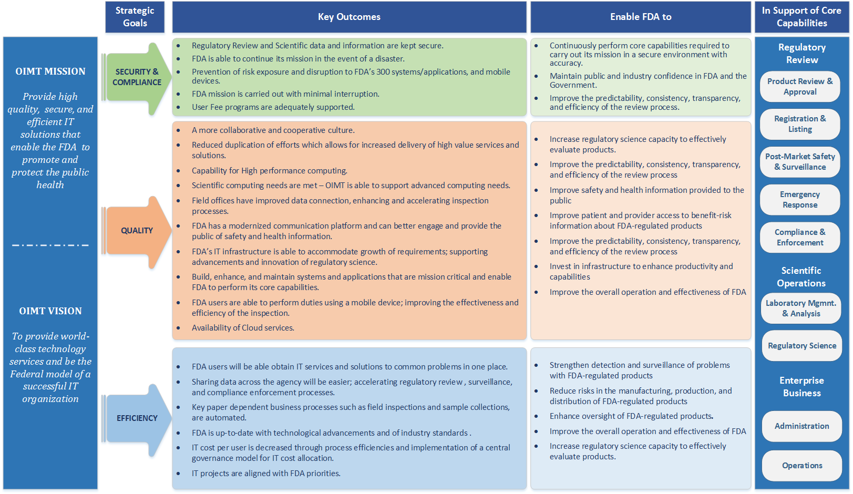
OIMT Strategic Plan
2015-2018
Notes:
OIMT Supporting FDA Priorities - This diagram was developed to show the key outcomes expected for each of the 3 strategic goals and how the outcomes enable FDA to meet its’ priorities.
<<walk through diagram if appropriate>>

Slide 9
Goal 1: Security and Compliance
Ensure the security, reliability and accuracy, of the Agency’s systems as required and in support of key regulations and mandates.
Objective 1.1: Enhance Cybersecurity Compliance & Operations
Key Initiatives:
1.1.1 Enhance and strengthen the FDA Cybersecurity Program: conduct highly effective incident response, insider threat detection, operational situational awareness, compliance, decrease the overall security risks to sensitive FDA information and IT infrastructure.
1.1.2 Implement data loss prevention, multi-factor authentication, security incident/event management tools, and encryption at rest.
1.1.3 Implement Continuous Diagnostics and Mitigation capabilities.
1.1.4 Develop, implement, and maintain cybersecurity risk management capabilities and methodologies.
1.1.5 Ensure compliance with and enforcement of national, departmental, and agency cybersecurity regulations, standards, and policies that align with federal requirements.
1.1.6 Address recommendations made by the Government Accountability Office (GAO) audit and long standing FISMA findings, threats, vulnerabilities, risks, and weaknesses.
1.1.7 Develop both a dynamic and static application security testing.
Objective 1.2: Improve FITARA Compliance
Key Initiatives:
1.2.1 Assess and implement FAC-P/PM strategy for major investments.
1.2.2 Improve process for budget formulation and tracking.
1.2.3 Develop strategy for software sourcing to enhance Agency-wide acquisition, shared use, and dissemination of software, as well as compliance with end user license agreements.
Notes:
Detailed in the next 2 slides are the key initiatives that we are working on to achieve the objectives for the Security and Compliance goal.
The FDA Cybersecurity Program provides near real-time cybersecurity capabilities and risk management methodologies to protect sensitive data and information systems in support of the U.S. Food and Drug Administration’s public health mission; and ensures security controls are appropriately applied to FDA systems for the protection of privacy and to ensure the confidentiality, integrity, and availability of information.
In support of this strategic plan, the FDA Cybersecurity Program will meet this objective by addressing the five strategic priorities:
▪ Information Protection
▪ Cyber, Threat and Vulnerability Management
▪ IT and Cybersecurity Compliance
▪ Center Engagement, Awareness, and Workforce Development
▪ Workflow Standardization and Alignment

Slide 10
Goal 1: Security and Compliance
Ensure the security, reliability and accuracy, of the Agency’s systems as required and in support of key regulations and mandates.
Objective 1.3: Improve Mandates & IT Audit Compliance
Key Initiatives:
1.3.1 Develop a framework for a records management strategy for mobile devices, including texts and voicemails.
1.3.2 Develop a strategy that includes a disaster recovery solution that provides business continuity for critical applications and vital records.
1.3.3 Develop a business continuity plan.
1.3.4 Enhance and improve backup processes to ensure that OIMT can meet business needs to return to operations.
1.3.5 Enhance the eDiscovery program.
1.3.6 Develop and implement a strategy to support User Fee programs.
1.3.7 Develop a strategy for data center optimization.

Slide 11
Goal 2: Quality
Deliver high quality IT products and services that are critical for the FDA to fulfill its mission and in support of related administrative and operational needs.
Objective 2.1: Improve Awareness and Accountability of Services
Key Initiatives:
2.1.1 Mature the Program Management Office by refining standard review and reporting procedures used to provide oversight for all IT projects and investments.
2.1.2 Develop Service Level Agreements (SLAs) with metrics tracking to ensure accountability of services.
Objective 2.2: Improve Communication
Key Initiatives:
2.2.1 Streamline communications within the organization and promote OIMT activities and accomplishments throughout the Agency.
2.2.2 Improve efficiency and frequency of communications with the Centers.
2.2.3 Develop a plan for modernizing the FDA’s communication platform used to engage and provide the public of safety and health information.
2.2.4 Employ a balanced scorecard methodology to inform our customers about IT initiatives and on-going activities, measure adherence to the established SLAs and OLAs.
2.2.5 Enhance the centralized internal knowledgebase that documents IT related issues or problems, and how they are resolved.
Notes:
Detailed in the next 4slides are the key initiatives that we are working on to achieve the objectives for the Quality goal.
In support of FDA’s mission, OIMT is committed to improving our partnership with the Centers in order to drive awareness and accountability of our services, while delivering quality systems and services in support of FDA’s priorities such as in the areas of cloud, mobility, scientific and high performance computing, and public communication.
In addition, OIMT will improve the reliability of tools and systems needed to maintain and support the Agency’s administrative and operational functions.
A high quality workforce will be needed to deliver high quality of services. OIMT will continue to develop and invest in our workforce to ensure current and future Agency needs are addressed at the highest level of quality possible.

Slide 12
Goal 2: Quality
Deliver high quality IT products and services that are critical for the FDA to fulfill its mission and in support of related administrative and operational needs.
Objective 2.3: Improve Delivery of Service
Key Initiatives:
2.3.1 Improve unified communications for field offices.
2.3.2 Develop high speed connections to remote offices to facilitate data transfer.
2.3.3 Implement continuous service improvement processes (i.e., Service Level Agreements (SLAs) and Operation Level Agreements (OLAs)) to ensure that customers are provided services in a timely manner.
2.3.4 Enforce a governance model that drives quality, consistency and integrity into the service and project delivery processes.
2.3.5 Increase the number of projects to be reviewed through the quality review process to ensure that projects are within scope, on time, and on budget, and help mitigate high probability risks and high impact issues.
2.3.6 Develop a strategy to provide Network as a Service.
2.3.7 Perform capacity management and IT forecasting to ensure that the IT infrastructure is able to meet anticipated business growth.
2.3.8 Utilize enterprise architecture methodologies to stabilize and modernize the infrastructure.
2.3.9 Develop a technology roadmap to modernize and more effectively plan for technology refresh.
2.3.10 Develop a strategy and implementation plan for application modernization.
2.3.11 Improve timely access to information and data to support the need for access to Agency data.

Slide 13
Goal 2: Quality
Deliver high quality IT products and services that are critical for the FDA to fulfill its mission and in support of related administrative and operational needs.
Objective 2.3: Improve Delivery of Service
Key Initiatives Continued:
2.3.12 Develop, communicate, and implement a comprehensive, standardized mobility strategy.
2.3.13 Implement a comprehensive cloud strategy.
2.3.14 Integrate FDA’s scientific computing program into the enterprise architecture, in order to meet advanced computing needs in support of the continuous advancement and evolution of Regulatory Science.
2.3.15 Continue to implement public and private Infrastructure as a Service (IaaS) to increase mission effectiveness and efficiency and meet OMB mandates.
2.3.16 Implement digitization project in order to reduce the physical document footprint in the field offices.
2.3.17 Develop a Master Data Management strategy to handle business data and Big Data requirements.
Objective 2.4: Improve Partnership with Customers
Key Initiatives:
2.4.1 Create an interactive self-help portal to allow users to identify IT solutions themselves.
2.4.2 Improve center engagement to address IT challenges to enable the centers to meet regulatory and compliance requirements.

Slide 14
Goal 2: Quality
Deliver high quality IT products and services that are critical for the FDA to fulfill its mission and in support of related administrative and operational needs.
Objective 2.5: Develop and Retain a Highly Skilled Workforce
Key Initiatives:
2.5.1 Develop a career growth program that will provide transparent and clearly defined IT career paths with criteria for progression to the next level in both technical and leadership positions.
2.5.2 Develop talent retention, and succession planning.
2.5.3 Implement role-based training that focuses on specialized knowledge, skills, abilities, and performance.
2.5.4 Develop a mentoring program which will provide new hires with the opportunity to understand the complexities that exist within FDA, as well as have the opportunity for collaboration.
2.5.5 Right size the staff level and contractor support for cost savings and agility.
2.5.6 Perform an organization assessment and staff rationalization to identify and redeploy staff with the requisite skills.
2.5.7 Review Position Descriptions (PD) for updates, using common PDs where applicable (for similar positions).

Slide 15
Goal 3: Efficiency
Provide IT systems and services in an efficient, effective, and timely manner.
Objective 3.1: Reduce Redundancy and Promote Consolidation
Key Initiatives:
3.1.1 Streamline the OIMT procurement portfolio by continuing to collaborate with OAGS to perform strategic sourcing and category management.
3.1.2 Leverage enterprise architecture (EA) and business capability model to reduce infrastructure footprint.
3.1.3 Perform application rationalization to identify unused, redundant and out of date applications, and trim down the portfolio through application modernization and decommissioning.
3.1.4 Align the FDA IT Investment Review Board (ITIRB) decisions through early engagement to reduce redundant efforts.
3.1.5 Create a standardized framework for application development.
Objective 3.2: Improve Asset Management
Key Initiatives:
3.2.1 Leverage enterprise architecture and asset management tools to collect a complete inventory of assets and applications to enhance asset management.
3.2.2 Evaluate available industry standard IT Service frameworks and develop and implement a strategy in support of managing,
maintaining, and applying IT governance over applications and technologies at FDA.
Notes:
Detailed in the next 3 slides are the key initiatives that we are working on to achieve the objectives for the Efficiency goal.
OIMT maintains over 80 systems that support FDA’s core, business management, and administrative capabilities. With rapid advancements in regulatory science and technology, governmental mandates and regulations, along with limited systems interoperability, OIMT has found it difficult to maintain the high volume of systems as the inventory continues to grow. There are multiple systems that:
1) Serve the same purpose, but were built for different
Offices/Centers,
2) Maintain or store the same data or information, and
3) Are part of a work process but are not connected,
requiring time consuming manual intervention, which
in turn increases the risk for inaccurate or incomplete
information being used for decision making.
Through consolidation of systems and reducing redundant applications, services and processes, support for these systems will be more manageable and will allow OIMT to better streamline our processes. This effort, along with improvements in asset management and increased systems interoperability, will allow the FDA to more efficiently and effectively work and share data while realizing long-term cost savings.

Slide 16
Goal 3: Efficiency
Provide IT systems and services in an efficient, effective, and timely manner.
Objective 3.3: Fully Leverage Consumption-Based Cost Model
Key Initiatives:
3.3.1 Provide transparency into the costs and consumption of OIMT Services via the OIMT Enterprise Service Catalog and Cost Allocation Model.
3.3.2 Institutionalize a FDA IT Investment Review Board (ITIRB) to improve acquisition and fiscal management accountability for capital planning execution.
3.3.3 Leverage IT service management to implement governance model for IT cost allocation
Objective 3.4: Improve Process Efficiency and Effectiveness
Key Initiatives:
3.4.1 Enforce a project management methodology to standardize how IT projects are managed.
3.4.2 Implement quality management processes to baseline, and begin routine reporting on the performance of projects, key metrics.
3.4.3 Provide comprehensive oversight and guidance to IT personnel responsible for managing IT contracts and acquisitions. Collaborate across organizational boundaries with the Office of Acquisitions and Grants (OAGS) to make the acquisitions process efficient and ensure IT contracts are managed appropriately and to defined performance service levels.
3.4.4 Redeploy staff with the requisite skills based on organization assessment and staff rationalization.
3.4.5 Develop a role-based competency model to meet future business needs.
3.4.6 Assess and refine performance work plans to ensure that they accurately reflect the expected performance in order to ensure accountability.
3.4.7 Adopt ITIL methodologies for release management, configuration management, and unified monitoring.
3.4.8 Develop and publish the Service Catalog.

Slide 17
Goal 3: Efficiency
Provide IT systems and services in an efficient, effective, and timely manner.
Objective 3.5: Utilize Technology to Improve Business Efficiency
Key Initiatives:
3.5.1 Identify and automate key paper dependent business processes (ex. field inspections and sample collections).
3.5.2 Improve system inter-operability to allow for more efficient data sharing.

Slide 18

Notes:
Thank you again for being here with us today. This concludes my overview of our updated IT Strategic Plan and priorities and now I will welcome, Mr. Craig Taylor, FDA’s Chief Information Security Officer to the podium to discuss Cybersecurity.

