Slide 1
Chapter 5
Feasibility and Business Planning

Slide 2
Developing a Business Concept
Once you have an idea for a new business, define it by writing a clear and concise business concept.
It contains 4 elements:
1. The product/service
2. The customer
3. The benefit
4. The distribution

Slide 3
Developing a Business Concept
In regards to The Benefit……
consider the features and benefits your product or service offers.
(What will make you different from the rest?)

Slide 4
Testing the Concept in the Market
An entrepreneur can use a feasibility analysis in order to decide if there is enough demand for a product or service, and to determine whether business conditions are appropriate to go forward with starting a business.
Is there Potential?

Slide 5
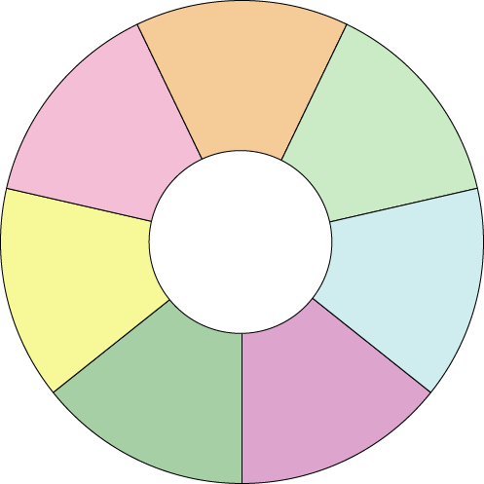
Feasibility Analysis Considerations
customers
product and service
industry
Feasibility Analysis
Questions
founding team
value chain
start-up needs
competition

Slide 6
Testing the Industry
The broadest level of feasibility analysis looks at the industry in which the business will operate.
You, the entrepreneur, will examine factors, such as…
health of the industry
trends/patterns of change
major players

Slide 7
Talking to Customers
The most important part of the analysis is testing customers to measure interest and identify the target customers.

Slide 8
Testing Product or Service Requirements
To consider all the requirements of a product or service, create a prototype.
This is TRUE, even if your business is not manufacturing products.

Slide 9
Studying the Competition
An easy way to evaluate the competition is to create a competitive grid
Five Column Grid that lists the name of your Competitor and their Customers, Benefits, Distribution, Strengths/Weaknesses

Slide 10
Looking at Start-Up Resources
A strong business model is important to investors because it describes how you intend to make money with your business concept.
In your feasibility study, you should calculate the costs of..
Equipment, Furnishings, a Facility, Inventory, Supplies, Employees, Product Development, Operating Expenses

Slide 11
Analyzing the Value Chain
A business can create a competitive advantage by improving the value chain (distribution channel) of its products and services. The value chain includes manufacturers, distributors, and retailers.
The goal is to….
Deliver maximum value for the least possible total cost.

Slide 12
The Business Plan: Your Road Map to Entrepreneurial Success
Once you have a feasible business concept, the next step is to develop a business plan.

Slide 13
The Parts of the Business Plan
Cover Page
Market Analysis
Title Page
Competitive Analysis
Table of Contents
Marketing Plan
Executive Summary
Operations Plan
Management Plan
Organizational Plan
Company Description
Financial Plan
Product and Service Plan
Growth Plan
Mission and Vision Statements
Contingency Plan
Industry Overview
Supporting Documents

Slide 14
Executive Summary
The executive summary should include the most important information from each section of the business plan.
Many times, investors and lenders rely on the E.S. to help them decide whether the concept interest them and is worth pursuing.

Slide 15
Management Team Plan
The management team presents your qualifications and those of any partners.
You must describe how your management team has the capabilities to execute your business plan.

Slide 16
Company Description
The company description section of the business plan outlines the company’s background information and basic business concept.

Slide 17
Product and Service Plan
In the product and service plan section of the business plan, you present the nature of your business and the unique features of the product/service or any spin-offs.

Slide 18
Vision and Mission Statements
The vision statement and mission statement state the guiding principles by which a company functions.
Walt Disney

Slide 19
Industry Overview
The industry overview section of the business plan presents your research into the industry, those companies providing similar, complementary, or supplementary products or services.

Slide 20
Market Analysis
The market analysis section of the business plan presents your research on the customer profile gathered from primary and secondary marketing research resources.
The results help you determine your overall marketing and sales strategies.

Slide 21
Competitive Analysis
The competitive analysis section of the business plan should demonstrate that the proposed business has an advantage over its competitors.

Slide 22
Marketing Plan
A marketing plan discusses how a company plans to make its customers aware of its products or services.
A marketing plan also describes the market niche, pricing, company image, marketing tactics, a media plan, and a marketing budget.

Slide 23
Operational Plan
The operational plan describes all the processes involving the production and delivery of the product or service.
The operational plan describes the distribution channel of the product or service.

Slide 24
Operational Plan
The operational plan describes the direct channel and/or indirect channel you will use to deliver your product or service.

Slide 25
Organizational Plan
The organizational plan section of a business plan looks at the people aspects and the legal form of the business.
It also describes the roles and compensation of key management personnel and important employment policies.

Slide 26
Financial Plan
The financial plan presents forecasts for the future of the business.
The financial plan includes financial statements.

Slide 27
Growth Plan
The growth plan describes how the business will expand in the future.
Investors and lenders like to see that a business has plans to grow in a planned and controlled way.

Slide 28
Contingency Plan
The contingency plan section of the business plan looks at the risks to business, such as changing economic conditions and lower-than-expected sales.
It then suggests ways to minimize the risks.

Slide 29
Cover Page, Title Page, Table of Contents, and Supporting Documents
Every business plan should have a cover page, a title page, a table of contents, and supporting documents.

Slide 30
Cover Page, Title Page, Table of Contents, and Supporting Documents
To begin developing a business plan:
Make a research plan and gather data.
Set up a notebook to organize data.
Write a first draft.

Slide 31
Common Mistakes in Preparing Business Plans
projecting exaggerated growth levels
projecting exaggerated growth levels
trying to have expertise in all areas
claiming performance above industry averages
underestimating the need for capital
underestimating the need for capital

Slide 32
Sources of Business Plan Information
Small Business Administration (SBA)
Service Corps of Retired Executives (SCORE)
Small Business Development Centers (SBDCs)
chambers of commerce
trade associations

Slide 33
Small Business Administration (SBA)
To encourage entrepreneurship in our free enterprise system, the government operates the Small Business Administration (SBA).

Slide 34
Trade Associations
Trade associations supply information to entrepreneurs about start-up issues, operating costs, and analysis of trends.

Slide 35
Packaging and Presenting the Business Plan
1
Bind the plan.
2
Use index tabs to separate sections.
3
Use an easily readable 12-point type.
4
Use bold subheadings and bullets.
5
Use the company logo at the top of every page.
6
Number each copy of the business plan and include a statement of confidentiality.
7
Include a statement on the cover page prohibiting copying of the plan.

