Slide 1
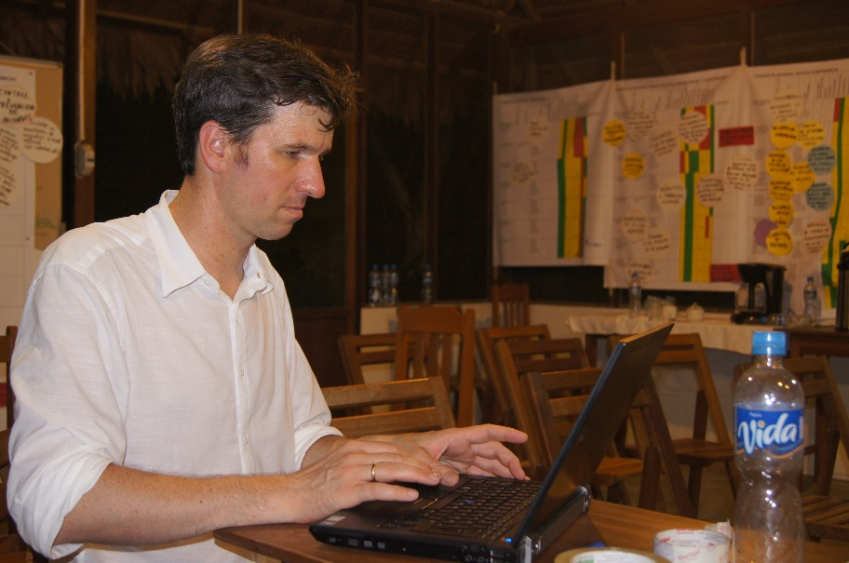
Operational planning and implementation of measures
© Pierre Ibisch 2014
Phase IV
Implementation and (non)-knowledge management
Step 25

Slide 2
Credits and conditions of use
© Centre for Econics and Ecosystem Management, 2014
The Centre for Econics and Ecosystem Management strongly recommends that this presentation is given by experts familiar with the adaptive management process in general (especially as designed as the Conservation Measures Partnership’s Open Standards for the Practice of Conservation) as well as the MARISCO Method itself.
You are free to share this presentation and adapt it for your use under the following conditions:
You must attribute the work in the manner specified by the authors (but
not in any way that suggests that they endorse you or your use of the work).
You may not use this work for commercial purposes.
If you alter, transform, or build upon this work, you must remove the Centre for
Econics and Ecosystem Management logo, and you may distribute the resulting work
only under the same or similar conditions to this one.
This material was created under the leadership and responsibility of Prof. Dr. Pierre Ibisch and Dr. Peter Hobson, co-directors of the Centre for Econics and Ecosystem Management, which was jointly established by Eberswalde University for Sustainable Development and Writtle College. Compare: Ibisch, P.L. & P.R. Hobson (eds.) (2014): The MARISCO method: Adaptive MAnagement of vulnerability and RISk at COnservation sites. A guidebook for risk-robust, adaptive, and ecosystem-based conservation of biodiversity. Centre for Econics and Ecosystem Management, Eberswalde (ISBN 978-3-00-043244-6). 195 pp. - The Powerpoint Presentation was conceived by Jamie Call, Christina Lehmann and Pierre Ibisch. Authors of graphs and photographs are indicated on the corresponding slides. Supported by the Deutsche Gesellschaft für Internationale Zusammenarbeit (GIZ) GmbH on behalf of the Bundesministerium für wirtschaftliche Zusammenarbeit und Entwicklung (BMZ).

Slide 4
Learning objectives
Participants have the skills to facilitate the process of operational planning based on the planned activities and strategies.
Participants are able to draw the line of the importance of strategy-based work planning development referring to consistency and coherence with the situation analysis and clear connection to the assumptions how the strategy will lead to an impact.

Slide 5
Outline
What is operational planning and the implementation of measures?
Why do we develop an operational plan and implement its measures?
How do we develop an operational plan and implement its measures?
Practical Tips

Slide 6
What is operational planning and the implementation of measures?
An operational plan is a highly detailed set of activities which stipulates the day-to-day practical and concrete activities to be carried out by the management team
Strategic Goals
Strategic plan
Operational plan
Implementation
A long-term (5+ years) plan which sets the general direction for the management entity
A short-term (1 year) plan with a detailed focus which outlines day-to-day actions of managers
Multiple operational plans run concurrently in order to cover the different aspects of the strategies
The translation of the operational plan into on-the-ground activities.
Operational planning and implementation are the concretization of the goals and plans created over the course of the workshop
Notes:
Pictures: Prof. Dr. Pierre Ibisch

Slide 7
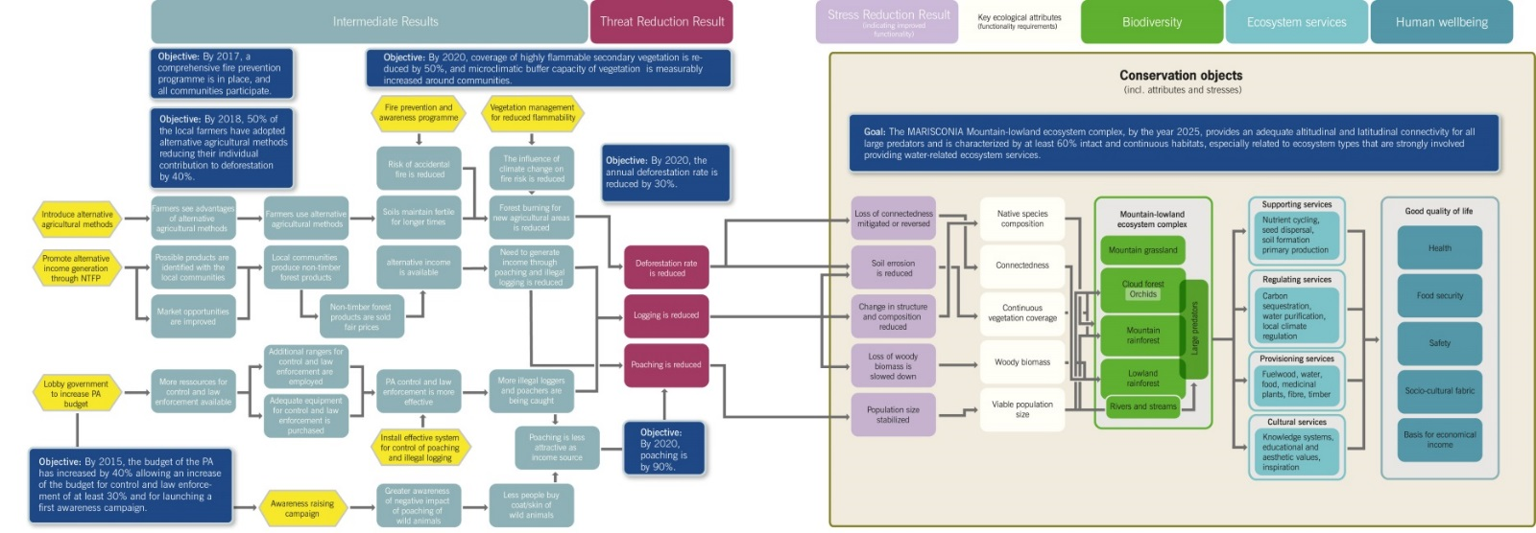
Why do we develop an operational plan and implement its measures?
Operational plans provide those within the organization with a clear picture of their tasks and responsibilities over a specified time period
It helps to achieve the strategic goals of the organization in a consistent and coherent manner
Clearly defining tasks allows for checks to assure that these tasks are in line with the strategic objectives
Concrete activities that should follow

Slide 8
How do we develop an operational plan and implement its measures?
Definition of available resources for project implementation such as time, money, personnel, knowledge etc.
Assessment of currently unavailable resources
Which resources are necessary for task execution but are currently not available?
Is there a lack of funding?
A lack of political will?
Is it likely that these resources will be available in the future?

Slide 9
How do we develop an operational plan and implement its measures?
Definition of specific responsibilities within the managing entity:
Who should be responsible for which activities?
Clarify: Define clearly which tasks must be undertaken
Delegate: Delegate responsibility to a person or group of people for each activity
Clarify: Have concrete timelines in which tasks must be completed
Indicate the amount of resources which will be dedicated to each task
Follow good practice guidelines, such as those from the Open Standards Methods
Clarify: Continue with the logic of the conceptual model and results webs to maintain consistency
Are detailed enough to provide all personnel with a clear idea of what is expected from them

Slide 10
How do we develop an operational plan and implement its measures?
Convert strategies and activities into concrete tasks which:
Define clearly which tasks must be undertaken
Delegate responsibility to a person or group of people for each activity
Have concrete timelines in which tasks must be completed
Indicate the amount of resources which will be dedicated to each task
Follow good practice guidelines, such as those from the Open Standards Methods
Continue with the logic of the conceptual model and results webs to maintain consistency
Are detailed enough to provide all personnel with a clear idea of what is expected from them
Follow up with monitoring of results, impacts and research
Refer to the following presentation for more detailed information

Slide 11
Practical Tips

