Slide 1
MANAGEMENT INFORMATION SYSTEM (MIS)
Management Information Systems
Managing The Digital Firm 13th Edition
Laudon and Laudon ( (2014)

Slide 2
Nama : Dr. Rhian Indradewa, ST. MSM
TTL : Jakarta, Desember 78
PENDIDIKAN :
1997 – 2001 : Fakultas Teknik UI (S1)
2003 – 2005 : Fakultas Ekonomi UI (S2)
2013 – 2016 : School of Business and Management ITB (S3)
PEKERJAAN :
2002 – 2007 : BAKRIE GROUP COMPANY
2007 – 2009 : PETRONAS INDONESIA
2009 – Sekarang : PT. PERTAMINA (Persero)
HP : 08121094095
Email :
rhian.indradewa@pertamina.com
rhian.indradewa@sbm-itb.ac.id

Slide 3
Management Information Systems
Jane P. Laudon Kenneth C. Laudon
Prentice-Hall Inc
13th edition

Slide 4
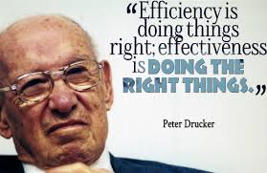
Peter Drucker :
Business Paradigm is shifting from Resources Based Organization to Human Based Organization
Business Paradigm is shifting again from Human Based Organization to Knowledge Based Organization

Slide 5
What are the consequences?
Decision making process based on feeling and intuition should be diminished
Decision making process should be based on data, information, and knowledge
Knowledge Management (KM) become more strategic
Human Capital Management, replacing Human Resources Management
Management Information Systems (digitalization) can become a power full tool in supporting business process
Intangible assets valuation and management will increase corporate value

Slide 6
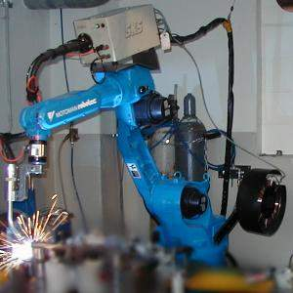
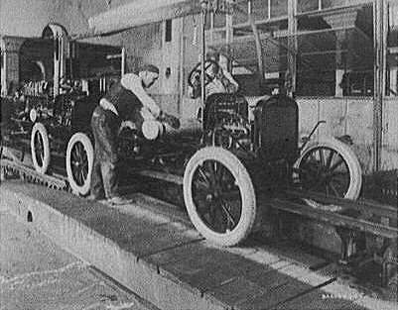
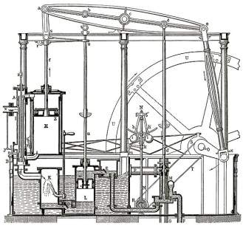
Industrial Evolution
4. Industrial revolution
Based on cyber-physical-
systems
3. Industrial revolution
Through the use of electronics
and IT further progression in
autonomous production
2. Industrial revolution
Introducing mass production
lines powered by electric
energy
Level of Complexity
1. Industrial revolution
Introducing mechanical
production machines powered
by water and steam
Industry 1.0
Industry 2.0
Industry 3.0
Industry 4.0
End of the
18th century.
Beginning of the
20th century
Beginning of the
70th
Today

Slide 7
Building blocks of Industry 4.0
Industry 4.0
Autonomous Robots
Simulation
Horizontal and vertical system integration
Additive Mfg
Industrial Internet of Things
Augmented reality
Big data analytics
Cyber Security

Slide 8
Impacting all aspect of value chain

Slide 9
CHAPTER 1
Information Systems in Global Business Today

Slide 10
Our Agenda Today

Slide 11
Information meaningful data (facts)
Societies mainly depend on the information
Information support to achieve desired objectives
Planning, organizing, decision making, …
IS process (handle) the data to be useful information
IS computer systems related to process data and provide required information
ATMs, airline reservation systems, course reservation systems
Data
Process
Information

Slide 12
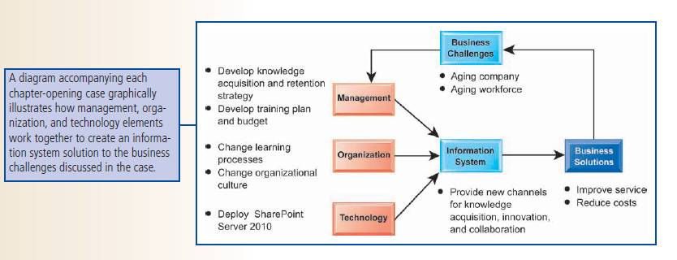

Slide 13
1.1. The Role of Information Systems in Business Today

Slide 14
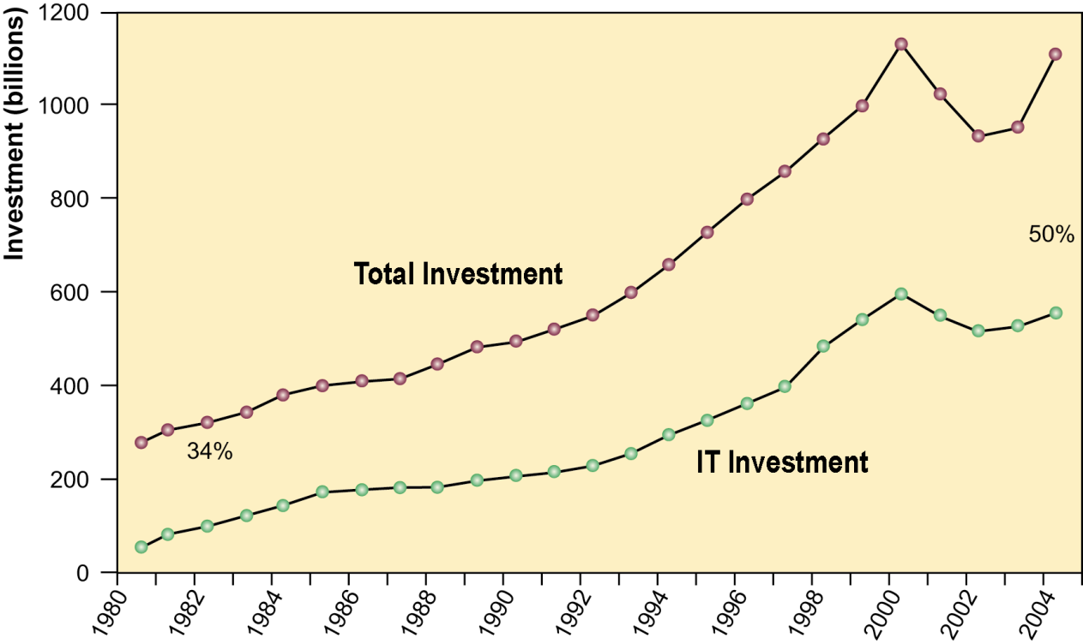
IS play vital role in business today
Information Technology Capital Investment
Information technology investment, defined as hardware, software, and communications equipment, grew from 34% to 50% between 1980 and 2014.

Slide 15
How INFORMATION SYSTEMS are Transforming Business
Increased technology investments
IS provide economic value to business
Increased responsiveness to customer demands
Shifts in media, advertising and commerce
New federal security and accounting laws required

Slide 16
What’s New in MIS?
3 interrelated changes in the technology area :
The emerging mobile digital platform
The growing business use of big data
The growth in cloud computing, where more business software runs over the internet
Discussing Table 1.1. What’s New in MIS (p.37)

Slide 17
Globalization Opportunities and Challenges
Opportunities
Flattened World
Internet reduced costs of operating, on global scale
Customers and firms More Closed
Using foreign markets, easily replicate service
Challenges
Security
Develop High Level Skills

Slide 18
The Emerging Digital Firm
Digital firm is :
It’s significant business relationships are digitally enabled and mediated
It’s core business processes are accomplished through digital networks
Key corporate assets are managed digitally
Digital firms offer greater flexibility in organization and management (time shifting 24/7, space shifting anywhere)

Slide 19
Business Process
Business process : tasks, rules, behaviors that been developed to produce business results.
Example :
Developing new product
Creating market plan
Hiring an employee
Considered source of competitive strength
IS automate many business process

Slide 20
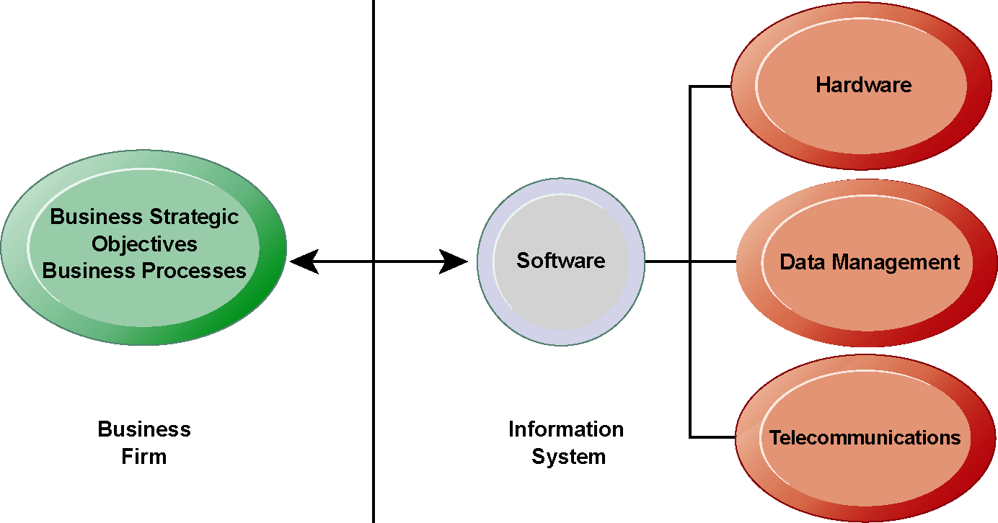
Strategic Business Objectives of IS
What make information systems so essential today? why are business investing so much in information systems and technologies?
There is a growing interdependence between a firm’s information systems and its business capabilities. Changes in strategy, rules, and business processes increasingly require changes in hardware, software, databases, and telecommunications. Often, what the organization would like to do depends on what its systems will permit it to do.

Slide 21
Business firms invest heavily in information systems to achieve six strategic business objectives:
Operational excellence
New products, services, and business models
Customer and supplier intimacy
Improved decision making
Competitive advantage
Survival

Slide 22
Operational Excellence
Improvement of efficiency of operation to attain higher profitability
Information technology tool to achieving greater efficiency and productivity
Practice business and management behavior based on IT.
E.g. Wal-Mart’s RetailLink system links suppliers to stores for superior replenishment system

Slide 23
2) New Products, Services, and Business Models
Business model: describes how company produces, delivers, and sells product or service to create wealth
Information systems and technology a major enabling tool for new products, services, business models
E.g. Apple’s iPod, iTunes and Netflix’s Internet-based DVD rentals

Slide 24
3) Customer and Supplier Intimacy
Serving customers well leads to customers returning, which raises revenues and profits
E.g. High-end hotels that use computers to track customer preferences and use to monitor and customize environment
Intimacy with suppliers allows them to provide vital inputs, which lowers costs
E.g. J.C.Penney’s information system which links sales records to contract manufacturer

Slide 25
4) Improved Decision-Making
Without accurate information:
Managers must use forecasts, best guesses, luck
Leads to:
Overproduction, underproduction of goods and services
Misallocation of resources
Poor response times
Poor outcomes raise costs, lose customers
IS provide real-time data for making decisions
E.g. Verizon’s Web-based digital dashboard to provide managers with real-time data on customer complaints, network performance, line outages, etc.

Slide 26
5) Competitive Advantage
Achieve higher sales and profit through using IS by:
Doing things better
Charging less for superior products
real time Responding
Using the internet is competitive advantage
E.g. Dell: Consistent profitability over 25 years; Dell remains one of the most efficient producer of PCs in world.
But Dell has lost some of its advantages to fast followers-- HP

Slide 27
6) Survival
Information technologies are necessity of doing business
May be:
Industry-level changes, e.g. Citibank’s introduction of ATMs
Governmental regulations requiring record-keeping
E.g. Toxic Substances Control Act, Sarbannes-Oxley Act

Slide 28
1.2. Perspectives on Information Systems

Slide 29
What is an Information system
Set of interrelated components
Collect, process, store, and distribute information
→By computers and software as a tool
Support decision making, coordination, control, problem analysis and create new product
Provide solutions to challenges in business environment
Information vs. data
Data are streams of raw facts
Information is data shaped into meaningful form

Slide 30
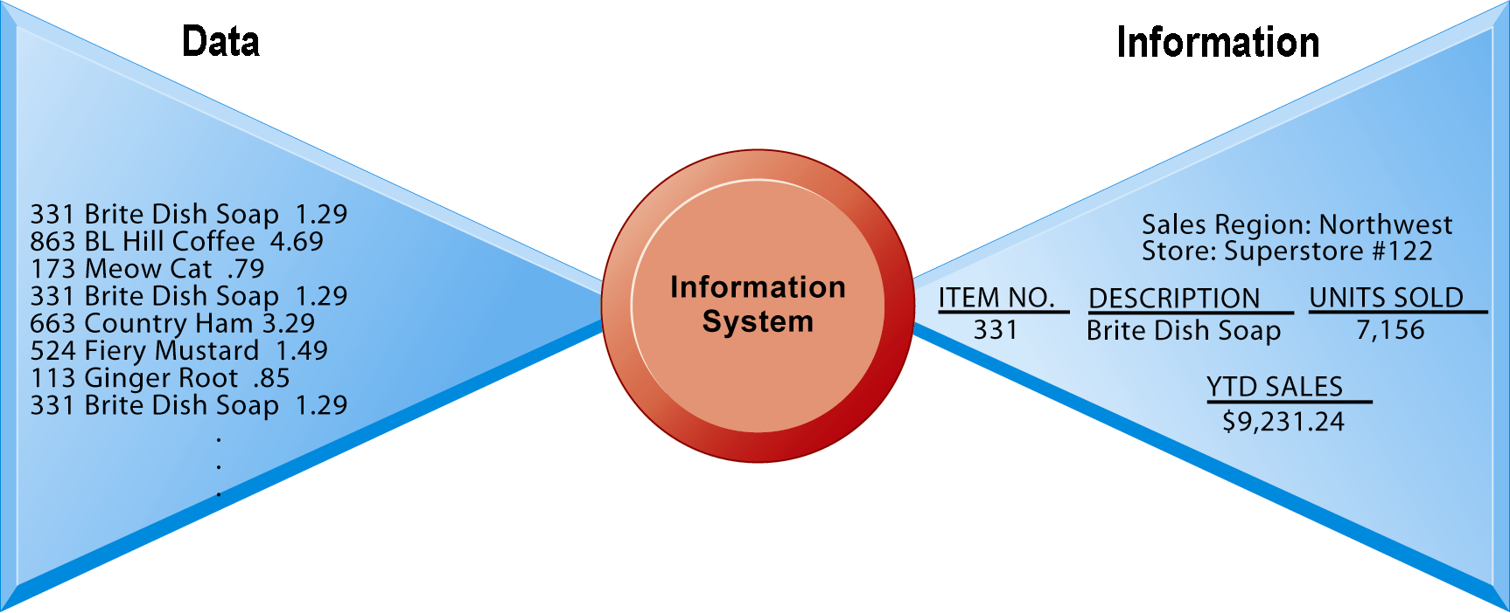
Data and Information
Raw data from a supermarket checkout counter can be processed and organized to produce meaningful information, such as the total unit sales of dish detergent or the total sales revenue from dish detergent for a specific store or sales territory.

Slide 31
Information system: activities produce required information
Input: Captures raw data from organization or external environment
Processing: Converts data into meaningful form
Output: Transfers processed information to people or activities that use it
Feedback: Output returned to appropriate members of organization to help evaluate or correct input stage

Slide 32
Functions of an Information System
An information system contains information about an organization and its surrounding environment. Three basic activities—input, processing, and output—produce the information organizations need. Feedback is output returned to appropriate people or activities in the organization to evaluate and refine the input. Environmental actors, such as customers, suppliers, competitors, stockholders, and regulatory agencies, interact with the organization and its information systems.

Slide 33
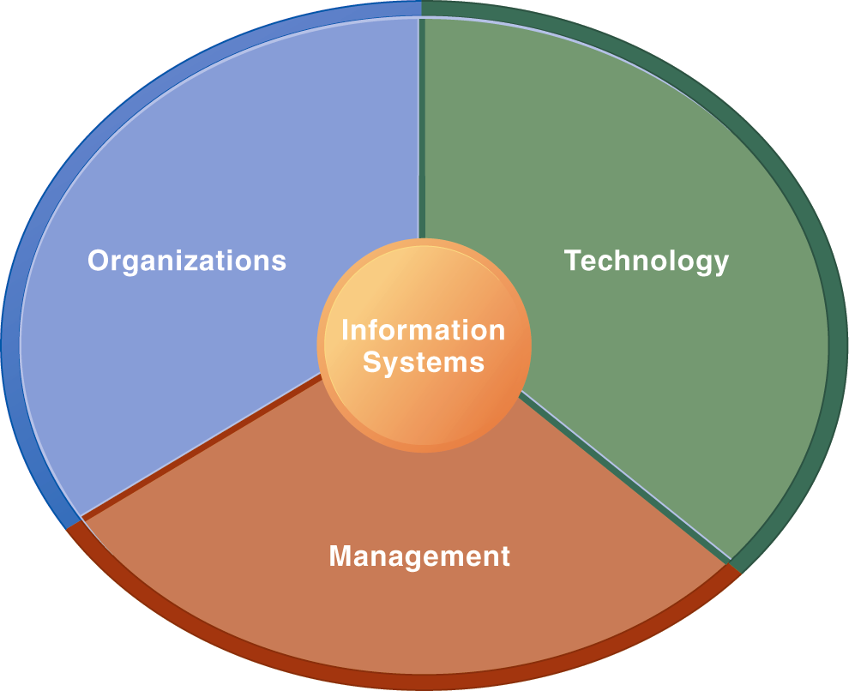
Dimensions of IS
Information Systems Are More Than Computers
Using information systems effectively requires an understanding of the organization, management, and information technology shaping the systems. An information system creates value for the firm as an organizational and management solution to challenges posed by the environment.

Slide 34
Organizational Dimension of IS
Structure: different levels and specialties
Business process: Organization coordinate its work through its hierarchy and business process
Culture and Political: ways of doing things, part is embedded in IS.

Slide 35
Levels in a Firm
Business organizations are hierarchies consisting of three principal levels: senior management, middle management, and operational management. Information systems serve each of these levels. Scientists and knowledge workers often work with middle management.

Slide 36
2) Management Dimension
Make decisions, formulate action plan and solve organizational problem
Managers set organizational strategy for responding to business challenges
In addition, managers must act creatively:
Creation of new products and services
Occasionally re-creating the organization

Slide 37
3) Technology Dimension
Computer hardware : the physical equipment used for input, processing, and output activities in an information system
Software: instructions that control and coordinated hardware components (chapter 5)
Data management technology: software governing the organization data on physical storage media (chapter 6)
Networking and telecommunications technology : both physical devices and software, links from various location (chapter 7)
IT infrastructure: platform that the firm can built on its IS (chapter 8)

Slide 38
It Isn’t Just Technology : Business perspective on IS
IS instrument for creating value to firms
Investments in IS result in superior returns:
Increases productivity and revenue
IS provides information that helps managers making better decisions and improve the execution of business process
Value of IS

Slide 39
The Business Information Value Chain
From a business perspective, information systems are part of a series of value-adding activities for acquiring, transforming, and distributing information that managers can use to improve decision making, enhance organizational performance, and, ultimately, increase firm profitability.

Slide 40
Complementary Assets :
Organizational Capital and the Right Business Model
Variation in Returns on Information Technology Investment
Although, on average, investments in information technology produce returns far above those returned by other investments, there is considerable variation across firms.

Slide 41
Investing in information technology does not guarantee good returns
Considerable variation in the returns firms receive from systems investments
Factors:
Adopting right business model according (suite) to new technology
complementary investments (business processes, models, management behavior and culture)

Slide 42
Complementary assets
Assets required to derive value from a primary investment
Firms supporting their technology investments with investment in complementary assets receive superior returns
E.g.: invest in technology and the people to make it work properly

Slide 43
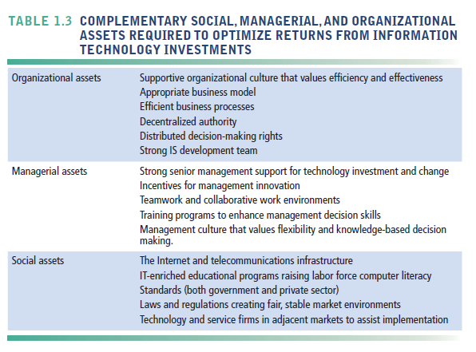
Complementary Assets Include

Slide 44
1.3. Contemporary Approaches to Information Systems

Slide 45
Contemporary Approaches to Information Systems
The study of information systems deals with issues and insights contributed from technical and behavioral disciplines.

Slide 46
Technical Approach
Emphasizes mathematically based models
Computer science theories of computation ,data storage
management science: models of decision making and practices
operations research: optimizing selected parameters of organization
Behavioral Approach
Behavioral issues such strategic business integration, implementation...
Psychology: how decision makers use formal information
Economics: how IS change the control and cost structures
Sociology: how system affect individuals and groups

Slide 47
Approach of this book: Sociotechnical view
Optimal organizational performance achieved by jointly optimizing both social and technical systems used in production
Helps avoid purely technological approach

Slide 48
A Sociotechnical Perspective on Information Systems
In a sociotechnical perspective, the performance of a system is optimized when both the technology and the organization mutually adjust to one another until a satisfactory fit is obtained.

