Slide 1
CHAPTER 12
ENHANCING DECISION MAKING

Slide 2
12.1. Decision Making and Information Systems

Slide 3
Decision Making and Information Systems
Business value of improved decision making
  Improving hundreds of thousands of “small” decisions adds up to large annual value for the business
Types of decisions:
  Unstructured: Decision maker must provide judgment, evaluation, and insight to solve problem
  Structured: Repetitive and routine; involve definite procedure for handling so they do not have to be treated each time as new
  Semistructured: Only part of problem has clear-cut answer provided by accepted procedure
Notes:
This slide discusses the importance of improved decision making and describes the three types of decisions that are made in an organization. Table 12-1 in the text illustrates how a small decision made hundreds of times a year can be just as valuable as a single decision made once a year. For example, the decision to schedule production to fill orders, made 150 times a year, with a value of $10,000 if this decision is improved, can mean an annual value of $1.5 million. The different levels in an organization tend to make different types of decisions, and require different types of support to make these decisions. Ask students to provide examples of each type of decision. Give students examples of decisions and ask what category the decision fall into and why.

Slide 4
Decision Making and Information Systems
Senior managers:
  Make many unstructured decisions
  For example: Should we enter a new market?
Middle managers:
  Make more structured decisions but these may include unstructured components
  For example: Why is order fulfillment report showing decline in Minneapolis?
Operational managers, rank and file employees
  Make more structured decisions
  For example: Does customer meet criteria for credit?
Notes:
This slide describes the types of decisions being made at the different levels within an organization. Semistructured decisions contain a portion that is unstructured and a portion that is structured. Which portion, of the example question for middle managers, is structured and which is unstructured? What would make this question a fully structured question? Ask students to come up with additional examples of decisions at the executive, middle management, and operational levels of the organization, for companies they have worked for.

Slide 5
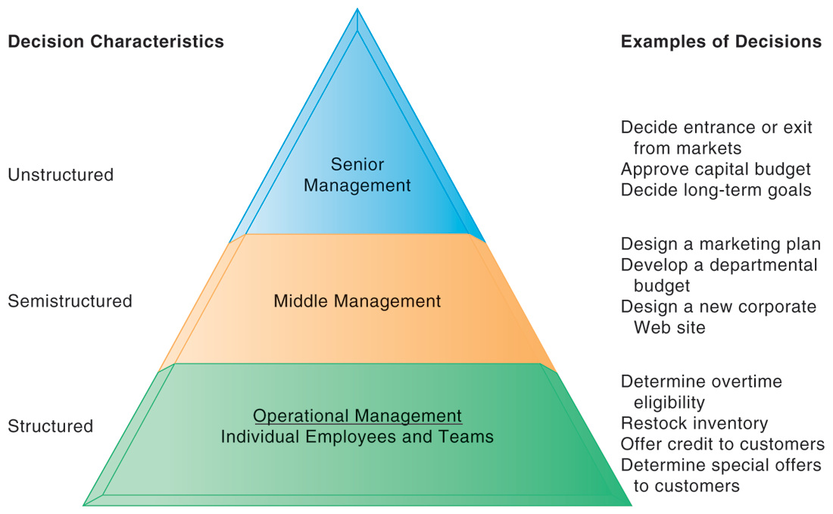
INFORMATION REQUIREMENTS OF KEY DECISION-MAKING GROUPS IN A FIRM
FIGURE 12-1
Senior managers, middle managers, operational managers, and employees have different types of decisions and information requirements.
Notes:
This figure provides an illustration of how the nature of decision making changes as you move up and down the corporate hierarchy. There are of course exceptions. Some senior managers like to take a hands-on approach to daily operations.

Slide 6
Decision Making and Information Systems
The four stages of the decision-making process
  Intelligence
    Discovering, identifying, and understanding the problems occurring in the organization
  Design
    Identifying and exploring solutions to the problem
  Choice
    Choosing among solution alternatives
  Implementation
    Making chosen alternative work and continuing to monitor how well solution is working
Notes:
This slide describes the process of decision making as a series of four stages. It is important to note that if an implemented solution doesn’t work, the decider can return to an earlier stage in the process and repeat as needed. Give the students an example decision, such as “what college should I apply to” and ask them to describe the actions taken at each of the four stages.

Slide 7
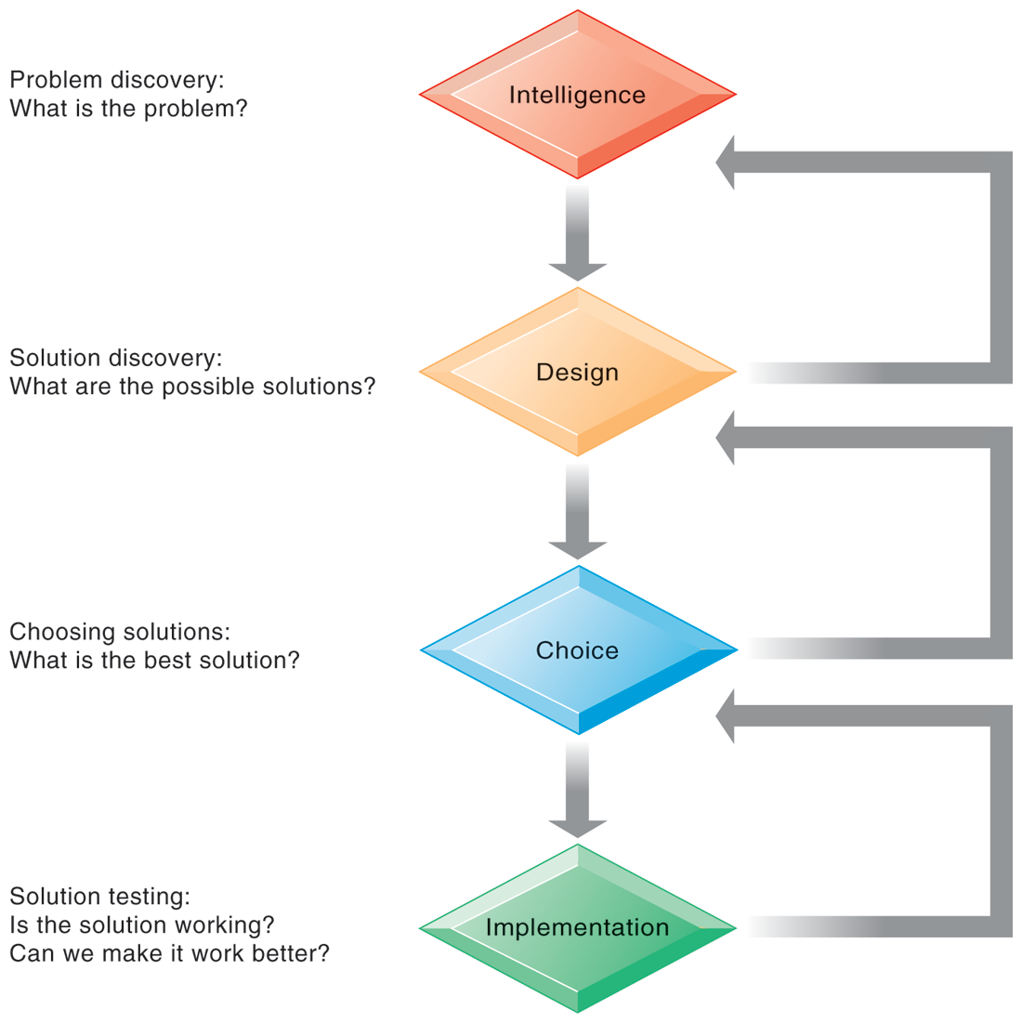
STAGES IN DECISION MAKING
The decision-making process is broken down into four stages.
FIGURE 12-2
Notes:
This graphic illustrates the four stages of decision making introduced in the previous slide, emphasizing that steps can be repeated as needed, depending on the outcome at each stage.

Slide 8
Decision Making and Information Systems
Information systems can only assist in some of the roles played by managers
Classical model of management: five functions
  Planning, organizing, coordinating, deciding, and controlling
More contemporary behavioral models
  Actual behavior of managers appears to be less systematic, more informal, less reflective, more reactive, and less well organized than in classical model
Notes:
This slide discusses the idea that, although information systems can assist in making decisions by providing information and tools for analysis, they cannot always improve on decisions being made. Ask the students to provide examples of decisions that an information system might not be able to assist in. Is there any similarity among these example decisions, and what does this say about the types of decisions an information system can help with?
You can understand the complexity and breadth of some of the decisions being made within an organization by looking at the activities of its managers. Although the classical model of management sees five functional roles of managers, real-life observation of managers sees far more complexity in managerial activities. Ask the students to recall the five attributes listed in the book as differing greatly from the classical description. Managers (1) perform a great deal of work at an unrelenting pace; (2) managerial activities are fragmented, lasting for less than 9 minutes; (3) managers prefer current, specific, ad hoc information; (4) manager prefer oral forms of communication; and (5) managers give high priority to maintaining a complex web of contacts as an informal information system. Ask students to explain attributes 3, 4, and 5.

Slide 9
Decision Making and Information Systems
Mintzberg’s 10 managerial roles
  Interpersonal roles
    Figurehead
    Leader
    Liaison
  Informational roles
    Nerve center
    Disseminator
    Spokesperson
  Decisional roles
    Entrepreneur
    Disturbance handler
    Resource allocator
    Negotiator
Notes:
This slide expands on the behavioral model of managers and describes Mintzberg’s behavioral model of managers which defines 10 managerial roles that fall into three categories. Ask students to give examples of activities for each role. Which of these roles can be assisted by information systems and which cannot?

Slide 10
Decision Making and Information Systems
Three main reasons why investments in information technology do not always produce positive results
  Information quality
    High-quality decisions require high-quality information
  Management filters
    Managers have selective attention and have variety of biases that reject information that does not conform to prior conceptions
  Organizational inertia and politics
    Strong forces within organizations resist making decisions calling for major change
Notes:
Even in decision-making situations that can be helped by information systems, the information system may fail in helping to solve the problem or lead to a better decision. This slide describes the three main reasons why investments in information systems do not always produce positive results. What is meant by information quality? The text lists seven quality dimensions: accuracy, integrity, consistency, completeness, validity, timeliness, accessibility. Ask students to identify and/or describe these dimensions?
Ask students to provide an example of what a management “filter” might be. Have they ever witnessed someone in a managerial position be unable to recognize or handle a problem because of a “filter” they are using (but don’t even know it)?
Ask students why people within an organization would resist using an information system.

Slide 11
Decision Making and Information Systems
High-velocity automated decision making
  Made possible through computer algorithms precisely defining steps for a highly structured decision
  Humans taken out of decision
  For example: High-speed computer trading programs
    Trades executed in 30 milliseconds
    Responsible for “Flash Crash” of 2010
  Require safeguards to ensure proper operation and regulation
Notes:
This slide looks at the growth of systems for executing high-velocity decision making, such as financial trading programs. A second example is Google’s search engine. What types of problems lend themselves to this type of system? Ask students what other activities would benefit from humans being taken out of the decision-making process.

Slide 12
12.2. Business Intelligence in The Enterprise

Slide 13
Business Intelligence in the Enterprise
Business intelligence
  Infrastructure for collecting, storing, analyzing data produced by business
  Databases, data warehouses, data marts
Business analytics
  Tools and techniques for analyzing data
  OLAP, statistics, models, data mining
Business intelligence vendors
  Create business intelligence and analytics purchased by firms
Notes:
This slide introduces the concept of business intelligence and analytics. The text gives the example of Hallmark Cards, which uses SAS analytics software to analyze buying patterns and determine the most effective marketing plan for different types of customers. For example, which customers would respond best to direct mail or e-mail, and to what types of messages. It is important to understand that business intelligence and business analytics are products defined by hardware and software vendors. This is also one of the fastest growing segments in the U.S. software environment. Ask students why this might be so.

Slide 14
Analytics Help the Cincinnati Zoo Know Its Customers
What management, organization, and technology factors were behind the Cincinnati Zoo losing opportunities to increase revenue?
Why was replacing legacy point-of-sale systems and implementing a data warehouse essential to an information system solution?
How did the Cincinnati Zoo benefit from business intelligence? How did it enhance operational performance and decision making? What role was played by predictive analytics?
Visit the IBM Cognos Web site and describe the business intelligence tools that would be the most useful for the Cincinnati Zoo.

Slide 15
Business Intelligence in the Enterprise
Six elements in the business intelligence environment
  Data from the business environment
  Business intelligence infrastructure
  Business analytics toolset
  Managerial users and methods
  Delivery platform—MIS, DSS, ESS
  User interface
Notes:
This slide looks at the six main elements at play in business intelligence. Ask students what is meant by managerial users and methods and why this is important. (Managers impose order on the analysis of data using a variety of managerial methods that define strategic business goals and specify how progress will be measured. Without management oversight, business analytics can produce a great deal of information that focus on the wrong matters and divert attention from the real issues. As the text notes, so far, only humans can ask intelligent questions.)

Slide 16
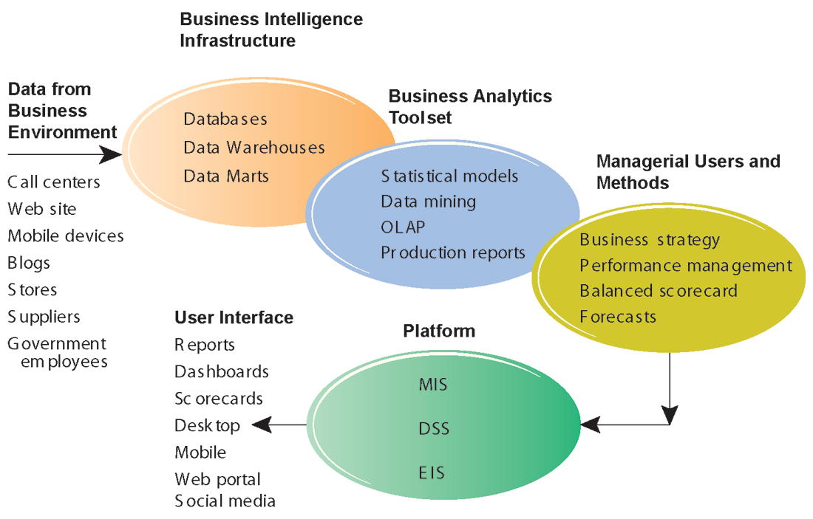
BUSINESS INTELLIGENCE AND ANALYTICS FOR DECISION SUPPORT
Business intelligence and analytics requires a strong database foundation, a set of analytic tools, and an involved management team that can ask intelligent questions and analyze data.
FIGURE 12-3
Notes:
This graphic looks at the different elements in the business intelligence environment; from left clockwise: Data, infrastructure, toolset, managerial users, platform, and user interface. This is an overview highlighting the kinds of hardware, software, and management capabilities that the major vendors offer and that firms develop over time.

Slide 17
Business Intelligence in the Enterprise
Business intelligence and analytics capabilities
  Goal is to deliver accurate real-time information to decision makers
  Main functionalities of BI systems
    Production reports
    Parameterized reports
    Dashboards/scorecards
    Ad hoc query/search/report creation
    Drill down
    Forecasts, scenarios, models
Notes:
This slide looks at the main functionalities of business intelligence systems. Parameterized reports are reports that can be adjusted to reflect user-defined parameters. The text gives the example of viewing a report by region and time of day to see how sales vary by these parameters. Ask students what is meant by drill down and give an example (the ability to move from a high level view summary to a detailed view). For example, a summary view might present the total numbers of products by category sold worldwide. Drilling down, views might go to products sold at national, regional, and local levels, and down from product categories to single products and product versions.

Slide 18
Business Intelligence in the Enterprise
Business intelligence users
  80% are casual users relying on production reports
  Senior executives
    Use monitoring functionalities
  Middle managers and analysts
    Ad-hoc analysis
  Operational employees
    Prepackaged reports
    For example: sales forecasts, customer satisfaction, loyalty and attrition, supply chain backlog, employee productivity
Notes:
This slide continues the look at how business intelligence is used today, in this case, who uses business intelligence? By far the greatest number of users are managers relying on production reports of varying types (Table 12-5 lists a variety of prepackaged reports for the different business functional areas). (The next slide’s graphic illustrates the different categories of user.)

Slide 19
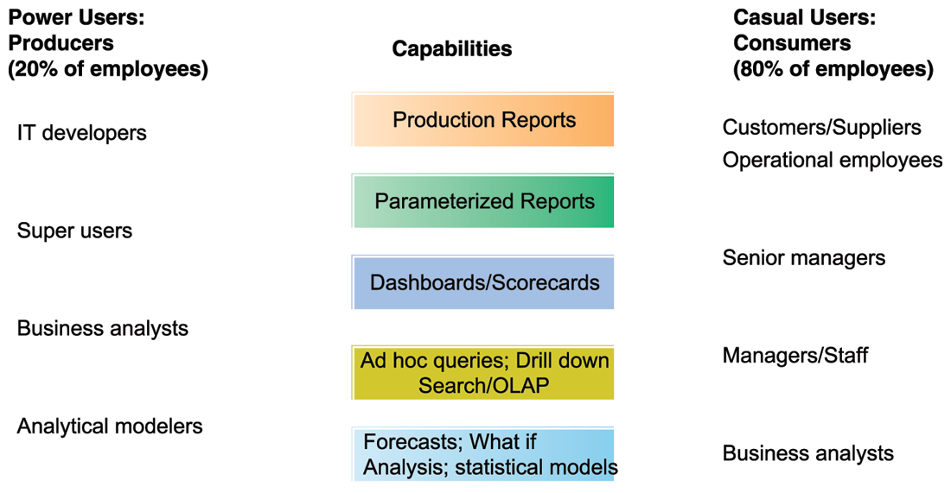
BUSINESS INTELLIGENCE USERS
FIGURE 12-4
Casual users are consumers of BI output, while intense power users are the producers of reports, new analyses, models, and forecasts.
Notes:
This graphic looks at the different types of users and what they use BI applications for. On the left, power users (users who rely on BI most intensively) are broken into four main categories, with each category placed beside the types of reports it uses most. On the right, casual users are also broken into various categories and placed along the types of capabilities used most. For example, senior managers rely most on parameterized reports and dashboards. Ask students if they have ever used BI reports in a job setting.

Slide 20
BI APPLICATION TYPES
1. Production reports
  Most widely used output of BI suites
  Common predefined, prepackaged reports
    Sales: Forecast sales; sales team performance
    Service/call center: Customer satisfaction; service cost
    Marketing: Campaign effectiveness; loyalty and attrition
    Procurement and support: Supplier performance
    Supply chain: Backlog; fulfillment status
    Financials: General ledger; cash flow
    Human resources: Employee productivity; compensation

Slide 21
Business Intelligence in the Enterprise
2. Predictive analytics
  Use variety of data, techniques to predict future trends and behavior patterns
    Statistical analysis
    Data mining
    Historical data
    Assumptions
  Incorporated into numerous BI applications for sales, marketing, finance, fraud detection, health care
    Credit scoring
    Predicting responses to direct marketing campaigns

Slide 22
Business Intelligence in the Enterprise
3. Big data analytics
  Big data: Massive datasets collected from social media, online and in-store customer data, and so on
  Help create real-time, personalized shopping experiences for major online retailers
  Hunch.com, used by eBay
    Customized recommendations
    Database includes purchase data, social networks
    Taste graphs map users with product affinities
Notes:
The text gives the example of FedEx using predictive analytics to develop models that predict how customers will respond to price changes, and has been giving an accuracy of 65 to 90%. Ask students if there are any disadvantages to predictive analytics.

Slide 23
Business Intelligence in the Enterprise
4. Additional BI applications
  Data visualization and visual analytics tools
    Help users see patterns and relationships that would be difficult to see in text lists
      Rich graphs, charts
      Dashboards
      Maps
  Geographic information systems (GIS)
    Ties location-related data to maps
    Example: For helping local governments calculate response times to disasters
Notes:
This slide looks at various additional examples of BI applications. Ask students for any examples of data visualization tools they have come across. An example might be tag clouds used for topic navigation on the Internet—the larger the tag, the more popular the category. Note that BI is also used in the public sector for analyzing data and determining public policy, such as allocating school resources, an example discussed in a chapter case.

Slide 24
Business Intelligence in the Enterprise
Two main management strategies for developing BI and BA capabilities
  One-stop integrated solution
    Hardware firms sell software that run optimally on their hardware
    Makes firm dependent on single vendor—switching costs
  Multiple best-of-breed solution
    Greater flexibility and independence
    Potential difficulties in integration
    Must deal with multiple vendors
Notes:
This slide looks at the options a firm has in purchasing BI and BA applications. There are advantages and disadvantages to both options—in one case a single vendor might be easier to deal with, but harder to switch. Using multiple applications means that each solution might be more specifically suited to your business, but may pose difficulties when integrating with hardware or other software. The text points out that the marketplace is highly competitive and “given to hyperbole,” and managers will need to carefully examine the software’s capabilities in light of needed expenditures.

Slide 25
12.3. Business Intelligence Constituencies

Slide 26
Business Intelligence Constituencies
Operational and middle managers
  Use MIS (running data from TPS) for:
    Routine production reports
    Exception reports
“Super user” and business analysts
  Use DSS for:
    More sophisticated analysis and custom reports
    Semistructured decisions
Notes:
This slide and the next several slides discuss the systems used by different levels in a firm to aid decision making. Ask students to recall what types of decisions operational and middle managers make. Ask how TPS systems fit into this picture (MIS produce standardized reports based on data from TPS).

Slide 27
Business Intelligence Constituencies
Decision support systems
  Use mathematical or analytical models
  Allow varied types of analysis
    “What-if” analysis
    Sensitivity analysis
    Backward sensitivity analysis
    Multidimensional analysis / OLAP
      For example: pivot tables
Notes:
This slide looks at the decision support systems used for the semistructured decisions made by the business analysts and “super users” identified on the previous slide and outlines a variety of analysis methods that are utilized. Ask students to give examples of the different types of analysis. Remind students that DSS are business intelligence systems. The text cites the example of Progressive Insurance which uses business intelligence to identify the best customers for its products.

Slide 28
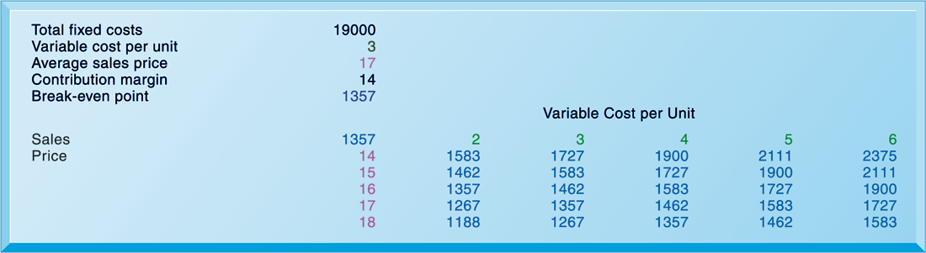
SENSITIVITY ANALYSIS
FIGURE 12-5
This table displays the results of a sensitivity analysis of the effect of changing the sales price of a necktie and the cost per unit on the product’s break-even point. It answers the question, “What happens to the break-even point if the sales price and the cost to make each unit increase or decrease?”
Notes:
This graphic illustrates the results of a sensitivity analysis of changing the sales price of a necktie—it answers the question “What happens to the break-even point if the sales price and the cost to make each unit increase or decrease?”

Slide 29
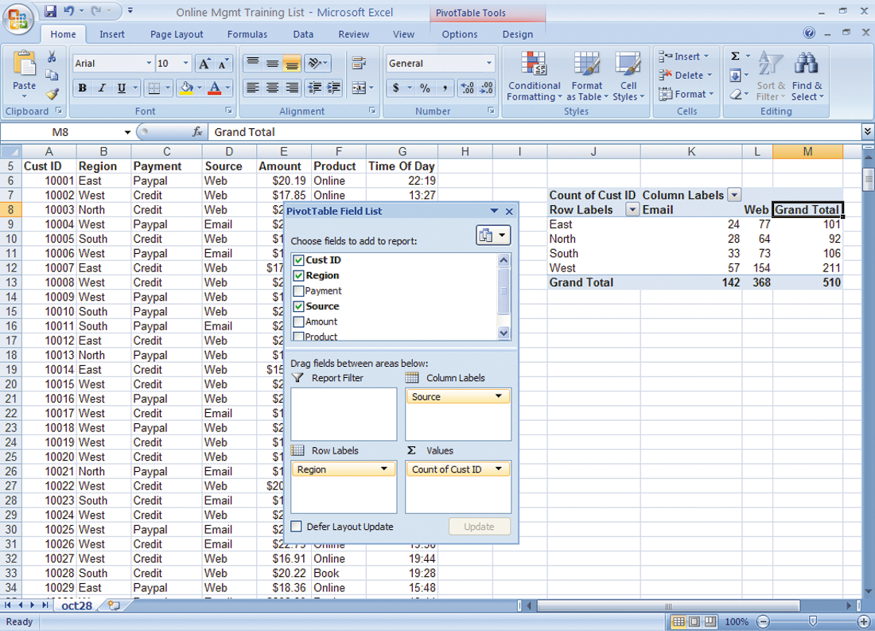
A PIVOT TABLE THAT EXAMINES CUSTOMER REGIONAL DISTRIBUTION AND ADVERTISING SOURCE
In this pivot table, we are able to examine where an online training company’s customers come from in terms of region and advertising source.
FIGURE 12-6
Notes:
This graphic shows the same Microsoft Excel spreadsheet with a PivotTable with two dimensions—it shows where customers come from in terms of region and advertising source.

Slide 30
Business Intelligence Constituencies
ESS: decision support for senior management
  Help executives focus on important performance information
  Balanced scorecard method:
    Measures outcomes on four dimensions:
      Financial
      Business process
      Customer
      Learning and growth
    Key performance indicators (KPIs) measure each dimension
Notes:
This slide looks at the business intelligence used by senior management. These executive support systems utilize some type of methodology to determine which information affects the profitability and success of the firm and how this information can be measured. One popular methodology is the balanced scorecard method. Another popular method is discussed on a following slide. Ask students how the scorecard itself is determined (a scorecard is developed by consultants and senior managers).

Slide 31
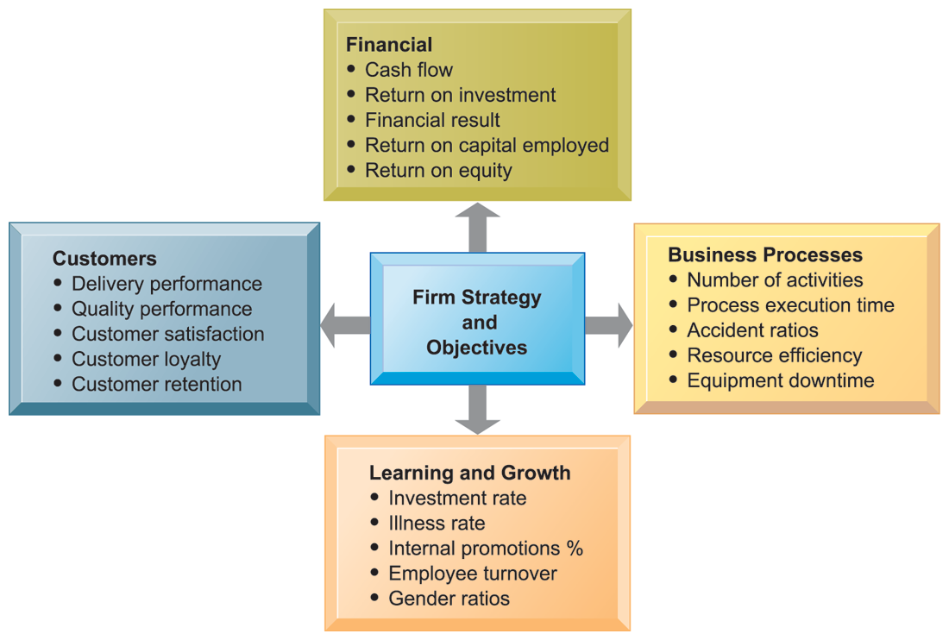
THE BALANCED SCORECARD FRAMEWORK
FIGURE 12-7
In the balanced scorecard framework, the firm’s strategic objectives are operationalized along four dimensions: financial, business process, customer, and learning and growth. Each dimension is measured using several KPIs.
Notes:
This graphic depicts the balanced scorecard methodology that many managers use to measure the performance of their business, and to understand how firm strategies are impacting the four dimensions of interest. For each of these dimensions performance is operationalized by identifying key performance indicators for that dimension.

Slide 32
Business Intelligence Constituencies
Decision support for senior management (cont.)
  Business performance management (BPM)
    Translates firm’s strategies (e.g., differentiation, low-cost producer, scope of operation) into operational targets
    KPIs developed to measure progress toward targets
  Data for ESS
    Internal data from enterprise applications
    External data such as financial market databases
    Drill-down capabilities
Notes:
This slide continues the discussion of business intelligence used by senior managers. Another methodology used by ESS, similar to the balanced scorecard method but with a stronger and more explicit emphasis on corporate strategy, is BPM. Ask students to describe what drill-down capabilities are—why is this important. It is important to note that information systems today allow for real-time management—information gathered on the factory floor is transmitted and summarized within hours and seconds for executive dashboards.

Slide 33
Colgate-Palmolive Keeps Managers Smiling with Executive Dashboards
Describe the different types of business intelligence users at Colgate-Palmolive.
Describe the “people” issues that were affecting Colgate’s ability to use business intelligence.
What management, organization, and technology factors had to be addressed in providing business intelligence capabilities for each type of user?
What kind of decisions does Colgate’s new business intelligence capability support? Give three examples. What is their potential business impact?

Slide 34
Business Intelligence Constituencies
Group decision support systems (GDSS)
  Interactive system to facilitate solution of unstructured problems by group
  Specialized hardware and software; typically used in conference rooms
    Overhead projectors, display screens
    Software to collect, rank, edit participant ideas and responses
    May require facilitator and staff
  Enables increasing meeting size and increasing productivity
  Promotes collaborative atmosphere, anonymity
  Uses structured methods to organize and evaluate ideas
Notes:
This slide discusses GDSS, another type of system that supports decision making. What types of problems might a group encounter when trying to make a decision as a group? What kinds of decisions might need to be made as a group? Increasingly GDSS use a virtual meeting or telepresence capability rather than physical group decision rooms used when these techniques were first developed.

