Slide 1
CHAPTER 13
BUILDING INFORMATION SYSTEMS

Slide 2
13.1. Systems as Planned Organizational Change

Slide 3
CHAPTER 13: BUILDING INFORMATION SYSTEMS
Systems as Planned Organizational Change
Structural organizational changes enabled by IT
  Automation
    Increases efficiency
    Replaces manual tasks
  Rationalization of procedures
    Streamlines standard operating procedures
    Often found in programs for making continuous quality improvements
      Total quality management (TQM)
      Six sigma
Notes:
This slide discusses the first two of four different types of organizational change that information systems can enable. Give examples of each type of change within the context of an example of a business, for example, a pizza chain. Define TQM (makes achieving quality an end in itself) and six sigma (specific measure of quality – 3.4 defects per million) and evaluate the two methods. Would one be better in some industries or types of businesses over the other method? Which method would be better for a restaurant chain? Which would be better for a clothing manufacturer? Why?

Slide 4
CHAPTER 13: BUILDING INFORMATION SYSTEMS
Systems as Planned Organizational Change
Structural organizational changes enabled by IT
  Business process redesign
    Analyze, simplify, and redesign business processes
    Reorganize workflow, combine steps, eliminate repetition
  Paradigm shifts
    Rethink nature of business
    Define new business model
    Change nature of organization
Notes:
This slide discusses the third and fourth types of organizational change that information systems can enable. Give examples of each type of change within the context of an example of a business; for example, a pizza chain. Or, you can provide examples of change, and determine what category that change falls into. For example, what type of organizational change is involved when a business implements its first accounting software? For business process redesign, the text gives the example of Ford Motor Company’s which redesigned its accounts payable process so that vendors no longer needed to send invoices which then needed to be reconciled with purchase orders – instead, purchase orders are entered directly into the system. An example of a paradigm shift is Schneider National which changed its business model from being a long-haul trucking and transportation firm to using its information systems to manage logistics for other companies.

Slide 5
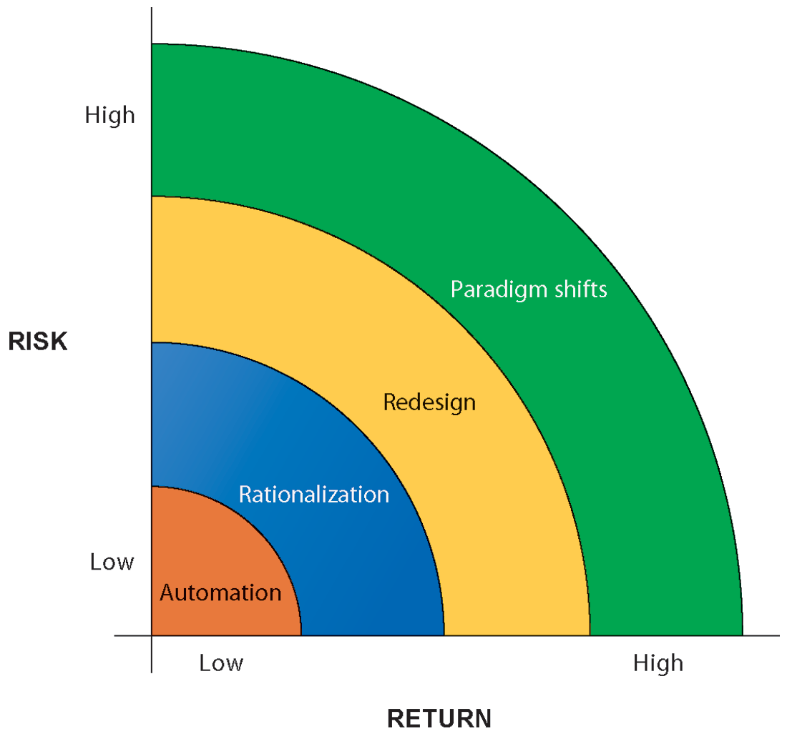
CHAPTER 13: BUILDING INFORMATION SYSTEMS
Systems as Planned Organizational Change
ORGANIZATIONAL CHANGE CARRIES RISKS AND REWARDS
The most common forms of organizational change are automation and rationalization. These relatively slow-moving and slow-changing strategies present modest returns but little risk. Faster and more comprehensive change—such as redesign and paradigm shifts—carries high rewards but offers substantial chances of failure.
FIGURE 13-1
Notes:
This graphic illustrates the four types of change, identifying them according to the potential return on investment as well as level of risk. What makes automation a low risk? What makes a paradigm shift or redesign a high risk? It is important to note that BPR and paradigm shifts have high failure rates. Organizational change is difficult to orchestrate.

Slide 6
CHAPTER 13: BUILDING INFORMATION SYSTEMS
Systems as Planned Organizational Change
Business process management (BPM)
  Variety of tools, methodologies to analyze, design, optimize processes
  Used by firms to manage business process redesign
Steps in BPM
  Identify processes for change
  Analyze existing processes
  Design the new process
  Implement the new process
  Continuous measurement
Notes:
This slide discusses business process management, a category of tools and techniques that help firms redesign business processes. It discusses the riskiness of business process reengineering, and the need to properly manage it in order for BPR to be effective. For example, why is it important to determine the right business process to change rather than all business processes (some processes may not yield time or cost savings, you could spend too much money trying to improve all processes, and some processes may already be effective.) Give an example of a business process and how the process could be measured. For example, how would you measure the business process of a customer ordering a meal? Of a kitchen preparing and delivering that meal? What about the business process of hiring a new employee? It is important to note that, even with effective process redesign, a majority of reengineering projects do not achieve breakthrough gains because of inadequate change management.

Slide 7
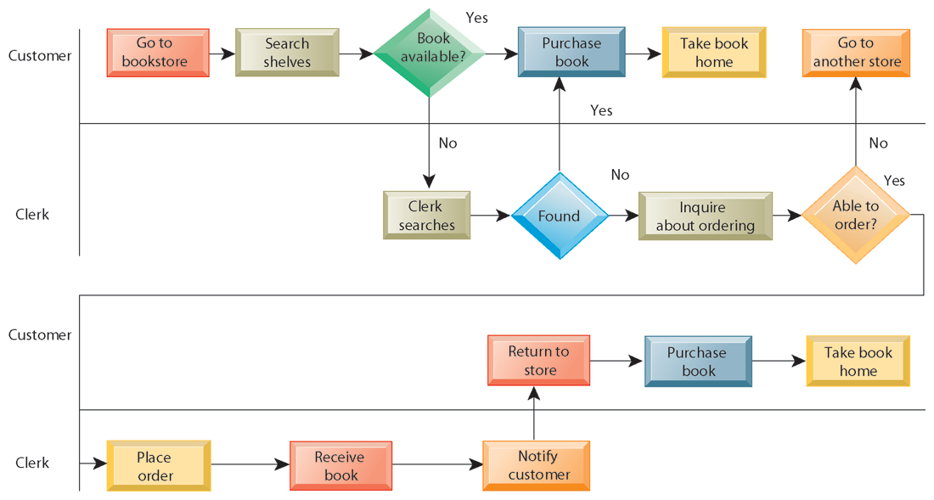
CHAPTER 13: BUILDING INFORMATION SYSTEMS
Systems as Planned Organizational Change
AS-IS BUSINESS PROCESS FOR PURCHASING A BOOK FROM A PHYSICAL BOOKSTORE
FIGURE 13-2
Purchasing a book from a physical bookstore requires many steps to be performed by both the seller and the customer.
Notes:
This slide’s graphic illustrates the process of purchasing a book prior to reengineering, including the steps if a book is not available. It emphasizes the sequential nature of the task. Besides the time taken for this process, what are other disadvantages of this traditional business process?

Slide 8
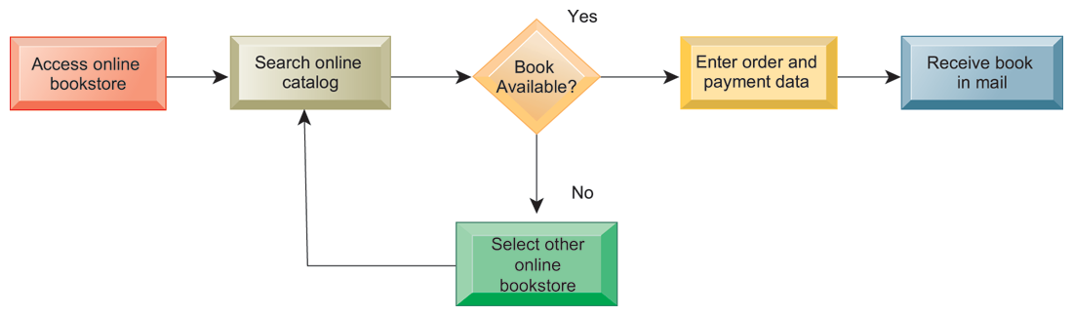
CHAPTER 13: BUILDING INFORMATION SYSTEMS
Systems as Planned Organizational Change
REDESIGNED PROCESS FOR PURCHASING A BOOK ONLINE
FIGURE 13-3
Using Internet technology makes it possible to redesign the process for purchasing a book so that it requires fewer steps and consumes fewer resources.
Notes:
This graphic illustrates the book purchasing process after reengineering as an online process. The new process and technology has reduced numerous stages to four or five. What are the elements that have allowed these steps to occur? Which of the four types of organizational change described earlier does this redesigned process most closely resemble – automation, rationalization, redesign, paradigm shift?

Slide 9
CHAPTER 13: BUILDING INFORMATION SYSTEMS
Systems as Planned Organizational Change
Variety of tools for BPM, to
  Identify and document existing processes
    Identify inefficiencies
  Create models of improved processes
  Capture and enforce business rules for performing processes
  Integrate existing systems to support process improvements
  Verify that new processes have improved
  Measure impact of process changes on key business performance indicators
Notes:
This slide gives an overview of the various types of BPM tools that firms use to redesign business processes. The text discusses the example of American National Insurance Company, which used Pegasystems BPM workflow software to streamline customer service processes across four business groups. BPM built rules to guide service reps through a single view of customer information across multiple systems, eliminating the need to access multiple applications when handling customer requests. This increased workload capacity of the representatives by 192%.

Slide 10
CHAPTER 13: BUILDING INFORMATION SYSTEMS
Systems as Planned Organizational Change
CAN BUSINESS PROCESS MANAGEMENT MAKE A DIFFERENCE?
Why are large companies such as AmerisourceBergen and Diebold good candidates for business process management?
What were the business benefits for each company from redesigning and managing their business processes?
How did BPM change the way these companies ran their businesses?
What might be some of the problems with extending BPM software across a large number of business processes?
What companies stand to gain the most by implementing BPM?
Notes:
This slide presents discussion questions regarding the chapter case on the experiences of two firms, AmerisourceBergen and Diebold, in implementing business process management. AmerisourceBergen used Metastorm BPM software to automate over 300 processes with tremendous efficiency savings. Diebold (security systems and services) used Progress Savvion’s Business Manager BPM to improve its order fulfillment system, with enough success to use the product to analyze and improve other processes.

Slide 11
13.2. Overview of Systems Development

Slide 12
CHAPTER 13: BUILDING INFORMATION SYSTEMS
Overview of Systems Development
Systems development:
  Activities that go into producing an information system solution to an organizational problem or opportunity
  Systems analysis
  Systems design
  Programming
  Testing
  Conversion
  Production and maintenance
Notes:
This slide and the following slides discuss the activities involved in system development – the creation of a new (or improvements to an existing) information system. The activities listed are performed in order – the first two, systems analysis and systems design are preparatory steps for the system. The last four steps translate the design of the system into actuality.
It is important to emphasize that an information system is not technology for technology’s sake. It is a solution to a problem or set of problems the organization perceives it is facing – including the problem of an opportunity that requires the use of information systems in order to undertake.

Slide 13
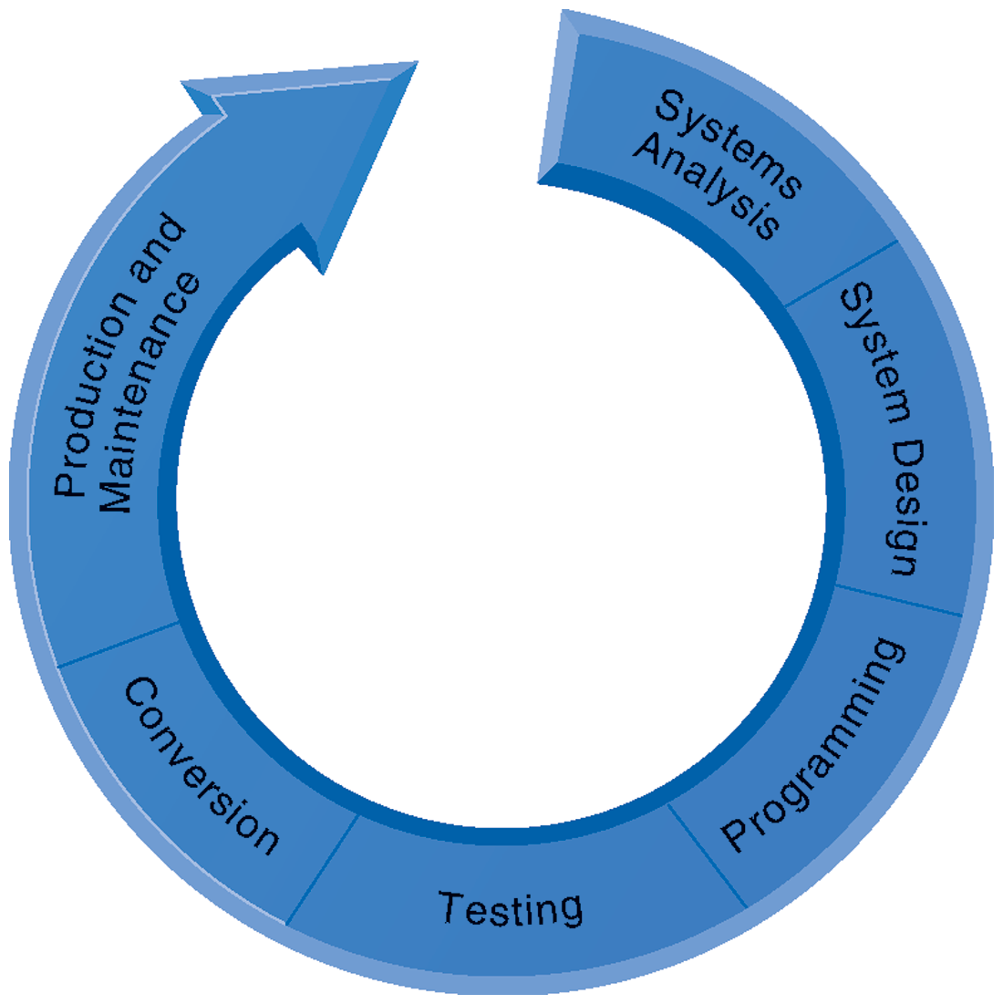
CHAPTER 13: BUILDING INFORMATION SYSTEMS
Overview of Systems Development
THE SYSTEMS DEVELOPMENT PROCESS
Building a system can be broken down into six core activities.
FIGURE 13-4
Notes:
This graphic illustrates the six core activities of systems building. Notice that these activities are represented as a circle.
The circular nature indicates that systems building is not a linear process that is finished once the system is built. Typically, additional changes and improvements will need to be made to the system or part of the system that will require additional analysis, design, programming, testing, conversion, and maintenance.

Slide 14
CHAPTER 13: BUILDING INFORMATION SYSTEMS
Overview of Systems Development
Systems analysis
  Analysis of problem to be solved by new system
    Defining the problem and identifying causes
    Specifying solutions
      Systems proposal report identifies and examines alternative solutions
    Identifying information requirements
  Includes feasibility study
    Is solution feasible and good investment?
    Is required technology, skill available?
Notes:
This slide and the next describe the first stage of systems development, systems analysis.
The systems analyst first creates a road map of the existing organization and systems. What does this road map consist of? (Identifying primary owners and users of data along with existing hardware and software.) What constitutes a primary owner of data? How an analyst would determine if a problem existed with existing systems. (by examining documents, work papers, procedures, observing system operations, and interviewing key users as well as managers).
What does it mean that a solution is feasible from a financial standpoint? A technical standpoint? An organizational standpoint?

Slide 15
CHAPTER 13: BUILDING INFORMATION SYSTEMS
Overview of Systems Development
System analysis (cont.)
  Establishing information requirements
    Who needs what information, where, when, and how
    Define objectives of new/modified system
    Detail the functions new system must perform
  Faulty requirements analysis is leading cause of systems failure and high systems development cost
Notes:
This slide continues the discussion about the first stage in systems development, systems analysis.
Establishing information requirements is an essential part of analysis. A system designed around the wrong set of requirements will either have to be discarded because of poor performance or will need to undergo major modifications. As the text discusses later in the chapter, user involvement is essential for gathering requirements. Why is this so? If user involvement is central to gathering information requirements, why should technical specialists, such as systems analysts, also be involved in this process?

Slide 16
CHAPTER 13: BUILDING INFORMATION SYSTEMS
Overview of Systems Development
Systems design
  Describes system specifications that will deliver functions identified during systems analysis
  Should address all managerial, organizational, and technological components of system solution
  Role of end users
    User information requirements drive system building
    Users must have sufficient control over design process to ensure system reflects their business priorities and information needs
    Insufficient user involvement in design effort is major cause of system failure
Notes:
This slide describes the second stage of systems development, systems design. The text explains that like houses or buildings, information systems may have many possible designs. Each design represents a unique blend of all technical and organizational components. What makes one design superior to others is the ease and efficiency with which it fulfills user requirements within a specific set of technical, organizational, financial, and time constraints. Given an identical systems analysis, what elements might be different in a system design created by two different systems designers?

Slide 17
CHAPTER 13: BUILDING INFORMATION SYSTEMS
Overview of Systems Development
OUTPUT Medium Content Timing INPUT Origins Flow Data entry USER INTERFACE Simplicity Efficiency Logic Feedback Errors DATABASE DESIGN Logical data model Volume and speed requirements File organization and design Record specifications | PROCESSING Computations Program modules Required reports Timing of outputs MANUAL PROCEDURES What activities Who performs them When How Where CONTROLS Input controls (characters, limit, reasonableness) Processing controls (consistency, record counts) Output controls (totals, samples of output) Procedural controls (passwords, special forms) SECURITY Access controls Catastrophe plans Audit trails | DOCUMENTATION Operations documentation Systems documents User documentation CONVERSION Transfer files Initiate new procedures Select testing method Cut over to new system TRAINING Select training techniques Develop training modules Identify training facilities ORGANIZATIONAL CHANGES Task redesign Job redesign Process design Organization structure design Reporting relationships
Notes:
This slide lists the various types of specifications that must be detailed and describe in a systems design. From this it is easy to see how complex designing a system can be, and how many opportunities there are for mistakes to creep in. Problems in any one of these areas could produce a less-than optimal system and losses in efficiency and productivity. Select a few of the specifications here. Think what types of problems could result from an inadequate definition of that specification.

Slide 18
CHAPTER 13: BUILDING INFORMATION SYSTEMS
Overview of Systems Development
Programming:
  System specifications from design stage are translated into software program code
Testing
  Ensures system produces right results
  Unit testing: Tests each program in system separately
  System testing: Test functioning of system as a whole
  Acceptance testing: Makes sure system is ready to be used in production setting
  Test plan: All preparations for series of tests
Notes:
This slide describes the third and fourth stages of systems development, programming and testing.
Many companies today do not perform their own programming, but purchase software or outsource programming to a vendor. In outsourcing, who would be responsible for the testing, the vendor or the purchasing company? Would any testing be needed when software is purchased as a package? It is important to note that the importance of testing is typically underrated in systems project planning, and the risks resulting from inadequate testing are enormous. If system testing is performed that checks the entire system, would unit testing be important?

Slide 19
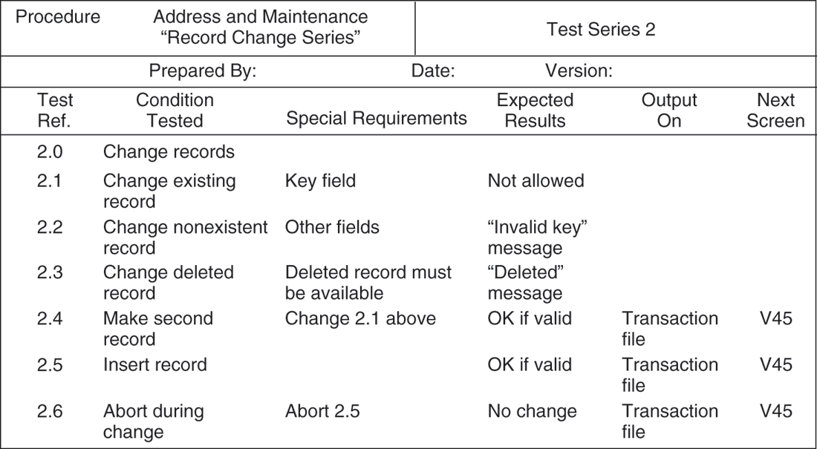
CHAPTER 13: BUILDING INFORMATION SYSTEMS
Overview of Systems Development
A SAMPLE TEST PLAN TO TEST A RECORD CHANGE
FIGURE 13-5
When developing a test plan, it is imperative to include the various conditions to be tested, the requirements for each condition tested, and the expected results. Test plans require input from both end users and information systems specialists.
Notes:
This graphic illustrates a portion of a test plan. Describe what the columns of this table mean. It looks at six different possible situations, given a user of the system attempting to change a record in the database, from trying to change an existing address in the system (2.1) to not completing the record change (2.6).

Slide 20
CHAPTER 13: BUILDING INFORMATION SYSTEMS
Overview of Systems Development
Conversion
  Process of changing from old system to new system
  Four main strategies
    Parallel strategy
    Direct cutover
    Pilot study
    Phased approach
  Requires end-user training
  Finalization of detailed documentation showing how system works from technical and end-user standpoint
Notes:
This slide describes the fifth stage of systems development, conversion. Describe each of the strategies. What would make one approach more appropriate than another? Is there any case in which a direct cutover would be the optimal strategy?

Slide 21
CHAPTER 13: BUILDING INFORMATION SYSTEMS
Overview of Systems Development
Production and maintenance
  System reviewed to determine if revisions needed
  May include post-implementation audit document
  Maintenance
    Changes in hardware, software, documentation, or procedures to a production system to correct errors, meet new requirements, or improve processing efficiency
      20% debugging, emergency work
      20% changes to hardware, software, data, reporting
      60% of work: User enhancements, improving documentation, recoding for greater processing efficiency
Notes:
This slide describes the sixth and final stage of systems development, production and maintenance, and shows that an information system is never “finished.” Situations and business environments always change, and systems have to change along with the business. Of course many businesses do not want to spend the resources to change their systems as required by a changing environment. And for this reason, systems can become dysfunctional, costing the firm money fixing the problems created by an outdated system. If any of the types of maintenance work listed here could be eliminated by better analysis and design?

Slide 22
CHAPTER 13: BUILDING INFORMATION SYSTEMS
Overview of Systems Development
SUMMARY OF SYSTEMS DEVELOPMENT ACTIVITIES
CORE ACTIVITY | DESCRIPTION
Systems analysis | Identify problem(s) Specify solutions Establish information requirements
Systems design | Create design specifications
Programming | Translate design specifications into code
Testing | Unit test Systems test Acceptance test
Conversion | Plan conversion Prepare documentation Train users and technical staff
Production and maintenance | Operate the system Evaluate the system Modify the system
Notes:
This slide summarizes the six stages in system development.

Slide 23
CHAPTER 13: BUILDING INFORMATION SYSTEMS
Overview of Systems Development
Most prominent methodologies for modeling and designing systems:
  Structured methodologies
  Object-oriented development
Structured methodologies
  Structured: Techniques are step-by-step, progressive
  Process-oriented: Focusing on modeling processes or actions that manipulate data
  Separate data from processes
Notes:
This slide identifies the two most prominent methodologies for modeling systems and introduces the core concepts behind a structured methodology. What does it mean to “separate data from processes?”

Slide 24
CHAPTER 13: BUILDING INFORMATION SYSTEMS
Overview of Systems Development
Data flow diagram:
  Primary tool for representing system’s component processes and flow of data between them
  Offers logical graphic model of information flow
  High-level and lower-level diagrams can be used to break processes down into successive layers of detail
Data dictionary: Defines contents of data flows and data stores
Process specifications: Describe transformation occurring within lowest level of data flow diagrams
Structure chart: Top-down chart, showing each level of design, relationship to other levels, and place in overall design structure
Notes:
This slide continues the discussion of the structured methodology, looking at the tools and techniques that it uses to model an information system. An example data flow diagram is shown on the next slide, so it may be helpful to move to that slide to discuss these diagrams. A data dictionary is needed so that system builders know exactly what data is stored and manipulated. Process specifications express the logic that is used when one piece of data is transformed by a process. A structure chart looks at the main function of the system, breaks it down into sub-functions, breaks sub-functions into more detailed sub-functions, until the smallest level of detail is reached. Give an example of what the smallest level of detail might look like, for example, in a university system managing student grades and reports.

Slide 25
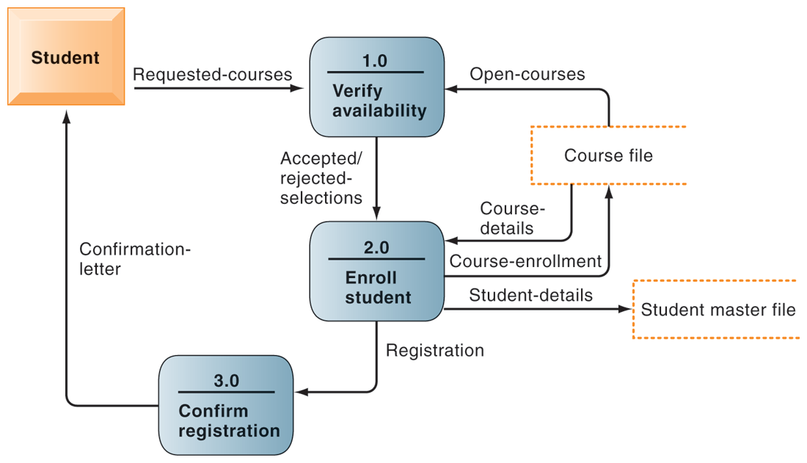
CHAPTER 13: BUILDING INFORMATION SYSTEMS
Overview of Systems Development
DATA FLOW DIAGRAM FOR MAIL-IN UNIVERSITY REGISTRATION SYSTEM
FIGURE 13-6
The system has three processes: Verify availability (1.0), Enroll student (2.0), and Confirm registration (3.0). The name and content of each of the data flows appear adjacent to each arrow. There is one external entity in this system: the student. There are two data stores: the student master file and the course file.
Notes:
This graphic is a data flow diagram. What the rounded boxes represent (processes) and what the square box represents (an external entity)? What about the open rectangle and the arrows? Where does the process begin? Step through the process of registering a student for a course, noting what data is transferred at each step. It’s always fun to do data flow diagrams as a group because it illustrates how the same process is seen differently by different people.

Slide 26
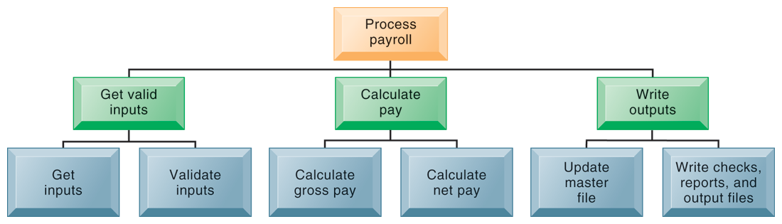
CHAPTER 13: BUILDING INFORMATION SYSTEMS
Overview of Systems Development
HIGH-LEVEL STRUCTURE CHART FOR A PAYROLL SYSTEM
FIGURE 13-7
This structure chart shows the highest or most abstract level of design for a payroll system, providing an overview of the entire system.
Notes:
This graphic shows a high-level structure chart. Note that this is high-level – and subfunctions exist for the functions “Get inputs,” “Validate inputs,” etc. What might be a subfunction for “Calculate gross pay”?

Slide 27
CHAPTER 13: BUILDING INFORMATION SYSTEMS
Overview of Systems Development
Object-oriented development
  Object is basic unit of systems analysis and design
    Object:
      Combines data and the processes that operate on those data
      Data encapsulated in object can be accessed and modified only by operations, or methods, associated with that object
  Object-oriented modeling based on concepts of class and inheritance
    Objects belong to a certain class and have features of that class
    May inherit structures and behaviors of a more general, ancestor class
Notes:
This slide introduces the second of the two main system modeling methodologies – object-oriented development. A key concept here is that of class and inheritance. Describe what a class is – (general category of similar objects) and objects that might be in the same class. For example, what objects might be in the category “Degrees” in a university’s information system?

Slide 28
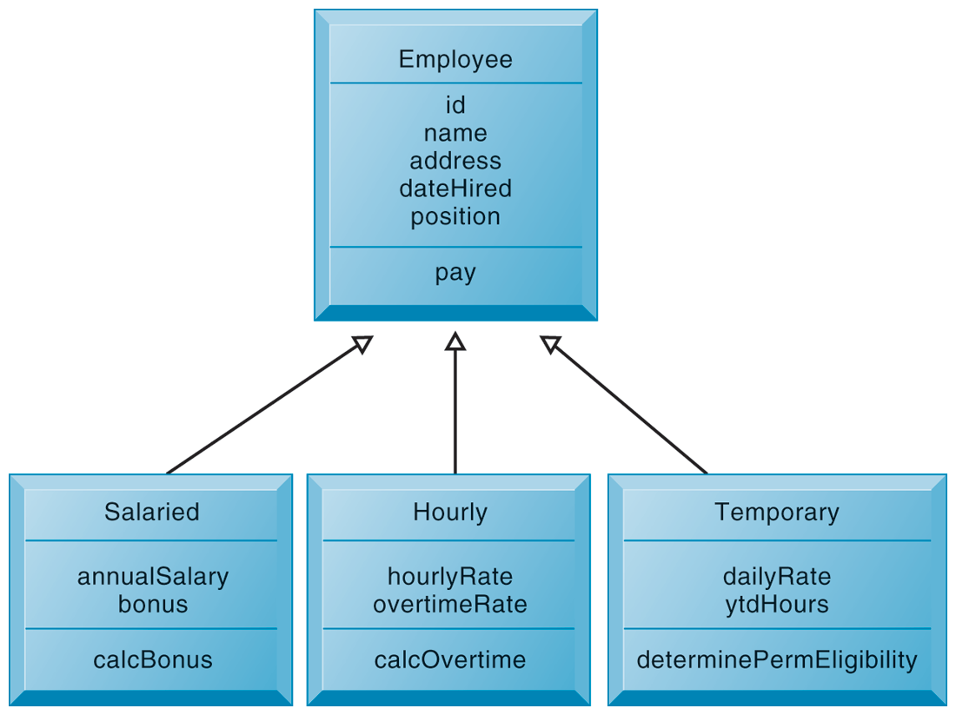
CHAPTER 13: BUILDING INFORMATION SYSTEMS
Overview of Systems Development
CLASS AND INHERITANCE
This figure illustrates how classes inherit the common features of their superclass.
FIGURE 13-8
Notes:
This graphic illustrates the concept of class and inheritance in object-oriented development. The Class employee allows subclasses to be created using the “template” or superclass “Employee” and use the processes and properties defined for Employee. Subclasses can use properties of their superclass and also add their own properties. If a subclass “Intern” was added to this chart, what unique properties might it have?

Slide 29
CHAPTER 13: BUILDING INFORMATION SYSTEMS
Overview of Systems Development
Object-oriented development
  More iterative and incremental than traditional structured development
    Systems analysis: Interactions between system and users analyzed to identify objects
    Design phase: Describes how objects will behave and interact; grouped into classes, subclasses and hierarchies
    Implementation: Some classes may be reused from existing library of classes, others created or inherited
  Because objects are reusable, object-oriented development can potentially reduce time and cost of development
Notes:
This slide continues the discussion of object-oriented development, highlighting unique considerations during the systems development process. Imagine to perform some rudimentary systems analysis and design for an information system that managed inventory for a department store. What classes might be created? What properties would they have? What subclasses would there be for one of these classes and what properties would they inherit?
It is important to emphasize that object-oriented development can reduce the time and cost of development through reusing objects and classes from one application for other applications.

Slide 30
CHAPTER 13: BUILDING INFORMATION SYSTEMS
Overview of Systems Development
Computer-aided software engineering (CASE)
  Software tools to automate development and reduce repetitive work, including
    Graphics facilities for producing charts and diagrams
    Screen and report generators, reporting facilities
    Analysis and checking tools
    Data dictionaries
    Code and documentation generators
  Support iterative design by automating revisions and changes and providing prototyping facilities
  Require organizational discipline to be used effectively
Notes:
CASE tools are software tools to automate development tasks for either of the two methodologies just discussed (structured, object-oriented). What does it mean that organizational discipline must be used to be used effectively? What kinds of gains in productivity can be expected if CASE tools are used properly?

Slide 31
13.3. Alternative Systems Building Approaches

Slide 32
CHAPTER 13: BUILDING INFORMATION SYSTEMS
Alternative Systems Building Approaches
Alternative Systems-Building Methods
  Traditional systems life-cycle
  Prototyping
  End-user development
  Application software packages
  Outsourcing
Notes:
Structured methodology and object-oriented development describe the structure of the software applications used by information systems. The next slides discuss different ways in which the work by the teams involved in creating this software can be organized.
Evaluate which of these methods, if implemented effectively, might produce the highest ROI. Which might be the riskiest?

Slide 33
CHAPTER 13: BUILDING INFORMATION SYSTEMS
Alternative Systems Building Approaches
Traditional systems lifecycle:
  Oldest method for building information systems
  Phased approach divides development into formal stages
    Follows “waterfall” approach: Tasks in one stage finish before another stage begins
  Maintains formal division of labor between end users and information systems specialists
  Emphasizes formal specifications and paperwork
  Still used for building large complex systems
  Can be costly, time-consuming, and inflexible
Notes:
This slide describes the first method for building systems, the traditional systems life-cycle. What is the role of end users in this method?

Slide 34
CHAPTER 13: BUILDING INFORMATION SYSTEMS
Alternative Systems Building Approaches
Prototyping
  Building experimental system rapidly and inexpensively for end users to evaluate
  Prototype: Working but preliminary version of information system
    Approved prototype serves as template for final system
  Steps in prototyping
      Identify user requirements
      Develop initial prototype
      Use prototype
      Revise and enhance prototype
Notes:
This slide discusses the second method of systems building, prototyping. It is an explicitly iterative process. The term iterative has been used several times; Describe what this means (steps to build the system can be repeated over and over). What are the benefits of an iterative process?
Note that once no more iterations are needed, the prototype becomes the finished specifications for the final application, or may serve as the production version of the application.

Slide 35
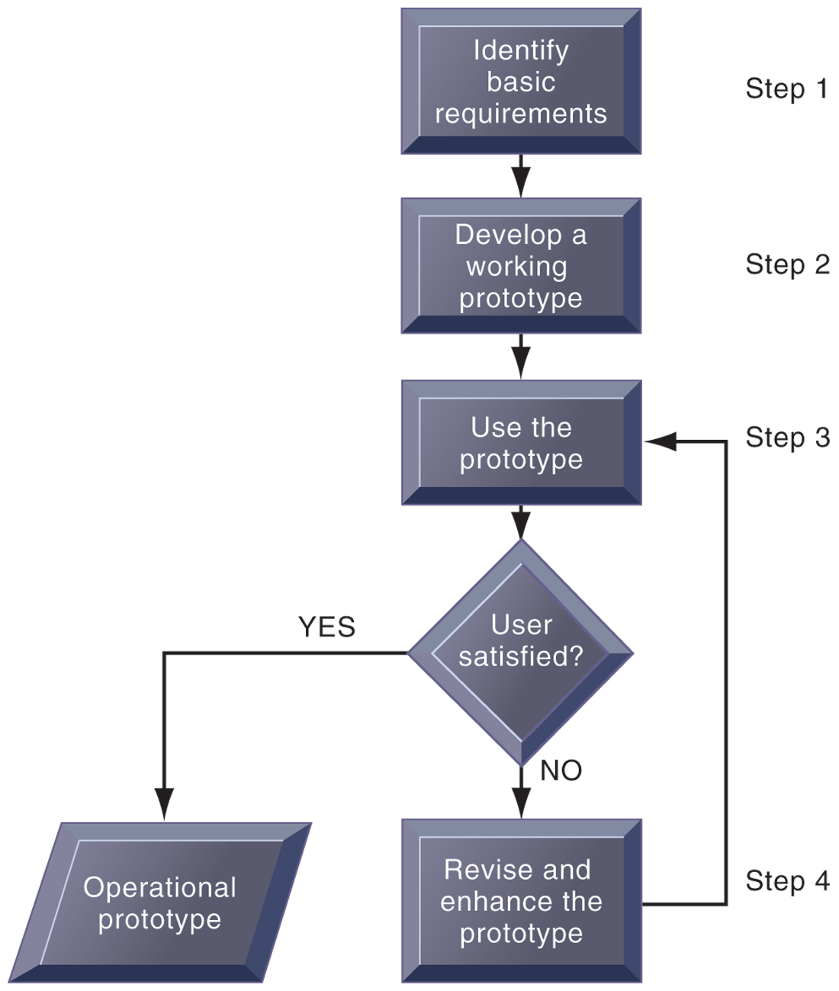
CHAPTER 13: BUILDING INFORMATION SYSTEMS
Alternative Systems Building Approaches
THE PROTOTYPING PROCESS
The process of developing a prototype can be broken down into four steps. Because a prototype can be developed quickly and inexpensively, systems builders can go through several iterations, repeating steps 3 and 4, to refine and enhance the prototype before arriving at the final operational one.
FIGURE 13-9
Notes:
This graphic illustrates the four steps (rectangles) of prototyping. The steps that are repeated are steps 3) Use the prototype and 4) Revise and enhance the prototype. Would this type of system development be appropriate for developing a large, enterprise management system?

Slide 36
CHAPTER 13: BUILDING INFORMATION SYSTEMS
Alternative Systems Building Approaches
Advantages of prototyping
  Useful if some uncertainty in requirements or design solutions
  Often used for end-user interface design
  More likely to fulfill end-user requirements
Disadvantages
  May gloss over essential steps
  May not accommodate large quantities of data or large number of users
    May not undergo full testing or documentation
Notes:
This slide continues the discussion of prototyping, listing the advantages and disadvantages to using this method of building systems.
Explain these advantages and disadvantages. For example, why is prototyping useful if there is uncertainty in requirements? What kinds of essential steps might be glossed over?

Slide 37
CHAPTER 13: BUILDING INFORMATION SYSTEMS
Alternative Systems Building Approaches
End-user development:
  Uses fourth-generation languages to allow end-users to develop systems with little or no help from technical specialists
  Fourth generation languages: Less procedural than conventional programming languages
    PC software tools
    Query languages
    Report generators
    Graphics languages
    Application generators
    Application software packages
    Very high-level programming languages
Notes:
This slide discusses a third alternative method in systems building, end-user development. What does it mean that fourth-generation languages are less “procedural” than conventional programming languages? What is an example of a conventional programming language? Describe or give an example of each type of fourth generation language category.

Slide 38
CHAPTER 13: BUILDING INFORMATION SYSTEMS
Alternative Systems Building Approaches
End-user development (cont.):
  Advantages:
    More rapid completion of projects
    High-level of user involvement and satisfaction
  Disadvantages:
    Not designed for processing-intensive applications
    Inadequate management and control, testing, documentation
    Loss of control over data
  Managing end-user development
    Require cost-justification of end-user system projects
    Establish hardware, software, and quality standards
Notes:
This slide continues the discussion of end-user development. What types of projects might end-user development be most suited for? How might this type of development result in a loss of control over data?

Slide 39
CHAPTER 13: BUILDING INFORMATION SYSTEMS
Alternative Systems Building Approaches
Application software packages
  Save time and money
  Many offer customization features:
    Software can be modified to meet unique requirements without destroying integrity of package software
  Evaluation criteria for systems analysis include:
    Functions provided by the package, flexibility, user friendliness, hardware and software resources, database requirements, installation and maintenance efforts, documentation, vendor quality, and cost
  Request for Proposal (RFP)
    Detailed list of questions submitted to packaged-software vendors
    Used to evaluate alternative software packages
Notes:
This slide discusses a fourth alternative in systems building, the use of application software packages. It is important to note that many functions are common to all business organizations—payroll, accounts receivable, or inventory control. Software packages will fulfill the need for many organizations for these types of functions. However, it is still important to perform systems analysis in order to determine your organization’s requirements for a system. Step through and explain the evaluation criteria for a package. For example, you would want to outline the functions you need from the package and determine whether the software package provides that.

Slide 40
CHAPTER 13: BUILDING INFORMATION SYSTEMS
Alternative Systems Building Approaches
Outsourcing
  Several types
    Cloud and SaaS providers
      Subscribing companies use software and computer hardware provided by vendors
    External vendors
      Hired to design, create software
      Domestic outsourcing
        Driven by firms need for additional skills, resources, assets
      Offshore outsourcing
        Driven by cost-savings
Notes:
This slide describes a fifth alternative in systems building, outsourcing. SaaS and cloud computing were introduced in chapter 5. Describe these types of outsourcing in their own words. Refer to the Learning Tracks on outsourcing and cloud computing.

Slide 41
CHAPTER 13: BUILDING INFORMATION SYSTEMS
Alternative Systems Building Approaches
Outsourcing (cont.)
  Advantages
    Allows organization flexibility in IT needs
  Disadvantages
    Hidden costs, e.g.
      Identifying and selecting vendor
      Transitioning to vendor
    Opening up proprietary business processes to third party
Notes:
This slide continues the discussion of outsourcing. It is important to emphasize the amount of work involved in partnering and sharing work with a vendor. It may take anywhere from 3 months to a year to fully transfer work to a vendor. What other types of hidden costs can you identify?

Slide 42
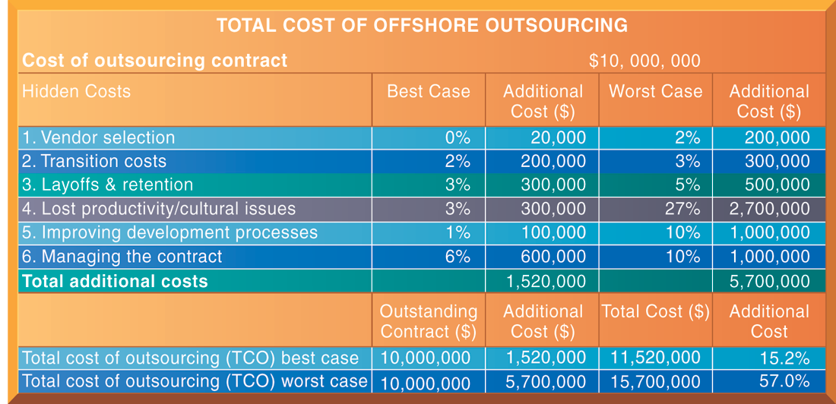
CHAPTER 13: BUILDING INFORMATION SYSTEMS
Alternative Systems Building Approaches
TOTAL COST OF OFFSHORE OUTSOURCING
FIGURE 13-10
If a firm spends $10 million on offshore outsourcing contracts, that company will actually spend 15.2 percent in extra costs even under the best-case scenario. In the worst-case scenario, where there is a dramatic drop in productivity along with exceptionally high transition and layoff costs, a firm can expect to pay up to 57 percent in extra costs on top of the $10 million outlay for an offshore contract.
Notes:
This graphic looks at the best and worst case scenarios regarding hidden costs in outsourcing. The best case column shows the lowest estimates for additional costs, and the worst case reflects the highest estimates for these costs. In the Additional Cost column at the lower right, you can see that hidden costs increase the total cost of an offshore outsourcing project by an extra 15 to 57 percent. However, it is important to note that even with these extra hidden costs, many firms will benefit from offshore outsourcing if they manage the work well.

Slide 43
13.4. Application Development for The Digital Firm

Slide 44
CHAPTER 13: BUILDING INFORMATION SYSTEMS
Application Development for the Digital Firm
Rapid application development (RAD)
  Process of creating workable systems in a very short period of time
  Utilizes techniques such as:
    Visual programming and other tools for building graphical user interfaces
    Iterative prototyping of key system elements
    Automation of program code generation
    Close teamwork among end users and information systems specialists
Notes:
The next slides discuss application development methods that emphasize providing fast solutions needed in an increasingly digital world. What elements in RAD are similar to building methods already discussed are used in RAD– CASE tools, prototyping, etc.?

Slide 45
CHAPTER 13: BUILDING INFORMATION SYSTEMS
Application Development for the Digital Firm
Joint application design (JAD)
  Used to accelerate generation of information requirements and to develop initial systems design
  Brings end users and information systems specialists together in interactive session to discuss system’s design
  Can significantly speed up design phase and involve users at intense level
Notes:
JAD is a second technique for accelerating the systems building process.

Slide 46
CHAPTER 13: BUILDING INFORMATION SYSTEMS
Application Development for the Digital Firm
Agile development
  Focuses on rapid delivery of working software by breaking large project into several small sub-projects
  Subprojects
    Treated as separate, complete projects
    Completed in short periods of time using iteration and continuous feedback
  Emphasizes face-to-face communication over written documents, allowing collaboration and faster decision making
Notes:
Agile development is a third technique used to accelerate the systems building process. Could all three of the techniques described be used at the same time?

Slide 47
CHAPTER 13: BUILDING INFORMATION SYSTEMS
Application Development for the Digital Firm
Component-based development
  Groups of objects that provide software for common functions (e.g., online ordering) and can be combined to create large-scale business applications
  Web services
    Reusable software components that use XML and open Internet standards (platform independent)
    Enable applications to communicate with no custom programming required to share data and services
    Can engage other Web services for more complex transactions
    Using platform and device-independent standards can result in significant cost-savings and opportunities for collaboration with other companies
Notes:
Component-based development also speeds up system and software building. Web services describe Internet-standards based reusable software components, that can be combined to build more complex applications, such as checking a customer’s credit, procurement, or placing orders.

