Slide 1
IMPLEMENTASI KEBIJAKAN
Deddy S BRATAKUSUMAH, PhD
2016

Slide 2
Implementasi kebijakan

Slide 3
IMPLEMENTASI KEBIJAKAN
TANTANGAN YANG SEBENARNYA BAGI PEMERINTAHAN, BUKAN IHWAL DIUNDANGKANNYA SUATU KEBIJAKAN TETAPI BAGAIMANA KEBIJAKAN ITU DIIMPLEMENTASIKAN.
KEBANYAKAN KEBIJAKAN TIDAK BERHASIL MENCAPAI SASARAN DARI KEBIJAKAN TERSEBUT.
Notes:
Whatever decisions are reached, there sometimes appears to be an ‘implementation gap’ between policy and its effective execution, partly perhaps because of intrinsic problems with the decision, but partly also because central government inevitably has to rely for implementation on others, such as local government or other public agencies, and their ‘street-level’ officials, and sometimes the private or voluntary sector. There may also be problems of insufficient financial or other resources for effective implementation, or unanticipated consequences which may even make the policy counter-productive.

Slide 4
HAKEKAT IMPLEMENTASI KEBIJAKAN
“ … POLICY IMPLEMENTATION ENCOMPASSES THOSE ACTIONS BY PUBLIC AND PRIVATE INDIVIDUALS (OR GROUPS) THAT AFFECT THE ACHIEVEMENT OF OBJECTIVES SET FORTH IN PRIOR POLICY DECISIONS.”
(Van Horn and Van Meter, 1977)

Slide 5
PRASYARAT IMPLEMENTASI KEBIJAKAN
DUKUNGAN POLITIK
KESIAPAN PERATURAN PELAKSANAAN
KESIAPAN INSTANSI PELAKSANA
PEMBAGIAN PERAN PADA INSTANSI PELAKSANA (manajemen pelaksanaan)
WAKTU YANG MEMADAI UNTUK PERSIAPAN PELAKSANAAN
SOSIALISASI KEBIJAKAN KEPADA PARApIHAK
SUMBER DAYA IMPLEMENTASI TELAH TERSEDIA DENGAN TEPAT JUMLAH DAN TEPAT WAKTU
KOMUNIKASI DAN KOORDINASI ANTAR INSTASI TERKAIT
Pembuatan kontrak atau perjanjian yang diperlukan
Notes:
Whatever decisions are reached, there sometimes appears to be an ‘implementation gap’ between policy and its effective execution, partly perhaps because of intrinsic problems with the decision, but partly also because central government inevitably has to rely for implementation on others, such as local government or other public agencies, and their ‘street-level’ officials, and sometimes the private or voluntary sector. There may also be problems of insufficient financial or other resources for effective implementation, or unanticipated consequences which may even make the policy counter-productive.

Slide 6
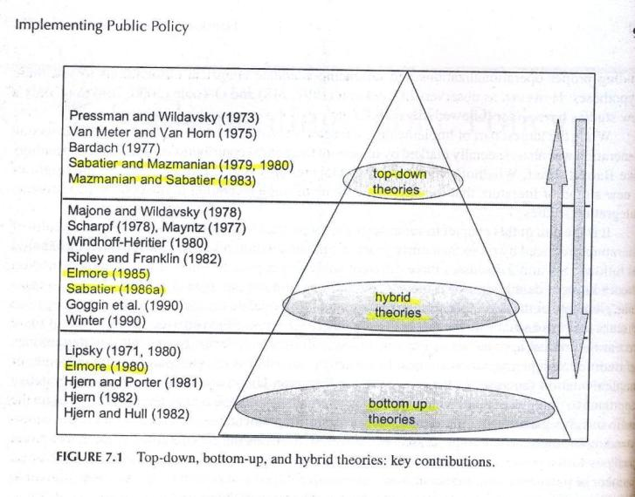
Teori Implementasi kebijakan
( T.A.Birkland, 2006 )

Slide 7
Teori Implementasi kebijakan
Top Down Theory: Implementation as concern with the degree to which the actions of implementing officials and target groups coincide with the goals embodied in an authoritative decision
A more realistic understanding of implementation can be gained by looking at a policy from the view of the target population and the service deliverers
Implementation plan should be developed using either the top-down or bottom-up approach depending on a set of parameters that describes the policy context
(Matland, 1995)

Slide 8
Perbedaan top down dan bottom up
 | Top Down | Bottom Up
Policy Rule Framework seen as: | Rigid | Flexible
Policy seen as: | An input | An output
Accountability seen as depending on: | Deference to a legislative process | Adaptability to customer/ client needs
(Hill 1997)

Slide 9
Instrumen penerapan kebijakan
No | Lineberry | Edward III | Hood
1 | Organizational Units | Bureaucratic Structure | Organization
2 | Standard Operating Procedures | Disposition | Authority
3 | Coordination and Communication | Communication | Nodality
4 | Allocation of Resources | Resources | Treasure
(Islamy, 2005)

Slide 10
ELEMEN PADA PENERAPAN KEBIJAKAN
Communications
Resources
Implementation
Dispositions
Bureaucratic
Structure
Communications
Transmission
Clarity
Consistency
Bureaucratic Structure
Standard Operating Procedures
Fragmentation
Resources
Staff
Information
Authority
Facilities
Dispositions
Effect of Dispositions
Staffing the Bureacracy
Incentives
(Edwards III, 1980)

Slide 11
Menurut Edward
Arahan yang dikomunikasikan dengan buruk dalam struktur yang salah dapat memperburuk sikap yang sudah ada sebelumnya terhadap kebijakan
Akibatnya sumber daya menjadi mubazir dan implementasi yang tidak efektif.

Slide 12
Faktor Penyebab masalah dalam implementasi
kebijakan baru
Desentralisasi implementasi
Kontroversi
Komplex
Krisis
Keputusan pengadilan
Kombinasi dari berbagai faktor Diatas

