Slide 1
LINGKUNGAN KEUANGAN
PERTEMUAN #1
FEB 302
MANAJEMEN
KEUANGAN
FAKULTAS EKONOMI DAN BISNIS
UNIVERSITAS ESA UNGGUL

Slide 2
VISI DAN MISI UNIVERSITAS ESA UNGGUL

Slide 3
KEMAMPUAN AKHIR YANG DIHARAPKAN
Mahasiswa diharapkan mampu:
Memahami pengertian laporan keuagan cash flow dan kaitan berbagai komponennya

Slide 4
MATERI SEBELUM UTS
01
Lingkungan - LK
03
02
Analisis informasi Akuntansi - LK
04
Perencanaan Keuangan-Peramalan keuangan
05
Time Value Of Money
06
Valuation
07
Risk and Return
Cost and Capital

Slide 5
MATERI SETELAH UTS
08
Analisis Resiko Rasio Keuangan
10
09
Pengelolaan Sturuktur Modal
11
Working Capital - Manajemen Asset
12
Manajemen Piutang
13
Manajemen Persediaan
14
Penggabungan Usaha
Analisis sewa - beli

Slide 6
Chapter
1
Introduction to Finance
Lawrence J. Gitman
Jeff Madura
The Financial Environment: Firms, Investors, and Markets

Slide 7
Learning Goals
Define finance and explain why it is relevant to students.
Explain the components of the financial environment.
Explain how investors monitor managers to ensure that managerial decisions are in the best interests of the owners.
Describe how the financial environment has become internationalized.

Slide 8
What is Finance?
Finance represents the processes that transfer money among businesses, individuals, and governments.

Slide 9
What is Finance?
Financial decisions affecting firms:
Dell computer expands its product line.
Gap builds additional stores.
Nike closes a production plant in Asia.
Ford borrows $3 billion.
Perot Systems issues stock valued at $3 billion.

Slide 10
What is Finance?
Financial events affecting investors:
Nike stock declines 5 percent after a financial crisis occurs in Asia.
Microsoft stock declines after the court rules against the company in an antitrust case.
Lotus stock rises by 50 percent on news it is being acquired by IBM.

Slide 11
What is Finance?
Financial events resulting from government actions:
Yields on bonds decline in response to Federal Reserve decisions.
Interest rates rise in response to inflationary fears.
The dollar declines as U.S. investors invest more money abroad.

Slide 12
The Relevance of Finance
This book discusses finance from two primary perspectives: the financial manager and the investor.
It also discusses how financial institutions and financial markets affect both types of decision makers.
Thus, this text will help to prepare students for careers in finance or in business in general.
It also helps to prepare students for making personal financial decisions as investors.

Slide 13
Components of the Financial Environment
Financial Managers
Financial managers are responsible for deciding how to raise and invest company funds.
Collectively, these decisions are referred to as financial management.
Financial managers are expected to make decisions that will maximize stock price and firm value and are frequently compensated in a manner that encourages the achievement of these activities.

Slide 14
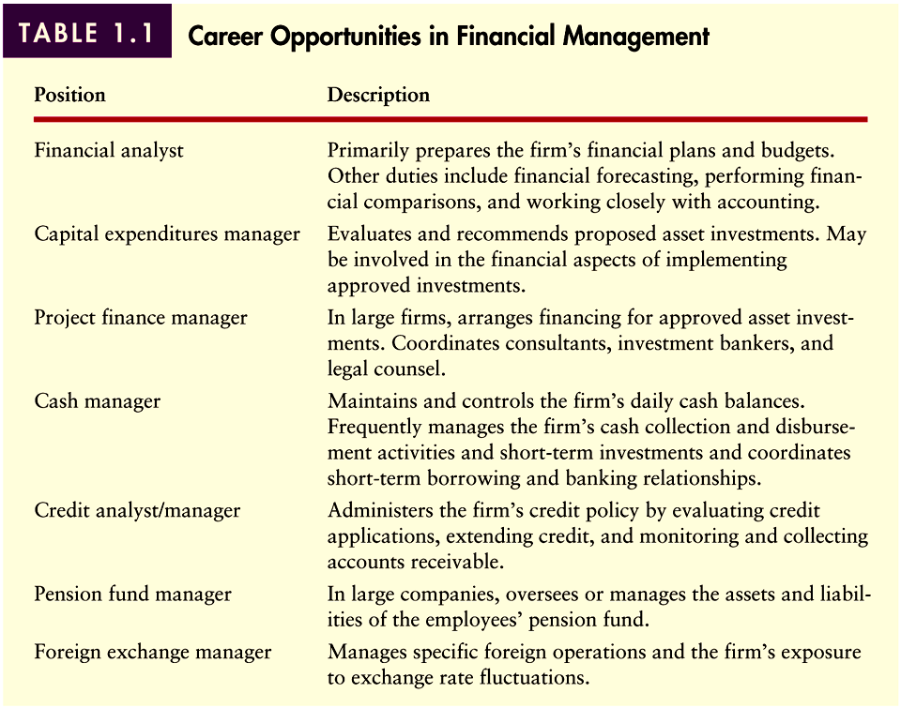
Financial Managers
Table 1.1

Slide 15
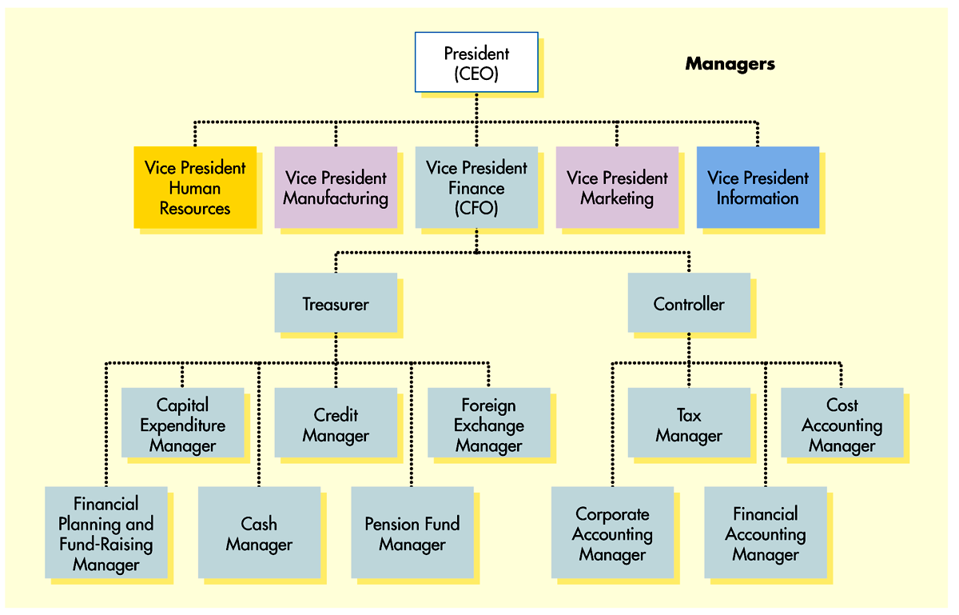
Financial Managers
Figure 1.1

Slide 16
Financial Managers
Interaction Between Financial Management and Other Business Functions

Slide 17
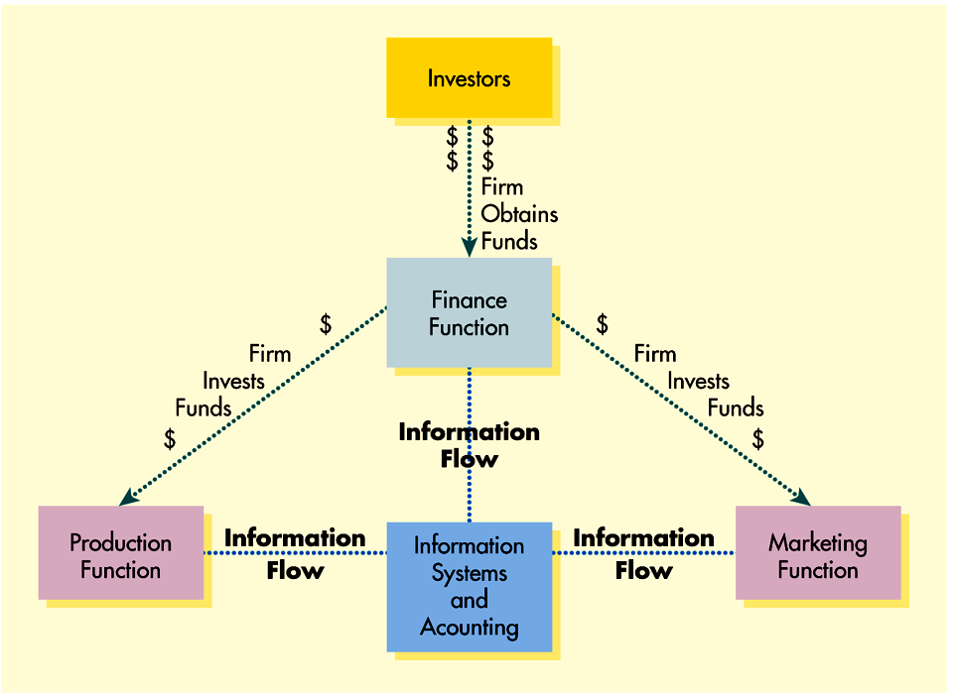
Financial Managers
Figure 1.2

Slide 18
Investment Decisions by Financial Managers
Financial managers are responsible for assessing the value of investment being considered by the firm.
Good investment decisions have a profound effect on the activities and the success of any business.
Both current and fixed asset decisions must be considered.
Investments are evaluated in terms of both risk and return.

Slide 19
Financing Decisions by Financial Managers
Financial managers are responsible for selecting the type of security and the amount of capital raised.
The financial manager must also decide between long-term and short-term capital.
For publicly traded firms, either equity or debt can be issued to obtain long term capital.
The firm can also use internally generated capital (retained equity) to fund investments.

Slide 20
Components of the Financial Environment
Investors
Investors represent individuals or financial institutions that provide funds to firms, government agencies, or individuals who need funds.
For publicly traded corporations, individuals provide funds to firms by purchasing their stocks and bonds.
Financial institutions that provide funds to firms are called institutional investors.
Some institutional investors provide loans, while others purchase securities issued by firms.

Slide 21
Debt Financing Provided by Investors
Loans provided to firms by financial institutions in exchange for fixed, periodic interest, and end-of-the-period principal repayment.
Debt securities (bonds) purchased by both individuals and institutions.
Investors profit by either purchasing debt at a discount or by receiving periodic interest payments and most debt can typically be traded in the financial markets.

Slide 22
Equity Financing Provided by Investors
When investors provide equity capital, they are purchasing ownership in a firm.
Stocks of publicly traded firms can be bought and sold in the market to other investors.
Investors can receive a return in the form of dividends and/or capital gains.

Slide 23
Return and Risk from Investing
Dividends represent a distribution of profits to the owners, while capital gains (losses) result when the security is later sold for more (less) than its purchase price.
Most investors are risk averse, meaning they prefer less risk to more.
The riskier the firm (stock), the greater will be an investor’s expected return.

Slide 24
Investors Use of Financial Services
Financial services firms include:
Financial planning firms
Banks, S&Ls, and credit unions
Brokerage firms
Insurance companies
Online sources

Slide 25
Components of the Financial Environment
Financial Markets
Financial markets represent forums that facilitate the flow of funds between investors, firms, and government units and agencies.
Examples of financial markets include the equity market and the debt market.
Each financial market is served by financial institutions that act as intermediaries between buyers and sellers.
Financial institutions acting as intermediaries include banks, brokerage firms, and insurance companies.

Slide 26
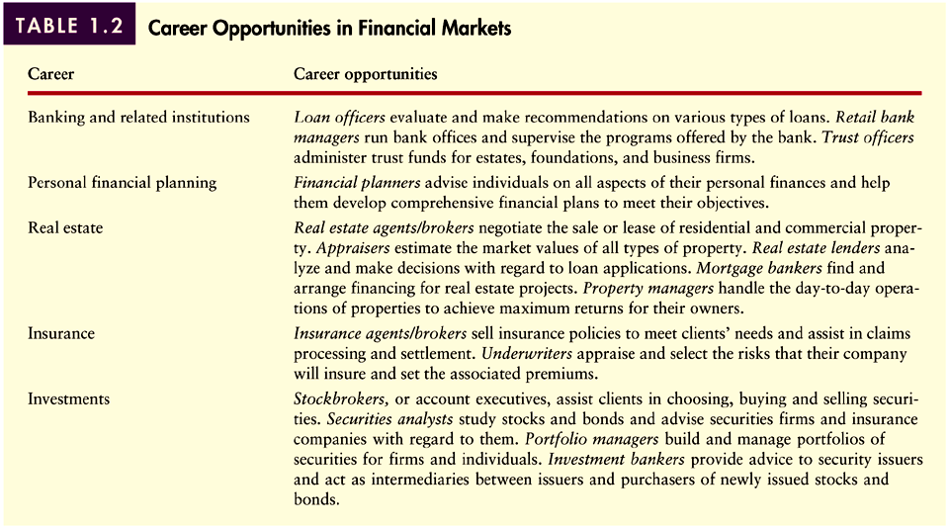
Careers of Participants in Financial Markets
Table 1.2

Slide 27
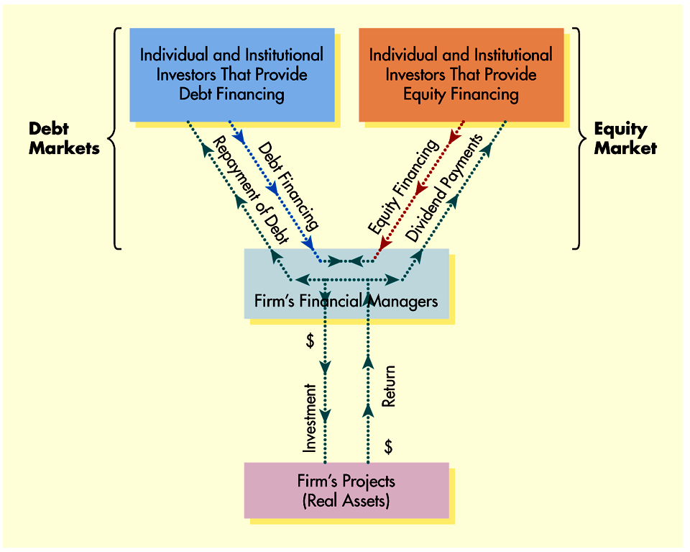
Integration of Components in Financial Markets
Figure 1.3

Slide 28
Investor Monitoring of Firms
Using Information to Value the Firm
Stock prices change continuously in response to changes in the supply and demand for shares.
Supply and demand changes in response to new information that is expected to impact a firm’s prospects.
Favorable information will impact share prices positively, while unfavorable information will have a negative impact on prices.

Slide 29
Investor Monitoring of Firms
How Investors Influence Firm Value
Because actions by management have an influence on firm performance and hence stock value, investors attempt to ensure that managers’ actions will maximize firm value.
Investors can influence management action through:
Trading
Shareholder activism
Threat of takeover

Slide 30
Investor Monitoring of Firms
Effects of Asymmetric Information
Investors monitor firms by reviewing financial statements and relying on reports by third-party services such as Moody’s, Standard & Poors, and Internet web sites.
However, the information provided by financial statements and information services is incomplete.
Asymmetric information results from the fact that more information is available to a firm’s managers than to its investors, and this information can affect stock prices.

Slide 31
Investor Monitoring of Firms
Effects of Asymmetric Information
Some institutional investors subscribe to proprietary information services not available to individual investors that reduce asymmetric information.
As a result, many individual investors choose to pay institutional investors (such as brokers) to make investment decisions for them.

Slide 32
The International Finance Environment
Risks of International Business
Exchange rate risk
Political risk
Risks resulting from cultural differences

Slide 33
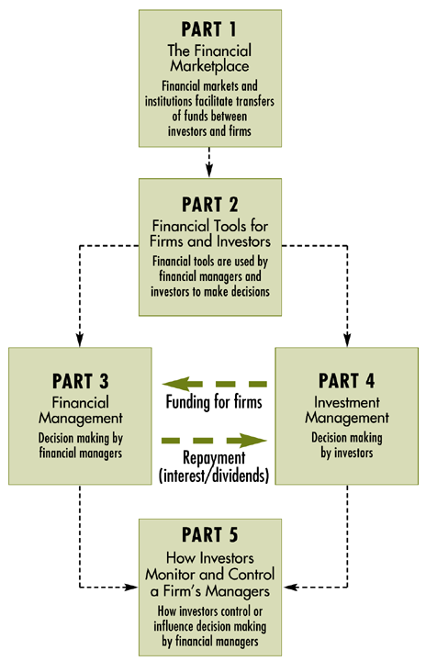
Using This Textbook
Part 1: The Financial Marketplace
Part 2: Financial Tools for Firms and Investors
Part 3: Financial Management
Part 4: Investment Management
Part 5: How Investors Monitor and Control a Firm’s Managers

Slide 34
Chapter
1
Introduction to Finance
Lawrence J. Gitman
Jeff Madura
End of Chapter

Slide 36
SEKIAN DAN TERIMA KASIH

