Slide 1
Working Capital Manajemen Asset
PERTEMUAN #10
FEB 302
MANAJEMEN KEUANGAN
FAKULTAS EKONOMI DAN BISNIS
UNIVERSITAS ESA UNGGUL

Slide 2
KEMAMPUAN AKHIR YANG DIHARAPKAN
Memahami dan memiliki wawasan
Pengukuran kebutuhan modal kerja
Pengelolaan asset

Slide 3
Chapter
13
Introduction to Finance
Lawrence J. Gitman
Jeff Madura
Capital Structure and Dividends

Slide 4
Learning Goals
Describe the basic types of capital, external assessment of capital structure, the capital structure of non-United States firms, and the optimal capital structure.
Discuss the EBIT-EPS approach to capital structure.
Review the return and risk of alternative capital structures and their linkage to market value, and other important capital structure considerations.

Slide 5
Learning Goals
Explain cash dividend payment procedures, dividend reinvestment plans, the residual theory of dividends, and the key arguments with regard to dividend relevance or irrelevance.
Understand the key factors involved in formulating a dividend policy and the three basic types of dividend policies.
Evaluate the key aspects of stock dividends, stock splits, and stock repurchases.

Slide 6
The Firm’s Capital Structure
Current Assets
Current Liabilities
Fixed Assets
Long-Term Debt
The Firm’s Capital Structure
Equity

Slide 7
The Firm’s Capital Structure
According to finance theory, firms possess a target capital structure that will minimize their cost of capital.
Unfortunately, theory can not yet provide financial managers with a specific methodology to help them determine what their firm’s optimal capital structure might be.
Theoretically, however, a firm’s optimal capital structure will just balance the benefits of debt financing against its costs.

Slide 8
The Firm’s Capital Structure
The major benefit of debt financing is the tax shield provided by the federal government regarding interest payments.
The costs of debt financing result from:
The increased probability of bankruptcy caused by debt obligations.
The agency costs resulting from lenders monitoring the firm’s actions.
The costs associated with the firm’s managers having more information about the firm’s prospects than do investors (asymmetric information).

Slide 9
The Firm’s Capital Structure
Capital Structures of United States and Non-United States Firms
In general, non-United States companies have much higher debt levels than United States companies primarily because United States capital markets are relatively more developed.
In addition, in most European countries and Japan, banks are more involved because they are permitted to make equity investments in non-financial corporations—a practice prohibited in the United States.

Slide 10
The Firm’s Capital Structure
Similarities between United States and foreign corporations include:
Similarity of industry capital structure patterns.
Similarity of large corporation capital structures.
In addition, it is expected that differences in capital structures will further diminish as countries rely less on banks and more on security issuance.

Slide 11
The Optimal Capital Structure
In general, it is believed that the market value of a company is maximized when the cost of capital (the firm’s discount rate) is minimized.
The value of the firm can be defined algebraically as follows:
EBIT ^{x} (1 - t)
V =
k_{a}
It can be described graphically as shown on the following two slides.

Slide 12
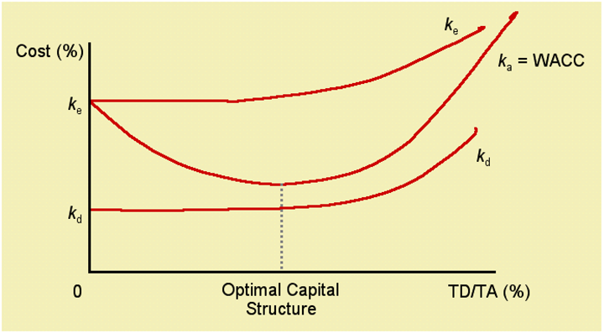
The Optimal Capital Structure

Slide 13
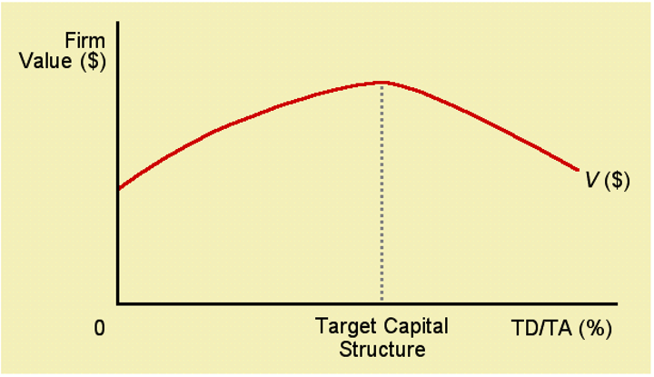
The Optimal Capital Structure

Slide 14
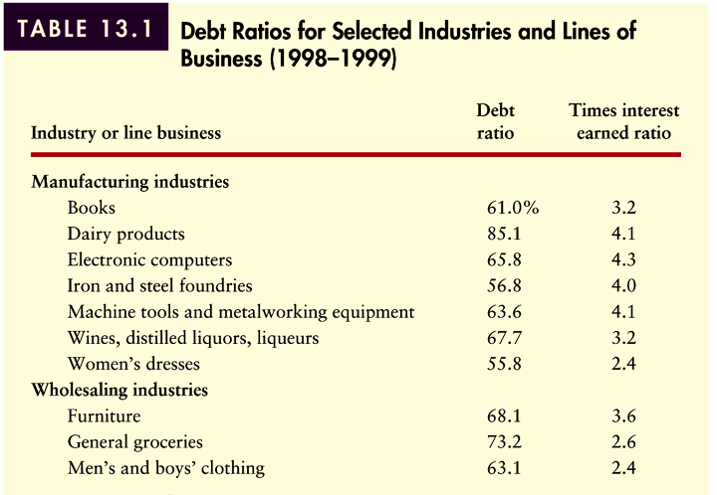
Debt Ratios for Selected Industries
Table 13.1 (Panel 1)

Slide 15
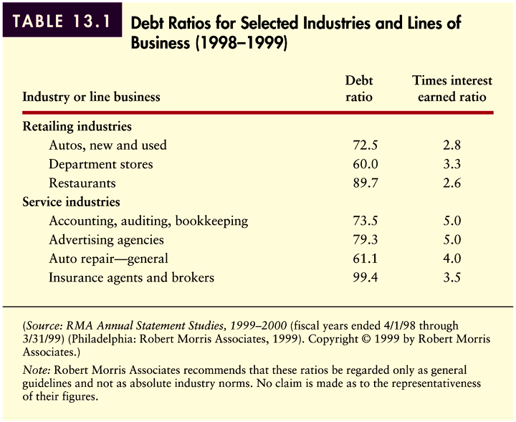
Debt Ratios for Selected Industries
Table 13.1 (Panel 2)

Slide 16
EPS-EBIT Approach to Capital Structure
The EPS-EBIT approach to capital structure involves selecting the capital structure that maximizes EPS over the expected range of EBIT.
Using this approach, the emphasis is on maximizing the owners’ returns (EPS).
A major shortcoming of this approach is the fact that earnings are only one of the determinants of shareholder wealth maximization.
This method does not explicitly consider the impact of risk.

Slide 17
EPS-EBIT Approach to Capital Structure
Example
The capital structure of Buzz Company, a soft drink manufacturer is shown in the table below. Currently, Buzz Company uses only equity in its capital structure. Thus the current debt ratio is 0.00%. Assume Buzz Company is in the 40% tax bracket.

Slide 18
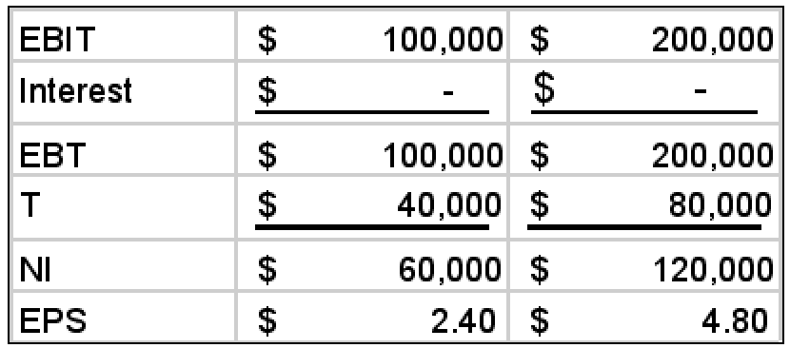
EPS-EBIT Approach to Capital Structure
EPS-EBIT coordinates for Buzz Company’s current capital structure can be found by assuming two EBIT values and calculating the associated EPS in the table below.
This can be plotted on an EPS-EBIT plane shown on the following slide.

Slide 19
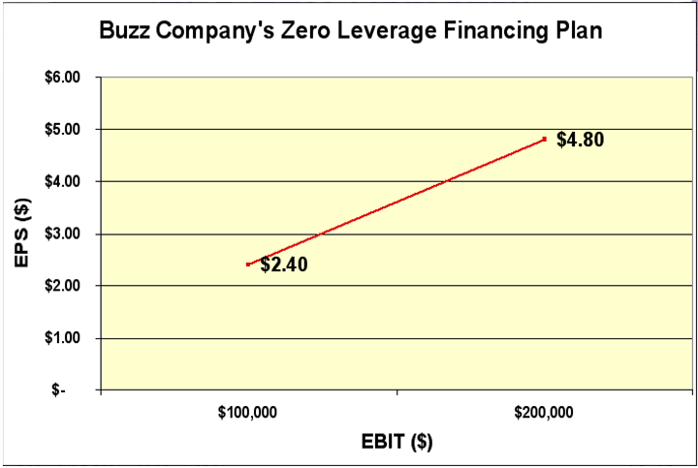
EPS-EBIT Approach to Capital Structure

Slide 20
EPS-EBIT Approach to Capital Structure
Buzz Company is considering altering its capital structure while maintaining its original $500,000 capital base as shown in the table below.
We can use this information to calculate the EPS-EBIT coordinates as shown on the following slide.

Slide 21
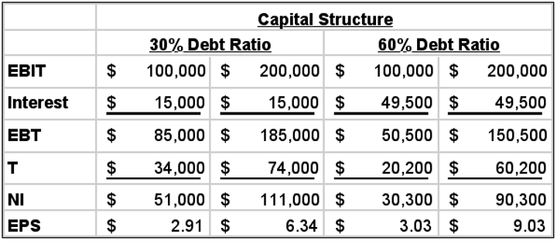
EPS-EBIT Approach to Capital Structure
This may be shown graphically as shown on the following slide.

Slide 22
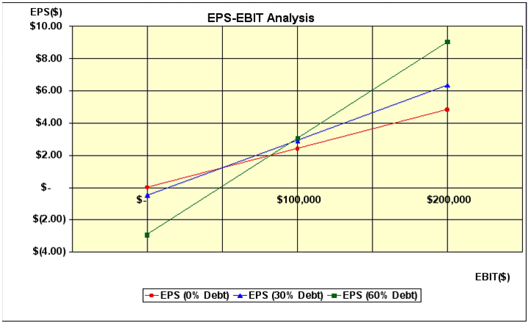
EPS-EBIT Approach to Capital Structure

Slide 23
Basic Shortcoming of EPS-EBIT Analysis
Although EPS maximization is generally good for the firm’s shareholders, the basic shortcoming of this method is that it does not necessary maximize shareholder wealth because it fails to consider risk.
If shareholders did not require risk premiums (additional return) as the firm increased its use of debt, a strategy focusing on EPS maximization would work.
Unfortunately, this is not the case.

Slide 24
Choosing the Optimal Capital Structure
The following discussion will attempt to create a framework for making capital budgeting decisions that maximizes shareholder wealth (i.e., considers both risk and return).
Perhaps the best way to demonstrate this is through the following example.
Assume that Buzz Company is attempting to choose the best of several alternative capital structures— specifically, debt ratios of 0, 10, 20, 30, 40, 50, and 60 percent. Furthermore, for each of these capital structures, the firm has estimated EPS, the CV of EPS, and required return.

Slide 25
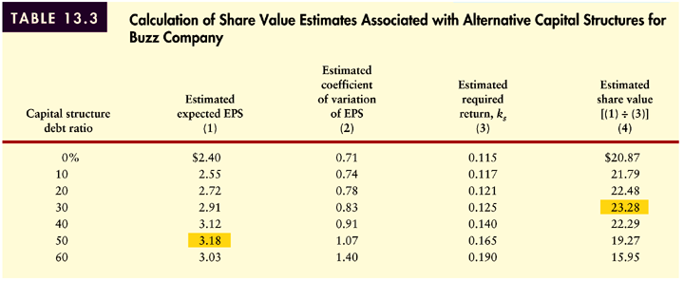
Choosing the Optimal Capital Structure
If we assume that all earnings are paid out as dividends, we can use the zero growth valuation model [P₀ = EPS/k_{s}] to estimate share value as shown in the table below.
Table 13.3

Slide 26
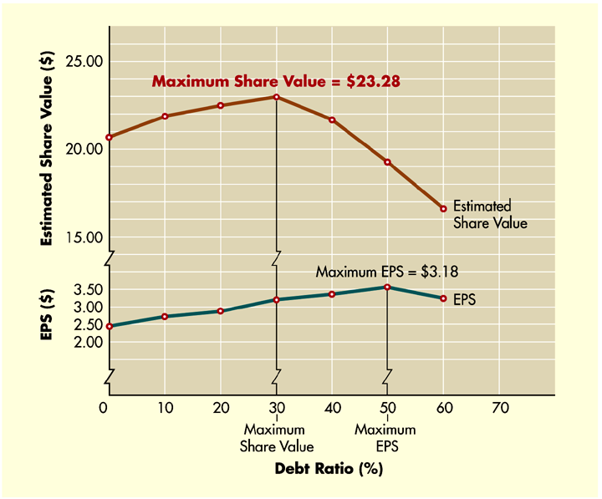
Choosing the Optimal Capital Structure
Figure 13.4

Slide 27
Other Important Considerations
Table 13.4 (Panel 1)

Slide 28
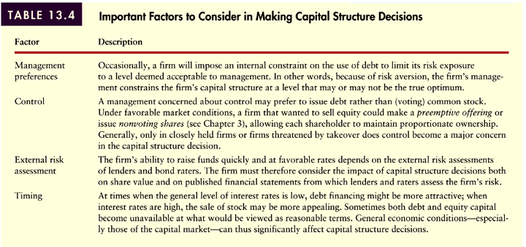
Other Important Considerations
Table 13.4 (Panel 2)

Slide 29
Dividend Fundamentals
Cash Dividend Payment Procedures
A dividend is a redistribution from earnings.
Most companies maintain a dividend policy whereby they pay a regular dividend on a quarterly basis.
Some companies pay an extra dividend to reward shareholders if they’ve had a particularly good year. Many companies pay dividends according to a preset payout ratio, which measures the proportion of dividends to earnings.
Many companies have paid regular dividends for over a hundred years.

Slide 30
Dividend Fundamentals
Cash Dividend Payment Procedures
Dividend growth tends to lag behind earnings growth for most corporations (see example next slide).
Since dividend policy is one of the factors that drives an investor’s decision to purchase a stock, most companies announce their dividend policy and telegraph any expected changes in policy to the public.
Therefore, it can be seen that many companies use their dividend policy to provide information not otherwise available to investors.

Slide 31
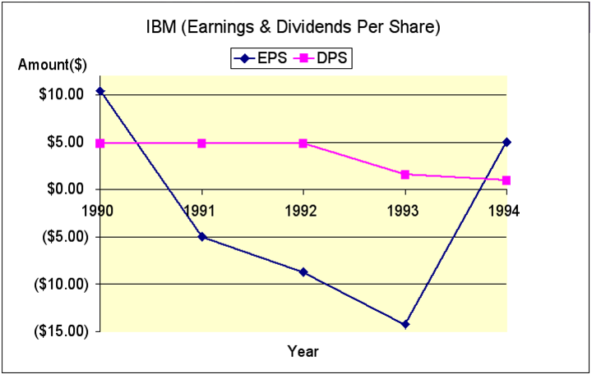
Dividend Fundamentals

Slide 32
Dividend Fundamentals
Cash Dividend Payment Procedures
Date of record: The date on which investors must own shares in order to receive the dividend payment.
ex dividend date: Four days prior to the date of record. The day on which a stock trades ex dividend (exclusive of dividends).
In the financial press: Transactions in the stock on the ex dividend date are indicated by an “x” next to the volume of transactions.
In general, stock prices fall by an amount equal to the quarterly dividend on the ex dividend date.
Distribution date: The day on which a dividend is paid (payment date) to stockholders. It is usually two or more weeks before stockholders who owned shares on the date of record receive their dividends.

Slide 33
Cash Dividend Payment Procedures
Example
At the quarterly dividend meeting on June 10th, the Jillian Company board of directors declared an $.80 cash dividend for holders of record on Monday, July 1st. The firm had 100,000 shares of stock outstanding. The payment (distribution) date was set at August 1st. Before the meeting, the relevant accounts showed the following.
Cash $200,000 Dividends Payable $0
Retained Earnings $1,000,000

Slide 34
Cash Dividend Payment Procedures
When the dividend was announced by the directors, $80,000 of the retained earnings ($.80/share ^{x} 100,000 shares) was transferred to the dividends payable account. As a result, the key accounts changed as follows:
Cash $200,000 Dividends Payable $80,000
Retained Earnings $920,000

Slide 35
Cash Dividend Payment Procedures
Jillian Company’s stock began selling ex dividend on June 25th, 4 days prior to the date of record (July 1st). This date was found by subtracting 6 days (because of the weekend) from July 1st.
Stockholders of record on June 24th or earlier received the rights to the dividends, while those purchasing on June 25th or later did not. Assuming a stable market, the price of the stock was expected to drop by $.80/share on June 25th. When the August 1st payment date arrived, the firm mailed payments to holders of record and recorded the following:

Slide 36
Cash Dividend Payment Procedures
Cash $120,000 Dividends Payable $0
Retained Earnings $920,000
Thus, the net effect of the dividend payment is a reduction of the firm’s assets (through a reduction in cash) and equity (through a reduction in retained earnings) by a total of $80,000 (the dividend payment).

Slide 37
Dividend Reinvestment Plans
Dividend reinvestment plans (DRIPS) permit stockholders to reinvest their dividends to purchase additional shares rather than to be paid out in cash.
With bank-directed DRIPS, banks purchase additional shares on the open market in huge blocks which substantially reduces per share commissions.
With company-directed DRIPS, the company itself issues new shares in exchange for the cash dividend completely eliminating commissions.
With brokerage-directed DRIPS, brokerage firms such as Charles Schwab will reinvest dividends for shareholders who hold stocks in street name at no charge.

Slide 38
Advantages of DRIPS
For Stockholders
Substantial reduction in commission costs.
They provide investors with an automatic savings mechanism.
For Companies
Goodwill
Reduction in cost of delivering dividend checks.
An inexpensive means of raising equity capital for firms company-directed plans.

Slide 39
Dividend Policy Theory
The Residual Theory of Dividends
The residual theory of dividends suggests that dividend payments should be viewed as residual— the amount left over after all acceptable investment opportunities have been undertaken.
Using this approach, the firm would treat the dividend decision in three steps as shown on the following slide.

Slide 40
Dividend Policy Theory
Step 1
Determine the optimal level of capital expenditures which is given by the point of intersection of the investment opportunities schedule (IOS) and weighted marginal cost of capital schedule (WMCC).
Step 2
Using the optimal capital structure proportions, estimate the total amount of equity financing needed to support the expenditures estimated in Step 1.
Step 3
Because the cost of retained earnings is less than new equity, use retained earnings to meet the equity requirement in Step 2. If inadequate, sell new stock. If there is an excess of retained earnings, distribute the surplus amount—the residual—as dividends.

Slide 41
Dividend Policy Theory
The Residual Theory of Dividends
In sum, this theory suggests that no cash dividend is paid as long as the firm’s equity need is in excess of the amount of retained earnings.
Furthermore, it suggests that the required return demanded by stockholders is not influenced by the firm’s dividend policy—a premise that in turn suggests that dividend policy is irrelevant.

Slide 42
Dividend Policy Theory
Dividend Irrelevance Arguments
Merton Miller and Franco Modigliani (MM) developed a theory that shows that in perfect financial markets (certainty, no taxes, no transactions costs or other market imperfections), the value of a firm is unaffected by the distribution of dividends.
They argue that value is driven only by the future earnings and risk of its investments.
Retaining earnings or paying them in dividends does not affect this value.

Slide 43
Dividend Policy Theory
Dividend Irrelevance Arguments
Some studies suggested that large dividend changes affect stock price behavior.
MM argued, however, that these effects are the result of the information conveyed by these dividend changes, not to the dividend itself.
Furthermore, MM argue for the existence of a “clientele effect.”
Investors preferring dividends will purchase high dividend stocks, while those preferring capital gains will purchase low dividend paying stocks.

Slide 44
Dividend Policy Theory
Dividend Irrelevance Arguments
In summary, MM and other dividend irrelevance proponents argue that—all else being equal— an investor’s required return, and therefore the value of the firm, is unaffected by dividend policy because:
The firm’s value is determined solely by the earning power and risk of its assets.
If dividends do affect value, they do so because of the information content, which signals management’s future expectations.
A clientele effect exists that causes shareholders to receive the level of dividends they expect.

Slide 45
Dividend Policy Theory
Dividend Relevance Arguments
Contrary to dividend irrelevance proponents, Gordon and Lintner suggested stockholders prefer current dividends and that a positive relationship exists between dividends and market value.
Fundamental to this theory is the “bird-in-the-hand” argument which suggests that investors are generally risk-averse and attach less risk to current as opposed to future dividends or capital gains.
Because current dividends are less risky, investors will lower their required return—thus boosting stock prices.

Slide 46
Factors that Affect Dividend Policy
Legal Constraints
Most state securities regulations prevent firms from paying out dividends from any portion of the company’s “legal capital” which is measured by the par value of common stock—or par value plus paid-in-capital.
Dividends are also sometimes limited to the sum of the firm’s most recent and past retained earnings— although payments in excess of current earnings is usually permitted.
Most states also prohibit dividends when firms have overdue liabilities or are legally insolvent or bankrupt.

Slide 47
Factors that Affect Dividend Policy
Legal Constraints
Even the IRS has ruled in the area of dividend policy.
Specifically, the IRS prohibits firms from acquiring earnings to reduce stockholders’ taxes.
The IRS can determine that a firm has accumulated an excess of earnings to allow owners to delay paying ordinary income taxes (on dividends), it may levy an excess earnings accumulation tax on any retained earnings above $250,000.
It should be noted, however, that this ruling is seldom applied.

Slide 48
Factors that Affect Dividend Policy
Contractual Constraints
In many cases, companies are constrained in the extent to which they can pay dividends by restrictive provisions in loan agreements and bond indentures.
Generally, these constraints prohibit the payment of cash dividends until a certain level of earnings are achieved or to a certain dollar amount or percentage of earnings.
Any violation of these constraints generally triggers the demand for immediate payment.

Slide 49
Factors that Affect Dividend Policy
Internal Constraints
A company’s ability to pay dividends is usually constrained by the amount of available cash rather than the level of retained earnings against which to charge them.
Although it is possible to borrow to pay dividends, lenders are usually reluctant to grant them because using the funds for this purpose produces no operating benefits that help to repay them.

Slide 50
Factors that Affect Dividend Policy
Growth Prospects
Newer, rapidly-growing firms generally pay little or no dividends.
Because these firms are growing so quickly, they must use most of their internally generated funds to support operations or finance expansion.
On the other hand, large, mature firms generally pay cash dividends since they have access to adequate capital and may have limited investment opportunities.

Slide 51
Factors that Affect Dividend Policy
Owner Considerations
As mentioned earlier, empirical evidence supports the notion that investors tend to belong to “clienteles”— where some prefer high dividends, while others prefer capital gains.
They tend to sort themselves in this way for a variety of reasons, including:
Tax status
Investment opportunities
Potential dilution of ownership

Slide 52
Factors that Affect Dividend Policy
Market Considerations
Perhaps the most important aspect of dividend policy is that the firm maintain a level of predictability.
Stockholders that prefer dividend-paying stocks prefer a continuous stream of fixed or increasing dividends.
Shareholders also view the firm’s dividend payment as a “signal” of the firm’s future prospects.
Fixed or increasing dividends are often considered a “positive” signal, while erratic dividend payments are viewed as “negative” signals.

Slide 53
Types of Dividend Policies
Constant-Payout-Ratio Policy
With a constant-payout-ratio dividend policy, the firm establishes that a specific percentage of earnings is paid to shareholders each period.
A major shortcoming of this approach is that if the firm’s earnings drop or are volatile, so too will the dividend payments.
As mentioned earlier, investors view volatile dividends as negative and risky—which can lead to lower share prices.

Slide 54
Types of Dividend Policies
Regular Dividend Policy
A regular dividend policy is based on the payment of a fixed-dollar dividend each period.
It provides stockholders with positive information indicating that the firm is doing well and it minimizes uncertainty.
Generally, firms using this policy will increase the regular dividend once earnings are proven to be reliable.

Slide 55
Types of Dividend Policies
Low-Regular-and-Extra Dividend Policy
Using this policy, firms pay a low regular dividend, supplemented by additional dividends when earnings can support it.
When earnings are higher than normal, the firm will pay this additional dividend, often called an extra dividend, without the obligation to maintain it during subsequent periods.
This type of policy is often used by firms whose sales and earnings are susceptible to swings in the business cycle.

Slide 56
Other Forms of Dividends
Stock Dividends
A stock dividend is paid in stock rather than in cash.
Many investors believe that stock dividends increase the value of their holdings.
In fact, from a market value standpoint, stock dividends function much like stock splits. The investor ends up owning more shares, but the value of their shares is less.
From a book value standpoint, funds are transferred from retained earnings to common stock and additional paid-in-capital.

Slide 57
Other Forms of Dividends
Stock Dividends
The current stockholder’s equity on the balance sheet of Trimline Corporation, a distributor of prefabricated cabinets, is shown in the following accounts.

Slide 58
Other Forms of Dividends
Stock Dividends
If Trimline declares a 10% stock dividend and the current market price of the stock is $15/share, $150,000 of retained earnings (10% ^{x} 100,000 shares ^{x} $15/share) will be capitalized.
The $150,000 will be distributed between the common stock (par) account and paid-in-capital in excess of par account based on the par value of the common stock. The resulting balances are as follows.

Slide 59
Other Forms of Dividends
Stock Dividends
Because 10,000 new shares (10% ^{x} 100,000) have been issued at the current price of $15/share, $150,000 ($15/share ^{x} 10,000 shares) is shifted from retained earnings to the common stock and paid-in-capital accounts.

Slide 60
Other Forms of Dividends
Stock Dividends
A total of $40,000 ($4 par ^{x} 10,000 shares) is added to common stock. The remaining $110,000 [($15 - $4) ^{x} 10,000 shares] is added to the paid-in-capital in excess of par account. Total stockholders equity has not changed.

Slide 61
Other Forms of Dividends
Stock Dividends
From a shareholder’s perspective, stock dividends result in a dilution of shares owned.
For example, assume a stockholder owned 100 shares at $20/share ($2,000 total) before a stock dividend.
If the firm declares a 10% stock dividend, the shareholder will have 110 shares of stock. However, the total value of her shares will still be $2,000.
Therefore, the value of her share must have fallen to $18.18/share ($2,000/110).

Slide 62
Other Forms of Dividends
Disadvantages of stock dividends include:
The cost of issuing the new shares.
Taxes and listing fees on the new shares.
Other recording costs.
Advantages of stock dividends include:
The company conserves needed cash.
Signaling effect to the shareholders that the firm is retaining cash because of lucrative investment opportunities.

Slide 63
Other Forms of Dividends
Stock Split
A stock split is a recapitalization that affects the number of shares outstanding, par value, earnings per share, and market price.
The rationale for a stock split is that it lowers the price of the stock and makes it more attractive to individual investors.
For example, assume a share of stock is currently selling for $135 and splits 3 for 2.
The new share price will be equal to 2/3 ^{x} $135, or $90.

Slide 64
Other Forms of Dividends
Stock Split
Continuing with the example, assume that the investor held 100 shares before the split with a total value of $13,500.
After the split, the shareholder will hold: $13,500/$90 = 150 shares worth $90 each

Slide 65
Other Forms of Dividends
Stock Split
A reverse stock split reduces the number of shares outstanding and raises stock price—the opposite of a stock split.
The rationale for a reverse stock split is to add respectability to the stock and convey the meaning that it isn’t a junk stock.
Research on both stock splits and stock dividends generally supports the theory that they do not affect the value of shares.
They are often used, however, to send a signal to investors that good things are going to happen.

Slide 66
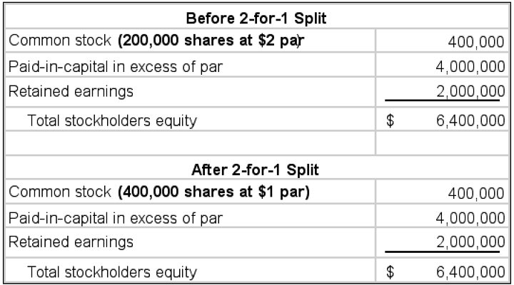
Other Forms of Dividends
Not only do stock splits leave the market value of shareholders unaffected, but they also have little affect from an accounting standpoint as this 2-for-1 split demonstrates.

Slide 67
Other Forms of Dividends
Stock Repurchases
Stock repurchase: The purchasing and retiring of stock by the issuing corporation.
A repurchase is a partial liquidation since it decreases the number of shares outstanding.
It may also be thought of as an alternative to cash dividends.

Slide 68
Other Forms of Dividends
Alternative Reasons for Stock Repurchases
To use the shares for another purpose
To alter the firm’s capital structure
To increase EPS and ROE resulting in a higher market price
To reduce the chance of a hostile takeover

Slide 69
Chapter
13
Introduction to Finance
Lawrence J. Gitman
Jeff Madura
End of Chapter

Slide 70
SEKIAN DAN TERIMA KASIH

