Slide 1
LEASING
PERTEMUAN #13
FEB 302
MANAJEMEN
KEUANGAN
FAKULTAS EKONOMI DAN BISNIS
UNIVERSITAS ESA UNGGUL

Slide 2
KEMAMPUAN AKHIR YANG DIHARAPKAN
Memahami dan memiliki wawasan tentang:
Sewa Guna Usaha (leasing)
Faktor yang dipertimbangkan dalam leasing

Slide 3
Chapter
15
Introduction to Finance
Lawrence J. Gitman
Jeff Madura
Short-Term Financial Management

Slide 4
Learning Goals
Describe the scope of short-term financial management and the cash conversion cycle.
Explain the funding requirements of the cash conversion cycle and strategies for minimizing negotiated liabilities.
Understand inventory management: differing views, common techniques, and international concerns.

Slide 5
Learning Goals
Explain the key aspects of accounts receivable management including credit selection and standards, credit terms, and credit monitoring.
Review the management of receipts and disbursements, including float, speeding collections, slowing payments, cash concentration and zero-balance accounts.
Discuss current liability management, including spontaneous liabilities, unsecured short-term financing, and secured short-term financing.

Slide 6
Managing the Cash Conversion Cycle
Short-term financial management—managing current assets and current liabilities—is one of the financial manager’s most important and time-consuming activities.
The goal of short-term financial management is to manage each of the firms’ current assets and liabilities to achieve a balance between profitability and risk that contributes positively to overall firm value.
Central to short-term financial management is an understanding of the firm’s cash conversion cycle.

Slide 7
Managing the Cash Conversion Cycle
The operating cycle (OC) is the time between ordering materials and collecting cash from receivables.
The cash conversion cycle (CCC) is the time between when a firm pays its suppliers (payables) for inventory and collecting cash from the sale of the finished product.

Slide 8
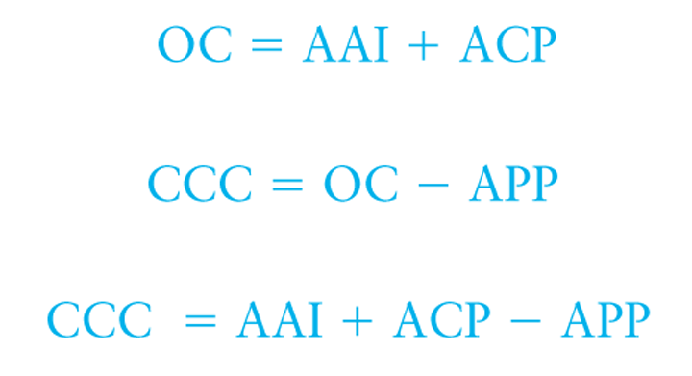
Managing the Cash Conversion Cycle
Both the OC and CCC may be computed mathematically as shown below.

Slide 9
Managing the Cash Conversion Cycle
Justin Industries has annual sales of $10 million, cost of goods sold of 75% of sales, and purchases that are 65% of cost of goods sold. Justin has an average age of inventory (AAI) of 60 days, an average collection period (ACP) of 40 days, and an average payment period (APP) of 35 days.
Using the values for these variables, the cash conversion cycle for Justin is 65 days (60 + 40 - 35 = 65) and is shown on a time line in Figure 15.1.

Slide 10
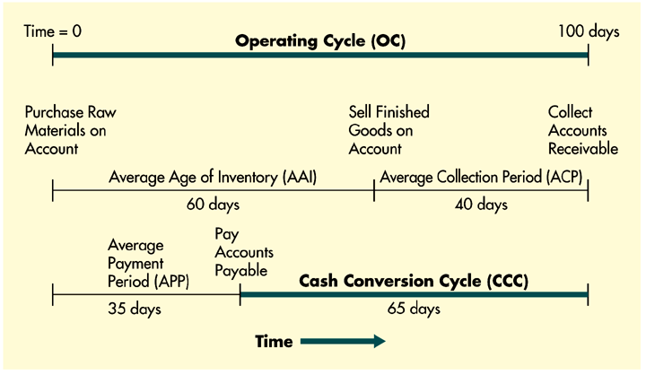
Managing the Cash Conversion Cycle
Figure 15.1

Slide 11
Managing the Cash Conversion Cycle
The resources Justin has invested in the cash conversion cycle assuming a 360-day year are:
Obviously, reducing AAI or ACP or lengthening APP will reduce the cash conversion cycle, thus reducing the amount of resources the firm must commit to support operations.

Slide 12
Funding Requirements of the CCC
Permanent versus Seasonal Funding Needs
If a firm’s sales are constant, then its investment in operating assets should also be constant, and the firm will have only a permanent funding requirement.
If sales are cyclical, then investment in operating assets will vary over time, leading to the need for seasonal funding requirements in addition to the permanent funding requirements for its minimum investment in operating assets.

Slide 13
Funding Requirements of the CCC
Permanent versus Seasonal Funding Needs
Crone Paper has seasonal funding needs. Crone has seasonal sales, with its peak sales driven by back-to-school purchases. Crone holds a minimum of $25,000 in cash and marketable securities, $100,000 in inventory, and $60,000 in account receivable. At peak times, inventory increases to $750,000 and accounts receivable increase to $400,000. To capture production efficiencies, Crone produces paper at a constant rate throughout the year. Thus accounts payable remain at $50,000 throughout the year.

Slide 14
Funding Requirements of the CCC
Permanent versus Seasonal Funding Needs
Based on this data, Crone has a permanent funding requirement for its minimum level of operating assets of $135,000 ($25,000 + $100,000 + $60,000 - $50,000 = $135,000) and peak seasonal funding requirements in excess of its permanent need of $990,000 [($25,000 + $750,000 + $400,000 - $50,000) - $135,000 = $990,000].
Crone’s total funding requirements for operating assets vary from a minimum of $135,000 (permanent) to a seasonal peak of $1,125,000 ($135,000 + 990,000) as shown in Figure 15.2 on the following slide.

Slide 15
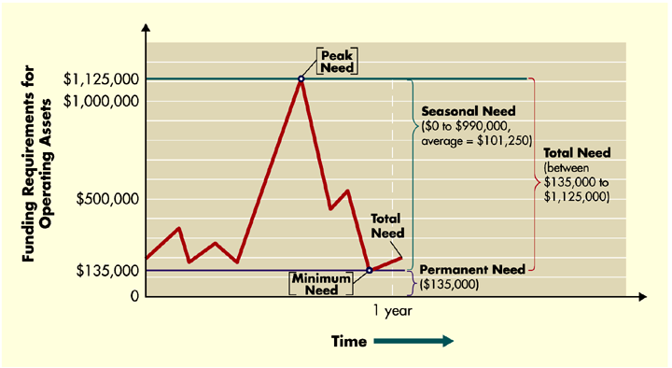
Funding Requirements of the CCC
Figure 15.2

Slide 16
Funding Requirements of the CCC
Aggressive versus Conservative Funding Strategies
Crone Paper has a permanent funding requirement of $135,000 and seasonal requirements that vary between $0 and $990,000 and average $101,250. If Crone can borrow short-term funds at 6.25% and long term funds at 8%, and can earn 5% on any invested surplus, then the annual cost of the aggressive strategy would be:

Slide 17
Funding Requirements of the CCC
Aggressive versus Conservative Funding Strategies
Alternatively, Crone can choose a conservative strategy under which surplus cash balances are fully invested. In Figure 15.2, this surplus would be the difference between the peak need of $1,125,000 and the total need, which varies between $135,000 and $1,125,000 during the year.

Slide 18
Funding Requirements of the CCC
Aggressive versus Conservative Funding Strategies
Clearly, the aggressive funding strategy’s heavy reliance on short-term financing makes it riskier than the conservative strategy because of interest rate swings and possible difficulties in obtaining needed funds quickly when the seasonal peaks occur.
The conservative funding strategy avoids these risks through the locked-in interest rate and long-term financing, but is more costly. Thus the final decision is left to management.

Slide 19
Inventory Management
Differing Views about Inventory
The different departments within a firm (finance, production, marketing, etc.) often have differing views about what is an “appropriate” level of inventory.
Financial managers would like to keep inventory levels low to ensure that funds are wisely invested.
Marketing managers would like to keep inventory levels high to ensure orders could be quickly filled.
Manufacturing managers would like to keep raw materials levels high to avoid production delays and to make larger, more economical production runs.

Slide 20
Techniques for Managing Inventory
The ABC System
The ABC system of inventory management divides inventory into three groups of descending order of importance based on the dollar amount invested in each.
A typical system would contain, group A would consist of 20% of the items worth 80% of the total dollar value; group B would consist of the next largest investment, and so on.
Control of the A items would be intensive because of the high dollar investment involved.
The EOQ model would be most appropriate for managing both A and B items.

Slide 21
Techniques for Managing Inventory
The Economic Order Quantity (EOQ) Model
EOQ assumes that relevant costs of inventory can be divided into order costs and carrying costs
Order costs decrease as the size of the order increases; carrying costs increase with increases in the order size
The EOQ model analyzes the tradeoff between order costs and carrying costs to determine the order quantity that minimizes the total inventory cost

Slide 22
Techniques for Managing Inventory
The Economic Order Quantity (EOQ) Model
Where:
S = usage in units per period (year)
O = order cost per order
C = carrying costs per unit per period (year)

Slide 23
Techniques for Managing Inventory
The Economic Order Quantity (EOQ) Model
Assume that RLB, Inc., a manufacturer of electronic test equipment, uses 1,600 units of an item annually. Its order cost is $50 per order, and the carrying cost is $1 per unit per year. Substituting into the equation on the previous slide we get:
The EOQ can be used to evaluate the total cost of inventory as shown on the following slides.

Slide 24
Techniques for Managing Inventory
The Economic Order Quantity (EOQ) Model
Cost
# of Orders
Ordering costs =
^{x}
Order
Year
Carry costs/Year ^{x} Order size
Carrying costs =
2
Total costs = Ordering costs + Carrying costs

Slide 25
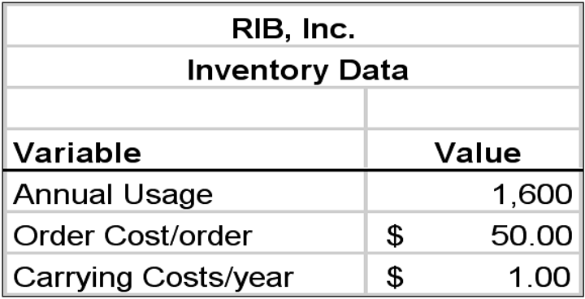
Techniques for Managing Inventory
The Economic Order Quantity (EOQ) Model

Slide 26
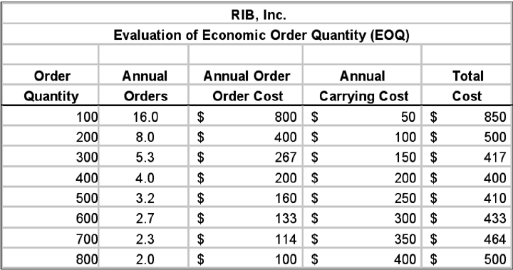
Techniques for Managing Inventory
The Economic Order Quantity (EOQ) Model

Slide 27
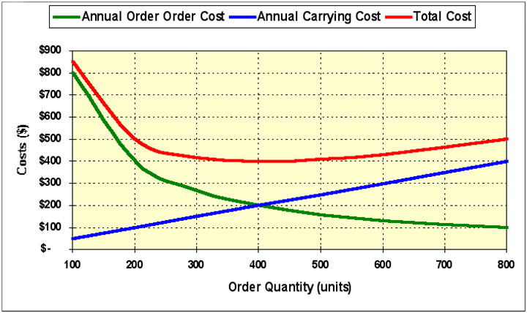
Techniques for Managing Inventory
The Economic Order Quantity (EOQ) Model

Slide 28
Techniques for Managing Inventory
The Reorder Point
Once a company has calculated its EOQ, it must determine when it should place its orders.
More specifically, the reorder point must consider the lead time needed to place and receive orders.
If we assume that inventory is used at a constant rate throughout the year (no seasonality), the reorder point can be determined by using the following equation:
Reorder point = Lead time in days ^{x} Daily usage
Daily usage = Annual usage/360

Slide 29
Techniques for Managing Inventory
The Reorder Point
Using the RIB example above, if they know that it requires 10 days to place and receive an order, and the annual usage is 1,600 units per year, the reorder point can be determined as follows:
Daily usage = 1,600/360 = 4.44 units/day
Reorder point = 10 ^{x} 4.44 = 44.44 or 45 units
Thus, when RIB’s inventory level reaches 45 units, it should place an order for 400 units. However, if RIB wishes to maintain safety stock to protect against stock outs, they would order before inventory reached 45 units.

Slide 30
Techniques for Managing Inventory
Materials Requirement Planning (MRP)
MRP systems are used to determine what to order, when to order, and what priorities to assign to ordering materials.
MRP uses EOQ concepts to determine how much to order using computer software.
It simulates each product’s bill of materials structure (all of the product’s parts), inventory status, and manufacturing process.
Like the simple EOQ, the objective of MRP systems is to minimize a company’s overall investment in inventory without impairing production.

Slide 31
Techniques for Managing Inventory
Just-In-Time System (JIT)
The JIT inventory management system minimizes the inventory investment by having material inputs arrive exactly at the time they are needed for production.
For a JIT system to work, extensive coordination must exist between the firm, its suppliers, and shipping companies to ensure that material inputs arrive on time.
In addition, the inputs must be of near perfect quality and consistency given the absence of safety stock.

Slide 32
Inventory Management
International Inventory Management
International inventory management is typically much more complicated for exporters and MNCs.
The production and manufacturing economies of scale that might be expected from selling globally may prove elusive if products must be tailored for local markets.
Transporting products over long distances often results in delays, confusion, damage, theft, and other difficulties.

Slide 33
The Five C’s of Credit
Capital
Character
Collateral
Capacity
Conditions

Slide 34
Credit Scoring
Credit scoring is a procedure resulting in a score that measures an applicant’s overall credit strength, derived as a weighted-average of scores of various credit characteristics.
Paula’s Stores, a major department store chain, uses a credit scoring model to make credit decisions. Paula’s uses a system measuring six separate financial and credit characteristics. Scores can range from 0 (lowest) to 100 (highest). The minimum acceptable score necessary for granting credit is 75. The results of such a score for Herb Conseca are illustrated in the following slide.

Slide 35
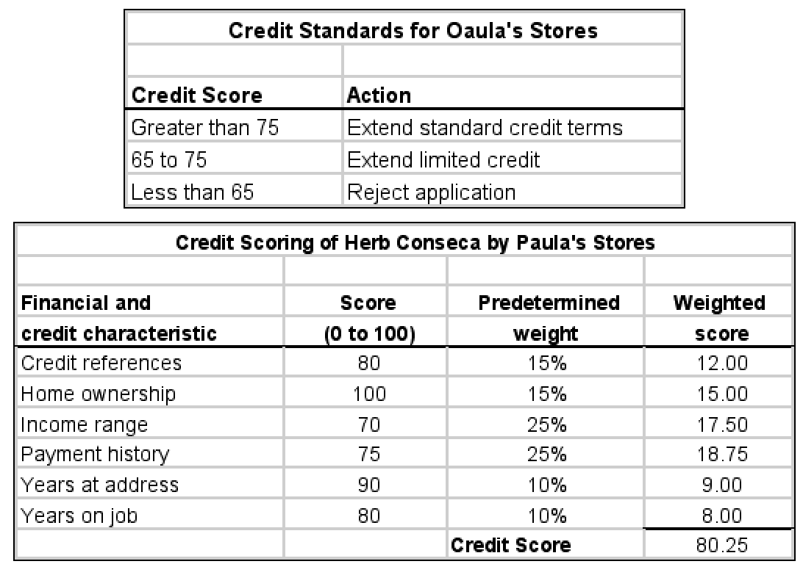
Credit Scoring

Slide 36
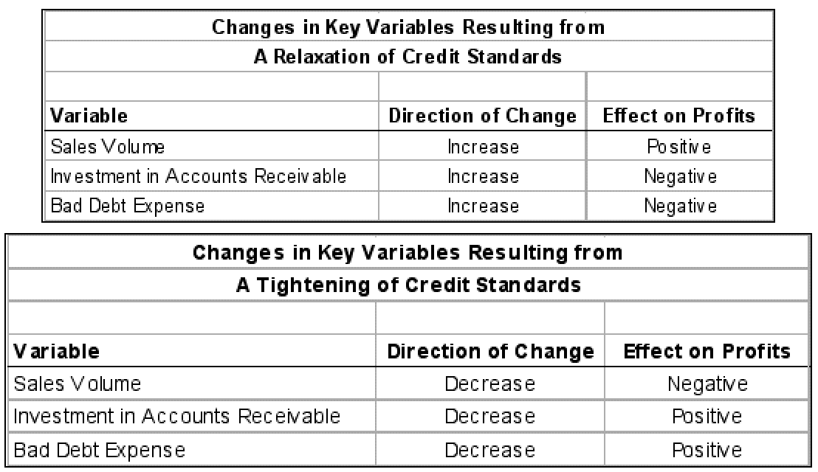
Changing Credit Standards
Key Variables

Slide 37
Orbit Tool Example
Orbit Tool, a manufacturer of lathe tools, is currently selling a product for $10/unit. Sales (all on credit) for last year were 60,000 units. The variable cost per unit is $6.
The firm’s total fixed costs are $120,000. Orbit is currently contemplating a relaxation of credit standards that is anticipated to increase sales 5% to 63,000 units. It is also anticipated that the ACP will increase from 30 to 45 days, and that bad debt expenses will increase from 1% of sales to 2% of sales. The opportunity cost of tying funds up in receivables is 15%
Given this information, should Orbit relax its credit standards?

Slide 38
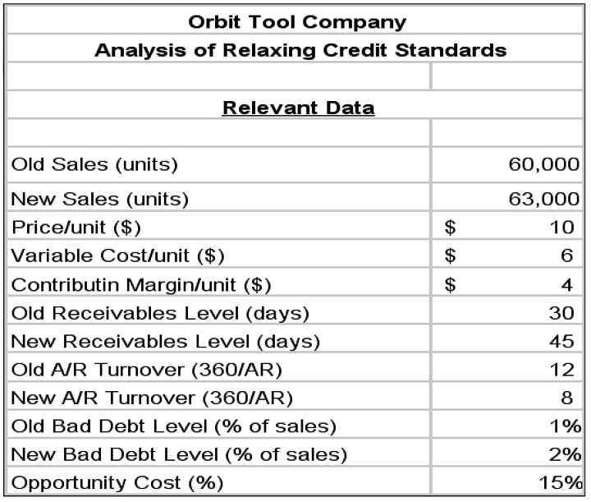
Orbit Tool Example

Slide 39
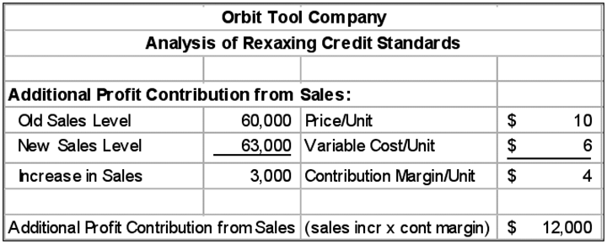
Orbit Tool Example
Additional Profit Contribution from Sales

Slide 40
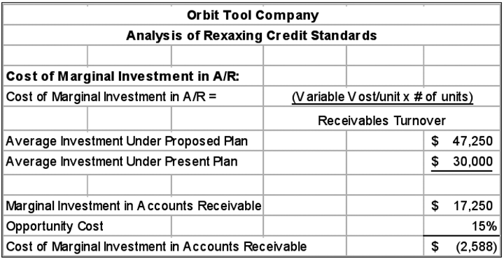
Orbit Tool Example
Cost of Marginal Investment in A/R

Slide 41
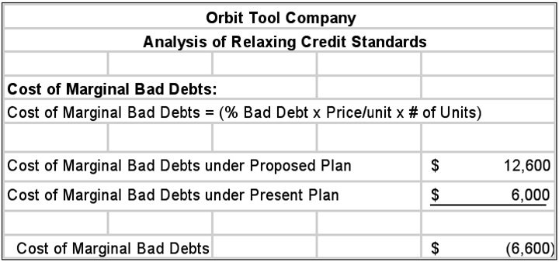
Orbit Tool Example
Cost of Marginal Bad Debts

Slide 42
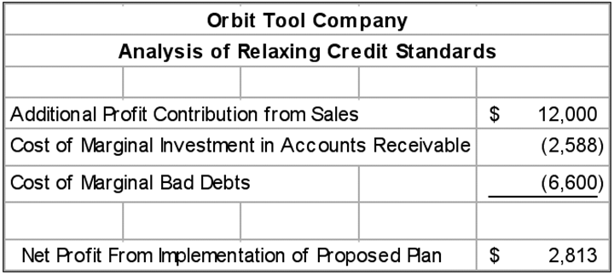
Orbit Tool Example
Net Profit from Implementation of Proposed Plan

Slide 43
Changing Credit Terms
A firm’s credit terms specify the repayment terms required of all of its credit customers.
Credit terms are composed of three parts:
The cash discount
The cash discount period
The credit period
For example, with credit terms of 2/10 net 30, the discount is 2%, the discount period is 10 days, and the credit period is 30 days.

Slide 44
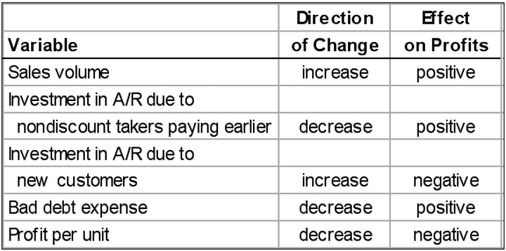
Changing Credit Terms
Cash Discount

Slide 45
Changing Credit Terms
Cash Discount
Orbit Tool is considering a initiating a cash discount of 2% for payment within 10 days of a purchase. The firm’s current average collection period (ACP) is 30 days (A/R turnover = 360/30 = 12). Credit sales of 60,000 units at $10/unit and the variable cost/unit is $6.
Orbit expects that if the cash discount is initiated, 60% will take the discount and pay early. In addition, sales are expected to increase 5% to 63,000 units. The ACP is expected to drop to 15 days (A/R turnover = 360/15 = 24). Bad debts will drop from 1% to 0.5% of sales. The opportunity cost to the firm of tying up funds in receivables is 15%.

Slide 46
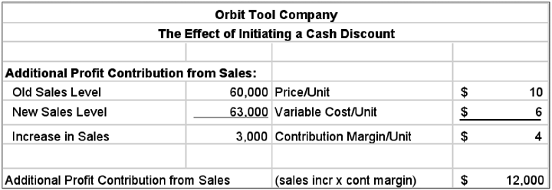
Changing Credit Terms
Cash Discount

Slide 47
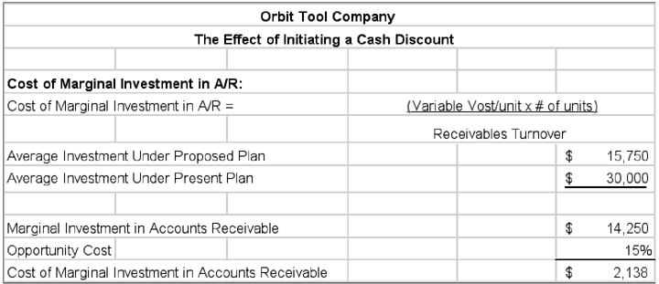
Changing Credit Terms
Cash Discount

Slide 48
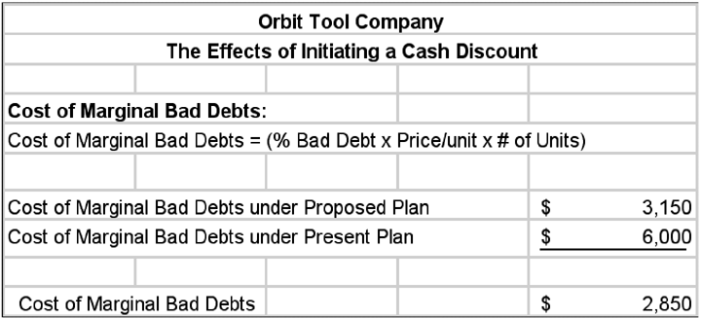
Changing Credit Terms
Cash Discount

Slide 49
Changing Credit Terms
Cash Discount

Slide 50
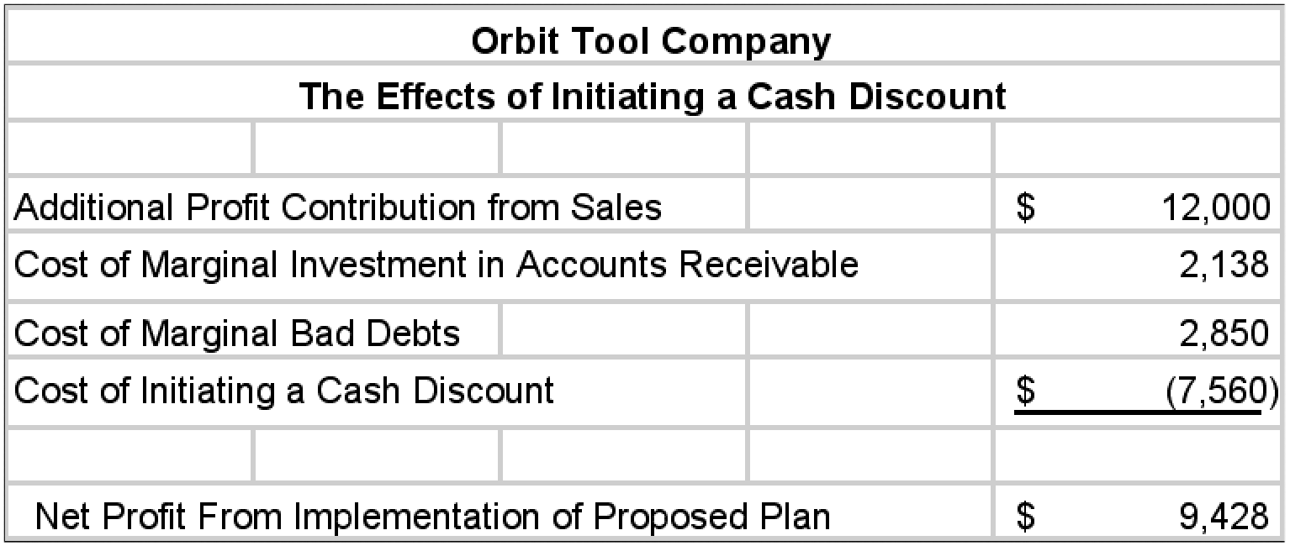
Changing Credit Terms
Cash Discount

Slide 51
Collection Policy
The firm’s collection policy is its procedures for collecting a firm’s accounts receivable when they are due.
The effectiveness of this policy can be partly evaluated by evaluating the level of bad expenses.
As seen in the previous examples, this level depends not only on collection policy but also on the firm’s credit policy.
In general, funds should be expended to collect bad debts up to the point where the marginal cost exceeds the marginal benefit (Point A on the following slide).

Slide 52
Collection Policy
Table 15.2

Slide 53
Collection Policy
Aging Accounts Receivable
Assume that Orbit Tool extends 30-day EOM credit terms to its customers. The firm’s December 31, 1998 balance sheet shows $200,000 of accounts receivable. An evaluation of the $200,000 of accounts receivable results in the following breakdown:
Given the firm’s credit policy, any December receivables still on the books are considered current. November receivables are between 0 and 31 days overdue, and so on. The percentage breakdown is given in the bottom row indicating the firm may have had a particular problem in October which should be investigated.

Slide 54
Management of Receipts and Disbursements
Float
Collection float is the delay between the time when a payer deducts a payment from its checking account ledger and the time when the payee actually receives the funds in spendable form.
Disbursement float is the delay between the time when a payer deducts a payment from its checking account ledger and the time when the funds are actually withdrawn from the account.
Both the collection and disbursement float have three separate components.

Slide 55
Management of Receipts and Disbursements
Float
Mail float is the delay between the time when a payer places payment in the mail and the time when it is received by the payee.
Processing float is the delay between the receipt of a check by the payee and the deposit of it in the firm’s account.
Clearing float is the delay between the deposit of a check by the payee and the actual availability of the funds which results from the time required for a check to clear the banking system.

Slide 56
Management of Receipts and Disbursements
Speeding Collections
Concentration Banking
Concentration banking is a collection procedure in which payments are made to regionally dispersed collection centers.
Checks are collected at these centers several times a day and deposited in local banks for quick clearing.
It reduces the collection float by shortening both the mail and clearing float components.

Slide 57
Management of Receipts and Disbursements
Speeding Collections
Lockboxes
A lockbox system is a collection procedure in which payers send their payments to a nearby post office box that is emptied by the firm’s bank several times a day.
It is different from and superior to concentration banking in that the firm’s bank actually services the lockbox which reduces the processing float.
A lockbox system reduces the collection float by shortening the processing float as well as the mail and clearing float.

Slide 58
Management of Receipts and Disbursements
Speeding Collections
Direct Sends and Other Techniques
A direct send is a collection procedure in which the payee presents checks for payment directly to the banks on which they are drawn, thus reducing the clearing float.
Pre-authorized checks (PAC) are checks written against a customer’s account for a previously agreed upon amount avoiding the need for the customer’s signature.
Depository transfer checks (DTC) are unsigned checks drawn on one of the firm’s accounts and deposited at a concentration bank to speed up transfers.

Slide 59
Management of Receipts and Disbursements
Speeding Collections
Direct Sends and Other Techniques
A wire transfer is a telecommunications bookkeeping device that removes funds from the payer’s bank and deposits them into the payee’s bank—thereby reducing collections float.
Automated clearinghouse (ACH) debits are pre-authorized electronic withdrawals from the payer’s account that are transferred to the payee’s account via a settlement among banks by the automated clearinghouse.
ACHs clear in one day, thereby reducing mail, processing, and clearing float.

Slide 60
Management of Receipts and Disbursements
Slowing Disbursements
Controlled disbursing involves the strategic use of mailing points and bank accounts to lengthen mail float and clearing float.
Playing the float is a method of consciously anticipating the resulting float or delay associated with the payment process and using it to keep funds in an account as long as possible.
Staggered funding is a method of playing the float by depositing a certain portion of a payroll into an account on several successive days following the issuance of checks.

Slide 61
Management of Receipts and Disbursements
Slowing Disbursements
With an overdraft system, if the firm’s checking account balance is insufficient to cover all checks presented, the bank will automatically lend money to cover the account.
A zero-balance account is an account in which a zero balance is maintained and the firm is required to deposit funds to cover checks drawn on the account only as they are presented for payment.

Slide 62
Current Liabilities Management
Accounts Payable and Accruals
The final component of the cash conversion cycle is the average payment period.
The firm’s goal is to pay as slowly as possible without damaging its credit rating.
This means that accounts payable should be paid on the last day possible given the supplier’s stated credit terms.

Slide 63
Current Liabilities Management
Accounts Payable and Accruals
Recall that Justin Company had an average payment period of 35 days (30 days until payment is mailed plus 5 days of payment float), which results in average accounts payable of $473,958. Thus the daily accounts payable generated is $13,542 ($473,958/35).
If Justin were to pay its accounts in 35 days instead of 30, its accounts payable would increase by $67,710 ($13,542 ^{x} 5). As a result, Justin would reduce its investment in operations by $67,710. Justin should therefore delay payment if it would not damage its credit rating.

Slide 64
Current Liabilities Management
Cash Discounts
When a firm is offered credit terms that include a cash discount, it has two options:
Pay the full amount of the invoice at the end of the credit period, or pay the invoice amount less the cash discount at the end of the cash discount period.
The formula for calculating the interest rate associated with not taking the discount but paying at the end of the credit period when cash discount terms are offered is shown on the following slide.

Slide 65
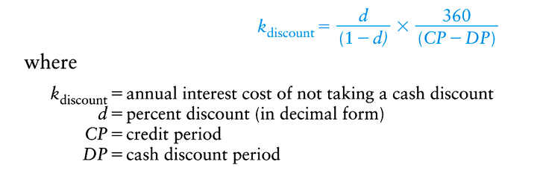
Current Liabilities Management
Cash Discounts
Assume a supplier of Justin Industries has changed its terms from net 30 to 2/10 net 30. Justin has a bank line of credit with a current interest rate of 10%. Should Justin take the cash discount or continue to use 30 days of credit from its supplier?

Slide 66
Current Liabilities Management
Cash Discounts
The annualized rate charged by the supplier for not taking the cash discount is 36.7%, whereas the bank charges 10%. Justin should take the cash discount and obtain needed short-term financing by drawing on its bank line of credit.

Slide 67
Unsecured Sources of Short-Term Loans
Bank Loans
The major type of loan made by banks to businesses is the short-term, self-liquidating loan which is intended to carry a firm through seasonal peaks in financing needs.
These loans are generally obtained as companies build up inventory and experience growth in accounts receivable.
As receivables and inventories are converted into cash, the loans are then retired.
These loans come in three basic forms: single-payment notes, lines of credit, and revolving credit agreements.

Slide 68
Unsecured Sources of Short-Term Loans
Bank Loans
Loan Interest Rates
Most banks loans are based on the prime rate of interest which is the lowest rate of interest charged by the nation’s leading banks on loans to their most reliable business borrowers.
Banks generally determine the rate to be charged to various borrowers by adding a premium to the prime rate to adjust it for the borrowers “riskiness.”

Slide 69
Unsecured Sources of Short-Term Loans
Bank Loans
Fixed- and Floating-Rate Loans
On a fixed-rate loan, the rate of interest is determined at a set increment above the prime rate and remains at that rate until maturity.
On a floating-rate loan, the increment above the prime rate is initially established and is then allowed to float with prime until maturity.
Like ARMs, the increment above prime is generally lower on floating rate loans than on fixed-rate loans.

Slide 70
Unsecured Sources of Short-Term Loans
Bank Loans
Line of Credit (LOC)
A line of credit is an agreement between a commercial bank and a business specifying the amount of unsecured short-term borrowing the bank will make available to the firm over a given period of time.
It is usually made for a period of 1 year and often places various constraints on borrowers.
Although not guaranteed, the amount of a LOC is the maximum amount the firm can owe the bank at any point in time.

Slide 71
Unsecured Sources of Short-Term Loans
Bank Loans
Line of Credit (LOC)
In order to obtain the LOC, the borrower may be required to submit a number of documents including a cash budget, and recent (and pro forma) financial statements.
The interest rate on a LOC is normally floating and pegged to prime.
In addition, banks may impose operating change restrictions giving it the right to revoke the LOC if the firm’s financial condition changes.

Slide 72
Unsecured Sources of Short-Term Loans
Bank Loans
Line of Credit (LOC)
Both LOCs and revolving credit agreements often require the borrower to maintain compensating balances.
A compensating balance is simply a certain checking account balance equal to a certain percentage of the amount borrowed (typically 10 to 20 percent).
This requirement effectively increases the cost of the loan to the borrower.

Slide 73
Unsecured Sources of Short-Term Loans
Bank Loans
Revolving Credit Agreements (RCA)
A RCA is nothing more than a guaranteed line of credit.
Because the bank guarantees the funds will be available, they typically charge a commitment fee which applies to the unused portion of of the borrowers credit line.
A typical fee is around 0.5% of the average unused portion of the funds.
Although more expensive than the LOC, the RCA is less risky from the borrower’s perspective.

Slide 74
Unsecured Sources of Short-Term Loans
Commercial Paper
Commercial paper is a short-term, unsecured promissory note issued by a firm with a high credit standing.
Generally only large firms in excellent financial condition can issue commercial paper.
Most commercial paper has maturities ranging from 3 to 270 days, is issued in multiples of $100,000 or more, and is sold at a discount form par value.
Commercial paper is traded in the money market and is commonly held as a marketable security investment.

Slide 75
Unsecured Sources of Short-Term Loans
International Loans
The main difference between international and domestic transactions is that payments are often made or received in a foreign currency
A U.S.-based company that generates receivables in a foreign currency faces the risk that the U.S. dollar will appreciate relative to the foreign currency.
Likewise, the risk to a U.S. importer with foreign currency accounts payables is that the U.S. dollar will depreciate relative to the foreign currency.

Slide 76
Secured Sources of Short-Term Loans
Characteristics
Although it may reduce the loss in the case of default, from the viewpoint of lenders, collateral does not reduce the riskiness of default on a loan.
When collateral is used, lenders prefer to match the maturity of the collateral with the life of the loan.
As a result, for short-term loans, lenders prefer to use accounts receivable and inventory as a source of collateral.

Slide 77
Secured Sources of Short-Term Loans
Characteristics
Depending on the liquidity of the collateral, the loan itself is normally between 30 and 100 percent of the book value of the collateral.
Perhaps more surprisingly, the rate of interest on secured loans is typically higher than that on a comparable unsecured debt.
In addition, lenders normally add a service charge or charge a higher rate of interest for secured loans.

Slide 78
Secured Sources of Short-Term Loans
Accounts Receivable as Collateral
Pledging accounts receivable occurs when accounts receivable are used as collateral for a loan.
After investigating the desirability and liquidity of the receivables, banks will normally lend between 50 and 90 percent of the face value of acceptable receivables.
In addition, to protect its interests, the lender files a lien on the collateral and is made on a non-notification basis (the customer is not notified).

Slide 79
Secured Sources of Short-Term Loans
Accounts Receivable as Collateral
Factoring accounts receivable involves the outright sale of receivables at a discount to a factor.
Factors are financial institutions that specialize in purchasing accounts receivable and may be either departments in banks or companies that specialize in this activity.
Factoring is normally done on a notification basis where the factor receives payment directly from the customer.

Slide 80
Secured Sources of Short-Term Loans
Inventory as Collateral
The most important characteristic of inventory as collateral is its marketability.
Perishable items such as fruits or vegetables may be marketable, but since the cost of handling and storage is relatively high, they are generally not considered to be a good form of collateral.
Specialized items with limited sources of buyers are also generally considered not to be desirable collateral.

Slide 81
Secured Sources of Short-Term Loans
Inventory as Collateral
A floating inventory lien is a lenders claim on the borrower’s general inventory as collateral.
This is most desirable when the level of inventory is stable and it consists of a diversified group of relatively inexpensive items.
Because it is difficult to verify the presence of the inventory, lenders generally advance less than 50% of the book value of the average inventory and charge 3 to 5 percent above prime for such loans.

Slide 82
Secured Sources of Short-Term Loans
Inventory as Collateral
A trust receipt inventory loan is an agreement under which the lender advances 80 to 100 percent of the cost of a borrower’s relatively expensive inventory in exchange for a promise to repay the loan on the sale of each item.
The interest charged on such loans is normally 2% or more above prime and are often made by a manufacturer’s wholly-owned subsidiary (captive finance company).
Good examples would include GE Capital and GMAC.

Slide 83
Secured Sources of Short-Term Loans
Inventory as Collateral
A warehouse receipt loan is an arrangement in which the lender receives control of the pledged inventory which is stored by a designated agent on the lender’s behalf.
The inventory may stored at a central warehouse (terminal warehouse) or on the borrower’s property (field warehouse).
Regardless of the arrangement, the lender places a guard over the inventory and written approval is required for the inventory to be released.
Costs run from about 3 to 5 percent above prime.

Slide 84
Using Microsoft® Excel
The Microsoft® Excel Spreadsheets used in the this presentation can be downloaded from the Introduction to Finance companion web site: http://www.awl.com/gitman_madura

Slide 85
Chapter
15
Introduction to Finance
Lawrence J. Gitman
Jeff Madura
End of Chapter

Slide 86
SEKIAN DAN TERIMA KASIH

