Slide 1
Analisis informasi Akuntansi (laporan Keuangan)
PERTEMUAN #2
FEB 302
MANAJEMEN
KEUANGAN
FAKULTAS EKONOMI DAN BISNIS
UNIVERSITAS ESA UNGGUL

Slide 2
KEMAMPUAN AKHIR YANG DIHARAPKAN
Mahasiswa mampu menjelaskan:
Analisis laporan keuangan perusahaan.
Rasio rasio keuanga

Slide 3
Chapter
2
Introduction to Finance
Lawrence J. Gitman
Jeff Madura
Financial Institutions and Markets

Slide 4
Learning Goals
Explain how financial institutions serve as intermediaries between investors and firms.
Provide and overview of financial markets.
Explain how firms and investors trade money market and capital market securities in the financial markets in order to satisfy their needs.
Describe the major securities exchanges.
Describe derivative securities and explain why they are used by firms and investors.
Describe the foreign exchange market.

Slide 5
Effective Financial Systems
An effective financial system must possess three characteristics:
Monetary systems that provide an efficient medium for exchanging goods and services
Facilitate capital formation whereby excess capital from savers is made available to borrowers (investors)
Efficient and complete financial markets which provide for the transfer of financial assets (such as stocks and bonds), and for the conversion of such assets into cash

Slide 6
Financial Institutions
Financial institutions serve as intermediaries by channeling the savings of individuals, businesses, and governments into loans or investments.
They are a primary source of funds for both individuals and businesses.
In addition, they are the main store of deposits for individuals through checking accounts (demand deposits) and savings accounts (time deposits).

Slide 7
Key Customers of Financial Institutions
The key customers of financial institutions are individuals, businesses, and governments.
Savings of individuals provide the main supply of funds to both businesses and other individuals.
As a group, individuals are net suppliers of funds.
Firms, on the other hand, are net demanders of funds.
Finally, like individuals, governments are net demanders of funds.
The different types of financial institutions are described on the following slide.

Slide 8
Financial Intermediaries in the United States
Depository Institutions
Commercial Banks
S&Ls
Savings Banks
Credit
Finance Companies
Sales Finance Companies
Consumer Finance Companies
Commercial Finance Companies
Contractual Savings Institutions
Life Insurance Companies
Private Pension Funds
State and Local Government Retirement Funds
Selected Securities Market Institutions
Mortgage Banking Companies
Investment Bankers and Brokerage Companies
Organized Securities Markets
Credit Reporting Organizations
Government Credit-Related Agencies
Investment Institutions
Investment Companies and Mutual Funds
Real Estate Investment Trusts
Money Market Funds

Slide 9
Commercial Banks
Commercial banks accumulate deposits from savers and use the proceeds to provide credit to firms, individuals, and government agencies.
Banks provide personal loans to individuals and commercial loans to firms.
Commercial banks earn much of their profit by earning a higher rate on loans than the rate they pay on deposits.
In recent years, banks have expanded the range of services they provide for customers.

Slide 10
Sources and Uses of Funds at Commercial Banks
Banks obtain most of their funds by accepting deposits, primarily from individuals but also from firms and governments.
These deposits are insured by the FDIC to a maximum of $100,000 per depositor.
Banks use most of their funds to provide loans to individuals or firms, or to purchase debt securities.
Some popular means by which banks extend credit to firms include term loans and lines of credit.

Slide 11
Sources and Uses of Funds at Commercial Banks
Term loans typically last from 4 to 8 years.
Lines of credit allow firms to access a specified amount of funds over a specified period of time and are generally used to meet working capital requirements.
Lines of credit must typically be renewed each year by the firm requesting them.
Commercial banks also invest in debt securities that are issued by firms.

Slide 12
Role of Commercial Banks as Financial Intermediaries
Commercial banks serve as financial intermediaries in several ways.
First, they repackage deposits received from investors into loans that are provided to firms.
Second, banks employ credit analysts who have the ability to assess the creditworthiness of firms that wish to borrow funds.

Slide 13
Role of Commercial Banks as Financial Intermediaries
Third, banks can diversify loans across several borrowers thereby reducing the risk of default.
Fourth, banks have recently served as intermediaries by placing (issuing) securities that are issued by firms.

Slide 14
Regulation of Commercial Banks
Banks are regulated by the Federal Reserve System (the Fed), which serves as the central bank of the United States.
Banks are also regulated by the Federal Deposit Insurance Corporation (FDIC) which insures depositors.
The general philosophy of regulators who monitor the banking system is to promote competition while at the same time limiting risk to safeguard the system.

Slide 15
Mutual Funds
Mutual funds are owned by investment companies.
Mutual funds sell shares to individuals and pools the proceeds to invest in securities.
Money market mutual funds invest in short-term money market securities issued by firms and other financial institutions.
Bond mutual funds invest in bonds.
Stock mutual funds pool the proceeds received from investors to invest in stocks.

Slide 16
Role of Mutual Funds as Intermediaries
When mutual funds invest in newly issued debt or equity securities, they are helping to finance new investment by firms.
When mutual funds purchase debt or equity securities already held by investors, they help to transfer ownership by investors.
Mutual funds enable small investors to diversify their portfolios to a greater extent than possible themselves.

Slide 17
Role of Mutual Funds as Intermediaries
Mutual funds also benefit investors by providing professional management expertise that most individual investors do not posses.
Mutual funds managers are armed with substantial resources with which to make investment decisions.
Finally, because mutual funds may own a substantial percentage of a given firm’s stock, they are able to exert considerable influence on firm and stock performance through management.

Slide 18
Securities Firms
Securities firms are a category of firms that include investment banks, investment companies, and brokerage firms.
They serve an investment banking function by placing securities issued by firms and government agencies.
They serve a brokerage role by helping investors purchase securities or sell securities that they previously purchased.

Slide 19
Insurance Companies
Insurance companies provide various types of insurance including: life insurance, property and casualty insurance, and health insurance.
They function as intermediaries by accepting customer premiums and paying claims.
They pool premiums and invest in securities issued by firms and government agencies and employ portfolio managers to make investment decisions.

Slide 20
Pension Funds
Pension funds invest payments (contributions) from employees and/or employers on behalf of employees.
Pension funds employ portfolio managers to invest funds from pooling the contributions.
Because of the large size of their investments in the stocks and bonds of firms, pension funds closely monitor the firms in which they invest.

Slide 21
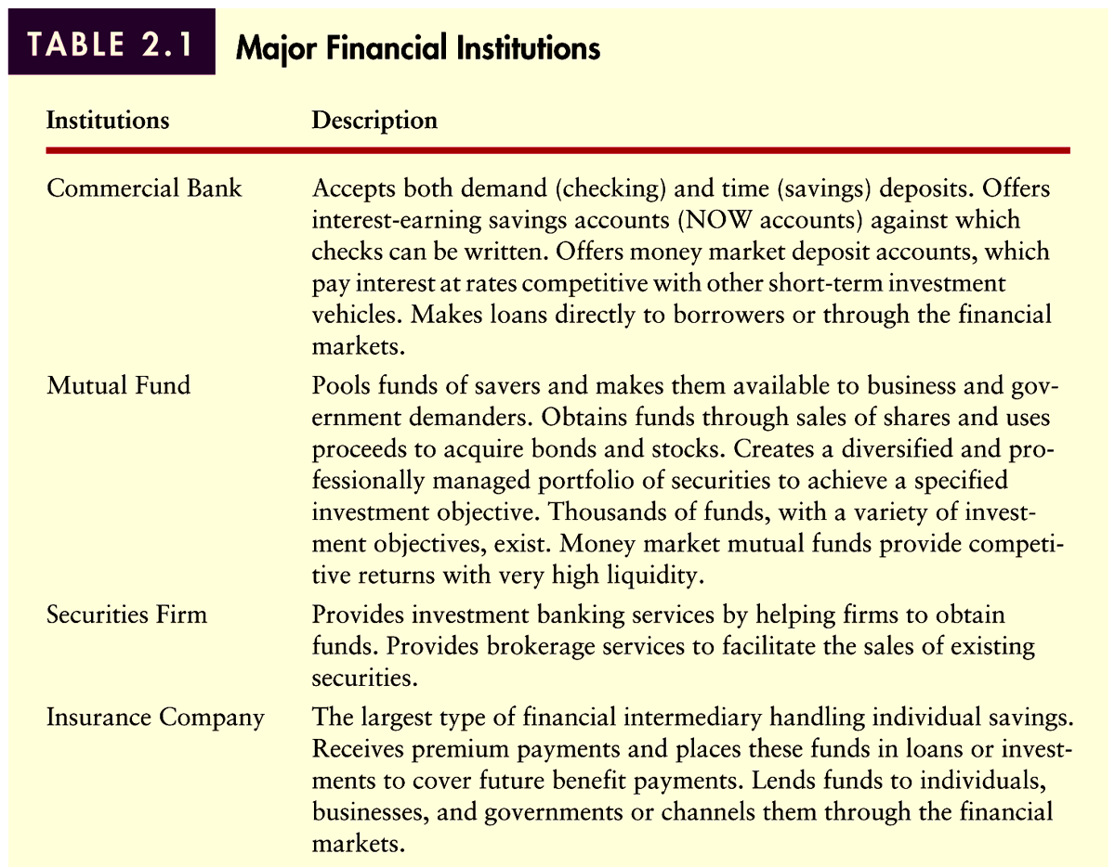
Comparison of Financial Institutions
Table 2.1 (Panel 1)

Slide 22
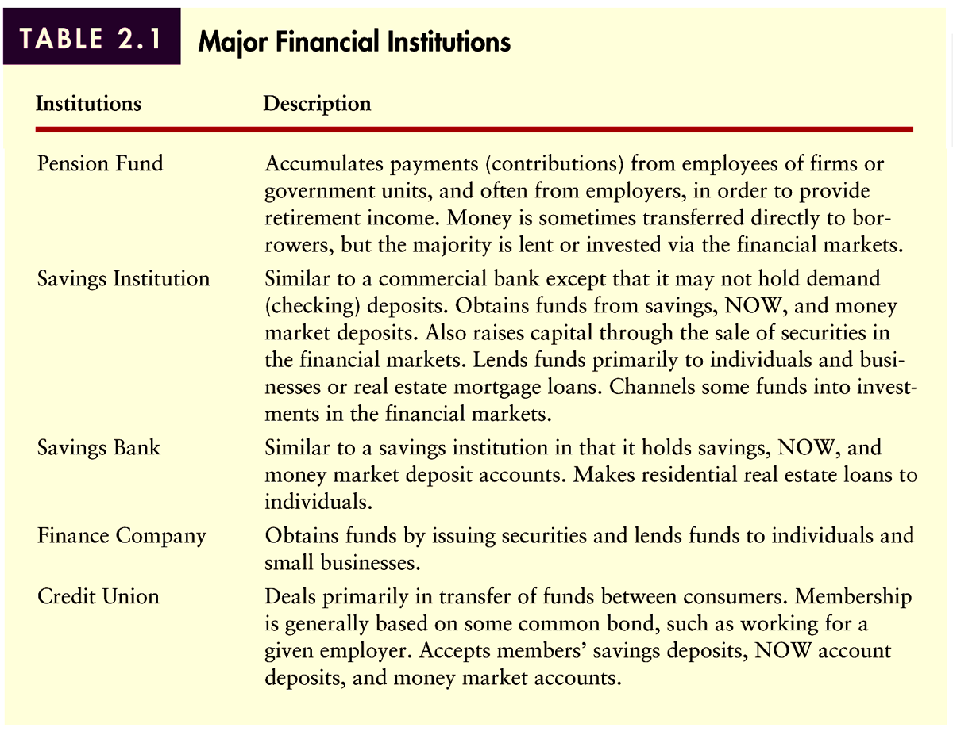
Comparison of Financial Institutions
Table 2.1 (Panel 2)

Slide 23
Consolidation of Financial Institutions
In recent years, financial conglomerates have been created that offer commercial banking services, investment banking services, brokerage services, mutual funds, and insurance services.
In general, financial conglomeration is expected to increase the competition among financial intermediaries, lowering the prices paid by individuals and firms for these services.

Slide 24
Globalization of Financial Institutions
Financial institutions have expanded internationally in recent years.
This expansion was spurred by the expansion of multinational corporations, and because banks recognized they could capitalize on their global image by establishing branches in foreign cities.
This global expansion is expected to continue in the future.

Slide 25
Overview of Financial Markets
Public Offering versus Private Placement
A public offering is the nonexclusive sale of securities to the general public.
Public offerings are normally executed with the help of a securities firm that provides investment banking services.
The securities firm may underwrite the offering, which means that it guarantees the amount to be received by the issuing firm.

Slide 26
Overview of Financial Markets
Public Offering versus Private Placement
A private placement is the sale of new securities directly to an investor or a group of investors.
In general, only institutional investors such as pension funds or insurance companies can afford to invest in private placements.

Slide 27
Overview of Financial Markets
Primary Markets versus Secondary Markets
Marketable financial assets can be categorized according to whether they trade in the primary market or the secondary market.
Primary markets are where new securities (IPOs) are issued.
Secondary markets are where securities are bought and sold after initially issued in the primary markets.
In addition, financial assets may be money market instruments or capital market instruments.

Slide 28
Key Types of Securities
Key Money Market Securities
U.S. Treasury Bills
Negotiable CDs
Banker’s Acceptances
Federal Funds
Commercial Paper
Repurchase Agreements

Slide 29
Key Types of Securities
Key Money Market Securities
U.S. Treasury Notes and Bonds
U.S. Government Agency Bonds
State and Local Government Bonds
Corporate Bonds
Corporate Stocks
Real Estate Mortgages

Slide 30
Major Securities Exchanges
Organized Exchanges
Organized securities exchanges are tangible secondary markets where outstanding securities are bought and sold.
They account for over 60% of the dollar volume of domestic shares traded.
Only the largest and most profitable companies meet the requirements necessary to be listed on the New York Stock Exchange.

Slide 31
Major Securities Exchanges
Organized Exchanges
Only those that own a seat on the exchange can make transactions on the floor (there are currently 1,366 seats).
Trading is conducted through an auction process where specialists “make a market” in selected securities.
As compensation for executing orders, specialists make money on the spread (the bid price minus the ask price).

Slide 32
Major Securities Exchanges
Organized Exchanges
Requirements NYSE AMEX
Shares held by public 1,100,000 400,000
Stockholders with 100+ shares 2,000 1,200
Pretax income (latest year) $2,500,000 $750,000
Pretax income (prior 2 years) $2,000,000 N/A
MV of public shares held $18,000,000 $300,000
Tangible assets $16,000,000 $4,000,000

Slide 33
Major Securities Exchanges
Over-the-Counter Exchange
The over-the-counter (OTC) market is an intangible market for securities transactions.
Unlike organized exchanges, the OTC is both a primary market and a secondary market.
The OTC is a computer-based market where dealers make a market in selected securities and are linked to buyers and sellers through the NASDAQ System.
Dealers also make money on the spread.

Slide 34
Derivative Securities Markets
Derivative securities are financial contracts whose values are derived from the values of underlying financial assets.
Derivatives allow investors to take (leveraged) positions based on their expectations of movements in the underlying assets.
Investors can use derivatives to take speculative positions or can use them to (hedge) reduce exposure to risk on other investments or portfolios.

Slide 35
Chapter
2
Introduction to Finance
Lawrence J. Gitman
Jeff Madura
End of Chapter

Slide 37
SEKIAN DAN TERIMA KASIH

