Slide 1
TIME VALUE OF MONEY
PERTEMUAN #4
FEB 302
MANAJEMEN KEUANGAN
FAKULTAS EKONOMI DAN BISNIS
UNIVERSITAS ESA UNGGUL

Slide 2
KEMAMPUAN AKHIR YANG DIHARAPKAN
Memahami dan memiliki wawasan tentang:
Konsep dari nilai waktu uang saat ini dan yang akan dating
Pengukuran nilai waktu uang

Slide 3
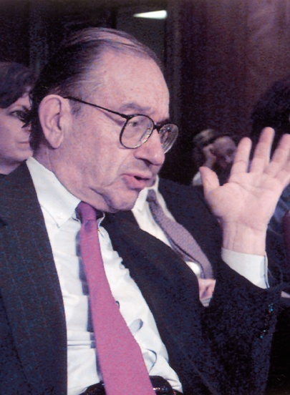
Chapter
4
Introduction to Finance
Lawrence J. Gitman
Jeff Madura
Interest Rate Fundamentals

Slide 4
Learning Goals
Discuss the components that influence the risk-free interest rate at a given point in time.
Explain why the risk-free interest rate changes over time.
Explain why the risk-free interest rate varies among possible maturities (investment horizons).
Explain the relationship between risk and nominal rate of interest.
Explain why required returns of risky assets change over time.

Slide 5
Interest Rate Fundamentals
The interest rate represents the cost of money to a borrower and the return on invested money to an investor (or lender).
The real rate of interest (k*) reflects the rate of interest that would exist if there was no expected inflation and no risk.
The risk-free rate of interest (R_{F}) reflects only the real rate of interest (k*) plus a premium (IP) to compensate investors for inflation (rising prices).
R_{F} = k* + IP

Slide 6
Interest Rate Fundamentals
The nominal rate of interest (k_{N}) is the rate of interest actually charged by the supplier of funds and paid by the demander of funds.
All nominal (observed) rates contain an inflation premium (IP) to compensate investors for inflation and a risk premium (RP) to compensate investors for issuer risk characteristics such as the risk of default.
k_{N} = k* + IP + RP

Slide 7
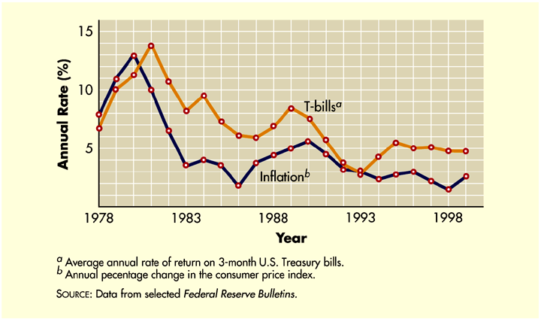
Interest Rate Fundamentals
Figure 4.1

Slide 8
Explaining Changes in the Risk-Free Rate
In this text, we will use the rate of interest on U.S. Treasury Bills (T-Bills) as proxy for the risk-free rate of interest because the return on this investment compensates investors only for the real rate of return plus an inflation premium.
Understanding changes in the risk-free rate is important because changes in this rate are reflected in all other interest rates.

Slide 9
How the Equilibrium Interest Rate Is Determined
The interest rate on borrowed funds is determined by the total (aggregate) supply of funds by investors and the total (aggregate) demand for funds by borrowers.
The aggregate supply of funds is dependent on the interest rate offered to investors.
At low interest rates, aggregate supply should be low because of the low reward to investors.
The opposite is true at high interest rates.

Slide 10
How the Equilibrium Interest Rate Is Determined
Like aggregate supply, the aggregate demand for funds also depends on the prevailing interest rate.
If the nominal interest rate is low, aggregate demand should be high because the cost of funds is relatively low.
The opposite would be true at high interest rates.
The combined effect of aggregate supply and demand is demonstrated in Figure 4.2 on the following slide.

Slide 11
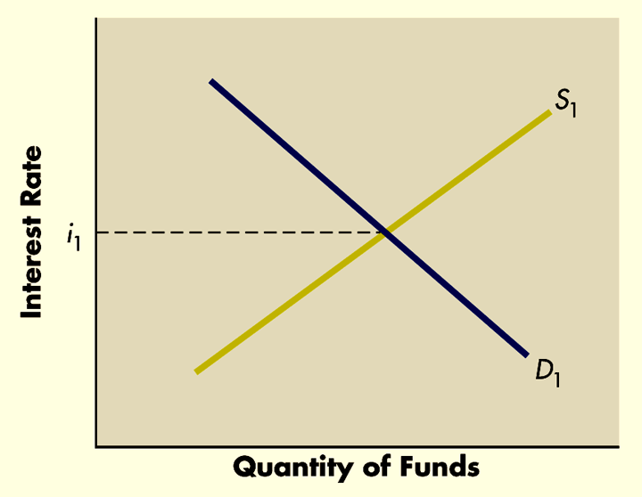
How the Equilibrium Interest Rate Is Determined
Figure 4.2

Slide 12
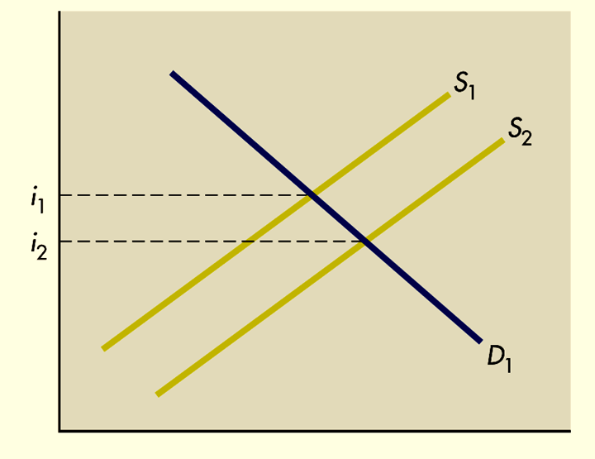
How Shifts in Supply Affect Interest Rates
Figure 4.3

Slide 13
Factors that Affect Shifts in Supply
Shift in savings by investors
Shift in monetary policy
Open market operations
Discount rate
How the Fed uses monetary policy to reduce interest rates
How the Fed uses monetary policy to increase interest rates

Slide 14
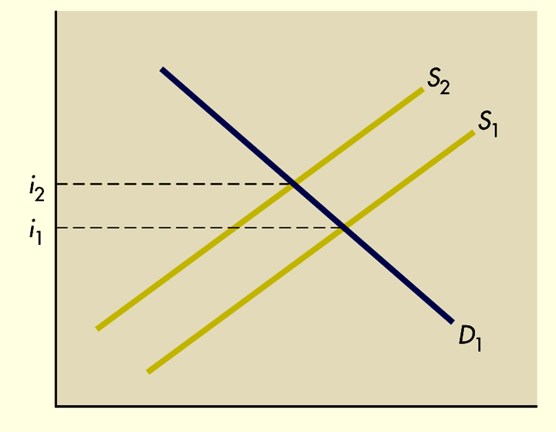
Factors that Affect Shifts in Supply
Figure 4.4

Slide 15
How Shifts in the Demand for Funds Affect Interest Rates
Shift in the government demand for funds
Shift in the business demand for funds
Shift in the household demand for funds
Combining shifts in supply and demand

Slide 16
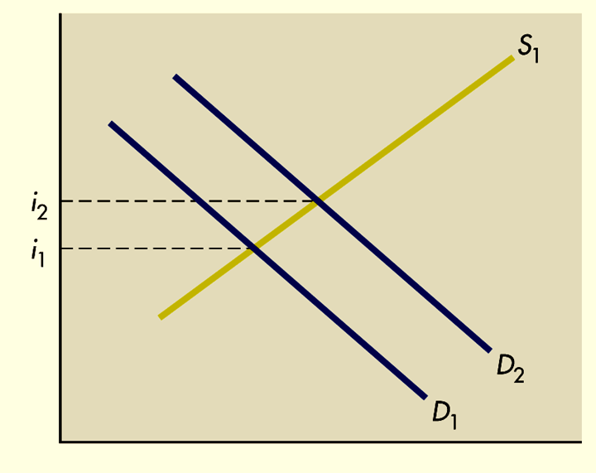
How Shifts in the Demand for Funds Affect Interest Rates
Figure 4.5

Slide 17
Term Structure of Interest Rates
The term structure of interest rates relates the interest rate to the time to maturity for securities with a common default risk profile.
Typically, treasury securities are used to construct yield curves since all have zero risk of default.
However, yield curves could also be constructed with AAA or BBB corporate bonds or other types of similar risk securities.

Slide 18
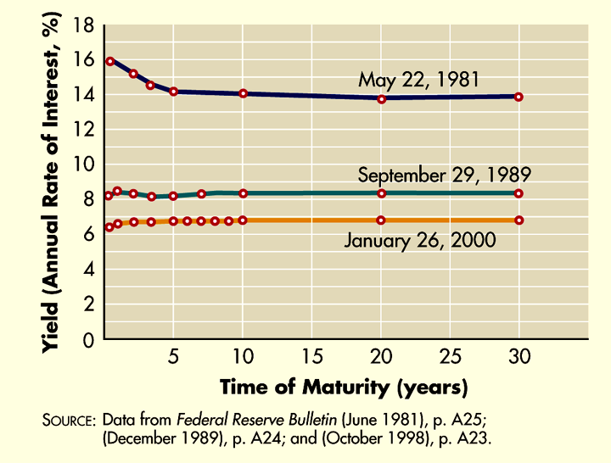
Yield Curves
Figure 4.6

Slide 19
Theories of Term Structure
Expectations Theory
This theory suggests that the shape of the yield curve reflects investors’ expectations about the future direction of inflation and interest rates.
Therefore, an upward-sloping yield curve reflects expectations of higher future inflation and interest rates.
In general, the very strong relationship between inflation and interest rates supports this theory.

Slide 20
Theories of Term Structure
Liquid Preference Theory
This theory contends that long-term interest rates tend to be higher than short-term rates for two reasons:
Long-term securities are perceived to be riskier than short-term securities.
Borrowers are generally willing to pay more for long-term funds because they can lock in at a rate for a longer period of time and avoid the need to roll over the debt.

Slide 21
Theories of Term Structure
Market Segmentation Theory
This theory suggests that the market for debt at any point in time is segmented on the basis of maturity.
As a result, the shape of the yield curve will depend on the supply and demand for a given maturity at a given point in time.

Slide 22
Risk Premiums
Risk Premiums on Debt Securities
The nominal rate of interest for a debt security with a specific maturity (k₁) is equal to the risk-free rate (R_{F}) for that same maturity, plus the risk premium (RP₁).
k₁ = R_{F} + RP₁
The risk premium represents the additional amount required by investors to compensate them for uncertainty surrounding the return on the security and varies with the risk of the borrower.

Slide 23
Risk Premiums
Risk Premiums on Debt Securities
One of the most important reasons for the existence of a risk premium on some debt securities is default risk.
Default risk is the possibility that the issuer of the security will default on its payments to the investors holding the debt securities.
Other issue- and issuer-related risks include liquidity risk, contractual provisions, maturity risk, and tax provisions as summarized in Table 4.1.

Slide 24
Risk Premiums on Debt Securities
Table 4.1 (Panel 1)

Slide 25
Risk Premiums on Debt Securities
Table 4.1 (Panel 2)

Slide 26
Risk Premiums
Risk Premiums on Equity Securities
The risk premiums on equity securities are not as easy to determine as they are on debt securities because equities do not have an observable interest rate that indicates the return to investors.
Investors will not necessarily agree on the exact risk premium that is required for every stock.
This explains why some investors will purchase a stock while others will not.

Slide 27
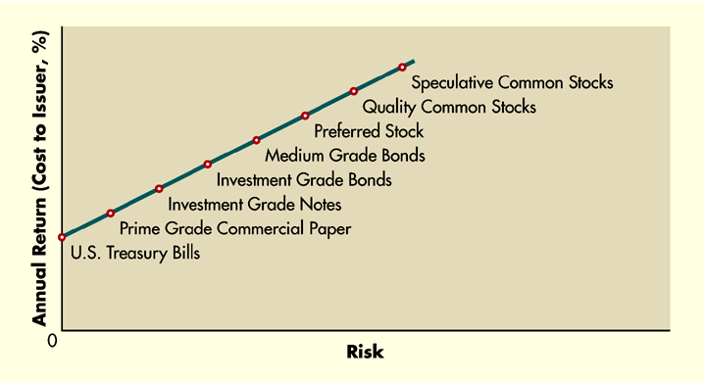
Risk and Return
Figure 4.7

Slide 28
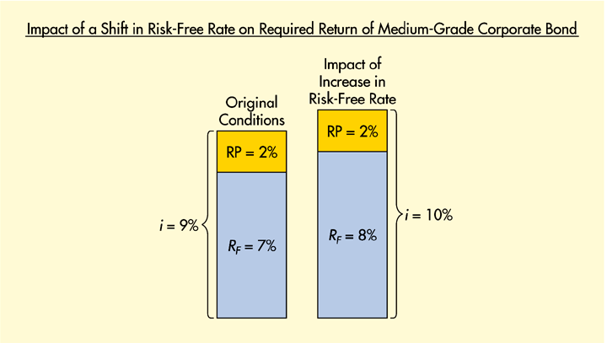
Explaining Shifts in Returns on Debt Securities
Figure 4.8 (Panel 1)

Slide 29
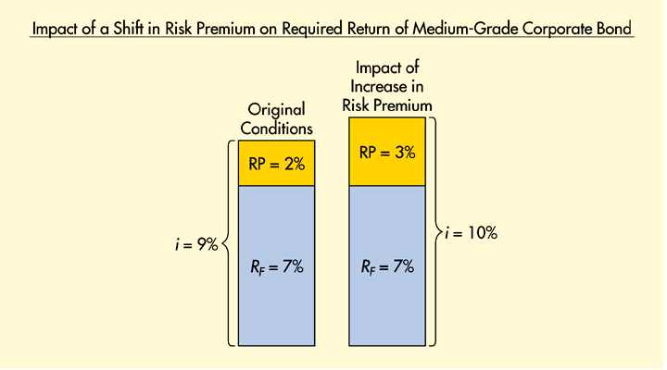
Explaining Shifts in Returns on Debt Securities
Figure 4.8 (Panel 2)

Slide 30
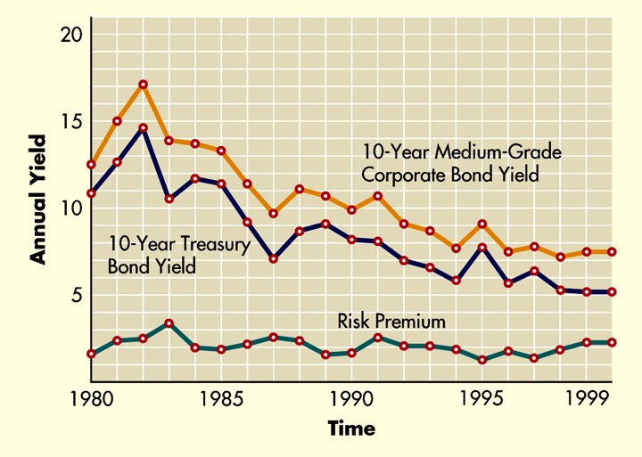
Actual Shifts in Returns on Debt Securities
Figure 4.9

Slide 31
Explaining Shifts in Required Returns
Actual Shifts in Returns on Equity Securities
Shifts in the risk-free rate
Shifts in the risk premium on equity securities

Slide 32
Chapter
4
Introduction to Finance
Lawrence J. Gitman
Jeff Madura
End of Chapter

Slide 33
SEKIAN DAN TERIMA KASIH

