Slide 1
COST OF CAPITAL
PERTEMUAN #7
FEB 302
MANAJEMEN
KEUANGAN
FAKULTAS EKONOMI DAN BISNIS
UNIVERSITAS ESA UNGGUL

Slide 2
KEMAMPUAN AKHIR YANG DIHARAPKAN
Memahami dan memiliki wawasan tentang:
Perhitungan atas penganggaran modal
Menganalisis biaya modal

Slide 3
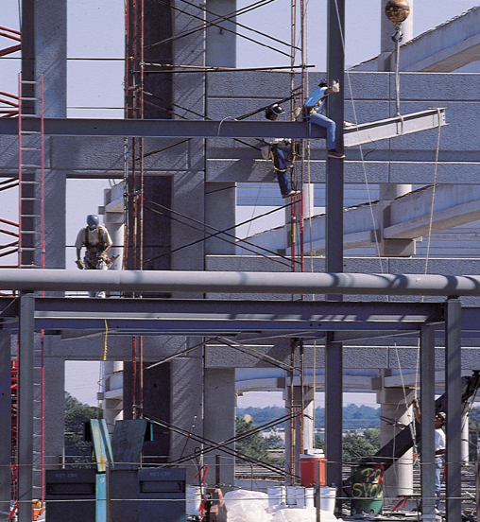
Chapter
10
Introduction to Finance
Lawrence J. Gitman
Jeff Madura
Capital Budgeting: Cash Flow Principles

Slide 4
Learning Goals
Understand the key capital expenditure motives and the steps in the capital budgeting process.
Define basic capital budgeting terminology.
Discuss the major components of relevant cash flows, expansion versus replacement cash flows, and international capital budgeting and long-term investments.

Slide 5
Learning Goals
Calculate the initial investment associated with a proposed capital expenditure.
Determine the relevant operating cash inflows using the income statement format.
Find the terminal cash flow.

Slide 6
Introduction
Capital budgeting is the process of identifying, evaluating, and implementing a firm’s investment opportunities.
It seeks to identify investments that will enhance a firm’s competitive advantage and increase shareholder wealth.
The typical capital budgeting decision involves a large up-front investment followed by a series of smaller cash inflows.
Poor capital budgeting decisions can ultimately result in company bankruptcy.

Slide 7
Key Motives for Capital Expenditures
Capital expenditures are made for many reasons.
The basic motives for capital expenditures are to expand, replace, or renew fixed assets or to obtain some other less tangible benefit over a long period.
Specific examples of key motives are shown on the following slide.
Details with regard to these motives can be found on the book’s web site:
http://www.awl.com/ gitman_madura.

Slide 8
Key Motives for Capital Expenditures
Examples
Replacing worn out or obsolete assets
Improving business efficiency
Acquiring assets for expansion into new products or markets
Acquiring another business
Complying with legal requirements
Satisfying work-force demands
Environmental requirements

Slide 9
Steps in the Process
Step 1: Proposal Generation
How are projects initiated?
How much is available to spend?
Step 2: Review and Analysis
Preliminary project review
Technically feasible?
Compatible with corporate strategy?
Step 3: Decision Making
What are the costs and benefits?
What is the project’s return?
What are the risks involved?
Our Focus

Slide 10
Steps in the Process
Step 4: Implementation
When to implement?
How to implement?
Step 5: Follow-Up
Is the project within budget?
What lessons can be drawn?

Slide 11
Independent versus Mutually Exclusive Projects
Mutually exclusive projects are investments that compete in some way for a company’s resources. A firm can select one or another but not both.
Independent projects, on the other hand, do not compete with the firm’s resources. A company can select one, or the other, or both—so long as they meet minimum profitability thresholds.

Slide 12
Unlimited Funds versus Capital Rationing
If the firm has unlimited funds for making investments, then all independent projects that provide returns greater than some specified level can be accepted and implemented.
However, in most cases firms face capital rationing restrictions since they only have a given amount of funds to invest in potential investment projects at any given time.

Slide 13
Accept-Reject versus Ranking Approaches
Two basic approaches to capital budgeting decisions are available.
The accept-reject approach involves evaluating capital expenditure proposals to determine whether they meet the firm’s minimum acceptance criterion.
The ranking approach involves ranking projects on the basis of some predetermined measure, such as the rate of return.

Slide 14
Conventional versus Nonconventional Cash Flow Patterns
A conventional cash flow pattern consists of an initial outflow followed only by a series of inflows as shown in Figure 10.1.
A nonconventional cash flow pattern is one in which an initial outflow is followed by a series of inflows and outflows as shown in Figure 10.2.
Difficulties often arise in evaluating projects with nonconventional cash flow patterns; we will limit our discussion in this book to conventional projects.

Slide 15
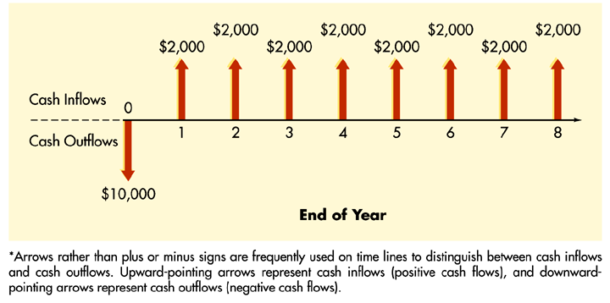
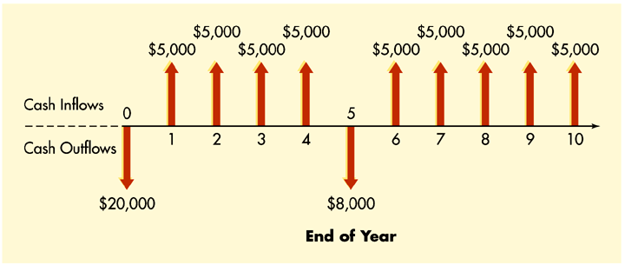
Conventional versus Nonconventional Cash Flow Patterns
Figures 10.1 and 10.2

Slide 16
The Relevant Cash Flows
Incremental Cash Flows
Only cash flows associated with the investment.
Effects on the firm’s other investments (both positive and negative) must also be considered.
For example, if a day-care center decides to open another facility, the impact of customers who decide to move from one facility to the new facility must be considered.

Slide 17
The Relevant Cash Flows
Incremental Cash Flows
Only cash flows associated with the investment.
Effects on the firms other investments (both positive and negative) must also be considered.
Note that cash outlays already made (sunk costs) are irrelevant to the decision process.
However, opportunity costs, which are cash flows that could be realized from the best alternative use of the asset, are relevant.

Slide 18
The Relevant Cash Flows
Incremental Cash Flows
Only cash flows associated with the investment.
Effects on the firms other investments (both positive and negative) must also be considered.
Estimating incremental cash flows is relatively straightforward in the case of expansion projects, but not so in the case of replacement projects.
With replacement projects, incremental cash flows must be computed by subtracting existing project cash flows from those expected from the new project.

Slide 19
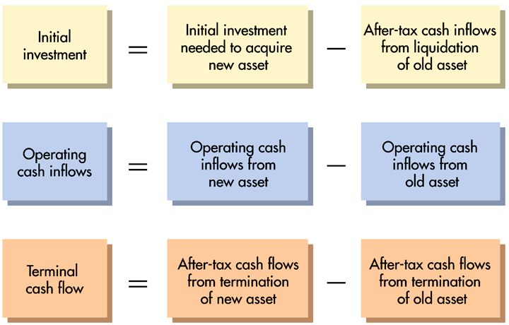
The Relevant Cash Flows
Figure 10.4

Slide 20
The Relevant Cash Flows
Examples of relevant cash flows:
Cash inflows, outflows, and opportunity costs
Changes in working capital
Installation, removal and training costs
Terminal values
Depreciation
Existing asset effects

Slide 21
The Relevant Cash Flows
Major Cash Flow Components:
Initial cash flows are cash flows resulting initially from the project. These are typically net negative outflows.
Operating cash flows are the cash flows generated by the project during its operation. These cash flows typically are net positive cash flows.
Terminal cash flows result from the disposition of the project. These are typically positive net cash flows.

Slide 22
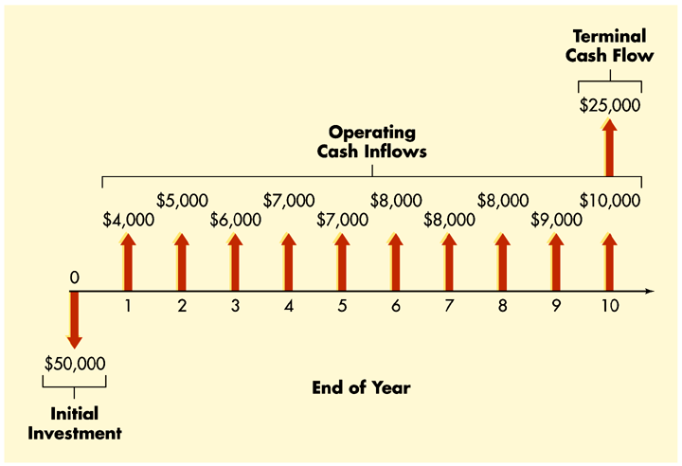
The Relevant Cash Flows
Figure 10.3

Slide 23
International Capital Budgeting
International capital budgeting analysis differs from purely domestic analysis because:
Cash inflows and outflows occur in a foreign currency.
Foreign investments potentially face significant political risks.
Despite these risks, the pace of foreign direct investment has accelerated significantly since the end of World War II.

Slide 24
Chapter Example
Morton Company, a large diversified manufacturer of electronics components, is trying to determine the initial investment required to replace an old machine with a new, more sophisticated model. The machine’s purchase price is $380,000 and an additional $20,000 will be needed to install it.
It will be depreciated under the MACRS 5-year recovery period. The old machine was purchased 3 years ago at a cost of $240,000 and was also depreciated under the MACRS 5-year class rates.
Morton has found a buyer willing to pay $280,000 for the present machine. Morton expects that a $35,000 increase in current assets and an $18,000 increase in current liabilities will be required to support the new machine. Morton is in the 40% tax bracket for both ordinary income and capital gains.

Slide 25
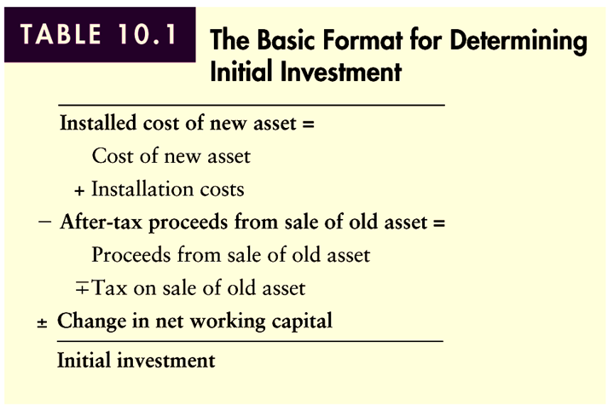
Finding the Initial Investment
Table 10.1

Slide 26
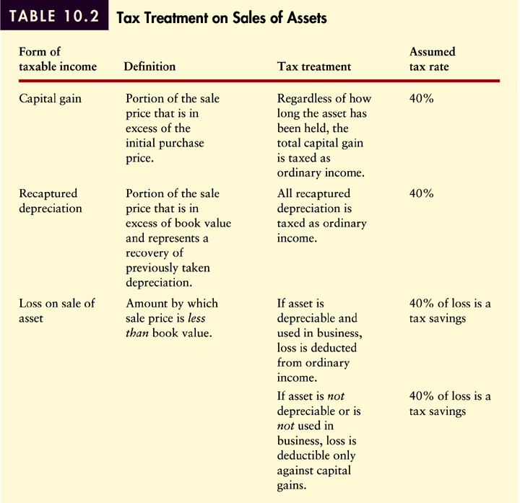
Finding the Initial Investment
Table 10.2

Slide 27
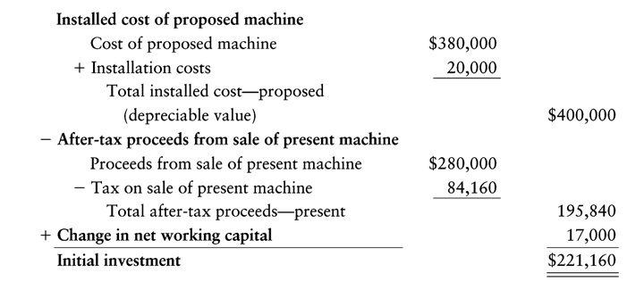
Finding the Initial Investment

Slide 28
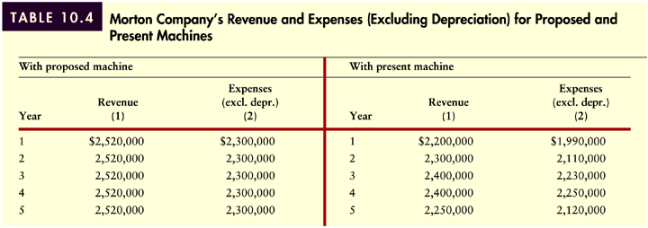
Finding Operating Cash Inflows
Morton Company’s estimates of its revenues and expenses (excluding depreciation), with and without the proposed new machine described in the preceding example, are given in Table 10.4. Note that both the expected life of the proposed machine and the remaining useful life of the present machine are 5 years.
Table 10.4

Slide 29
Finding Operating Cash Inflows
The amount to be depreciated with the proposed machine is calculated by summing the price of $380,000 and the installation costs of $20,000. The proposed machine is to be depreciated under MACRS using a 5-year recovery period. The resulting depreciation on this machine for each of the 6 years, as well as the remaining 3 years of depreciation (years 4, 5, 6) on the present machine, are calculated in Table 10.5 on the following two slides.

Slide 30
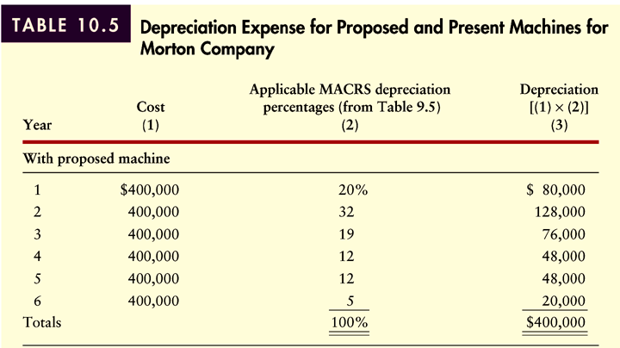
Finding Operating Cash Inflows
Table 10.5 (Panel 1)

Slide 31
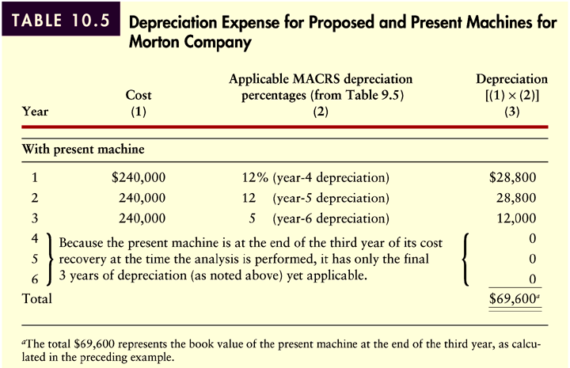
Finding Operating Cash Inflows
Table 10.5 (Panel 2)

Slide 32
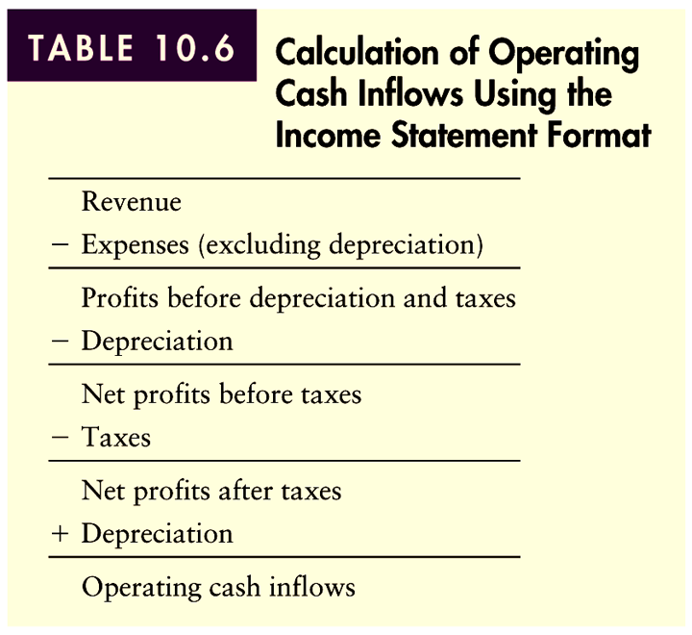
Finding Operating Cash Inflows
The operating cash inflows in each year can be calculated using the income statement format as shown in Table 10.6 below. The results as applied to the Morton Company are depicted in Table 10.7 on the following two slides.
Table 10.6

Slide 33
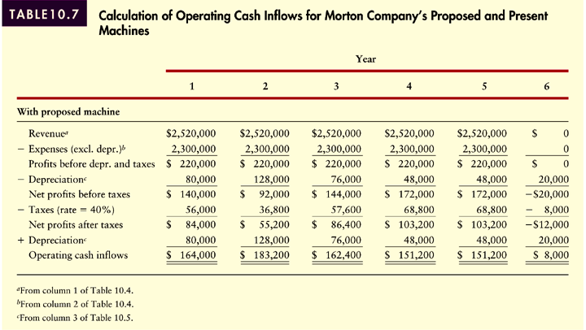
Finding Operating Cash Inflows
Table 10.7 (Panel 1)

Slide 34
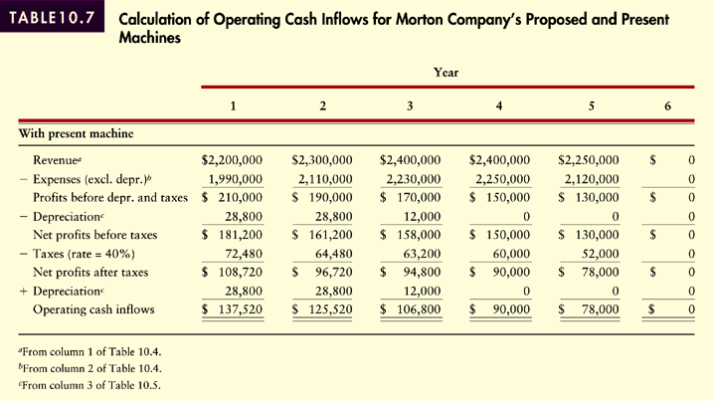
Finding Operating Cash Inflows
Table 10.7 (Panel 2)

Slide 35
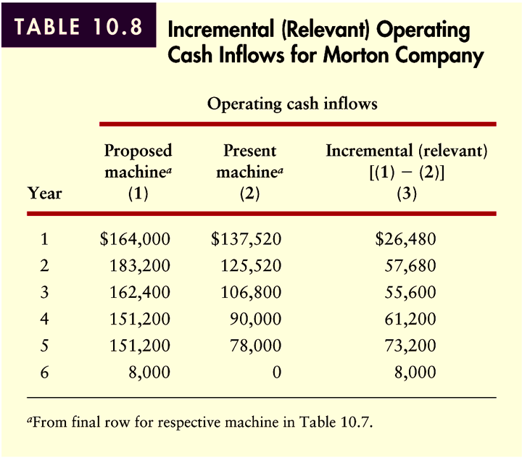
Finding Operating Cash Inflows
Table 10.8 demonstrates the calculation of Morton Company’s incremental (relevant) operating cash inflows for each year.
Table 10.8

Slide 36
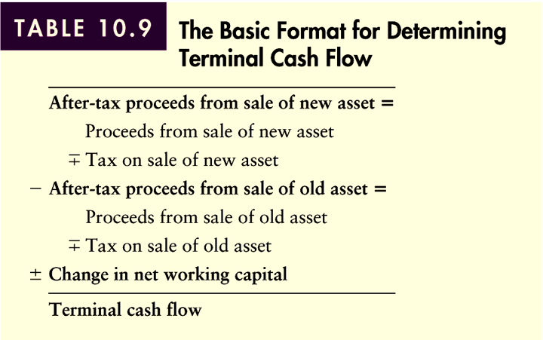
Finding the Terminal Cash Flows
Terminal cash flow is the cash flow resulting from termination and liquidation of a project at the end of its economic life. The general format for calculating terminal cash flow is shown in Table 10.9 below.
Table 10.9

Slide 37
Finding the Terminal Cash Flows
Continuing with the Morton Company example, assume that the firm expects to be able to liquidate the new machine at the end of its 5-year usable life to net $50,000 after paying removal and cleanup costs. The old machine can be liquidated at the end of the 5 years to net $0 because it will then be completely obsolete. The firm expects to recover its $17,000 net working capital investment upon termination of the project. Both ordinary income and capital gains are taxed at 40%.

Slide 38
Finding the Terminal Cash Flows
The proposed (new) machine will have a book value of $20,000 (equal to the year 6 depreciation at the end of 5 years). The present (old) machine will be fully depreciated and therefore have a book value of zero at the end of 5 years. Because the sale price of $50,000 for the new machine is greater than its $20,000 book value, it will have to pay tax of $30,000 on recaptured depreciation. Applying the ordinary tax rate of 40% results in a tax of $12,000. Because the present machine would net $0 at termination and its book value would also be $0, its after-tax proceeds would also be $0. Substituting these values in the format in Table 10.9 results in a terminal cash flow of $55,000 as shown on the following slide.

Slide 39
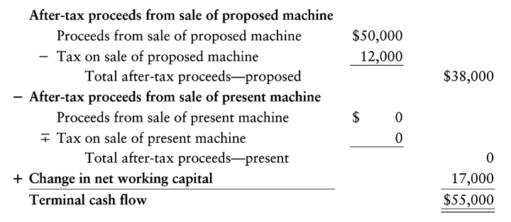
Finding the Terminal Cash Flows

Slide 40
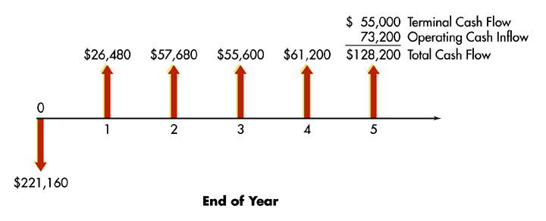
Summarizing the Relevant Cash Flows

Slide 41
Chapter
10
Introduction to Finance
Lawrence J. Gitman
Jeff Madura
End of Chapter

Slide 42
SEKIAN DAN TERIMA KASIH

