Slide 1
Analisis Resiko Rasio Keuangan
PERTEMUAN #8
FEB 302
MANAJEMEN KEUANGAN
FAKULTAS EKONOMI DAN BISNIS
UNIVERSITAS ESA UNGGUL

Slide 2
KEMAMPUAN AKHIR YANG DIHARAPKAN
Memahami dan memiliki wawasan tentang:
Pemahaman kelayakan suatu proyek
Mengukur kelayakan suatu proyek
Menganalisis kelayakan proyek

Slide 3
Chapter
11
Introduction to Finance
Lawrence J. Gitman
Jeff Madura
Capital Budgeting Techniques: Certainty and Risk

Slide 4
Learning Goals
Calculate, interpret and evaluate the payback period.
Apply net present value (NPV) and internal rate of return (IRR) to relevant cash flows to choose acceptable capital expenditures.
Use net present value profiles to compare NPV and IRR techniques in light of conflicting rankings.

Slide 5
Learning Goals
Recognize sensitivity and scenario analysis and simulation as behavioral approaches for dealing with project risk.
Discuss the unique risks that multinational companies face.
Understand how to determine and use risk-adjusted discount rates (RADRs).

Slide 6
Capital Budgeting Techniques
We will use one basic problem to illustrate all the techniques described in this chapter.
Onlab Company, a medium-sized metal fabricator is currently contemplating two projects: Project A requires an initial investment of $42,000, Project B an initial investment of $45,000. The projected relevant cash flows are presented in Table 11.1 and depicted on a time line in Figure 11.1 on the following slides.

Slide 7
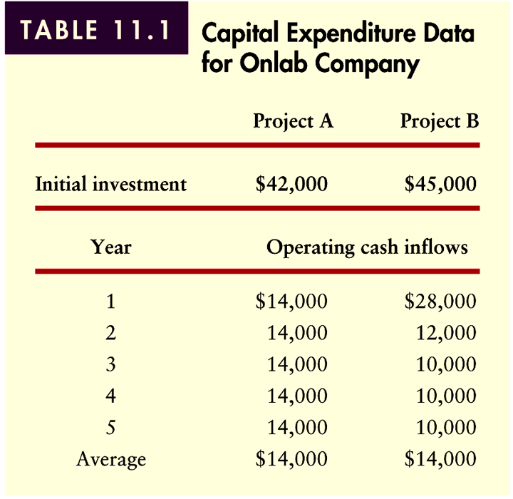
Capital Budgeting Techniques
Table 11.1

Slide 8
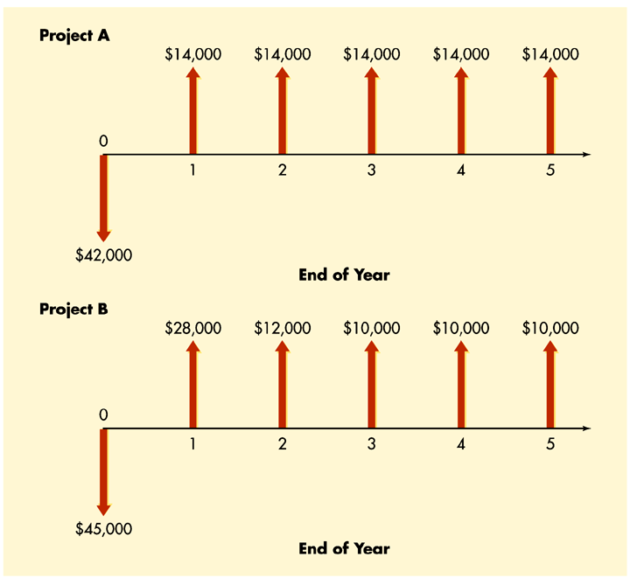
Capital Budgeting Techniques
Figure 11.1

Slide 9
Payback Period
The payback period simply measures how long (in years and/or months) it takes for a firm to recover its initial investment in a project.
Decision Critera:
If the payback period is less than the maximum acceptable payback period, accept the project.
If the payback period is greater than the maximum acceptable payback period, reject the project.

Slide 10
Payback Period
Assume the maximum payback for Onlab’s Projects is 2.75 years.
Based on this criteria, we would make the following decision with regard to Projects A and B.
Project A: Payback = 3.0 years > 2.75 years: Reject
Project B: Payback = 2.5 years < 2.75 years: Accept

Slide 11
Payback Period
Pros and Cons of Payback
The payback period is widely used by large firms to evaluate small projects and by small firms to evaluate most projects.
Its popularity results from its simplicity and intuitive appeal.
It is also appealing that it considers cash flows rather than accounting profits.

Slide 12
Payback Period
Pros and Cons of Payback
The major weakness of the payback period is that the appropriate payback requirement is merely a subjectively determined number.
A second weakness is that this approach fails to fully account for the time value of money.
A third weakness is the failure to recognize cash flows that occur after the required payback period as illustrated in Table 11.2.

Slide 13
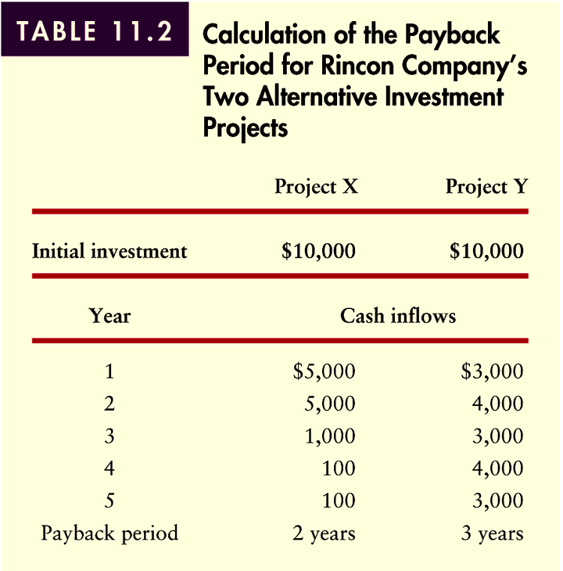
Payback Period
Pros and Cons of Payback
Table 11.2

Slide 14
Net Present Value (NPV)
Net present value is found by subtracting the present value of the after-tax outflows from the present value of the after-tax inflows.
Decision Criteria
If NPV > 0, accept the project
If NPV < 0, reject the project
If NPV = 0, indifferent

Slide 15
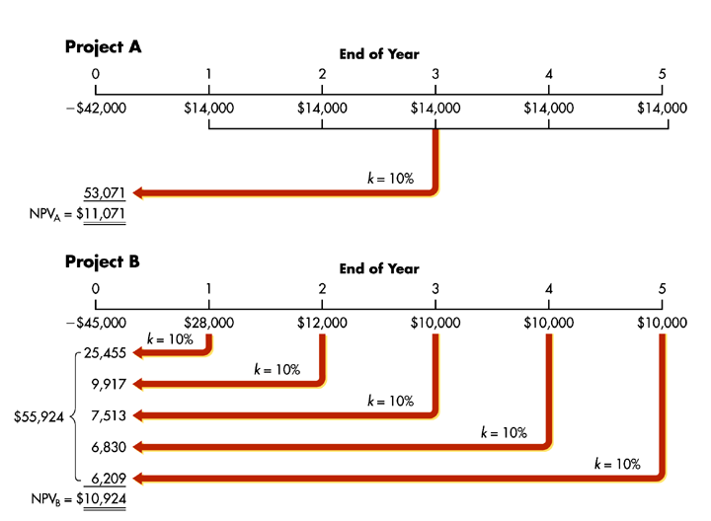
Net Present Value (NPV)
Figure 11.2

Slide 16
Internal Rate of Return (IRR)
The internal rate of return (IRR) is probably the most widely used and sophisticated capital budgeting technique.
The internal rate of return (IRR) is the discount rate that will equate the present value of the outflows with the present value of the inflows.
It is the compound annual rate of return the firm will earn if it invests in the project and receives the given cash inflows.
The IRR is the project’s intrinsic rate of return.

Slide 17
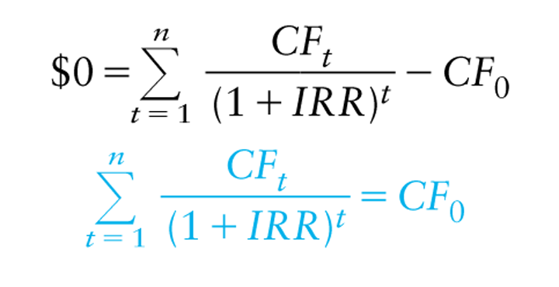
Internal Rate of Return (IRR)
Decision Criteria
If IRR > k, accept the project
If IRR < k, reject the project
If IRR = k, indifferent

Slide 18
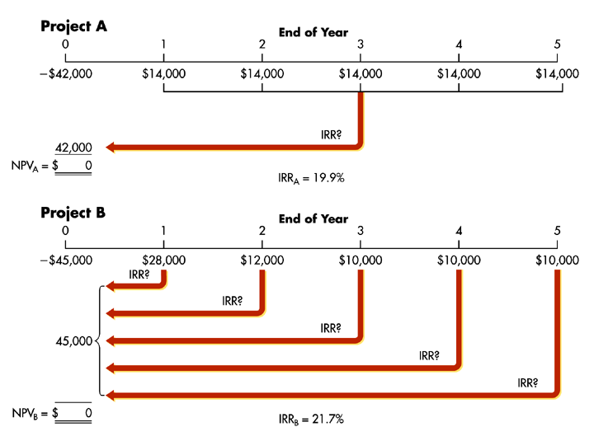
Internal Rate of Return (IRR)
Figure 11.3

Slide 19
Comparing NPV and IRR
Net Present Value Profile
Projects can be compared by graphically constructing net present value profiles that depict project NPVs for various discount rates.
To prepare net present value profiles for Onlab Company’s two projects, A and B, the first step is to develop a number of “discount rate-net present value” coordinates. Using the data in Table 11.1 and Figure 11.1 we can obtain three such coordinates for each project as shown in Table 11.3 and shown graphically as in Figure 11.4.

Slide 20
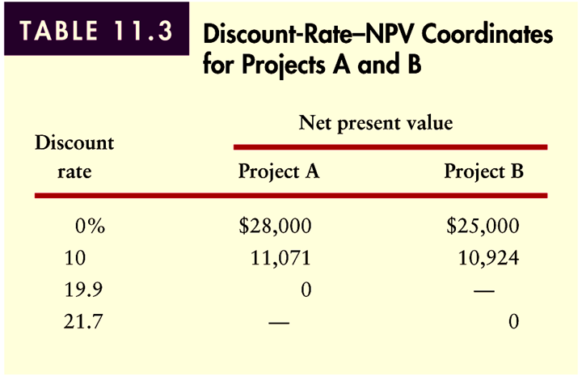
Comparing NPV and IRR
Net Present Value Profile
Table 11.3

Slide 21
Comparing NPV and IRR
Conflicting Rankings
Ranking is important when projects are mutually exclusive or when capital rationing is necessary.
When projects are mutually exclusive, ranking enables a firm to determine which project is best from a financial viewpoint.
When capital rationing is necessary, ranking projects will provide a logical starting point for determining what group of projects to accept.

Slide 22
Comparing NPV and IRR
Conflicting Rankings
Conflicting rankings using NPV and IRR result from differences in the magnitude and timing of cash flows.
The underlying cause of conflicting rankings is the implicit assumption concerning the reinvestment of intermediate cash inflows.
NPV assumes that intermediate cash flows are reinvested at the cost of capital, whereas IRR assumes they are reinvested at the less conservative IRR.

Slide 23
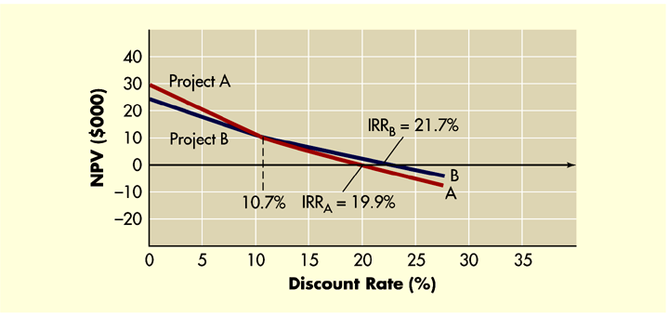
Comparing NPV and IRR
Conflicting Rankings
This can be illustrated by graphically depicting the NPV profile as shown in Figure 11.4 below.
Figure 11.4

Slide 24
Comparing NPV and IRR
Which Approach is Better?
On a purely theoretical basis, NPV is better because it implicitly assumes intermediate cash flows are reinvested at the more conservative cost of capital.
In addition, certain mathematical properties may cause a project with a non-conventional cash flow pattern to have zero or more than one real IRR.
From a practical perspective, financial managers prefer IRR due to their general preference for working with more intuitively appealing rates of return.

Slide 25
Behavioral Approaches for Dealing with Risk
Sensitivity Analysis
Bigpaw Tire Company has a 10% cost of capital and is considering investing in one of two mutually exclusive projects A or B. Each project has a $10,000 initial cost and a useful life of 15 years.
As financial manager, you have provided pessimistic, most-likely, and optimistic estimates of the equal annual cash inflows for each project as shown in Table 11.5.

Slide 26
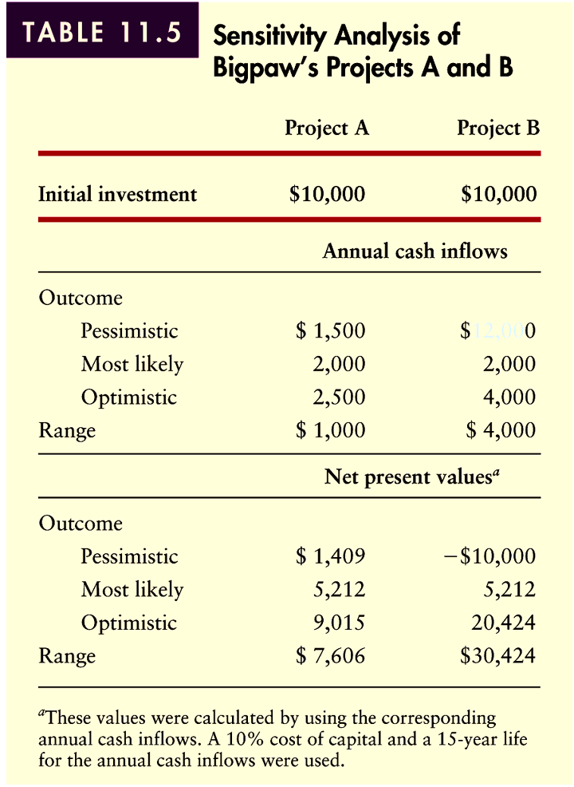
Behavioral Approaches for Dealing with Risk
Sensitivity Analysis
Table 11.5

Slide 27
Behavioral Approaches for Dealing with Risk
Simulation
Simulation is a statistically based behavioral approach that applies predetermined probability distributions and random numbers to estimate risky outcomes.
By tying the various cash flow components together in a mathematical model and repeating the process, the financial manager can develop a probability distribution of projected returns as shown in Figure 11.5.

Slide 28
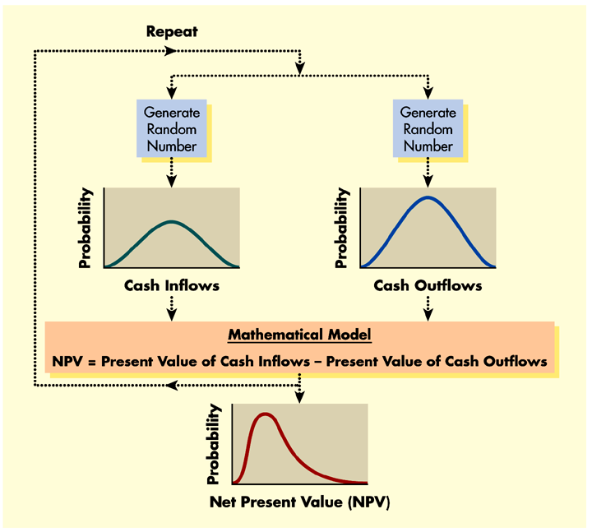
Behavioral Approaches for Dealing with Risk
Simulation
Figure 11.5

Slide 29
Behavioral Approaches for Dealing with Risk
International Risk Considerations
Exchange rate risk refers to the danger that an unexpected change in the exchange rate between the dollar and the currency in which a project’s cash flows are denominated can reduce the value of the project.
Short-term exchange rate risk can be managed by hedging using instruments such as currency futures and options.
Long-term exchange rate risk can be minimized by financing the project in the local currency.

Slide 30
Behavioral Approaches for Dealing with Risk
International Risk Considerations
Political risk is much more difficult to protect against.
Therefore, it is important for managers to account for this risk before making an investment by adjusting project cash inflows or using risk-adjusted discount rates.
Other considerations in international capital budgeting include taxes and transfer pricing.
Finally, it is important that firms view international investments from a strategic view, rather than from a strictly financial perspective.

Slide 31
Risk-Adjusted Discount Rates (RADR)
The risk-adjusted discount rate (RADR) is the rate of return that must be earned on a given project to compensate the firm’s owners adequately.
The higher the risk of a project, the higher the RADR, and therefore the lower the NPV for a given project.

Slide 32
Risk-Adjusted Discount Rates (RADR)
Onlab Company wishes to use the risk-adjusted discount rate approach to determine, according to NPV, whether to implement project A or B.
Onlab’s management after much analysis has assigned a “risk index” of 1.6 to project A and 1.0 to project B. The associated RADR for Onlab’s various risk index measures is given on the following slide. Calculation and results are depicted in Figure 11.6.

Slide 33
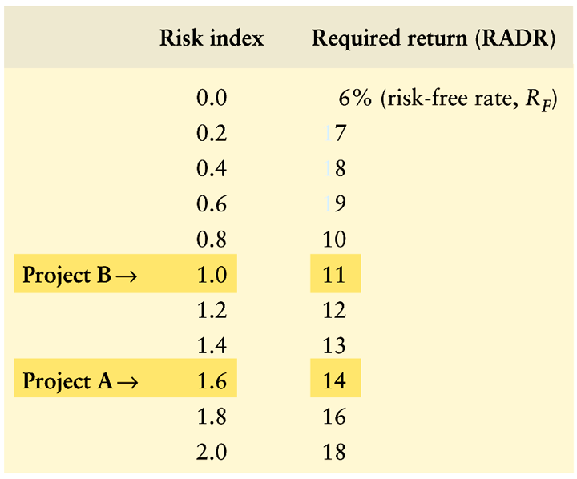
Risk-Adjusted Discount Rates (RADR)

Slide 34
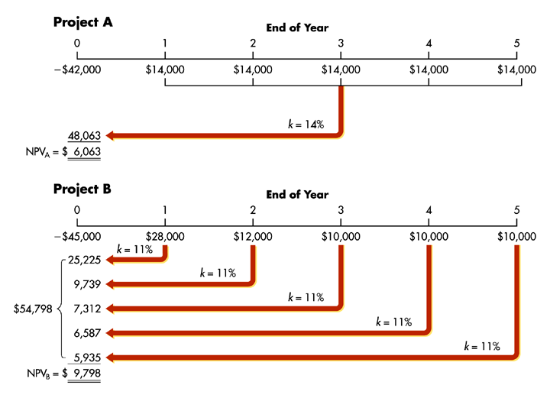
Risk-Adjusted Discount Rates (RADR)
Figure 11.6

Slide 35
Risk-Adjusted Discount Rates (RADR)
The popularity of RADRs stems from two facts:
They are consistent with the general disposition of financial decision makers toward rates of return.
They are easily estimated and applied.
In practice, firms often establish a number of risk classes with RADRs assigned to each class as illustrated in Table 11.6.

Slide 36
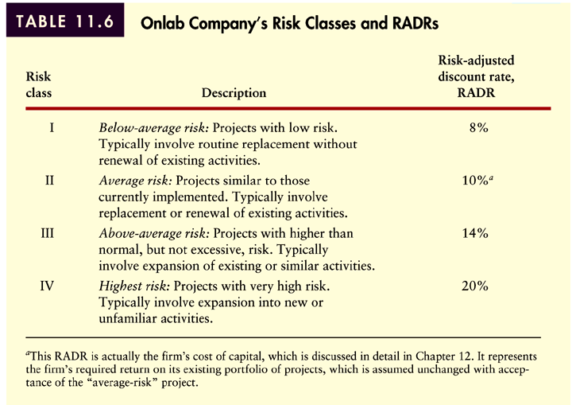
Risk-Adjusted Discount Rates (RADR)
Table 11.6

Slide 37
Chapter
11
Introduction to Finance
Lawrence J. Gitman
Jeff Madura
End of Chapter

Slide 38
SEKIAN DAN TERIMA KASIH

