Slide 1
STRUKTUR MODAL
PERTEMUAN #9
FEB 302
MANAJEMEN KEUANGAN
FAKULTAS EKONOMI DAN BISNIS
UNIVERSITAS ESA UNGGUL

Slide 2
KEMAMPUAN AKHIR YANG DIHARAPKAN
Memahami dan memiliki wawasan tentang:
Perhitungan kebutuhan modal /pendanan perusahaan
Menganalisis kebutuhan modal / pendanaan perusahaan

Slide 3
Chapter
12
Introduction to Finance
Lawrence J. Gitman
Jeff Madura
Cost of Capital

Slide 4
Learning Goals
Understand the basic cost of capital concept and the specific sources of capital it includes.
Determine the cost of long-term debt and the cost of preferred stock.
Calculate the cost of common stock equity and convert it into the cost of retained earnings and the cost of new issues of common stock.

Slide 5
Learning Goals
Find the weighted average cost of capital (WACC).
Describe the procedures used to determine break points and the weighted marginal cost of capital (WMCC).
Explain how the weighted marginal cost of capital can be used with the investment opportunities schedule to make the firm’s financing/investment decisions.

Slide 6
An Overview of the Cost of Capital
The cost of capital is an important financial concept that links the firm’s long-term investment decisions with the wealth of the owners.
It is a “magic number” that is used to decide whether a proposed corporate investment will increase or decrease the firm’s stock price.
The cost of capital is the rate of return that a firm must earn on its project investments to maintain the market value of its stock.

Slide 7
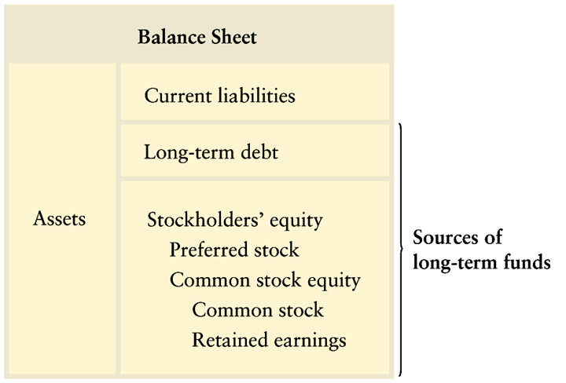
The Firm’s Capital Structure

Slide 8
The Basic Concept
Why do we need to determine a company’s overall “weighted average cost of capital”?
Assume that ABC company has the following investment opportunity:
Initial Investment = $100,000
Useful Life = 20 years
IRR = 7%
Least cost source of financing, Debt = 6%
Given the above information, a firm’s financial manger would be inclined to accept and undertake the investment.

Slide 9
The Basic Concept
Why do we need to determine a company’s overall “weighted average cost of capital?”
Imagine now that only one week later, the firm has another available investment opportunity
Initial investment = $100,000
Useful life = 20 years
IRR = 12%
Least cost source of financing, Equity = 14%
Given the above information, the firm would reject this second, yet clearly more desirable investment opportunity.

Slide 10
The Basic Concept
As the above simple example clearly illustrates, using this piecemeal approach to evaluate investment opportunities is clearly not in the best interest of the firm’s shareholders.
Over the long haul, the firm must undertake investments that maximize firm value.
This can only be achieved if it undertakes projects that provide returns in excess of the firm’s overall weighted average cost of financing (or WACC).

Slide 11
Some Basic Assumptions
Business risk—the risk to the firm of being unable to cover operating costs—is assumed to be unchanged. This means that the acceptance of a given project does not affect the firm’s ability to meet operating costs.
Financial risk—the risk to the firm of being unable to cover required financial obligations—is assumed to be unchanged. This means that the projects are financed in such a way that the firm’s ability to meet financing costs is unchanged.
After-tax costs are considered relevant—the cost of capital is measured on an after-tax basis.

Slide 12
The Cost of Specific Sources of Capital
The After-Tax Cost of Debt (k_{i})
The pre-tax cost of debt is equal to the the yield-to-maturity on the firm’s debt adjusted for flotation costs.
Recall from Chapter 7 that a bond’s yield-to-maturity depends upon a number of factors including the bond’s coupon rate, maturity date, par value, current market conditions, and selling price.
After obtaining the bond’s yield, a simple adjustment must be made to account for the fact that interest is a tax-deductible expense to the issuing firm.

Slide 13
The Cost of Specific Sources of Capital
The After-Tax Cost of Debt (k_{i})
You will recall from Chapter 7 that the YTM on a bond can be calculated in three ways:
Trial and error
Using a financial calculator
Using Microsoft® Excel
We will demonstrate the calculation of the cost of debt using Microsoft® Excel.
Your instructor will review trial and error and/or using a financial calculator as needed.

Slide 14
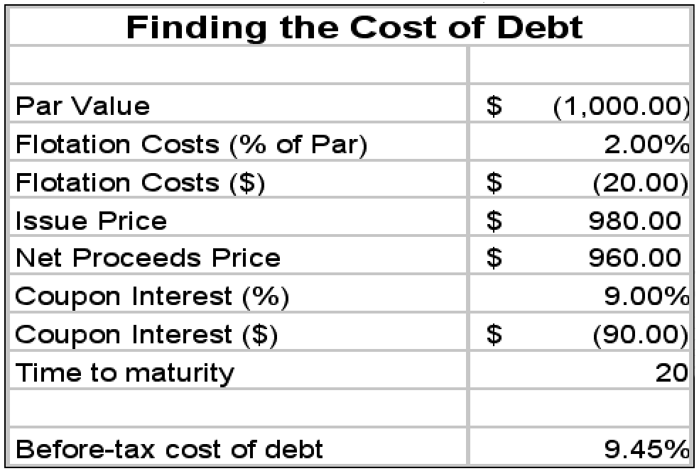
The Cost of Specific Sources of Capital
The After-Tax Cost of Debt (k_{i})
Suppose a company could issue 9% coupon, 20 year debt with a face value of $1,000 for $980. Suppose further that flotation costs will amount to 2% of par value. Find the pre-tax cost of debt.
Microsoft® Excel formula for computing the cost of debt (k_{d}) =RATE(B10,B9,B7,B3)

Slide 15
The Cost of Specific Sources of Capital
The After-Tax Cost of Debt (k_{i})
k_{i} = k_{d} (1 - t)
Find the after-tax cost of debt assuming the company in the previous example is in the 40% tax bracket:
k_{i} = 9.45% (1-.40) = 5.67%
This suggests that the after-tax cost of raising debt capital is 5.67%.

Slide 16
The Cost of Specific Sources of Capital
The Cost of Preferred Stock (k_{p})
k_{p} = D_{p} (P_{p} - F)
In the above equation, F represents flotation costs (in $). As was the case for debt, the cost of raising new preferred stock will be more than the yield on the firm’s existing preferred stock since the firm must pay investment bankers to sell (or float) the issue.

Slide 17
The Cost of Specific Sources of Capital
The Cost of Preferred Stock (k_{p})
k_{p} = D_{p}/(P_{p} - F)
k_{p} = D_{p}/N_{p}
For example, if a company could issue preferred stock that pays a $5 annual dividend, sell it for $55 per share, and have to pay $3 per share to sell it, the cost of preferred stock would be:
k_{p} = $5/($55 - $3) = $5/$52 = 9.62%

Slide 18
The Cost of Specific Sources of Capital
The Cost of Common Equity
There are two forms of common stock financing: retained earnings and new issues of common stock.
In addition, there are two different ways to estimate the cost of common equity: any form of the dividend valuation model and the capital asset pricing model (CAPM).
The dividend valuation models are based on the premise that the value of a share of stock is based on the present value of all future dividends.

Slide 19
The Cost of Specific Sources of Capital
The Cost of Common Equity
Using the constant growth model, we have:
k_{s} = (D₁/P₀) + g
We can also estimate the cost of common equity using the CAPM:
k_{s} = r_{f} + b(k_{m} - r_{f})
The CAPM differs from dividend valuation models in that it explicitly considers the firm’s risk as reflected in beta.

Slide 20
The Cost of Specific Sources of Capital
The Cost of Common Equity
On the other hand, dividend valuation models do not explicitly consider risk.
These models use the market price (P₀) as a reflection of the expected risk-return preference of investors in the marketplace.
Although both are theoretically equivalent, dividend valuation models are often preferred because the data required are more readily available.

Slide 21
The Cost of Specific Sources of Capital
The Cost of Common Equity
The two methods also differ in that the dividend valuation model (unlike the CAPM) can easily be adjusted for flotation costs when estimating the cost of new equity.
This will be demonstrated in the examples that follow.

Slide 22
The Cost of Specific Sources of Capital
The Cost of Common Equity
Cost of retained earnings (k_{s})
Security market line approach
k_{s} = r_{f} + b(k_{m} - r_{f})
For example, if the 3-month T-bill rate is currently 5.0%, the market risk premium is 9%, and the firm’s beta is 1.20, the firm’s cost of retained earnings will be:
k_{s} = 5.0 + 1.2(9) = 15.8%

Slide 23
The Cost of Specific Sources of Capital
The Cost of Common Equity
Cost of retained earnings (k_{s})
Constant dividend growth model
k_{s} = (D₁/P₀) + g
For example, assume a firm has just paid a dividend of $2.50 per share, expects dividends to grow at 10% indefinitely, and is currently selling for $50 per share.
First, D₁ = 2.50(1 + .10) = 2.75, and
k_{s} = (2.75/50) + .10 = 15.5%

Slide 24
The Cost of Specific Sources of Capital
The Cost of Common Equity
Cost of retained earnings (k_{s})
The previous example indicates that our estimate of the cost of retained earnings is somewhere between 15.5% and 15.8%. At this point, we could either choose one or the other estimate or average the two.
Using some managerial judgement and preferring to err on the high side, we will use 15.8% as our final estimate of the cost of retained earnings.

Slide 25
The Cost of Specific Sources of Capital
The Cost of Common Equity
Cost of new equity (k_{n})
Constant dividend growth model
k_{n} = [D₁/(P₀ - F)] + g
Continuing with the previous example, how much would it cost the firm to raise new equity if flotation costs amount to $4.00 per share?
k_{n} = [2.75/(50 - 4)] + .10 = 15.97% or 16%

Slide 26
The Weighted Average Cost of Capital
The weighted average cost of capital (WACC), k_{a}, reflects the expected average future cost of funds over the long run.
It is found by weighting the cost of each specific type of capital by its proportion in the firm’s capital structure.
The calculation of the WACC is straight-forward and is shown on the following slide.

Slide 27
The Weighted Average Cost of Capital
WACC (k_{a}) = w_{i}k_{i} + w_{p}k_{p} + w_{s}k_{s}
Capital Structure Weights
The weights in the above equation are intended to represent a specific financing mix (where w_{i} = % of debt, w_{p} = % of preferred, and w_{s} = % of common).
Specifically, these weights are the target percentages of debt and equity that will minimize the firm’s overall cost of raising funds.

Slide 28
The Weighted Average Cost of Capital
WACC (k_{a}) = w_{i}k_{i} + w_{p}k_{p} + w_{s}k_{s}
Capital Structure Weights
For example, assume the market value of the firm’s debt is $40 million, the market value of the firm’s preferred stock is $10 million, and the market value of the firm’s equity is $50 million.
Dividing each component by the total of $100 million gives us market value weights of 40% debt, 10% preferred, and 50% common.

Slide 29
The Weighted Average Cost of Capital
WACC (k_{a}) = w_{i}k_{i} + w_{p}k_{p} + w_{s}k_{s}
Capital Structure Weights
Using the costs previously calculated along with the market value weights, we may calculate the weighted average cost of capital as follows:
WACC = .4(5.67%) + .1(9.62%) + .5 (15.8%) = 11.13%
This assumes the firm has sufficient retained earnings to fund any anticipated investment projects.

Slide 30
The WMCC and Investment Decisions
The Weighted Marginal Cost of Capital (WMCC)
The WACC typically increases as the volume of new capital raised within a given period increases.
This is true because companies need to raise the return to investors in order to entice them to invest to compensate them for the increased risk introduced by larger volumes of capital raised.
In addition, the cost will eventually increase when the firm runs out of cheaper retained equity and is forced to raise new, more expensive equity capital.

Slide 31
The WMCC and Investment Decisions
The Weighted Marginal Cost of Capital (WMCC)
Finding breaking points
Finding the break points in the WMCC schedule will allow us to determine at what level of new financing the WACC will increase due to the factors listed above.
BP_{j} = AF_{j}/w_{j}
Where:
BP_{j} = breaking point form financing source j
AF_{j} = amount of funds available at a given cost
w_{j} = target capital structure weight for source j

Slide 32
The WMCC and Investment Decisions
The Weighted Marginal Cost of Capital (WMCC)
Finding breaking points
Assume that in the example we have been using that the firm has $2 million of retained earnings available. When it is exhausted, the firm must issue new (more expensive) equity. Furthermore, the company believes it can raise $1 million of cheap debt after which it will cost 7% (after-tax) to raise additional debt.
Given this information, the firm can determine its break points as follows:

Slide 33
The WMCC and Investment Decisions
The Weighted Marginal Cost of Capital (WMCC)
Finding breaking points
This implies that the firm can fund up to $4 million of new investment before it is forced to issue new equity and $2.5 million of new investment before it is forced to raise more expensive debt.
Given this information, we may calculate the WMCC as follows:
BP_{equity} = $2,000,000/.5 = $4,000,000
BP_{debt} = $1,000,000/.4 = $2,500,000

Slide 34
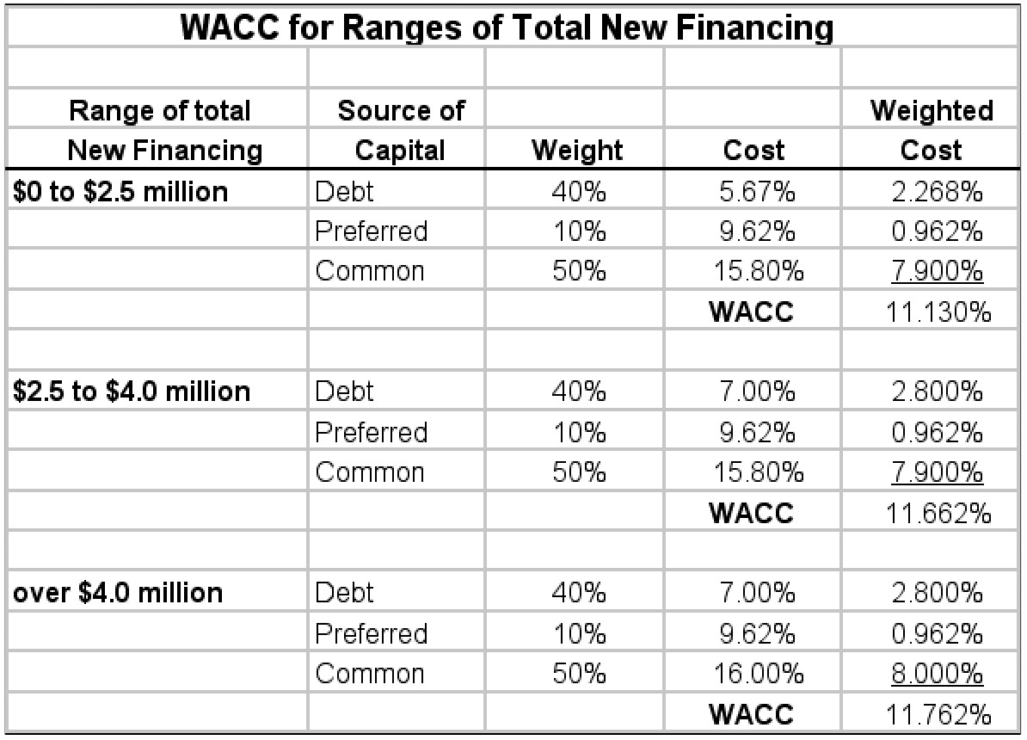
The WMCC and Investment Decisions

Slide 35
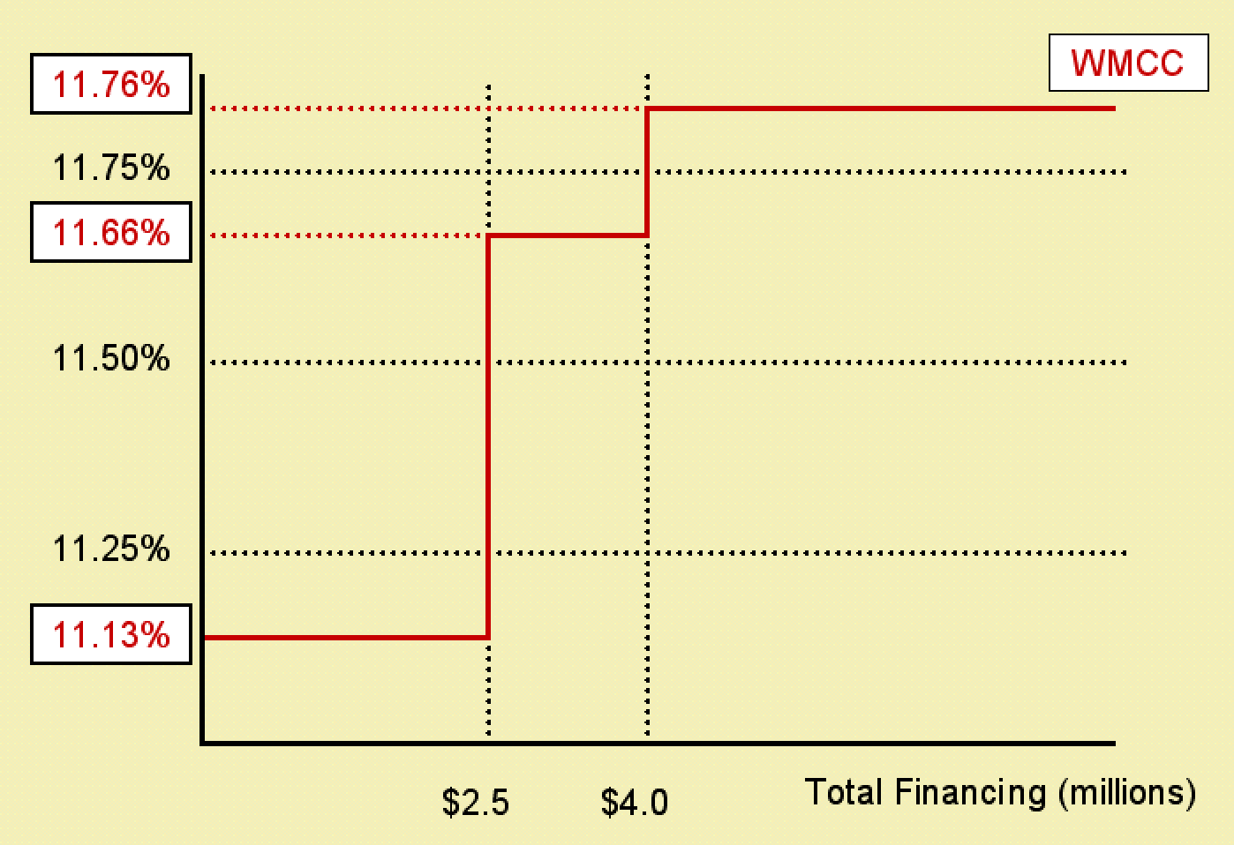
The WMCC and Investment Decisions

Slide 36
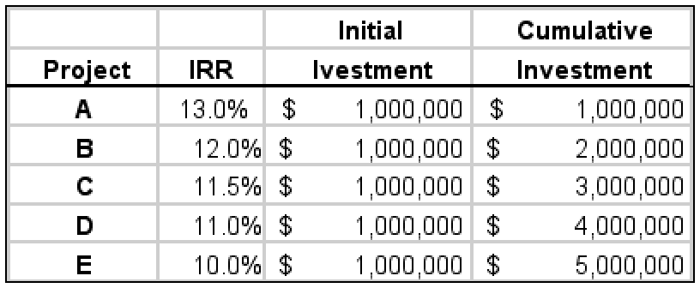
The WMCC and Investment Decisions
Investment Opportunities Schedule (IOS)
Now assume the firm has the following investment opportunities available:
Combining the WMCC with the IOS yields the following:

Slide 37
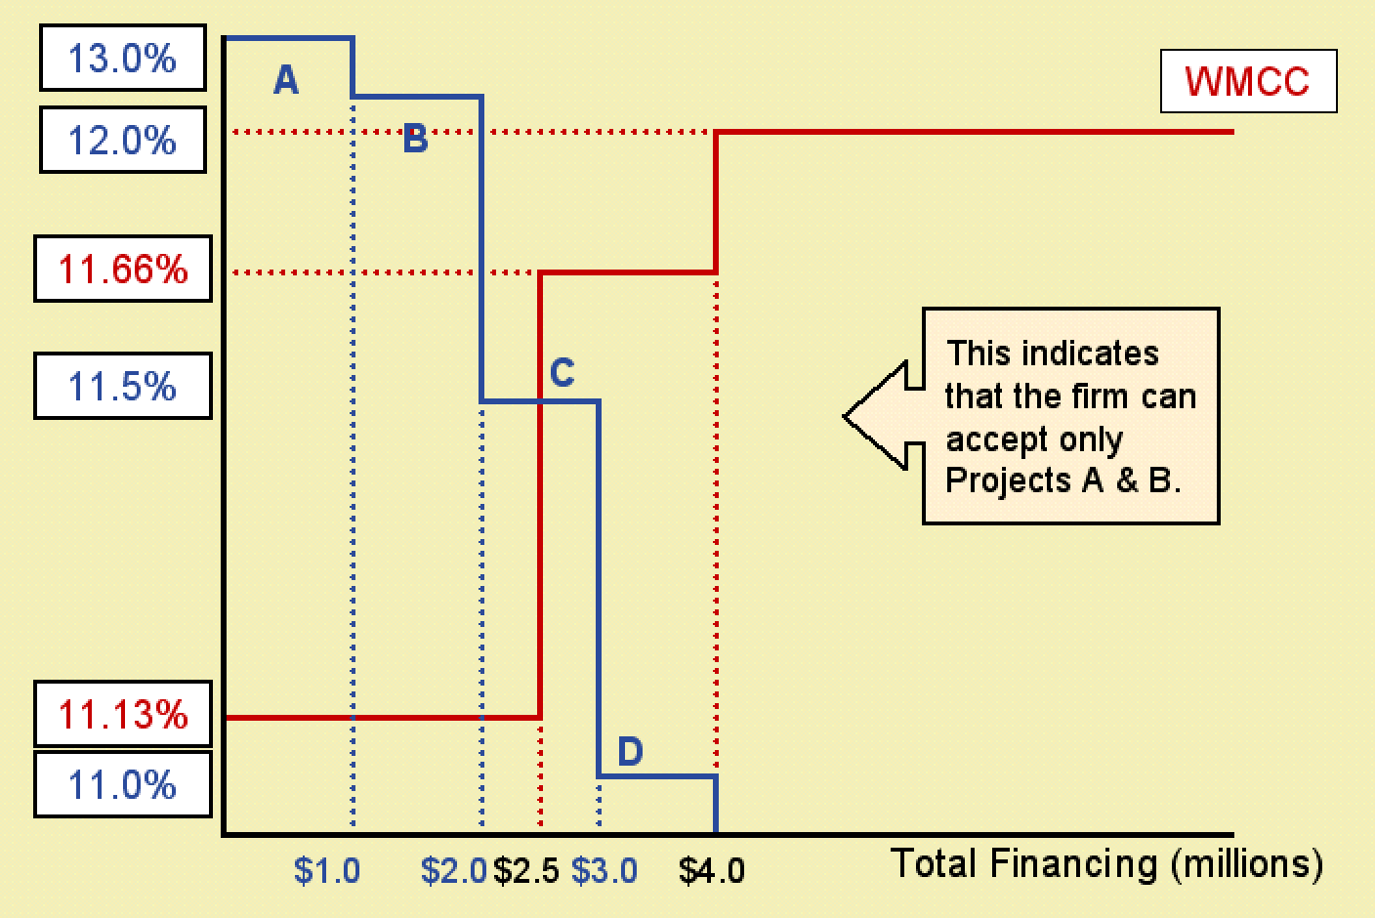
The WMCC and Investment Decisions

Slide 38
Using Microsoft® Excel
The Microsoft® Excel Spreadsheets used in the this presentation can be downloaded from the Introduction to Finance companion web site: http://www.awl.com/gitman_madura

Slide 39
Chapter
12
Introduction to Finance
Lawrence J. Gitman
Jeff Madura
End of Chapter

Slide 40
SEKIAN DAN TERIMA KASIH

