Slide 1
CHAPTER 14
MANAGING PROJECT

Slide 2
14.1. The Importance of Project Management

Slide 3
Management Information Systems
Chapter 14 Project Management: Establishing the Business Value of Systems and Managing Change
The Importance of Project Management
Runaway projects and system failure
Project management objectives
Consequences of Poor Project Management
Without proper management, a systems development project takes longer to complete and most often exceeds the allocated budget. The resulting information system most likely is technically inferior and may not be able to demonstrate any benefits to the organization. Great ideas for systems often flounder on the rocks of implementation.
Figure 14-1

Slide 4
14.2. Selecting Projects

Slide 5
Management Information Systems
Chapter 14 Project Management: Establishing the Business Value of Systems and Managing Change
Selecting Projects
Management structure for information systems projects
Linking systems projects to the business plan
Enterprise analysis and critical success factors
Portfolio analysis
Scoring models

Slide 6
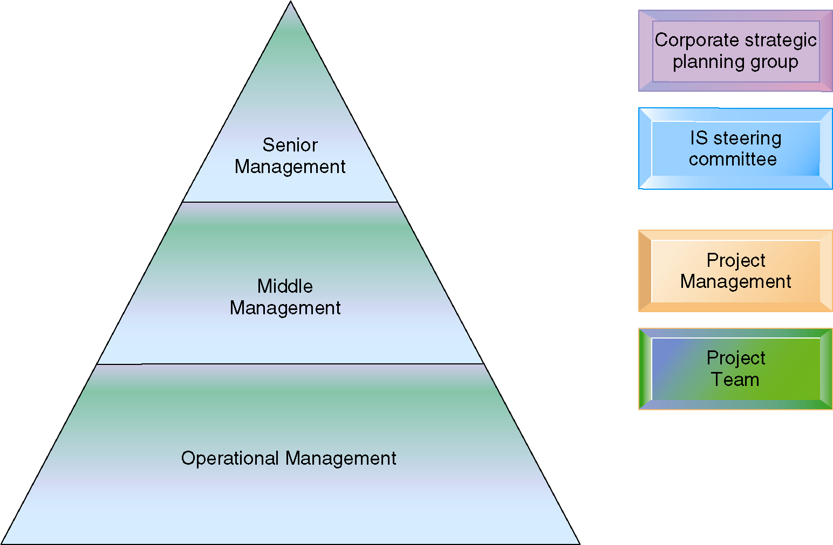
Management Information Systems
Chapter 14 Project Management: Establishing the Business Value of Systems and Managing Change
Selecting Projects
Management Control of Systems Projects
Each level of management in the hierarchy is responsible for specific aspects of systems projects, and this structure helps give priority to the most important systems projects for the organization.
Figure 14-2

Slide 7
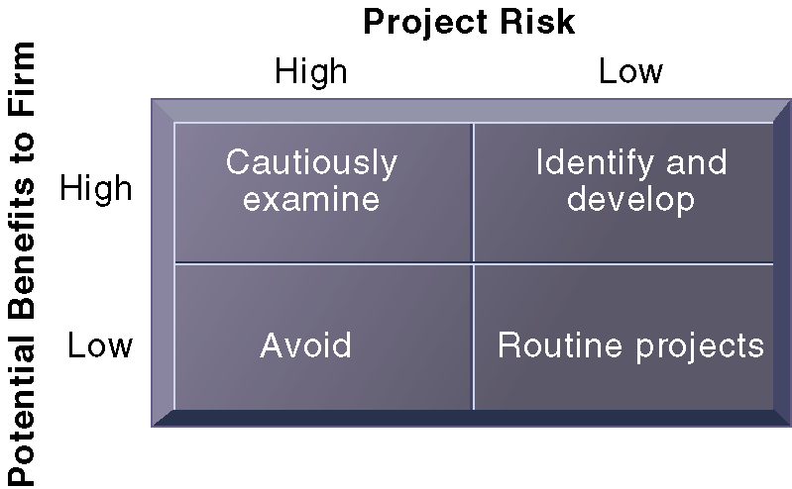
Management Information Systems
Chapter 14 Project Management: Establishing the Business Value of Systems and Managing Change
Selecting Projects
A System Portfolio
Companies should examine their portfolio of projects in terms of potential benefits and likely risks. Certain kinds of projects should be avoided altogether and others developed rapidly. There is no ideal mix. Companies in different industries have different profiles.
Figure 14-5

Slide 8
14.3. Establishing the Business Value of Information
Systems

Slide 9
Management Information Systems
Chapter 14 Project Management: Establishing the Business Value of Systems and Managing Change
Establishing the Business Value of Information Systems
Information system costs and benefits
Capital budgeting for information systems
Case example: Capital budgeting for a new supply chain management system
The payback method
Accounting rate of return on investment (ROI)
Net present value
Internal rate of return (IRR)
Results of the capital budgeting analysis

Slide 10
Management Information Systems
Chapter 14 Project Management: Establishing the Business Value of Systems and Managing Change
Establishing the Business Value of Information Systems
Real options pricing models
Limitations of financial models

Slide 11
14.4. Managing Project Risk

Slide 12
Management Information Systems
Chapter 14 Project Management: Establishing the Business Value of Systems and Managing Change
Managing Project Risk
Dimensions of project risk
Change management and the concept of implementation
The concept of implementation
The role of end users
Management support and commitment
Change management challenges for business process reengineering, enterprise applications, and mergers and acquisitions

Slide 13
Management Information Systems
Chapter 14 Project Management: Establishing the Business Value of Systems and Managing Change
Managing Project Risk
Controlling risk factors
Managing technical complexity
Formal planning and control tools
Increasing user involvement and overcoming user resistance
Designing for the organization
Sociotechnical design
Project management software tools

Slide 14
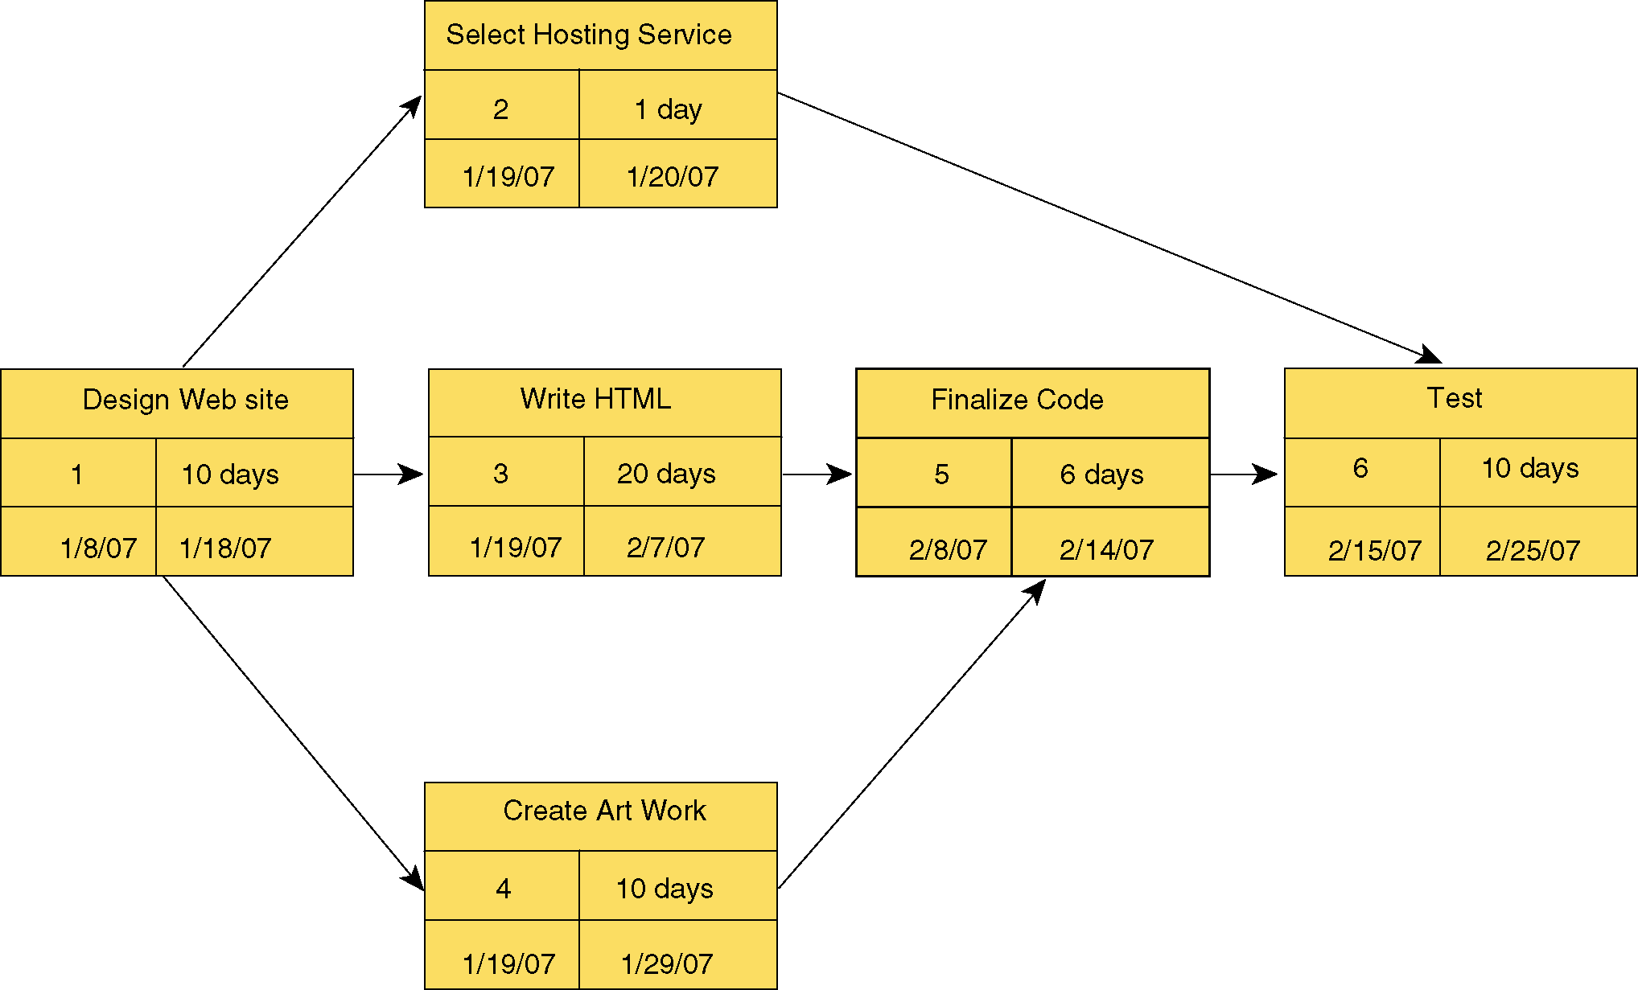
Management Information Systems
Chapter 14 Project Management: Establishing the Business Value of Systems and Managing Change
Managing Project Risk
A PERT Chart
This is a simplified PERT chart for creating a small Web site. It shows the ordering of project tasks and the relationship of a task with preceding and succeeding tasks.
Figure 14-9

Slide 15
Management Information Systems
Chapter 14 Project Management: Establishing the Business Value of Systems and Managing Change
Managing Project Risk
Managing IT in the Merger and Acquisition Game
Read the Interactive Session: Management, and then discuss the following questions:
What are some of the risks involved when one firm acquires another firm’s IT infrastructure?
Why do firms often fail to take the target firm’s information systems and IT infrastructure into account when purchasing other firms?
How would you go about assessing the value of another firm’s IT infrastructure and operational capabilities? What questions would you ask?

Slide 16
Management Information Systems
Chapter 14 Project Management: Establishing the Business Value of Systems and Managing Change
Managing Project Risk
Getting Buy-In and ROI for CRM
Read the Interactive Session: Organizations, and then discuss the following questions:
Why was the director of IT assigned the job of implementing a CRM system? Would this job be better performed by the sales manager?
Why were sales reps reluctant to share customer information with other sales reps? What strategies did Kirstin Johnson use to overcome user resistance? How would you recommend the firm overcome this problem?
What do you think the metrics for CRM success should be in a firm like this? How would you change the sales rep compensation plan to support more effective use of the CRM system?

