Slide 1
CHAPTER 4
ETHICAL AND SOCIAL ISSUES IN INFORMATION SYSTEMS

Slide 2
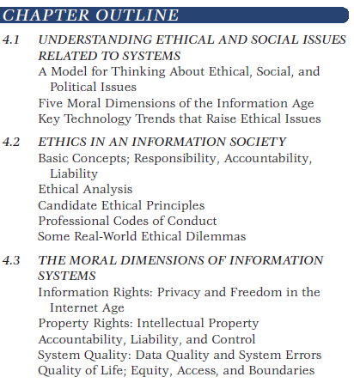

Slide 3
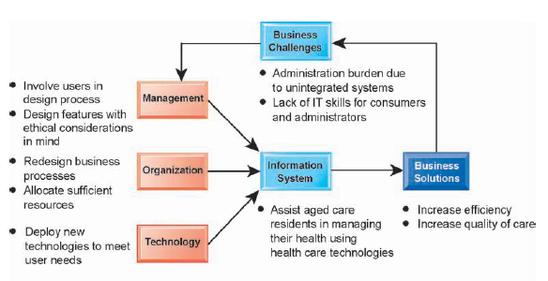

Slide 4
4.1. Understanding Ethical and Social Issues Related to
Systems

Slide 5
Understanding Ethical and Social Issues Related to Systems
Recent cases of failed ethical judgment in business:
Barclay’s Bank, GlaxoSmithKline, Walmart
In many, information systems used to bury decisions from public scrutiny
Ethics
Principles of right and wrong that individuals, acting as free moral agents, use to make choices to guide their behaviors
Notes:
There are numerous examples of business ethical failures to ask students about. You could ask how information systems or their absence might have been related to the current financial crisis in the United States, the investment banks that have suffered heavy losses, and individuals who were able to defraud investors of millions. What role did IS have in this crisis? The Madoff Ponzi scheme is instructive: systems were used for more than twenty years to fool investors, regulators, and investigators about the true nature of Madoff’s business.

Slide 6
Understanding Ethical and Social Issues Related to Systems
Information systems and ethics
Information systems raise new ethical questions because they create opportunities for:
Intense social change, threatening existing distributions of power, money, rights, and obligations
New kinds of crime
Notes:
Ask students to describe some of the ethical dilemmas that are presented by information systems and new developments in technology. Privacy is an important issue—mention the opening case again and explain that the business models of Google, Facebook, and many other sites depend on getting users to give up their personal information so it can be used to market and sell them products.

Slide 7
Understanding Ethical and Social Issues Related to Systems
A model for thinking about ethical, social, and political Issues
Society as a calm pond
IT as rock dropped in pond, creating ripples of new situations not covered by old rules
Social and political institutions cannot respond overnight to these ripples—it may take years to develop etiquette, expectations, laws
Requires understanding of ethics to make choices in legally gray areas
Notes:
Can students provide any examples of how IT has challenged some area of ethics, social life, or legal arrangements?

Slide 8
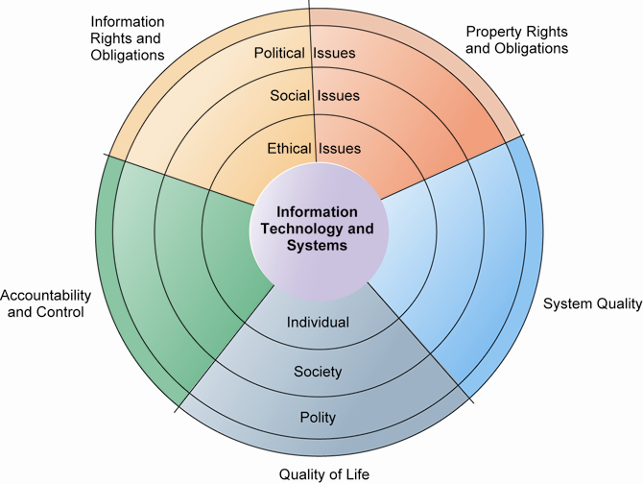
THE RELATIONSHIP AMONG ETHICAL, SOCIAL, POLITICAL ISSUES IN AN INFORMATION SOCIETY
The introduction of new information technology has a ripple effect, raising new ethical, social, and political issues that must be dealt with on the individual, social, and political levels. These issues have five moral dimensions: information rights and obligations, property rights and obligations, system quality, quality of life, and accountability and control.
Notes:
Explain to students that the graphic displays the five moral dimensions listed in the caption. Consider online P2P bit torrent shared music as an example of how a new technology has ethical, social, and eventually political (legal) ramifications. If music can be ripped off, why pay any money for it? Why should anyone care about record labels or artist’s income?

Slide 9
Understanding Ethical and Social Issues Related to Systems
Five moral dimensions of the information age:
Information rights and obligations
Property rights and obligations
Accountability and control
System quality
Quality of life
Notes:
Give examples of each of the five major issues. For example, an issue dealing with information rights might be, what rights do individuals possess with respect to themselves? What do they have a right to protect? An issue dealing with quality of life might be: what values should be preserved in an information- and knowledge-based society? An issue dealing with system quality might be: what standards of data and system quality should we demand to protect individual rights and the safety of society?

Slide 10
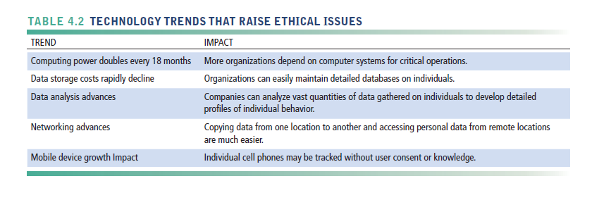
Understanding Ethical and Social Issues Related to Systems
Key technology trends that raise ethical issues
Notes:
Which of these trends do students believe might have the most adverse consequences? Why do they feel this way? Do the positives outweigh the negatives for all four issues? Why or why not?

Slide 11
Understanding Ethical and Social Issues Related to Systems
Advances in data analysis techniques
Profiling
Combining data from multiple sources to create dossiers of detailed information on individuals
Nonobvious relationship awareness (NORA)
Combining data from multiple sources to find obscure hidden connections that might help identify criminals or terrorists
Mobile device growth
Tracking of individual cell phones
Notes:
Online profiling is one of the most controversial computer-related ethical, social, and political issues today. Although it is used fairly extensively on the Internet, it is also used by insurance firms, health insurance firms, casinos, and of course national authorities around the globe for finding potential terrorists.

Slide 12
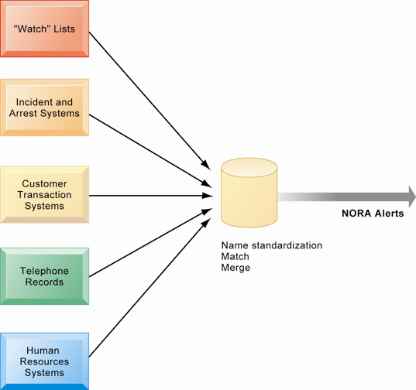
NONOBVIOUS RELATIONSHIP AWARENESS (NORA)
NORA technology can take information about people from disparate sources and find obscure, nonobvious relationships. It might discover, for example, that an applicant for a job at a casino shares a telephone number with a known criminal and issue an alert to the hiring manager.
Notes:
Explain that NORA is used by both the government and the private sector for its profiling capabilities. Ask students to provide potential examples of NORA (other than the one mentioned in the caption) for both governmental and business purposes. One such example might be an airline identifying potential terrorists attempting to board a plane. Another might be government identifying potential terrorists by monitoring phone calls.

Slide 13
4.2. Ethics in an Information Society

Slide 14
Ethics in an Information Society
Basic concepts for ethical analysis
Responsibility:
Accepting the potential costs, duties, and obligations for decisions
Accountability:
Mechanisms for identifying responsible parties
Liability:
Permits individuals (and firms) to recover damages done to them
Due process:
Laws are well-known and understood, with an ability to appeal to higher authorities
Notes:
Explain that information systems do not exist in a vacuum and that these concepts are instrumental in understanding the impact of systems and measuring their success. Ask students why liability and due process are such important ethical concepts? (A rough answer would be that they provide recourse to individuals negatively effected by mismanagement of information systems, providing incentive to “play by the rules”.)

Slide 15
Ethics in an Information Society
Five-step ethical analysis
Identify and clearly describe the facts.
Define the conflict or dilemma and identify the higher-order values involved.
Identify the stakeholders.
Identify the options that you can reasonably take.
Identify the potential consequences of your options.
Notes:
Do students believe that any aspect of ethical analysis is lacking from this process? If so, what? Can students offer a brief example of an ethical dilemma and how they would resolve it using this process? One class exercise is to work with students to identify an ethical situation they are aware of, or that may have been in the news. Then, go through the ethical analysis described in the slide to illustrate the process of analyzing an ethical situation.

Slide 16
Ethics in an Information Society
Candidate ethical principles
Golden Rule
Do unto others as you would have them do unto you.
Immanuel Kant’s Categorical Imperative
If an action is not right for everyone to take, it is not right for anyone.
Descartes’ Rule of Change
If an action cannot be taken repeatedly, it is not right to take at all.
Notes:
Ensure students understand the difference between the categorical imperative and the rule of change. Briefly, the difference is that the categorical imperative spans the entirety of the populace, whereas the rule of change applies to the decisions of one person over time. For example, the categorical imperative applies to an employee who tries to steal money from his employer. He shouldn’t do this, because if all employees attempted to do so, the company would fail. The rule of change applied to the same situation might run as follows: although the employee’s stealing one dollar from the company would not lead to any true problem, repeatedly stealing one dollar, or stealing a lot of dollars, would be unacceptable and ultimately lead to the destruction of the company.

Slide 17
Ethics in an Information Society
Candidate ethical principles (cont.)
Utilitarian Principle
Take the action that achieves the higher or greater value.
Risk Aversion Principle
Take the action that produces the least harm or potential cost.
Ethical “No Free Lunch” Rule
Assume that virtually all tangible and intangible objects are owned by someone unless there is a specific declaration otherwise.
Notes:
How does the “no free lunch” rule relate to copyrights, patents, and trademarks? (These concepts are discussed in later slides.)
Explain that the appearance of unethical behavior is as harmful as actual unethical behavior at times, so adherence to these principles are critical. In an age of “open source software” how does the principle of “no free lunch” work out? Open source software is an example of an economic good which is licensed by the creator for distribution often without charge, or even attribution. In this case, there is a “free lunch.” But it occurs because the creators of the software consent to this arrangement.

Slide 18
Ethics in an Information Society
Professional codes of conduct
Promulgated by associations of professionals
Examples: AMA, ABA, AITP, ACM
Promises by professions to regulate themselves in the general interest of society
Real-world ethical dilemmas
One set of interests pitted against another
Example: right of company to maximize productivity of workers versus workers right to use Internet for short personal tasks
Notes:
Other ethical dilemmas include companies trying to use new systems to reduce the size of their workforce, such as telephone companies using automated systems to reduce the need for human operators. Emphasize that in cases like these, right and wrong are not clearly defined, but instead, contrasting values are at odds with one another (companies value productivity, employees value their work).

Slide 19
4.3. The Moral Dimensions of Information Systems

Slide 20
The Moral Dimensions of Information Systems
1. INFORMATION RIGHTS: PRIVACY AND FREEDOM IN THE INTERNET AGE
Privacy:
Claim of individuals to be left alone, free from surveillance or interference from other individuals, organizations, or state; claim to be able to control information about yourself
In the United States, privacy protected by:
First Amendment (freedom of speech)
Fourth Amendment (unreasonable search and seizure)
Additional federal statues (e.g., Privacy Act of 1974)
Notes:
Do students believe that there are sufficient protections for privacy in law? If not, what are possible methods of developing appropriate privacy protections? Table 4-3 in the text lists a variety of other laws affecting both the government and private institutions, but few areas of the private sector are as well regulated with respect to privacy. Do an in-class poll and ask students who among them feel they can control the use of their personal information on the Internet. You should get no one raising their hand.

Slide 21
The Moral Dimensions of Information Systems
Fair information practices (FIP):
Set of principles governing the collection and use of information
Basis of most U.S. and European privacy laws
Based on mutuality of interest between record holder and individual
Restated and extended by FTC in 1998 to provide guidelines for protecting online privacy
Used to drive changes in privacy legislation
COPPA
Gramm-Leach-Bliley Act
HIPAA
Do-Not-Track Online Act of 2011
Notes:
Explain what is meant by a “mutuality of interest between record holder and individual.” (Briefly, the individual wants to engage in a transaction, and the record holder needs information about the individual to support the transaction—both are interested parties in the transaction.)

Slide 22
The Moral Dimensions of Information Systems
FTC FIP principles:
Notice/awareness (core principle)
Web sites must disclose practices before collecting data.
Choice/consent (core principle)
Consumers must be able to choose how information is used for secondary purposes.
Access/participation
Consumers must be able to review and contest accuracy of personal data.
Notes:
Do students believe that the Web sites they visit actually disclose their data collection and utilization practices? Is it difficult to find where?

Slide 23
The Moral Dimensions of Information Systems
FTC FIP principles (cont.)
Security
Data collectors must take steps to ensure accuracy, security of personal data.
Enforcement
Must be mechanism to enforce FIP principles.
Notes:
These five Fair Information Practices provide the foundation for all privacy legislation in the United States, and much of Europe. You might go to a popular Web site, find its privacy policy, and see how well the site conforms to the principles above. Chances are good that the Web site you choose will have several statements in their policies which permit them to do anything they want with personal information. Also, do a search on “FTC privacy” and go to one of the reports listed. A search on “FTC behavioral targeting” also produces many fine reports on the topic.

Slide 24
The Moral Dimensions of Information Systems
European Directive on Data Protection:
Companies must inform people information is collected and disclose how it is stored and used.
Requires informed consent of customer.
EU member nations cannot transfer personal data to countries without similar privacy protection (e.g., the United States).
U.S. businesses use safe harbor framework.
Self-regulating policy and enforcement that meets objectives of government legislation but does not involve government regulation or enforcement.
Notes:
EU protections of privacy are far more powerful than the United States because they require informed consent before a firm can do anything with personal information besides support the transaction at hand. In Europe, there is no junk postal mail for instance because advertising firms are prohibited from using personal information obtained from third parties, and without the consent of the individual.

Slide 25
The Moral Dimensions of Information Systems
Internet challenges to privacy:
Cookies
Identify browser and track visits to site
Super cookies (Flash cookies)
Web beacons (Web bugs)
Tiny graphics embedded in e-mails and Web pages
Monitor who is reading e-mail message or visiting site
Spyware
Surreptitiously installed on user’s computer
May transmit user’s keystrokes or display unwanted ads
Google services and behavioral targeting
Notes:
What are students attitudes toward these technologies? Emphasize that cookies can be useful at trusted sites, but perhaps invasive at others. Have students had any experience with spyware or Web bugs on their own computers? How would they know they are being tracked?

Slide 26
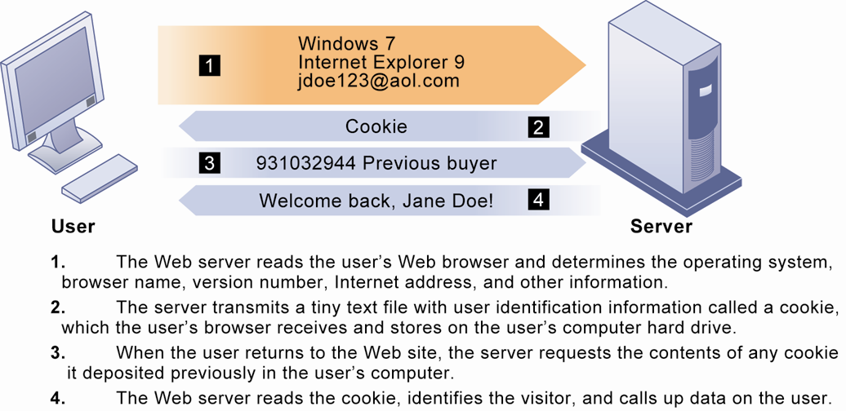
HOW COOKIES IDENTIFY WEB VISITORS
Figure 4-3
Cookies are written by a Web site on a visitor’s hard drive. When the visitor returns to that Web site, the Web server requests the ID number from the cookie and uses it to access the data stored by that server on that visitor. The Web site can then use these data to display personalized information.
Notes:
Ask students to pinpoint where potential privacy invasions might occur in the process shown above. Students may suggest that no real privacy violation is occurring in the figure, which is a legitimate point of view. If so, ask them how they might feel about a Web site they did not trust engaging in the displayed process.

Slide 27
The Moral Dimensions of Information Systems
The United States allows businesses to gather transaction information and use this for other marketing purposes.
Opt-out vs. opt-in model
Online industry promotes self-regulation over privacy legislation.
However, extent of responsibility taken varies:
Complex/ambiguous privacy statements
Opt-out models selected over opt-in
Online “seals” of privacy principles
Notes:
Do students believe that businesses should be pressed to provide more comprehensive privacy protections online? Explain that businesses prefer the looser regulation, but that individuals may not. Also emphasize that most individuals do not take the proper steps to ensure their own privacy in any case. Most people do not know how to protect their privacy online. Does that mean that privacy is unimportant or that people don’t care?

Slide 28
The Moral Dimensions of Information Systems
Technical solutions
E-mail encryption
Anonymity tools
Anti-spyware tools
Browser features
“Private” browsing
“Do not track” options
Overall, few technical solutions

Slide 29
Life on the Grid: iPhone becomes iTrack
Why do mobile phone manufacturers (Apple, Google, and BlackBerry) want to track where their customers go?
Do you think mobile phone customers should be able to turn tracking off? Should customers be informed when they are being tracked? Why or why not?
Do you think mobile phone tracking is a violation of a person’s privacy?
Notes:
Does tracking cell phones cause harm to people? What harm could result?

Slide 30
The Moral Dimensions of Information Systems
2. PROPERTY RIGHTS: INTELLECTUAL PROPERTY
Intellectual property: intangible property of any kind created by individuals or corporations
Three main ways that intellectual property is protected:
Trade secret: intellectual work or product belonging to business, not in the public domain
Copyright: statutory grant protecting intellectual property from being copied for the life of the author, plus 70 years
Patents: grants creator of invention an exclusive monopoly on ideas behind invention for 20 years
Notes:
Do students believe that the property rights guaranteed by trade secrets, copyrights, and patents are strong enough to avoid the theft of intellectual property online? Give an example of a trade secret (the formula for Coke; a method of doing business or business process). Give an example of a copyright (which could include the copyright of a photo or newspaper article). And give an example of a patent (such as Amazon’s One Click shopping as a business process patent, or Kodak’s claim to have a patent on digital still cameras with digital displays for a viewfinder).

Slide 31
The Moral Dimensions of Information Systems
Challenges to intellectual property rights
Digital media different from physical media (e.g., books)
Ease of replication
Ease of transmission (networks, Internet)
Difficulty in classifying software
Compactness
Difficulties in establishing uniqueness
Digital Millennium Copyright Act (DMCA)
Makes it illegal to circumvent technology-based protections of copyrighted materials
Notes:
Students may be unwilling to admit to infringing upon intellectual property rights themselves, but ask them whether they are familiar with the Internet and its ability to bypass intellectual property protections. Do they believe that legislation such as the DMCA is having any effect? How many have friends who download “free” music from P2P sights? Free videos?

Slide 32
The Moral Dimensions of Information Systems
3. ACCOUNTABILITY, LIABILITY, CONTROL
Computer-related liability problems
If software fails, who is responsible?
If seen as part of machine that injures or harms, software producer and operator may be liable.
If seen as similar to book, difficult to hold author/publisher responsible.
What should liability be if software seen as service? Would this be similar to telephone systems not being liable for transmitted messages?
Notes:
Using the example from the text, who do students consider to be the liable party for the incident involving Bank of America customers whose paychecks were denied due to an operating error at the bank’s computer center? Is it the designers of the systems at the center? Is there no liability involved? Explain that it is difficult to ascribe liability to software developers for the same reason that it is difficult to ascribe a publisher liability for the effects of a book.

Slide 33
The Moral Dimensions of Information Systems
4. SYSTEM QUALITY: DATA QUALITY AND SYSTEM
ERRORS
What is an acceptable, technologically feasible level of system quality?
Flawless software is economically unfeasible.
Three principal sources of poor system performance:
Software bugs, errors
Hardware or facility failures
Poor input data quality (most common source of business system failure)
Notes:
Do students have any opinion about when software is “good enough?” Does it depend on the particular product? For example, distinguish between software used by air traffic controllers and software used for word processing. Do students believe that there are different levels of acceptable quality for these products?

Slide 34
The Moral Dimensions of Information Systems
5. QUALITY OF LIFE: EQUITY, ACCESS, BOUNDARIES
Negative social consequences of systems
Balancing power: although computing power decentralizing, key decision making remains centralized
Rapidity of change: businesses may not have enough time to respond to global competition
Maintaining boundaries: computing, Internet use lengthens work-day, infringes on family, personal time
Dependence and vulnerability: public and private organizations ever more dependent on computer systems
Notes:
Ask students whether they have witnessed any of these negative consequences first hand. It’s likely that they know someone who has become dependent on their computer to some extent or have even experienced something similar first hand. Which of the above consequences do students feel is the most alarming?

Slide 35
The Moral Dimensions of Information Systems
Computer crime and abuse
Computer crime: commission of illegal acts through use of computer or against a computer system—computer may be object or instrument of crime
Computer abuse: unethical acts, not illegal
Spam: high costs for businesses in dealing with spam
Employment:
Reengineering work resulting in lost jobs
Equity and access—the digital divide:
Certain ethnic and income groups in the United States less likely to have computers or Internet access
Notes:
Ask students what experience they have had with spam. A notable statistic is that spam accounts for more than 75% of all e-mail traffic and is relatively unlikely to decrease, because it is so difficult to regulate and so cheap to send.
Do students believe that the end result of continuing advances in information technology will be rising unemployment and a small number of elite corporate professionals? Students may enjoy debating this idea, which is somewhat far-fetched, but conceptually stimulating. There is some evidence that today’s manufacturing technology (including robots and computer controlled machines) is displacing factory jobs.

Slide 36
The Moral Dimensions of Information Systems
Health risks:
Repetitive stress injury (RSI)
Largest source is computer keyboards
Carpal tunnel syndrome (CTS)
Computer vision syndrome (CVS)
Eyestrain and headaches related to screen use
Technostress
Aggravation, impatience, fatigue
Notes:
Have students encountered any of these health risks, either from personal experience or from someone they know?

