Slide 1
Chapter
7
Telecommunications, the Internet, and Wireless Technology

Slide 2
Management Information Systems
Chapter 7 Telecommunications, the Internet, and Wireless Technology
LEARNING OBJECTIVES
Describe the features of telecommunications networks and identify key networking technologies.
Evaluate alternative transmission media, types of networks, and network services.
Demonstrate how the Internet and Internet technology work and how they support communication and e-business.

Slide 3
Management Information Systems
Chapter 7 Telecommunications, the Internet, and Wireless Technology
LEARNING OBJECTIVES (cont’d)
Identify and describe the principal technologies and standards for wireless networking, communication, and Internet access.
Assess the business value of wireless technology and important wireless applications in business.

Slide 4
Management Information Systems
Chapter 7 Telecommunications, the Internet, and Wireless Technology
Hyatt Regency Osaka Uses Wireless Networking for High-Touch Service
Problem: Overcoming poor location and steep competition.
Solutions: Deploy IP network, wireless LAN, and wireless clients with links to customer database to increase service and revenue.
Wireless mobile access to customer systems and wireless data and voice services enable employees to work more efficiently and focus on customers.
Demonstrates IT’s role in providing superior customer service and redesigning processes and job functions.
Illustrates digital technology’s ability to overcome business weaknesses by creating new strengths.

Slide 5
Management Information Systems
Chapter 7 Telecommunications, the Internet, and Wireless Technology
Telecommunications and Networking in Today’s Business World
Networking and communication trends
What is a computer network?
Networks in large companies
Key digital networking technologies
Client/server computing
Packet switching
TCP/IP and connectivity

Slide 6
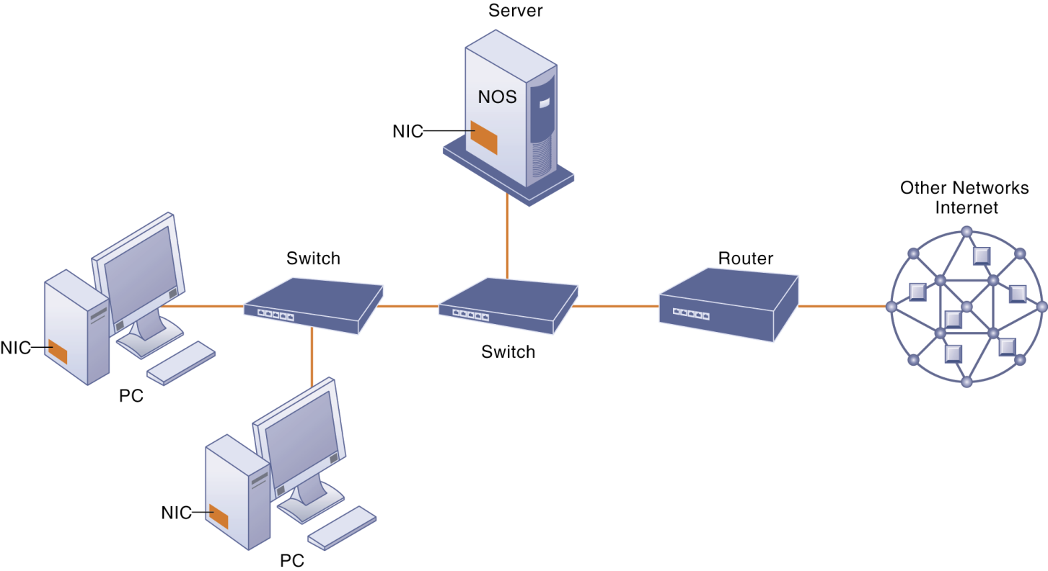
Management Information Systems
Chapter 7 Telecommunications, the Internet, and Wireless Technology
Telecommunications and Networking in Today’s Business World
Components of a Simple Computer Network
Illustrated here is a very simple computer network, consisting of computers, a network operating system residing on a dedicated server computer, cable (wiring) connecting the devices, network interface cards (NIC), switches, and a router.
Figure 7-1

Slide 7
Management Information Systems
Chapter 7 Telecommunications, the Internet, and Wireless Technology
Communications Networks
Signals: digital vs. analog
Types of networks
Local area networks
Metropolitan and wide area networks
Physical transmission media
Twisted wire
Coaxial cable
Fiber optics and optical networks
Wireless transmission media and devices
Transmission speed
Broadband network services and technologies

Slide 8
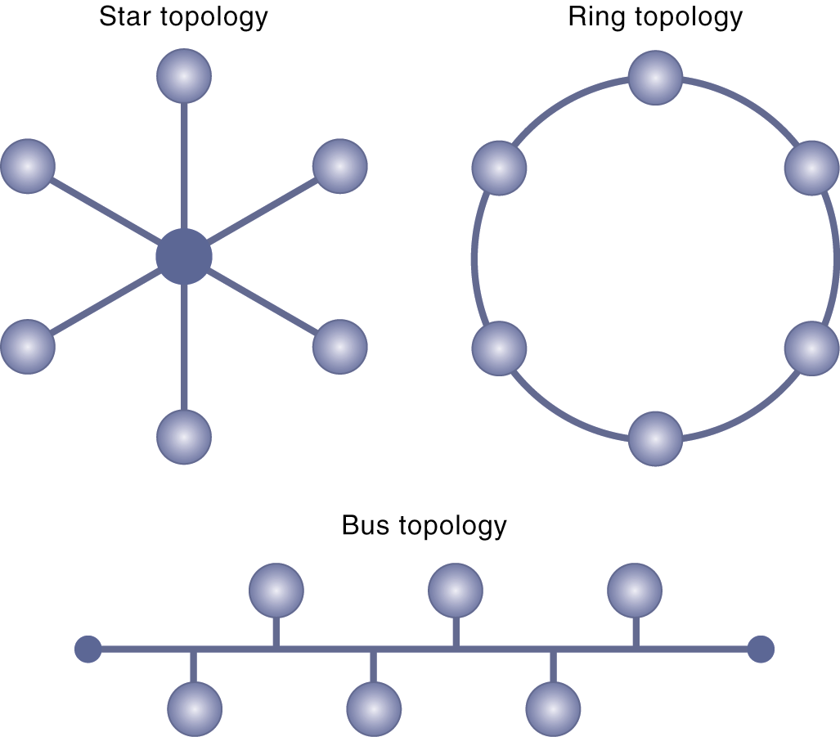
Management Information Systems
Chapter 7 Telecommunications, the Internet, and Wireless Technology
Communications Networks
Network Topologies
The three basic network topologies are the bus, star, and ring.
Figure 7-6

Slide 9
Management Information Systems
Chapter 7 Telecommunications, the Internet, and Wireless Technology
The Internet
What is the Internet?
Internet addressing and architecture
The Domain Name System
Internet architecture and governance
The future Internet: IPv6 and Internet2
Internet services
The World Wide Web
Hypertext
Web servers
Searching for information on the Web
Web 2.0

Slide 10
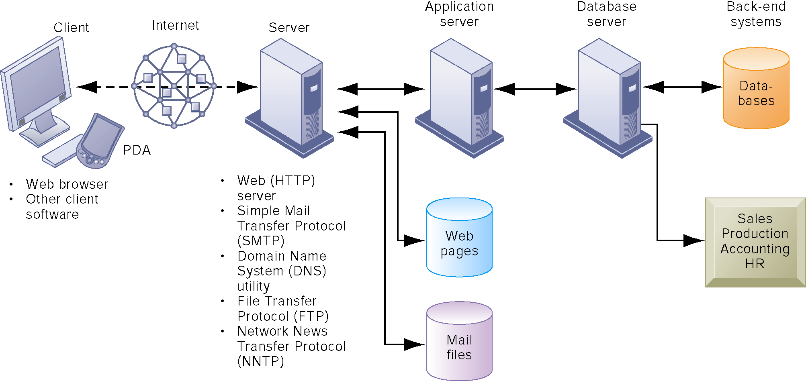
Management Information Systems
Chapter 7 Telecommunications, the Internet, and Wireless Technology
The Internet
Client/Server Computing on the Internet
Client computers running Web browser and other software can access an array of services on servers over the Internet. These services may all run on a single server or on multiple specialized servers.
Figure 7-10

Slide 11
Management Information Systems
Chapter 7 Telecommunications, the Internet, and Wireless Technology
The Internet
Intranets and extranets
Technologies and tools for communication and e-business
E-mail, chat, instant messaging, and electronic discussions
Internet telephony
Virtual private networks

Slide 12
Management Information Systems
Chapter 7 Telecommunications, the Internet, and Wireless Technology
The Internet
Monitoring Employees on Networks: Unethical or Good Business?
Read the Interactive Session: Management, and then discuss the following questions:
Should managers monitor employee e-mail and Internet usage? Why or why not?
Describe an effective e-mail and Web use policy for a company.

Slide 13
Management Information Systems
Chapter 7 Telecommunications, the Internet, and Wireless Technology
The Wireless Revolution
Wireless devices
Cellular systems
Cellular network standards and generations
Mobile wireless standards for Web access
Wireless computer networks and Internet access
Bluetooth
Wi-Fi
Wi-Fi and wireless Internet access
WiMax
Broadband cellular wireless and emerging wireless services
RFID and wireless sensor networks

Slide 14
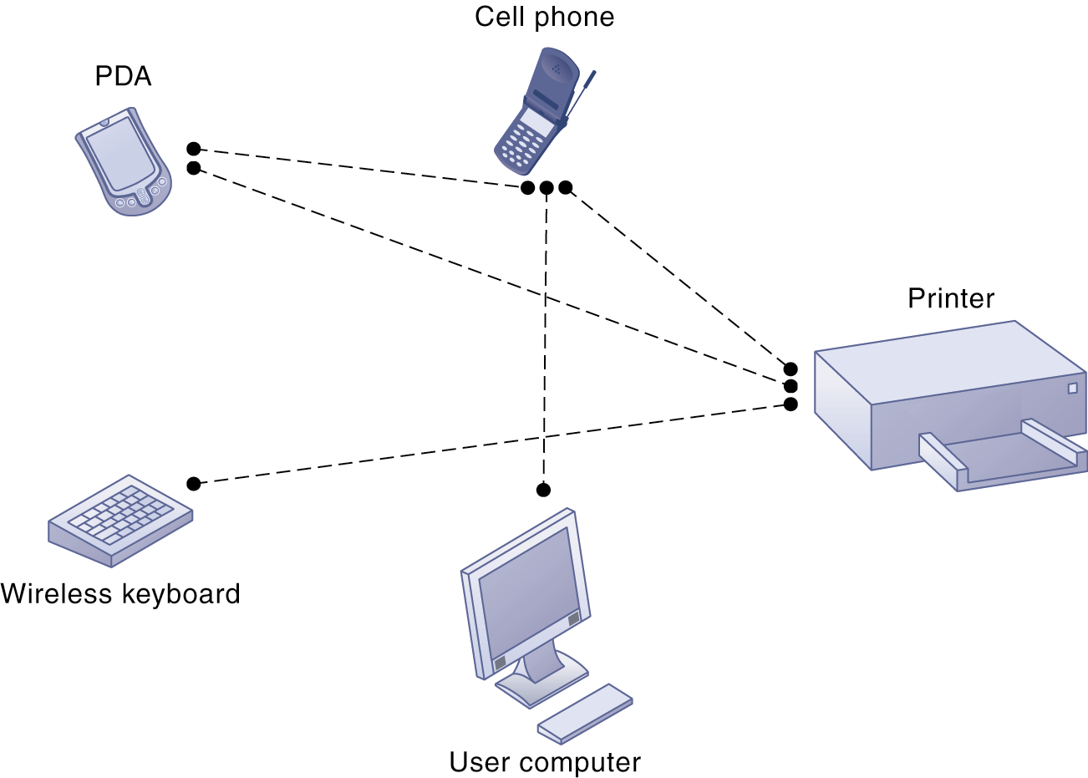
Management Information Systems
Chapter 7 Telecommunications, the Internet, and Wireless Technology
The Wireless Revolution
A Bluetooth Network (PAN)
Bluetooth enables a variety of devices, including cell phones, PDAs, wireless keyboards and mice, PCs, and printers, to interact wirelessly with each other within a small 30-foot (10-meter) area. In addition to the links shown, Bluetooth can be used to network similar devices to send data from one PC to another, for example.
Figure 7-16

Slide 15
Management Information Systems
Chapter 7 Telecommunications, the Internet, and Wireless Technology
The Wireless Revolution
Wal-Mart Grapples with RFID
Read the Interactive Session: Organizations, and then discuss the following questions:
How is RFID technology related to Wal-Mart’s business model? How does it benefit suppliers?
What management, organization, and technology factors explain why Wal-Mart suppliers had trouble implementing RFID systems?
What conditions would make adopting RFID more favorable for suppliers?
Should Wal-Mart require all its suppliers to use RFID? Why or why not? Explain your answer.

