Slide 1
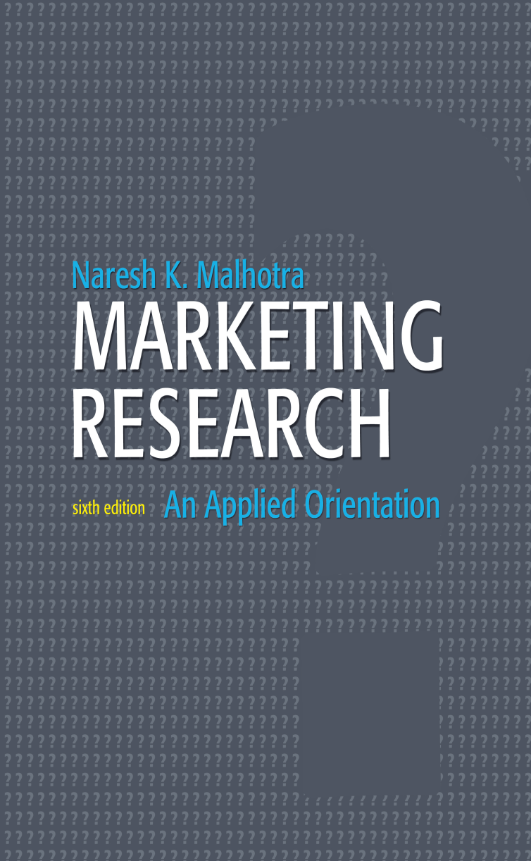
Introduction and Early Phases of Marketing Research
Chapter 1

Slide 2
Chapter Outline
1) Overview
2) Definition of Marketing Research
3) A Classification of Marketing Research
4) Marketing Research Process
5) The Role of Marketing Research in Marketing Decision Making
6) Marketing Research and Competitive Intelligence
7) The Decision to Conduct Research

Slide 3
Chapter Outline
8) Marketing Research Suppliers and Services
9) Selecting a Research Supplier
10) Careers in Marketing Research
11) The Role of Marketing Research in MIS and DSS
12) The Department Store Project
13) International Marketing Research
14) Ethics in Marketing Research
15) Summary

Slide 4
Real Research
Boeing: Taking Flight
-premier Manufacturer of commercial jetliners for more than 40 years.
-Provide products & services to customers in 145 countries
-Headquarter in Chicago
-Boeing has 13,000 commercial jetliners in service worldwide (75% of the world fleet)
Boeing Commercial Airplanes (BCA) division develops and sell airplanes in the commercial segment.

Slide 5
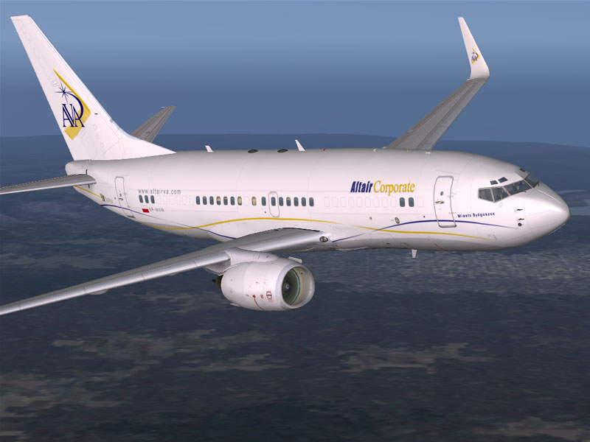
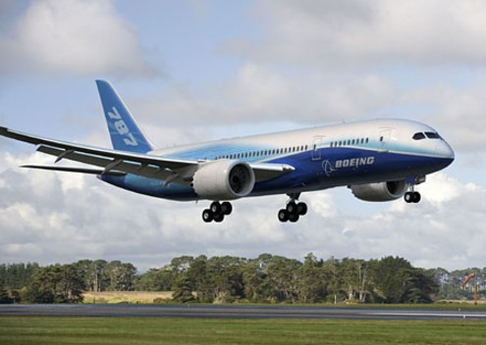

Slide 6
Boeing: Taking Flight
In the airplanes Manufacturing industry there is few players, but the competition is intense.
The BCA understand it is important to continuously monitor the dynamic marketplace and understand the needs & priorities of BCA customers.
Customers (airlines) and their customers (people who fly).
To achieve this, CBA employ marketing research on a regular basis.

Slide 7
Boeing: Taking Flight
Boeing entrusted Harris Interactive Inc.
Harris Interactive Inc. is one of the largest research firms in the world and is based on NY.
Boeing commissioned a study to determine the aircraft preference of fliers.
“What we found was that travelers taking very long flights generally prefer the more convenient and flexible experience provided by small planes” Dr. David Bakken

Slide 8
The Study
The study was survey based on 913 interviews conducted in the United Kingdom, Tokyo and Hong Kong.
International travelers aged 18 and over who had taken at least one recent eight-hour or longer flight.
Interviews were conducted b/w Nov. 2003 & Feb. 2004.
Respondents were first screened and qualified by telephone or in-person.
Then completed an online survey at home or work.

Slide 9
Results
More than 60% prefer a single-passenger airplane to double-deck, 550-passenger airplane for nonstop flights.
Seven out of 10 travelers prefer a non-stop trip on a single.
Travelers in all the classes of service from all three regions believe smaller airplanes will provide a better experience with check-in, boarding, disembarking, baggage claim, and customs or immigration than the 550-seat aircraft.

Slide 10
Redefining Marketing Research
The American Marketing Association (AMA) redefined Marketing Research as:
The function that links the consumer, the
customer, and public to the marketer
through INFORMATION

Slide 11
Redefining Marketing Research
Used to identify and define market opportunities and problems
Information
Generate, refine, and evaluate marketing performance
Monitor marketing performance
Improve understanding of marketing as a process

Slide 12
Definition of Marketing Research
Marketing research is the systematic and objective
identification
collection
analysis
dissemination
and use of information
For the purpose of improving decision making related to the
identification and
solution of problems and opportunities in marketing

Slide 13
Market Research
Specifies the information necessary to address these issues
Manages and implements the data collection process
Analyzes the results
Communicates the findings and their implications
Helps managers use this information to make decisions

Slide 14
Classification of Marketing Research
Problem-Identification Research
Research undertaken to help identify problems which are not necessarily apparent on the surface and yet exist or are likely to arise in the future. Examples: market potential, market share, image, market characteristics, sales analysis, forecasting, and trends research.
Problem-Solving Research
Research undertaken to help solve specific marketing problems. Examples: segmentation, product, pricing, promotion, and distribution research.

Slide 15
A Classification of Marketing Research
Fig. 1.1
Marketing Research
Problem
Identification Research
Problem-Solving Research
Market Potential Research
Market Share Research
Market Characteristics Research
Sales Analysis Research
Forecasting Research
Business Trends Research
Segmentation Research
Product Research
Pricing Research
Promotion Research
Distribution Research

Slide 16
Problem-Solving Research
Table 1.1
SEGMENTATION RESEARCH
Determine the basis of segmentation
Establish market potential and responsiveness for various segments
Select target markets
Create lifestyle profiles: demography, media, and product image characteristics
PRODUCT RESEARCH
Test concept
Determine optimal product design
Package tests
Product modification
Brand positioning and repositioning
Test marketing
Control score tests

Slide 17
Problem-Solving Research
Table 1.1 cont.
PROMOTIONAL RESEARCH
Optimal promotional budget
Sales promotion relationship
Optimal promotional mix
Copy decisions
Media decisions
Creative advertising testing
Evaluation of advertising effectiveness
Claim substantiation
0.00%
APR
PRICING RESEARCH
Pricing policies
Importance of price in brand selection
Product line pricing
Price elasticity of demand
Initiating and responding to price changes
$ALE

Slide 18
Problem-Solving Research
Table 1.1 cont.
DISTRIBUTION RESEARCH
Determine…
Types of distribution
Attitudes of channel members
Intensity of wholesale & resale coverage
Channel margins
Location of retail and wholesale outlets

Slide 19
Marketing Research Process
Step 1 : Problem Definition
Step 2 : Development of an Approach to the Problem
Step 3 : Research Design Formulation
Step 4 : Fieldwork or Data Collection
Step 5 : Data Preparation and Analysis
Step 6 : Report Preparation and Presentation

Slide 20
Marketing Research Process
Step 1: Defining the Problem
Step 2: Developing an Approach to the Problem
Step 3: Formulating a Research Design
Step 4: Doing Field Work or Collecting Data
Step 5: Preparing and Analyzing Data
Step 6: Preparing and Presenting the Report

Slide 21
The Role of Marketing Research
Fig. 1.2
Customer Groups
Consumers
Employees
Shareholders
Suppliers
Uncontrollable
Controllable
Environmental
Marketing
Factors
Variables
Marketing
Economy
Technology
Laws & Regulations
Social & Cultural Factors
Political Factors
Product
Pricing
Promotion
Distribution
Research
Assessing
Providing
Marketing
Information
Information
Decision
Needs
Making
Marketing Managers
Market Segmentation
Target Market Selection
Marketing Programs
Performance & Control

Slide 22
Power Decisions’ Methodology
Fig. 1.3
Opportunity scan
Solve Problem
Option generation
Refine options
Decision
Client
Needs
Find
Seek
Plan
Act
Achieve Goal
How We
Help
Research
Evaluate
Interpret
Facilitate
Market Plan
Advise
Assist
Execution
Clarify
Decisions
Analysis
Recommend
Research

Slide 23
Marketing Research Suppliers & Services
Fig. 1.4
RESEARCH
SUPPLIERS
INTERNAL
EXTERNAL
FULL SERVICE
LIMITED SERVICE
Syndicate
Services
Internet
Services
Field
Services
Other
Services
Customized
Services
Standardized
Services
Focus Groups
and Qualitative
Services
Technical
and Analytical
Services

Slide 24
Table 1.2 Top 50 U.S. Marketing Research Firms
U.S. Rank Organization Headquarters Website U.S. Global Non-U.S.
2007 2006
1 1 | The Nielsen Co. | New York | nielsen.com | $2,173.0 | $4,220.0 | 48.5%
2 2 | IMS Health Inc. | Norwalk, Conn. | imshealth.com | 801.0 | 2,192.6 | 63.5
3 3 | Kantar Group* | Fairfield, Conn. | kantargroup.com | 526.8 | 1,551.4 | 66.0
4 5 | Westat Inc. | Rockville, MD | westat.com | 467.8 | 467.8 | —
5 4 | IRI | Chicago | infores.com | 441.0 | 702.0 | 37.2
6 6 | TNS U.S. | New York | tnsglobal.com | 379.8 | 2,137.2 | 82.2
7 7 | Arbitron Inc. | New York | arbitron.com | 338.5 | 352.1 | 3.9
8 8 | GfK AG USA | Nuremberg, Germany | gfk.com | 319.7 | 1,603.00 | 80.1
9 9 | Ipsos | New York | ipsos-na.com | 281.2 | 1,270.30 | 77.9
10 10 | Synovate | London | synovate.com | 250.4 | 867.0 | 71.1
11 11 | Maritz Research | Fenton, Mo. | maritzresearch.com | 187.4 | 223.3 | 16.1
12 13 | J.D. Power and Associates* | Westlake Village, Calif. | jdpower.com | 184.5 | 260.5 | 29.2
13 12 | Harris Interactive Inc. | Rochester, N.Y. | harrisinteractive.com | 161.0 | 227.0 | 29.1
14 14 | The NPD Group Inc. | Port Washington, N.Y. | npd.com | 160.4 | 211.1 | 24.0
15 — | Opinion Research/ Guideline Group | Omaha, Neb. | infousa.com | 124.7 | 206.7 | 39.7
15 | Opinion Research Corp. | Princeton, N.J. | opinionresearch.com | 97.5 | 179.5 | 45.7

Slide 25
Table 1.2 Top 50 U.S. Marketing Research Firms (Cont…)
U.S. Rank Organization Headquarters Website U.S. Global Non-U.S.
2007 2006
38 | Guideline Inc. | New York | guideline.com | 26.8 | 26.8 | —
16 18 | comScore Inc. | Reston, Va. | comscore.com | 77.0 | 87.2 | 11.7
17 20 | Market Strategies Inc. | Livonia, Mich. | marketstrategies.com | 75.7 | 80.4 | 5.8
20 | Market Strategies Inc. | Livonia, Mich. | markestrategies.com | 53.4 | 58.1 | 8.1
37 | Flake-Wilkerson Market Insights | Little Rock, Ark. | fw-mi.com | 22.3 | 22.3 | —
18 17 | Lieberman Research Worldwide | Los Angeles | Irwonline.com | 71.0 | 87.4 | 18.8
19 — | Abt Associates Inc. | Cambridge, Mass. | abtassociates.com | 55.1 | 55.1 | —
19 | Abt Associates Inc. | Cambridge, Mass. | abtassociates.com | 33.0 | 33.0 | —
41 | Abt SRBI Inc. | New York | srbi.com | 22.1 | 22.1 | —
20 23 | OTX | Los Angeles | otxresearch.com | 50.8 | 54.5 | 6.8
21 21 | Burke Inc. | Cincinnati | burke.com | 47.0 | 53.1 | 11.5
22 22 | MVL Group Inc. | Jupiter, Fla. | mvlgroup.com | 42.3 | 42.3 | —
23 26 | Knowledge Networks Inc. | Menlo Park, Calif. | knowledgenetworks.com | 37.3 | 37.3 | —
23 25 | National Research Corp. | Lincoln, Neb. | nationalresearch.com | 37.3 | 41.3 | 9.7
25 24 | Directions Research Inc. | Cincinnati | directionsresearch.com | 37.2 | 37.2 | —
26 40 | Phoenix Marketing International | Rhineback, N.Y. | phoenixmi.com | 33.5 | 34.9 | 4.0

Slide 26
Table 1.2 Top 50 U.S. Marketing Research Firms (Cont…)
U.S. Rank Organization Headquarters Website U.S. Global Non-U.S.
2007 2006
27 34 | Lieberman Research Group | Great Neck, N.Y. | liebermanresearch.com | 30.1 | 30.1 | —
28 27 | ICR/Int'l Communications Research | Media, Pa. | icrsurvey.com | 28.8 | 29.7 | 3.0
29 28 | Morpace Inc. | Farmington Hills, Mich. | morpace.com | 28.7 | 33.2 | 13.6
30 33 | MarketCast | Los Angeles | marketcastonline.com | 25.1 | 25.1
31 36 | Data Development Worldwide | New York | datadw.com | 25.0 | 25.3 | 1.2
32 39 | C&R Research Services Inc. | Chicago | crresearch.com | 23.6 | 23.6 | —
33 32 | Informa Research Services Inc. | Calabasas, Calif. | informars.com | 23.5 | 23.5 | —
34 31 | National Analysts Worldwide | Philadelphia | nationalanalysts.com | 23.3 | 23.3 | —
35 44 | Service Management Group | Kansas City, Mo. | servicemanagement.com | 22.4 | 23.0 | 2.6
36 34 | Market Probe Inc. | Milwaukee | marketprobe.com | 21.7 | 41.4 | 47.6
37 — | Hitwise | New York | hitwise.com | 21.6 | 49.9 | 56.7
38 42 | Walker Information | Indianapolis | walkerinfo.com | 21.2 | 25.5 | 16.9
39 43 | KS&R Inc. | Syracuse, N.Y. | ksrinc.com | 17.1 | 21.0 | 18.6
40 47 | Bellomy Research Inc. | Winston-Salem, N.C. | bellomyresearch.com | 16.7 | 16.7 | —
41 46 | MarketVision Research Inc. | Cincinnati | marketvisionresearch.com | 16.4 | 16.4 | —
42 28 | Public Opinion Strategies | Alexandra, Va. | pos.org | 15.5 | 15.5 | —

Slide 27
Table 1.2 Top 50 U.S. Marketing Research Firms (Cont…)
U.S. Rank Organization Headquarters Website U.S. Global Non-U.S.
2007 2006
43 — | Compete Inc. | Boston | compete.com | 14.9 | 14.9 | —
44 45 | Savitz Research Companies | Dallas | savitzresearch.com | 14.8 | 14.8 | —
45 48 | RDA Group Inc. | Bloomfield Hills, Mich. | rdagroup.com | 13.7 | 16.8 | 18.5
46 — | Gongos Research Inc. | Auburn Hills, Mich. | gongos.com | 13.3 | 13.3 | —
47 — | Q Research Solutions Inc. | Old Bridge, N.J. | whoisq.com | 13.0 | 13.2 | 1.5
48 49 | Marketing Analysts Inc. | Charleston, S.C. | marketinganalysts.com | 12.8 | 13.6 | 5.9
49 50 | RTi Market Research & Brand Strategy | Stamford, Conn. | rtiresearch.com | 12.2 | 12.2 | —
50 — | The Link Group | Atlanta | the-link-group.com | 11.9 | 13.3 | 10.5
 |  |  | Total | $7.828.7 | $17,638.0 | 55.6%
 |  |  | All other (150 CASRO companies not included in the Top 50) | $774.3 | $870.1 | 11.0%
 |  |  | Total (200 companies) | $8,603.0 | $18,508.1 | 53.5%
*Estimated by Top 50. U.S. and worldwide revenue may include nonresearch activities for some companies that are significantly higher. Rate of growth from year to year has been adjusted so as not to include revenue gains or losses from acquisitions or divestitures. Total revenue of 150 survey research companies that provide financial information on a confidential basis to CASRO.

Slide 28
Selected Marketing Research Career Descriptions
Fig. 1.5
Vice President of Marketing Research: The senior position in marketing research. The vice president (VP) is responsible for the entire marketing research operation of the company and serves on the top management team. This person sets the objectives and goals of the marketing research department.
Research Director: Also a senior position. The research director has the general responsibility for the development and execution of all the marketing research projects.
Assistant Director of Research: Serves as an administrative assistant to the director and supervises some of the other marketing research staff members.
(Senior) Project Manager: Has overall responsibility for design, implementation, and management of research projects.
Statistician/Data Processing Specialist: Serves as an expert on theory and application of statistical techniques. Responsibilities include experimental design, data processing, and analysis.

Slide 29
Selected Marketing Research Career Descriptions
Fig. 1.5 cont.
Research Director
Also part of senior management
Heads the development and execution of all research projects
Vice President of Marketing Research
Part of company’s top management team
Directs company’s entire market research operation
Sets the goals & objectives of the marketing research department
Assistant Director of Research
Administrative assistant to director
Supervises research staff members
Senior Project Manager
Responsible for design, implementation, & research projects

Slide 30
Selected Marketing Research Career Descriptions
Fig. 1.5 cont.
Senior Analyst
Participates in the development of projects
Carries out execution of assigned projects
Coordinates the efforts of analyst, junior analyst, & other personnel in the development of research design and data collection
Prepares final report
Analyst
Handles details in execution of project
Designs & pretests questionnaires
Conducts preliminary analysis of data
Statistician/Data Processing
Serves as expert on theory and application on statistical techniques
Oversees experimental design, data processing, and analysis
Junior Analyst
Secondary data analysis
Edits and codes questionnaires
Conducts preliminary analysis of data
Fieldwork Director
Handles selection, training, supervision, and evaluation of interviewers and field workers

Slide 31
Marketing Research Suppliers & Services
Internal suppliers
External suppliers
Full-service suppliers
Syndicated services
Standardized services
Customized services
Internet services
Limited-service suppliers
Field services
Focus groups and qualitative services
Technical and analytical services
Other services

Slide 32
Criteria for Selecting a Research Supplier
What is the reputation of the supplier?
Do they complete projects on schedule?
Are they known for maintaining ethical standards?
Are they flexible?
Are their research projects of high quality?
What kind and how much experience does the supplier have? Has the firm had experience with projects similar to this one?
Do the supplier's personnel have both technical and non-technical expertise?
Can they communicate well with the client?
Competitive bids should be compared on the basis of quality as well as price.

Slide 33
Careers in Marketing Research
Career opportunities are available with marketing research firms (e.g., AC Nielsen, Burke)
Careers in business and non-business firms and agencies with in-house marketing research departments (e.g., Procter & Gamble, Coca-Cola, the Federal Trade Commission, United States Census Bureau)
Advertising agencies (e.g., BBDO International, Ogilvy & Mather, J. Walter Thompson)
Positions: VP of marketing research, research director/assistant director, project manager, field work director, statistician/data processing specialist, senior/junior analyst, and supervisor

Slide 34
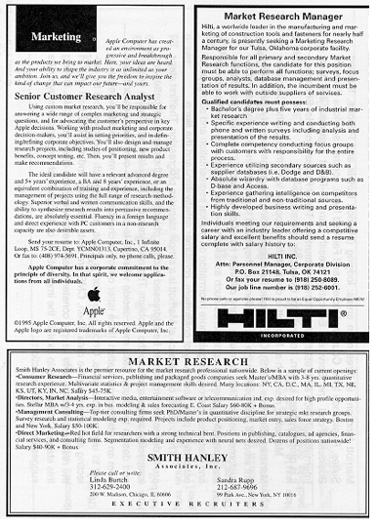
A Sample of Marketing Research Jobs

Slide 35
Preparation for a Career in Marketing Research
Take all the marketing courses you can.
Take courses in statistics and quantitative methods.
Acquire Internet and computer skills. Knowledge of programming languages is an added asset.
Take courses in psychology and consumer behavior.
Acquire effective written and verbal communication skills.
Think creatively. Creativity and common sense command a premium in marketing research.

Slide 36
Management Information Systems Vs. Decision Support Systems
Fig. 1.6
MIS
DSS
Structured Problems
Use of Reports
Rigid Structure
Information Displaying Restricted
Can Improve Decision Making by Clarifying Data
Unstructured Problems
Use of Models
User Friendly Interaction
Adaptability
Can Improve Decision Making by Using “What if” Analysis

Slide 37
The Department Store Project
The following information was solicited:
1. Familiarity with the ten department stores
2. Frequency with which household members shopped at each of the ten stores
3. Relative importance attached to each of the eight factors of the choice criteria
4. Evaluation of the ten stores on each of the eight factors of the choice criteria
5. Preference ratings for each store
6. Rankings of the ten stores (from most preferred to least preferred)
7. Degree of agreement with 21 lifestyle statements
8. Standard demographic characteristics (age, education, etc.)
9. Name, address, and telephone number

Slide 38
Marketing Research Associations Online
Domestic
AAPOR : American Association for Public Opinion Research (www.aapor.org)
AMA : American Marketing Association (www.ama.org)
ARF : The Advertising Research Foundation (www.amic.com/arf)
CASRO : The Council of American Survey Research Organizations (www.casro.org)
MRA : Marketing Research Association (www.mra-net.org)
QRCA : Qualitative Research Consultants Association (www.qrca.org)
RIC : Research Industry Coalition (www.researchindustry.org)

Slide 39
Marketing Research Associations Online
International
ESOMAR: European Society for Opinion and Marketing Research (www.esomar.nl)
MRS: The Market Research Society (UK) (www.marketresearch.org.uk)
MRSA: The Market Research Society of Australia (www.mrsa.com.au)
PMRS: The Professional Marketing Research Society (Canada) (www.pmrs-aprm.com)

Slide 43
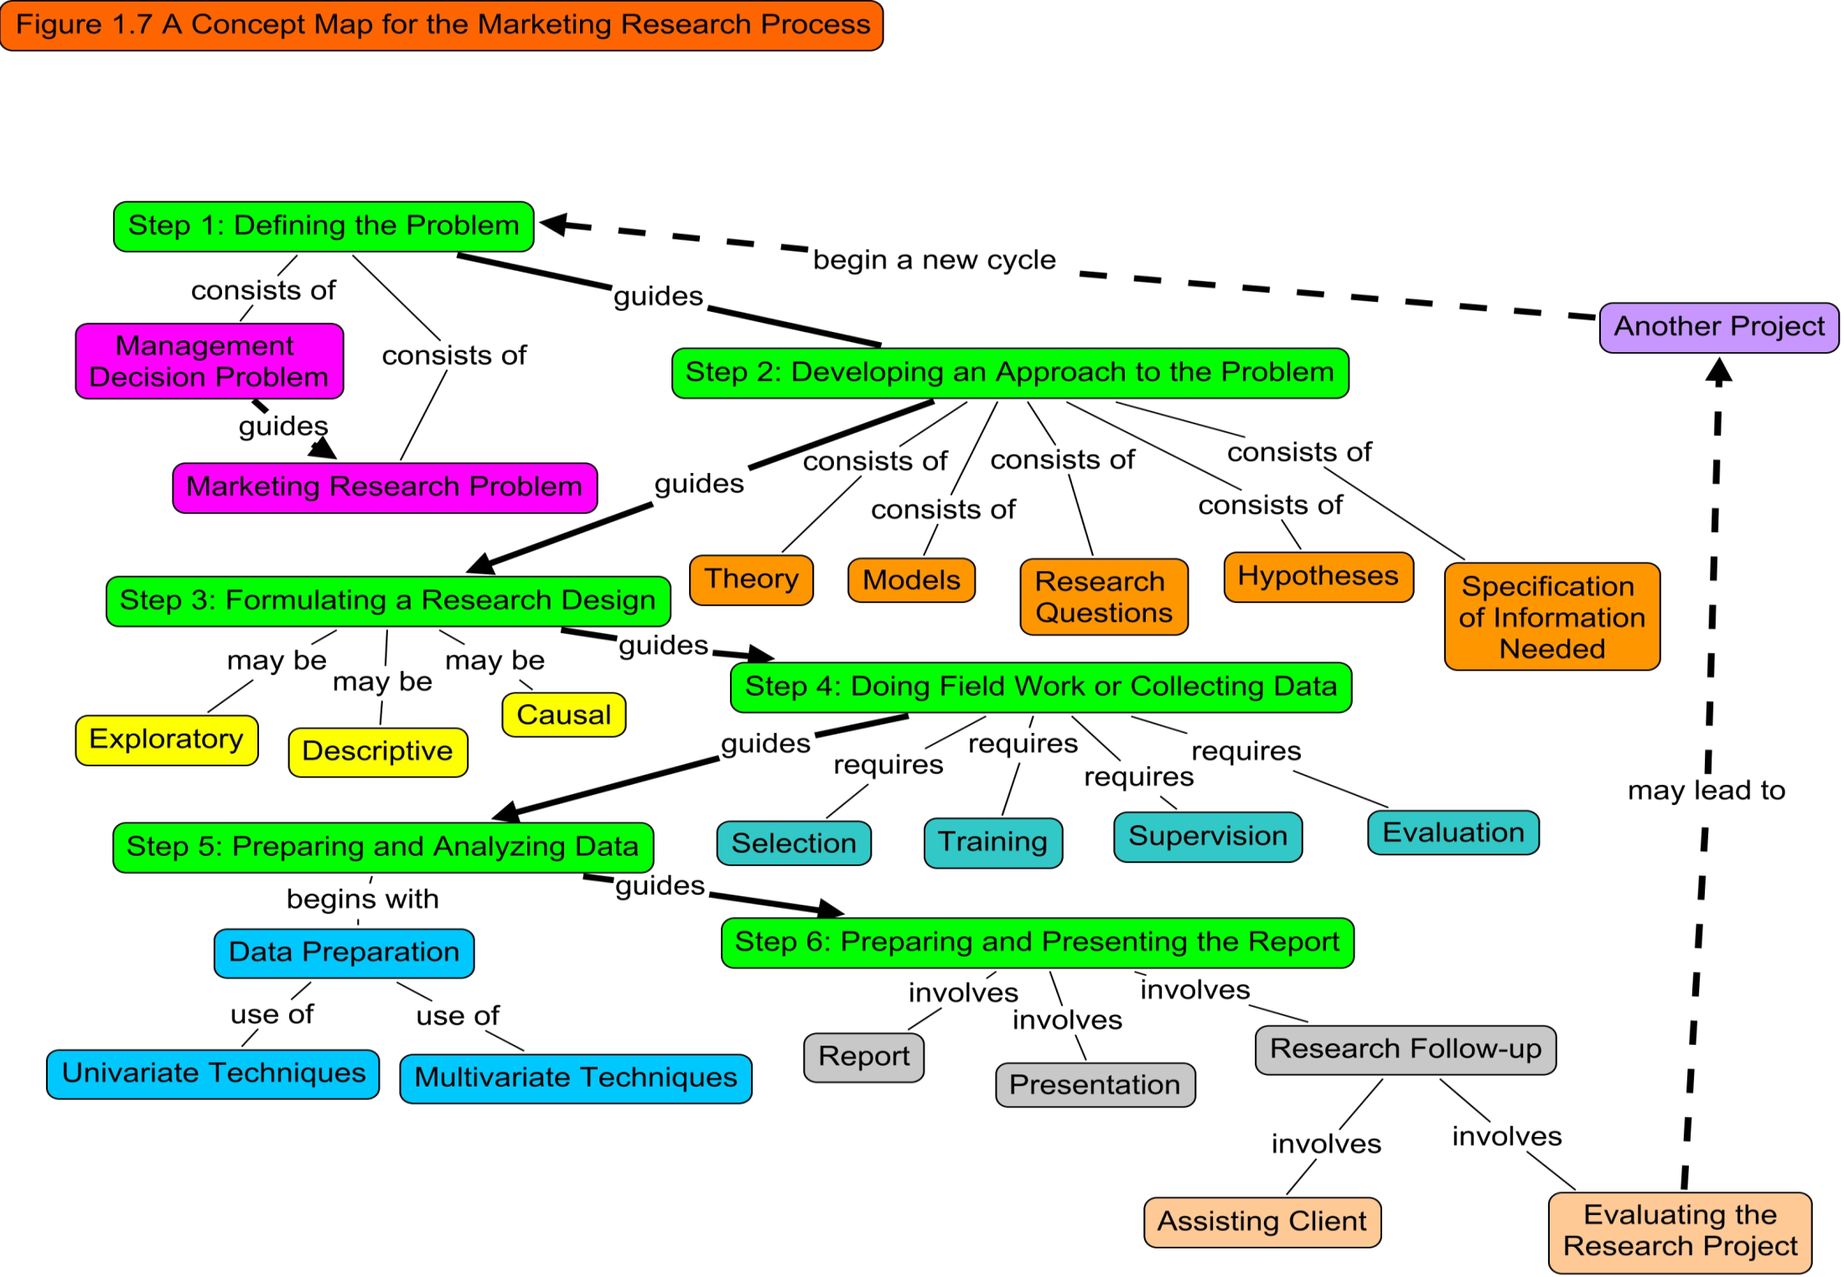

Slide 44
All rights reserved. No part of this publication may be reproduced, stored in a retrieval system, or transmitted, in any form or by any means, electronic, mechanical, photocopying, recording, or otherwise, without the prior written permission of the publisher. Printed in the United States of America.
Copyright © 2010 Pearson Education, Inc. publishing as Prentice Hall

