Slide 1
Chapter Eleven
Sampling: Design and Procedures
Copyright © 2010 Pearson Education, Inc.

Slide 2
1. Chapter Outline
1) Overview
2) The Sampling Design Process
3) A Classification of Sampling Techniques
4) Nonprobability Sampling
5) Probability Sampling
6) Choosing Nonprobability Versus Probability Sampling

Slide 3
2. The Sampling Design Process
A. Define the Population
B. Determine the Sampling Frame
C. Select Sampling Technique(s)
D. Determine the Sample Size
E. Execute the Sampling Process

Slide 4
2. The Sampling Design Process: Define the Target Population
Define the Target Population
The target population is the collection of elements/objects/people that possess the information sought by the researcher and about which inferences are to be made. The target population should be defined in terms of:
An element is the object about which or from which the information is desired
e.g., a person in the population.
A sampling unit is an element that is available for selection at some stage of the sampling process.
E.g., a respondent who takes your survey
Extent refers to the geographical boundaries.
Time is the time period under consideration.

Slide 5
2. The Sampling Design Process: Define the Target Population
Important factors in determining the sample size are:
the nature of the research
Surveys need more people; qualitative interviews need less
the number of variables
More variables = more people
the nature of the analysis
Certain methods require more people – e.g. t-tests need more than simple averages.
sample sizes used in similar studies

Slide 6
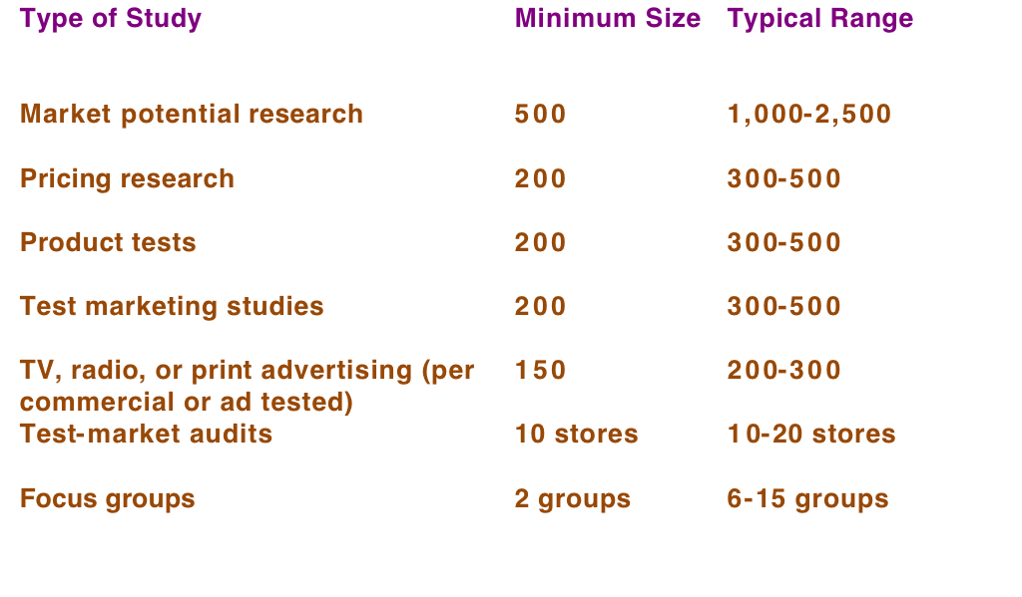
2. Sample Sizes Used in Marketing Research Studies

Slide 7
3. Classification of Sampling Techniques
Sampling Techniques
Nonprobability
Sampling Techniques
Probability
Sampling Techniques
Convenience
Sampling
Judgmental
Sampling
Quota
Sampling
Snowball
Sampling
Simple Random
Sampling
Systematic
Sampling
Stratified
Sampling
Cluster
Sampling

Slide 8
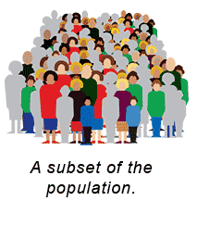
3. Classification of Sampling Techniques
A probability sampling scheme is
one in which every unit in the
population has a chance (greater
than zero) of being selected in the
sample.
Nonprobability sampling is any sampling method where some elements of the population have no chance of selection
these are sometimes referred to as 'out of coverage'/'undercovered'.

Slide 9
4. Nonprobability Sampling - Convenience Sampling
Nonprobability sampling techniques include:
convenience, judgmental, quota, and snowball sampling
Convenience sampling attempts to obtain a sample of convenient elements. Often, respondents are selected because they happen to be in the right place at the right time. Examples:
Use of student respondents
Members of social organizations
“People on the street” interviews

Slide 10
4. Nonprobability Sampling - Judgmental Sampling
Judgmental sampling is a form of nonprobability sampling in which the population elements are selected based on the judgment of the researcher.
Examples:
Test markets.
e.g. Columbus, OH
Bellwether precincts (precincts that indicate broader trends) selected in voting behavior research.

Slide 11
4. Nonprobability Sampling - Quota Sampling
Quota sampling may be viewed as two-stage restricted judgmental sampling.
The first stage consists of developing quotas of population elements.
In the second stage, sample elements are selected based on convenience or judgment.
Quota Population Sample Variable composition composition
319m. total 1000 total Sex Percentage Percentage Number Male 48% 48% 480 Female 52% 52% 520 ____ ____ ____ 100% 100% 1000

Slide 12
4. Nonprobability Sampling - Snowball Sampling
In snowball sampling, an initial group of respondents is selected, usually at random.
After being interviewed, these respondents are asked to identify others who belong to the target population of interest.
Subsequent respondents are selected based on the referrals.

Slide 13
5. Probability Sampling – Simple Random Sampling
Probability sampling techniques include:
Simple random, systematic, stratified, and cluster sampling
Simple Random Sample:
Each element in the population has a known and equal probability of selection.
This implies that every element is selected independently of every other element.

Slide 14
5. Probability Sampling – Systematic Sampling
Systematic Sampling
The sample is chosen by selecting a random starting point and then picking every ith (e.g. 5th, 10th) element in succession from the sampling frame.
The sampling interval, i, is determined by dividing the population size, N, by the sample size, n, and rounding to the nearest integer.
For example: 500,000 (N)/1,000(n) = 500(i)
When the ordering of the elements is related to the characteristic of interest (e.g. age), systematic sampling increases the representativeness of the sample.

Slide 15
5. Probability Sampling – Systematic Sampling
For example:
There are 100,000 people in the population (N).
Each person is put into order based on age.
A sample (n) of 1,000 is desired.
In this case the sampling interval, i, is 100.
(100,000/1,000) = 100
A random number between
1 and 100 is selected.
If, for example, this number
is 23, the sample consists
of elements 23, 123, 223,
323, 423, 523, and so on.

Slide 16
5. Probability Sampling – Stratified Sampling
Stratified Sampling:
A two-step process in which the population is partitioned into subpopulations, or strata.
Every person in the population should be assigned to one and only one stratum and no population elements should be omitted.
Next, elements are selected from each stratum by a random procedure, usually simple random sampling.
A major objective of stratified sampling is to increase precision without increasing cost.

Slide 17
5. Probability Sampling – Stratified Sampling
The elements/people within a stratum (e.g. male) should be as homogeneous as possible.
The elements/people across strata (e.g. male, female) should be as heterogeneous as possible.
The stratification variables should also be closely related to the characteristic of interest.

Slide 18
5. Probability Sampling – Cluster Sampling
Cluster Sampling:
The target population is first divided into mutually exclusive and collectively exhaustive subpopulations, or clusters.
Then a random sample of clusters is selected, based on a probability sampling technique such as simple random sampling.
For each selected cluster, all the elements are generally included in the sample.

Slide 19
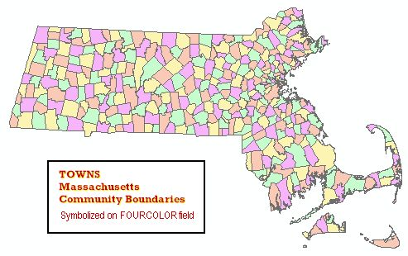
5. Probability Sampling – Cluster Sampling
Note: In stratified sampling, a random sample is drawn from each of the strata (e.g. five people from every town), whereas in cluster sampling only the selected clusters are studied (e.g. every person from five towns).

Slide 20
6. Choosing Nonprobability Vs. Probability Sampling
Technique
Strengths
Weaknesses
Nonprobability Sampling
Least expensive, least
Selection bias, sample not
Convenience sampling
time-consuming, most
representative, not recommended for
convenient
descriptive or causal research
Judgmental sampling
Low cost, convenient,
Does not allow generalization,
not time-consuming
Subjective, selection bias
Quota sampling
Sample can be controlled
Selection bias, no assurance of
for certain characteristics
representativeness
Snowball sampling
Can estimate rare
Selection bias, time-consuming
Characteristics, convenient
Probability Sampling
Representative,
Difficult to construct sampling
Simple random sampling
results,
projectable
frame, expensive,
lower precision
Systematic sampling
Can increase
Can accidentally decrease
representativeness,
representativeness
easier to implement than
SRS, sampling frame not
necessary
Stratified sampling
Include all important
Difficult to select relevant
subpopulations,
stratification variables, not feasible to
representative
stratify on many variables, expensive
Cluster sampling
Easy to implement, cost
Imprecise, difficult to compute and
effective, more representative
interpret results

Slide 21
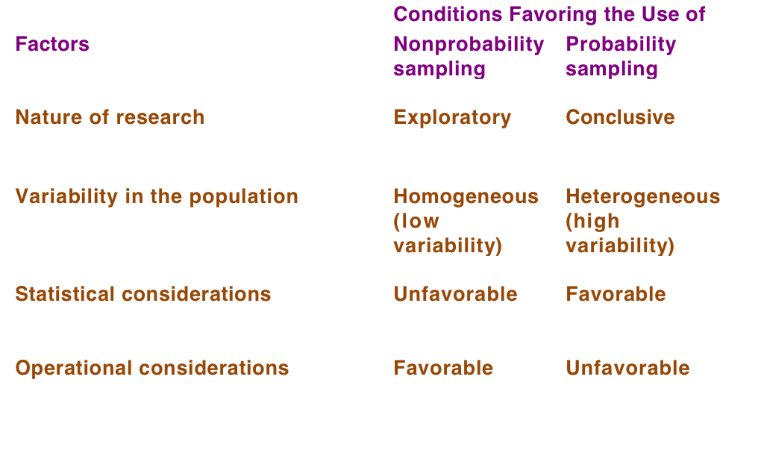
6. Choosing Nonprobability Vs. Probability Sampling

Slide 22
Questions??
Thanks!

