Slide 1
Chapter Twelve
Data Preparation
Copyright © 2010 Pearson Education, Inc.

Slide 2
1) Chapter Outline
1) Overview
2) The Data Preparation Process
3) A Classification of Statistical Techniques

Slide 3
2) Data Preparation Process
Prepare Preliminary Plan of Data Analysis
Check Questionnaire
Edit
Code
Transcribe
Clean Data
Statistically Adjust the Data
Select Data Analysis Strategy

Slide 4
Preparing Preliminary Plan of Data Analysis
Start by answering the following:
What data collection methods am I using?
Survey, experiment, etc.
What data analysis method am I using? (this is based on your collection method)
T tests, Chi-square, ANOVA, etc.
What are my IVs and DVs?
Are my IVs and DVs reflected in my hypotheses?
How will I code my data?

Slide 5
Questionnaire Checking
Once responses begin coming in, start by checking questionnaires – this step is crucial!
A questionnaire returned from the field may be unacceptable for several reasons.
Parts of the questionnaire may be incomplete.
The pattern of responses may indicate that the respondent did not understand or follow the instructions.
The responses show little variance.
One or more sections are missing.
The questionnaire is answered by someone who does not qualify for participation.

Slide 6
Editing
If we notice any issues with the questionnaires, we need to begin editing (preliminary checks)…
Treatment of Unsatisfactory Results
Returning to the Field – The questionnaires with unsatisfactory responses may be returned to the field, where the interviewers recontact the respondents.
Assigning Missing Values – If returning the questionnaires to the field is not feasible, the editor may assign missing values to unsatisfactory responses. (see next slide)
Discarding Unsatisfactory Respondents – In this approach, the respondents with unsatisfactory responses are simply discarded.

Slide 7
Editing – Assigning Missing Values
Assigning Missing Values – The editor may assign missing values to unsatisfactory responses.
Imputation: the substitution of some value for missing data.
“Best guess” value can be imputed.
Average value can be imputed.
Bootstrapping (creating a new sample, via computer, with different values but similar means and standard deviations) can also be done.
Imputation is a controversial technique for dealing with missing data.

Slide 8
Coding
Coding means assigning a code, usually a number, to each possible response to each question.
Data should be coded to retain as much detail as possible.

Slide 9
Coding – Unstructured Questions
Guidelines for Coding Unstructured Questions:
Create categories.
Category codes should be mutually exclusive and collectively exhaustive.
All responses should categorized and should not overlap.
Only a few (10% or less) of the responses should fall into the “other” category.
These may even be deleted.
Category codes should be assigned for critical issues even if no one has mentioned them.

Slide 10
Codebook
A codebook contains coding instructions and the necessary information about variables in the data set. A codebook generally contains the following information:
column number
variable name
question number
instructions for coding
Codebooks can be saved in a separate tab in Excel, or recorded under ‘Values’ in SPSS.

Slide 11
SPSS Variable View of the Data of Table 14.1

Slide 12
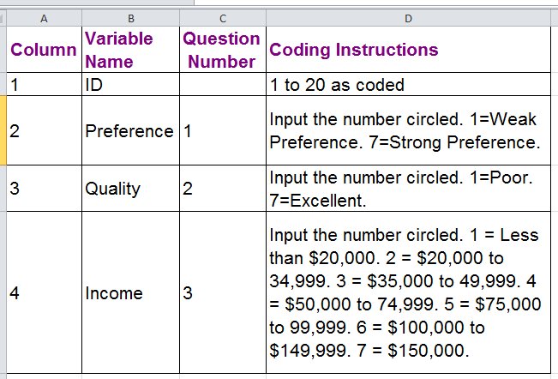
Codebook Excerpt - Excel
Question: What types of scales are each of these items on? Nominal, ordinal, interval or ratio

Slide 13
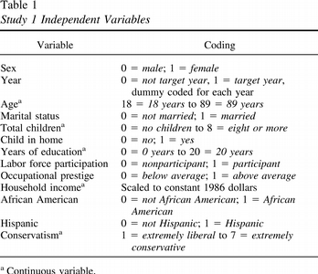
Example of Questionnaire Coding
Question: How would you code “home state”?
E.g. MA, NH, RI, VT etc.

Slide 14
Data Transcription
Transcribing responses into hard data.
With online surveys, this is done for you….simply download the Excel or SPSS sheet.
Hard copy surveys must be manually transcribed.
Qualitative data must be first categorized and coded, then transcribed.

Slide 15
Data Cleaning Consistency Checks
After transcribing data, data cleaning (a follow-up to editing) must be conducted…
Consistency checks identify data that are out of range, logically inconsistent, or have extreme values.
Reverse coding (changing the directionality of a question) can help identify logically inconsistent answers.
Often times, this means the respondent was not paying attention – throw out their responses.
Extreme values, or outliers, should be closely examined.
Sometimes, outliers are thrown out. Other times, they are kept.

Slide 16
Data Cleaning Treatment of Missing Responses
Did we find more issues with missing data?
Imputation:
Impute a neutral value – A neutral value, typically the mean response, is substituted for the missing responses.
Impute a calculated response – The respondents' pattern of responses to other questions are used to impute a suitable response to the missing questions.
Deletion:
In casewise deletion, respondents with any missing responses are discarded from the analysis.
In pairwise deletion, instead of discarding all respondents with any missing values, the researcher uses only the respondents with complete responses for each calculation.
Keep all respondents, but don’t use them for all variables.

Slide 17
Statistically Adjusting the Data Weighting
Sometimes, it is appropriate to alter the data…
In weighting, each case or respondent in the database is multiplied by a weight to reflect its importance relative to other cases or respondents.
Weighting is most widely used to make the sample data more representative of a target population on specific characteristics.

Slide 18
Statistically Adjusting the Data
Use of Weighting for Representativeness
Weighting so that sample matches percentage of known population
Years of Sample Population
Education Percentage Percentage
(in LA) Weight
Elementary School
0 to 7 years 2.49 4.23 1.70
8 years 1.26 2.19 1.74
High School
1 to 3 years 6.39 8.65 1.35
4 years 25.39 29.24 1.15
College
1 to 3 years 22.33 29.42 1.32
4 years 15.02 12.01 0.80
5 to 6 years 14.94 7.36 0.49
7 years or more 12.18 6.90 0.57
Totals 100.00 100.00

Slide 19
Statistically Adjusting the Data – Variable Respecification
Variable respecification involves the transformation of data to create new variables or modify existing variables.
For example, the researcher may create new variables that are composites of several other variables.
Dummy variables are used for respecifying categorical variables.
A dummy variable is one that takes the value 0 or 1 to indicate the absence or presence of some categorical effect.

Slide 20
Statistically Adjusting the Data – Variable Respecification
Product Usage Original Dummy Variable Code
Category Variable
(Gatorade) Code X₁ X₂ X₃
Nonusers 1 1 0 0
Light users 2 0 1 0
Medium users 3 0 0 1
Heavy users 4 0 0 0
Note that X₁ = 1 for nonusers and 0 for all others.
X₂ = 1 for light users and 0 for all others.
X₃ = 1 for medium users and 0 for all others.
In analyzing the data, X₁, X₂, and X₃ are used to represent all user/nonuser groups.

Slide 21
Coding in Excel - Variable Respecification
Month of Ad Campaign | January | February | March
January | 1 | 0 | 0
February | 0 | 1 | 0
January | 1 | 0 | 0
March | 0 | 0 | 1
March | 0 | 0 | 1
February | 0 | 1 | 0
January | 1 | 0 | 0
March | 0 | 0 | 1
February | 0 | 1 | 0
February | 0 | 1 | 0
In Excel: =IF(A2="January",1,0)
Or, go to ‘Formulas’ > ‘Recently Used’ > IF
Go into Excel and try recreating this chart

Slide 22
Statistically Adjusting the Data – Scale Transformation and Standardization
Scale transformation involves a manipulation of scale values to ensure comparability with other scales or otherwise make the data suitable for analysis.
For example, if your IV is on a 5-point Likert, and your DV is on a 7-point Likert, you could scale all items to 35 (5*7) in order to make them comparable.

Slide 23
Thanks!
Questions??

