Slide 1
Chapter Thirteen
Frequency Distribution,
Cross-Tabulation, and
Hypothesis Testing

Slide 2
Chapter Outline
Chapter 15a (Mid Sept.)
1) Frequency Distribution (slide 15-5)
2) Hypothesis Testing (slide 15-16)
Chapter 15b (Late Sept.)
3) Cross-Tabulations (slide 15-27)
Chapter 15c and d (October)
4) Testing for Differences; Parametric Tests (Slide 15-51)
5) Non-Parametric Tests (15-62)

Slide 3
1) Internet Usage Data
Table 15.1
Respondent Sex Familiarity Internet Attitude Toward Usage of Internet
Number Usage Internet Technology Shopping Banking
1 1.00 7.00 14.00 7.00 6.00 1.00 1.00
2 2.00 2.00 2.00 3.00 3.00 2.00 2.00
3 2.00 3.00 3.00 4.00 3.00 1.00 2.00
4 2.00 3.00 3.00 7.00 5.00 1.00 2.00 5 1.00 7.00 13.00 7.00 7.00 1.00 1.00
6 2.00 4.00 6.00 5.00 4.00 1.00 2.00
7 2.00 2.00 2.00 4.00 5.00 2.00 2.00
8 2.00 3.00 6.00 5.00 4.00 2.00 2.00
9 2.00 3.00 6.00 6.00 4.00 1.00 2.00
10 1.00 9.00 15.00 7.00 6.00 1.00 2.00
11 2.00 4.00 3.00 4.00 3.00 2.00 2.00
12 2.00 5.00 4.00 6.00 4.00 2.00 2.00
13 1.00 6.00 9.00 6.00 5.00 2.00 1.00
14 1.00 6.00 8.00 3.00 2.00 2.00 2.00
15 1.00 6.00 5.00 5.00 4.00 1.00 2.00
16 2.00 4.00 3.00 4.00 3.00 2.00 2.00
17 1.00 6.00 9.00 5.00 3.00 1.00 1.00
18 1.00 4.00 4.00 5.00 4.00 1.00 2.00
19 1.00 7.00 14.00 6.00 6.00 1.00 1.00
20 2.00 6.00 6.00 6.00 4.00 2.00 2.00
21 1.00 6.00 9.00 4.00 2.00 2.00 2.00
22 1.00 5.00 5.00 5.00 4.00 2.00 1.00
23 2.00 3.00 2.00 4.00 2.00 2.00 2.00
24 1.00 7.00 15.00 6.00 6.00 1.00 1.00
25 2.00 6.00 6.00 5.00 3.00 1.00 2.00
26 1.00 6.00 13.00 6.00 6.00 1.00 1.00
27 2.00 5.00 4.00 5.00 5.00 1.00 1.00
28 2.00 4.00 2.00 3.00 2.00 2.00 2.00
29 1.00 4.00 4.00 5.00 3.00 1.00 2.00
30 1.00 3.00 3.00 7.00 5.00 1.00 2.00

Slide 4
1) Frequency Distribution
In a frequency distribution, one variable is considered at a time.
A frequency distribution for a variable produces a table of frequency counts, percentages, and cumulative percentages for all the values associated with that variable.

Slide 5
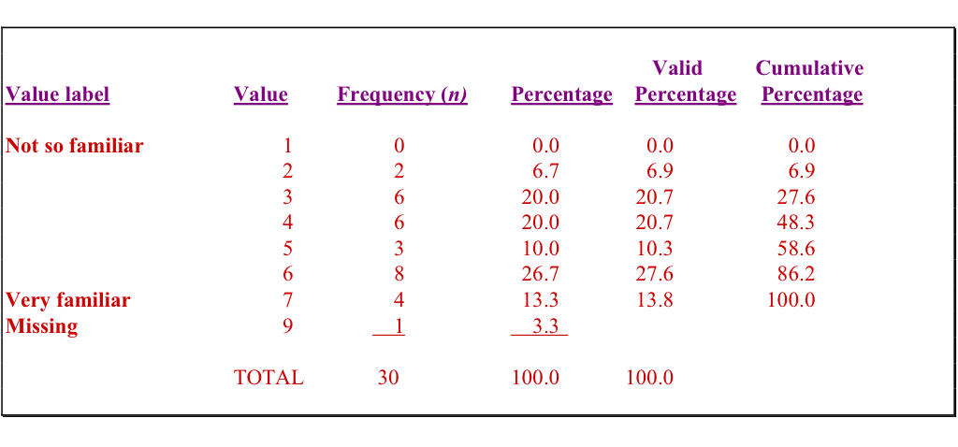
1) Frequency of Familiarity with the Internet
Table 15.2

Slide 6
1) Frequency Histogram
Fig. 15.1
8
7
6
5
Frequency
4
3
2
1
0
2
3
4
5
6
7
Familiarity

Slide 7
1) Statistics Associated with Frequency Distribution: Measures of Location
The mean, or average value, is the most commonly used measure of central tendency. The mean, ,is given by
Where,
X_{i} = Observed values of the variable X
n = Number of observations (sample size)
The mode is the value that occurs most frequently.
The mode represents the highest peak of the distribution.
The mode is a good measure of location when the variable has been grouped into categories (in other words, when there is no mean).
X
X
X
n
=
/
i

Slide 8
1) Statistics Associated with Frequency Distribution: Measures of Location
The median of a sample is the middle value when the data are arranged in ascending or descending order.
If the number of data points is even, the median is usually estimated as the midpoint between the two middle values – by adding the two middle values and dividing their sum by 2.

Slide 9
1) Statistics Associated with Frequency Distribution: Measures of Variability
The range measures the spread of the data. It is simply the difference between the largest and smallest values in the sample.
Range = X_{largest} – X_{smallest}
The interquartile range is the difference between the 75th and 25th percentile.
In other words, the interquartile range encompasses the middle 50% of observations.

Slide 10
1) Statistics Associated with Frequency Distribution: Measures of Variability
Deviation from the mean is the difference between the mean and an observed value.
Mean = 4; observed value = 7
Deviation from the mean = ______________
The variance is the mean squared deviation from the mean. The variance can never be negative.
Example: 3 point scale; 10 respondents = n
Responses: 2 ppl. = 1; 6 ppl. = 2; 2 ppl. = 3
Mean = 2 =(1+1+2+2+2+2+2+2+3+3)/10
Variance = (2 * (1 – 2)² + 6 * (2 – 2)² + 2 * (3 – 2)²)/9
n-1
Mean
Actual response
Frequency of response

Slide 11
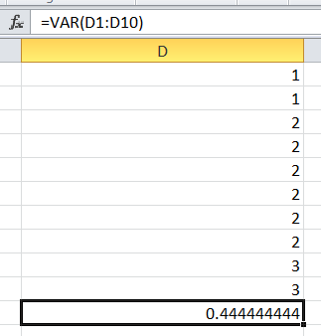
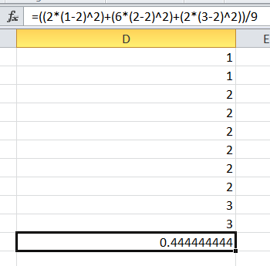
1) Statistics Associated with Frequency Distribution: Measures of Variability
How do we calculate variance in Excel?
Easy Method
Difficult Method

Slide 12
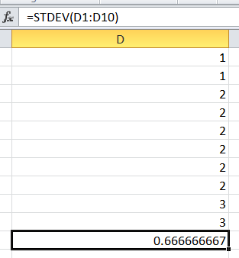
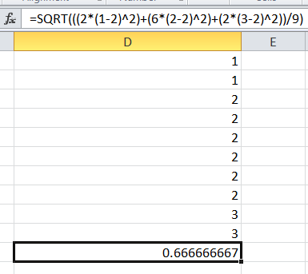
1) Statistics Associated with Frequency Distribution: Measures of Variability
The standard deviation is the square root of the variance. How do we calculate variance in Excel?
Easy Method
Difficult Method

Slide 13
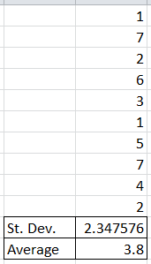
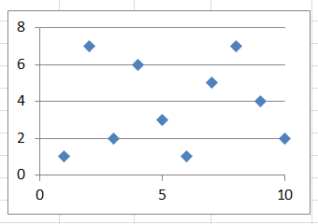
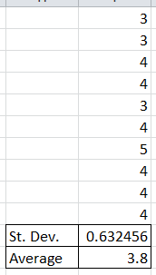
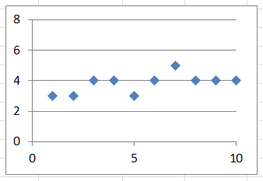
1) Statistics Associated with Frequency Distribution: Measures of Variability
How to interpret standard deviation and variance:
When the data points are scattered, the variance and standard deviation are large.
When the data points are clustered around the mean, the variance and standard deviation are small.

Slide 14
1) Statistics Associated with Frequency Distribution: Measures of Shape
Skewness. The tendency of the deviations from the mean to be larger in one direction than in the other.
It can be thought of as the tendency for one tail of the distribution to be heavier than the other.
Kurtosis is a measure of the relative peakedness or flatness of the curve defined by the frequency distribution.
If the kurtosis is positive, then the distribution is more peaked than a normal distribution.
A negative value means that the distribution is flatter than a normal distribution.

Slide 15
1) Skewness of a Distribution
Fig. 15.2
Symmetric Distribution
Skewed Distribution
Mean Median Mode (a)
Mean Median Mode (b)

Slide 16
2) Steps Involved in Hypothesis Testing
Formulate Hypotheses
Select Appropriate Test
Choose Level of Significance (usually .05)
Collect Data and Calculate Test Statistic
Compare with Level of Significance
Reject or Do Not Reject H₀
Draw Marketing Research Conclusion

Slide 17
2) A General Procedure for Hypothesis Testing Step 1: Formulate the Hypothesis
A null hypothesis is a statement of the status quo, one of no difference or no effect.
If the null hypothesis is not rejected, no changes will be made.
An alternative hypothesis is one in which some difference or effect is expected.
Accepting the alternative hypothesis will lead to changes in opinions or actions.

Slide 18
2) A General Procedure for Hypothesis Testing Step 1: Formulate the Hypothesis
A null hypothesis may be rejected, but it can never be accepted based on a single test.
There is no way to determine whether the null hypothesis is true.
In marketing research, the null hypothesis is formulated in such a way that its rejection leads to the acceptance of the desired conclusion. The alternative hypothesis represents the conclusion for which evidence is sought.
Example:
H₁: Millennials shop more online than Baby Boomers.
H₀: Millennials shop the same amount online as Baby Boomers.

Slide 19
2) A General Procedure for Hypothesis Testing Step 2: Select an Appropriate Test
The test statistic measures how close the sample has come to the null hypothesis.
In our example, the paired samples t-test, is appropriate.
The t-test is good for testing if there is a difference between groups.

Slide 20
2) A General Procedure for Hypothesis Testing Step 3: Choose a Level of Significance
Whenever we draw inferences about a population, we risk the following errors:
Type I Error
Type I error occurs when the sample results lead to the rejection of the null hypothesis when it is in fact true.
The probability of type I error ( ) is also called the level of significance.
generally = .05, but it is up to the researcher.
Type II Error
Type II error occurs when, based on the sample results, the null hypothesis is not rejected when it is in fact false.
a
a

Slide 21
2) Step 3: Potential Errors
Outcome | Null hypothesis (H₀) is true | Null hypothesis (H₀) is false
Reject null hypothesis | Type I error False positive | Correct outcome True positive
Fail to reject null hypothesis | Correct outcome True negative | Type II error False negative

Slide 22
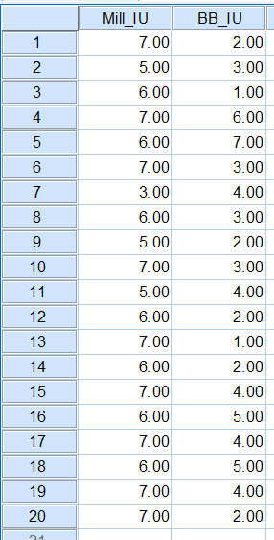
2) A General Procedure for Hypothesis Testing Step 4: Collect Data and Calculate Test Statistic
The required data are collected and the value of the test statistic computed.
20 Millennials, 20 Baby Boomers
7 = high internet usage; 1 = low internet usage
In SPSS:
Analyze →Compare Means → Paired Samples T-test

Slide 23
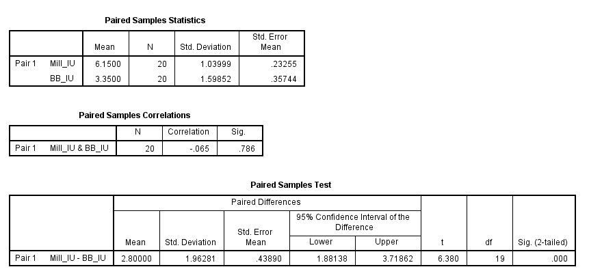
2) A General Procedure for Hypothesis Testing Step 4: Collect Data and Calculate Test Statistic
The mean for Millennials is high than for Baby Boomers

Slide 24
2) A General Procedure for Hypothesis Testing Step 5: Collect Data and Calculate Test Statistic
Sig. is below .05

Slide 25
2) A General Procedure for Hypothesis Testing Step 6: Making the Decision on H₀
If the probability associated with the calculated or observed value of the test statistic is less than the level of significance, the null hypothesis is rejected.
The probability associated with the calculated or observed value of the test statistic is 0.000. This is less than the level of significance of 0.05. Hence, the null hypothesis is rejected.

Slide 26
2) A General Procedure for Hypothesis Testing Step 7: Marketing Research Conclusion
The conclusion reached by hypothesis testing must be expressed in terms of the marketing research problem.
In our example, we conclude that there is evidence that Millennials shop online more than Baby Boomers. Hence, the recommendation to a retailer would be to target the online efforts towards primarily Millennials.
NOT REJECTED:
H₁: Millennials shop more online than Baby Boomers.

Slide 27
3) Cross-Tabulation
A cross-tabulation is another method for presenting data.
Cross-tabulation results in tables that reflect the joint distribution of two or more variables with a limited number of categories or distinct values, e.g., Table 15.3.
Cross tabulation shows two types of results: some association between variables or no association between variables.

Slide 28
3) Gender and Internet Usage
Table 15.3
Gender
Row
Internet Usage
Male
Female
Total
Light (1)
5
10
15
Heavy (2)
10
5
15
Column Total 15
1
5

Slide 29
3) Two Variables Cross-Tabulation
Since two variables have been cross-classified, percentages could be computed either columnwise, based on column totals (Table 15.4), or rowwise, based on row totals (Table 15.5).
The general rule is to compute the percentages in the direction of the independent variable, across the dependent variable. The correct way of calculating percentages is as shown in Table 15.4.
Independent Variable (IV) is free to vary.
Dependent Variable (DV) depends on the IV.

Slide 30
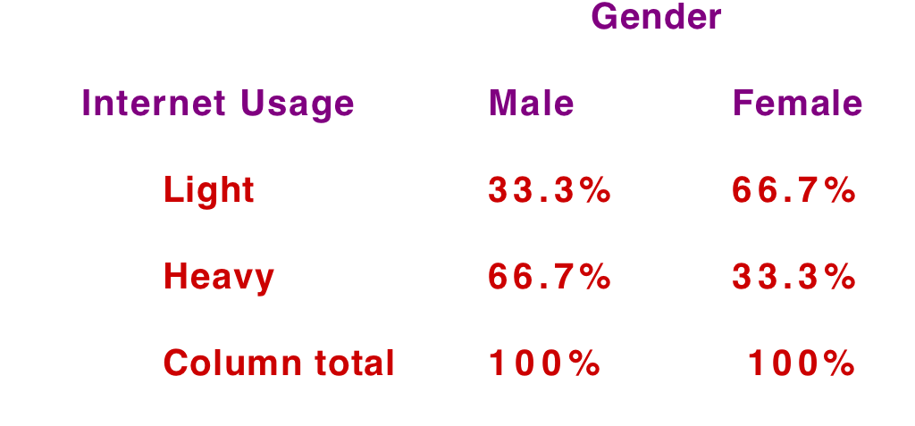
3) Internet Usage by Gender
Table 15.4: Columnwise
Independent Variable (IV) = Gender
Dependent Variable (DV) = Internet Usage
What does this mean? Can we switch the IV and DV?

Slide 31
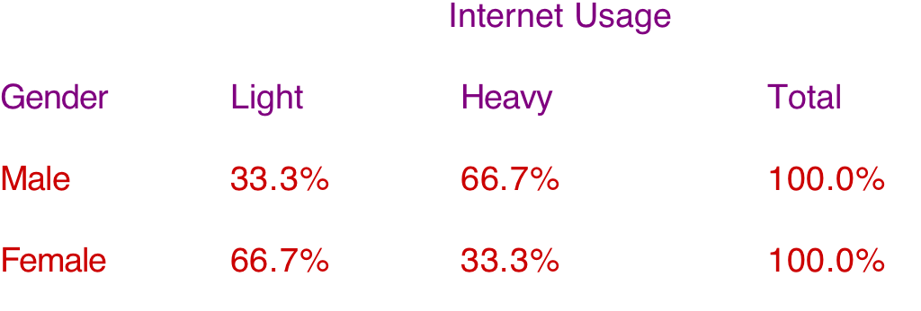
3) Gender by Internet Usage
Table 15.5: Rowwise
Although table 15.5 is not wrong, table 15.4 is generally considered to be favorable.

Slide 32
Introduction of a Third Variable in Cross-Tabulation
Fig. 15.7
Original Two Variables
Some Association between the Two Variables
No Association between the Two Variables
The introduction of a third variable can result in four possibilities:
Introduce a Third Variable
Introduce a Third Variable
Refined Association between the Two Variables
No Association between the Two Variables
No Change in the Initial Pattern
Some Association between the Two Variables

Slide 33
Three Variables Cross-Tabulation: Refine an Initial Relationship
Refine an Initial Relationship:
As can be seen from Table 15.6:
52% of unmarried respondents fell in the high-purchase category
31% of married respondents fell in the high–purchase category
Before concluding that unmarried respondents purchase more fashion clothing than those who are married, a third variable, the buyer's sex, was introduced into the analysis.
Table 15.6
Purchase of
Current Marital Status
Fashion
Clothing
Married
Unmarried
High
31%
52%
Low
69%
48%
Column
100%
100%
Number of
700
300
respondents

Slide 34
Purchase of Fashion Clothing by Marital Status
As shown in Table 15.7 (next slide):
60% of the unmarried females fall in the high-purchase category
25% of the married females fall in the high-purchase category
However, the percentages are much closer for males:
40% of the unmarried males fall in the high-purchase category
35% of the married males fall in the high-purchase category
Therefore, the introduction of sex (third variable) has refined the relationship between marital status and purchase of fashion clothing (original variables).
Conclusion: Overall, unmarried respondents are more likely to fall in the high purchase category than married ones. However, this effect is much more pronounced for females than for males.

Slide 35
Purchase of Fashion Clothing by Marital Status
Table 15.7
Purchase of
Sex
Fashion
Male
Female
Clothing
Married
Not
Married
Not
Married
Married
High
35%
40%
25%
60%
Low
65%
60%
75%
40%
Column totals
100%
100%
100%
100%
Number of
400
120
300
180
cases
What are the IVs? What is the DV? Explain.

Slide 36
Three Variables Cross-Tabulation: Initial Relationship was Spurious
Initial Relationship was Spurious
Table 15.8 (two variables):
32% of those with college degrees own an expensive car.
21% of those without college degrees own an expensive car.
However, income may also be a factor…
Table 15.9 (three variables):
the percentages of those with and without college degrees who own expensive automobiles are the same for each of the income groups.
When the data for the high income and low income groups are examined separately, the association between education and ownership of expensive automobiles disappears.
Therefore, the initial relationship observed between these two variables was spurious.
A spurious relationship exists when two events or variables have no direct causal connection, yet it may be wrongly inferred that they do, due to either coincidence or the presence of a certain third, unseen variable (referred to as a "confounding variable" or "lurking variable”).

Slide 37
Ownership of Expensive Automobiles by Education Level
Table 15.8: Education = IV; Own Expensive Car = DV
Own Expensive
Education
Car
College Degree
No College Degree
Yes
No
Column totals
Number of cases
32%
68%
100%
250
21%
79%
100%
750

Slide 38
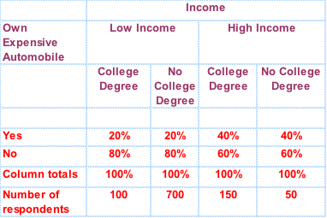
Ownership of Expensive Automobiles by Education Level and Income Levels
Table 15.9
What are the IVs? What is the DV? What do these results say? Also, note the number of respondents….

Slide 39
Three Variables Cross-Tabulation: Reveal Suppressed Association
Reveal Suppressed Association
Table 15.10 shows no association between desire to travel abroad and age.
Table 15.11: when sex is introduced as the third variable, a relationship between age and desire to travel abroad is revealed.
Among men, 60% of those under 45 indicated a desire to travel abroad, as compared to 40% of those 45 or older.
The pattern was reversed for women, where 35% of those under 45 indicated a desire to travel abroad as opposed to 65% of those 45 or older.

Slide 40
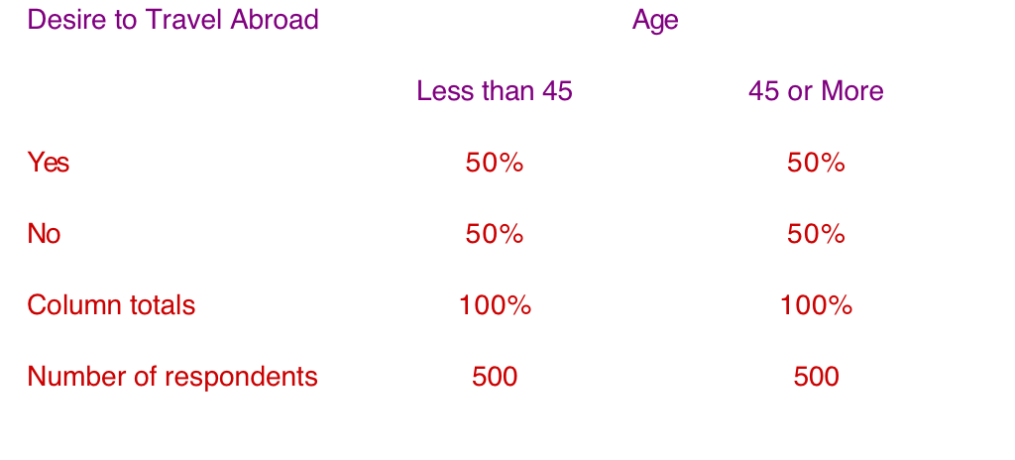
Desire to Travel Abroad by Age
Table 15.10
Since the association between desire to travel abroad and age runs in the opposite direction for males and females, the relationship between these two variables is masked when the data are aggregated across sex.

Slide 41
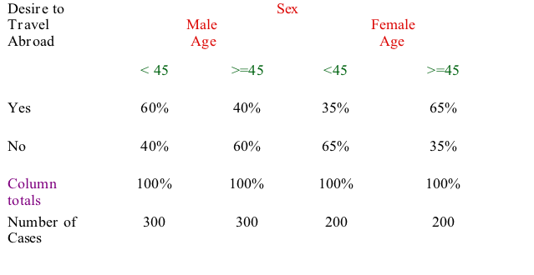
Desire to Travel Abroad by Age and Gender
Table 15.11
But when the effect of sex is controlled, as in Table 15.11, the suppressed association between desire to travel abroad and age is revealed for the separate categories of males and females.

Slide 42
Three Variables Cross-Tabulations: No Change in Initial Relationship
No Change in Initial Relationship
Consider the cross-tabulation of family size and the tendency to eat out frequently in fast-food restaurants, as shown in Table 15.12. No association is observed.
When income was introduced as a third variable in the analysis, Table 15.13 was obtained. Again, no association was observed.

Slide 43
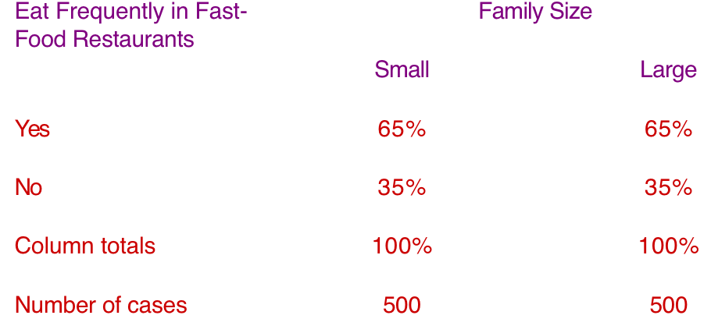
Eating Frequently in Fast-Food Restaurants by Family Size
Table 15.12

Slide 44
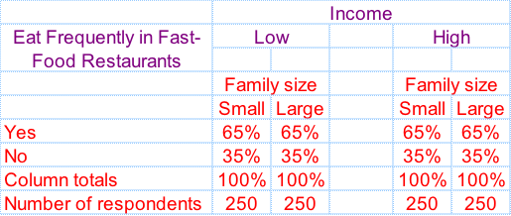
Eating Frequently in Fast-Food Restaurants by Family Size and Income
Table 15.13
What do these findings mean?

Slide 45
Statistics Associated with Cross-Tabulation: Chi-Square
Pearson’s Chi-square:
Used to determine whether paired observations on two variables are independent of each other.
The chi-square statistic ( ) is used to test the statistical significance of the observed association in a cross-tabulation.
We are aiming to reject the null hypothesis (H₀).
H₀: there is no association between the two variables.
We say this is the H₀ because we believe that some association does exist!
2
c

Slide 46
An Old Example: Gender and Internet Usage
Table 15.3
Gender
Row
Internet Usage
Male
Female
Total
Light (1)
5
10
15
Heavy (2)
10
5
15
Column Total 15
1
5
Statistically, is there an association between gender and internet usage?
H₀: there is no association between gender and internet usage

Slide 47
Statistics Associated with Cross-Tabulation Chi-Square
For the data in Table 15.3, the expected frequencies for the cells going from left to right and from top to bottom, are:
Then the value of is calculated as follows:
15
X
15
15
X
15
=
7.50
=
7.50
30
30
15
X
15
15
X
15
=
7.50
=
7.50
30
30
c
2
S
(
f
-
f
)
2
o=observation
e=expected
c
2
=
o
e
f
e

Slide 48
Statistics Associated with Cross-Tabulation Chi-Square
c
2
For the data in Table 15.3, the value of is
calculated as:
= (5 -7.5)² + (10 - 7.5)² + (10 - 7.5)² + (5 - 7.5)²
7.5 7.5 7.5 7.5
=0.833 + 0.833 + 0.833+ 0.833
= 3.333

Slide 49
Statistics Associated with Cross-Tabulation Chi-Square
For the cross-tabulation given in Table 15.3, there are (2-1) x (2-1) = 1 degree of freedom.
Table 3 in the Statistical Appendix contains upper-tail areas of the chi-square distribution for different degrees of freedom. For 1 degree of freedom, the probability of exceeding a chi-square value of 3.841 is 0.05.
The calculated chi-square statistic had a value of 3.333.
Since this is less than the critical value of 3.841, the null hypothesis of no association can not be rejected indicating that the association is not statistically significant at the 0.05 level.
Another example: http://www.youtube.com/watch?v=Ahs8jS5mJKk

Slide 50
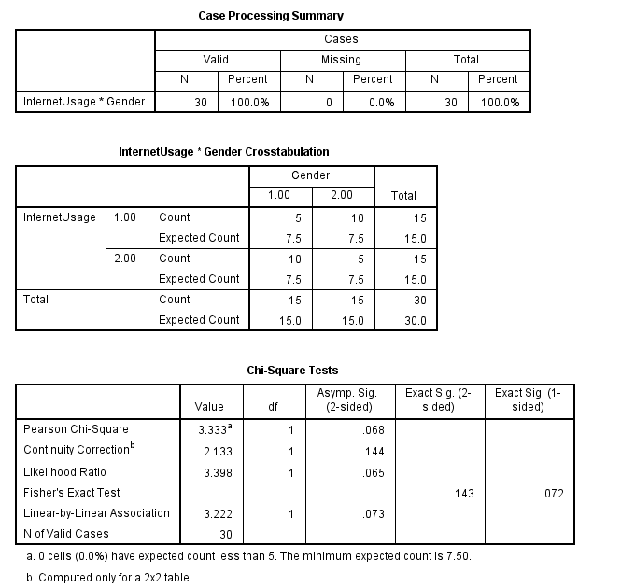
View in SPSS
In SPSS:
Analyze →
Descriptive Stats →
Crosstabs
Make sure to click:
Statistics →
Chi-square

Slide 51
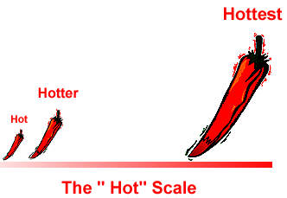
4) Hypothesis Testing Related to Differences
Parametric tests assume that the variables of interest are measured on at least an interval scale (see chapter 11).
Nonparametric tests assume that the variables are measured on a nominal or ordinal scale (see chapter 11).

Slide 52
Parametric v. Non-parametric Scales
Non-parametric level scales:
Nominal level Scale: Any numbers used are mere labels: they express no mathematical properties.
Examples are SKU inventory codes and UPC bar codes.
Ordinal level scale: Numbers indicate the relative position of items, but not the magnitude of difference.
An example is a preference ranking.
Parametric level scales:
Interval level scale: Numbers indicate the magnitude of difference between items, but there is no absolute zero point.
Examples are attitude (Likert) scales and opinion scales.
Ratio level scale: Numbers indicate magnitude of difference and there is a fixed zero point. Ratios can be calculated.
Examples include: age, income, price, and costs.

Slide 53
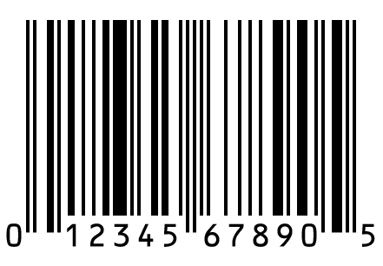
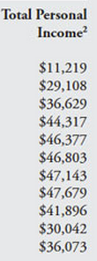
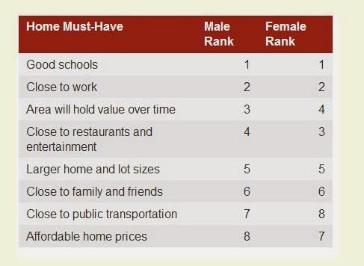
Parametric v. Non-parametric Scales

Slide 54
Parametric Tests
Parametric tests provide inferences for making statements about the means of parent populations.
A t-test is a common procedure used with parametric data. It can be used for:
One-sample test: e.g. Does the market share for a given product exceed 15 percent?
Two-sample test: e.g. Do the users and nonusers of a brand differ in terms of their perception of a brand?

Slide 55
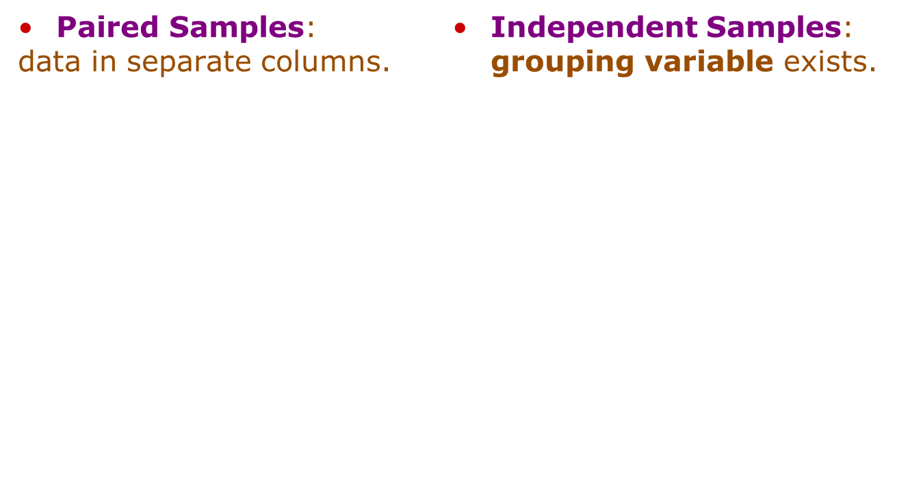
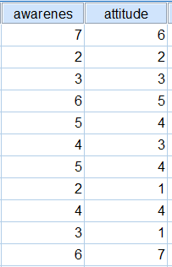
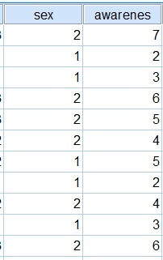
Parametric Tests
Two-sample tests can be:

Slide 56
SPSS Windows: One Sample t Test
Ex.: Does the market share for a given product exceed 15 percent?
Select ANALYZE from the SPSS menu bar.
Click COMPARE MEANS and then ONE SAMPLE T TEST.
Choose your TEST VARIABLE(S).
E.g. “Market share”
Choose your TEST VALUE box.
E.g. “15 percent”
Click OK.

Slide 57
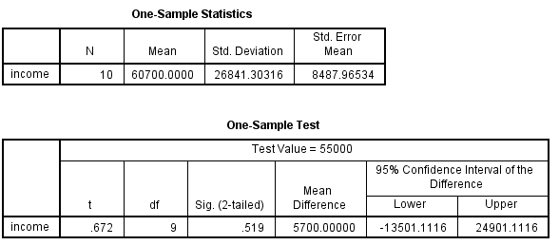
SPSS Windows: One Sample t Test
Choose your TEST VARIABLE(S): “Income”
Choose your TEST VALUE: “$55,000”
Results:
Mean = $60,700
P-value of the t-test = .519
There is no statistical difference between the mean of the sample and $55,000.

Slide 58
SPSS Windows: Two Independent Samples t Test
Select ANALYZE from the SPSS menu bar.
Click COMPARE MEANS and then INDEPENDENT SAMPLES T TEST.
Chose your TEST VARIABLE(S).
E.g. perception of brand.
Chose your GROUPING VARIABLE.
E.g. usage rate.
Click DEFINE GROUPS.
Type “1” in GROUP 1 box and “2” in GROUP 2 box.
Click CONTINUE.
Click OK.

Slide 59
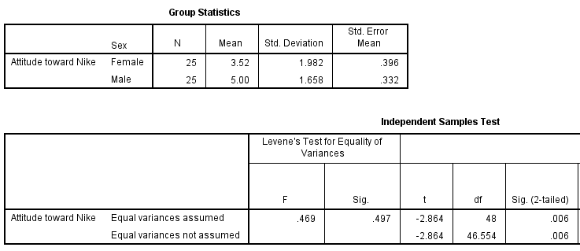
SPSS Windows: Two Independent Samples t Test
Choose your TEST VARIABLE(S): “Attitude toward Nike”
Choose your GROUPING VARIABLE: “Sex”
Results:
Means = 3.52 (Female) compared to 5.00 (Male).
P-value of the t-test = .006
There is a statistical difference between men and women in regards to attitude towards Nike.

Slide 60
SPSS Windows: Paired Samples t Test
Select ANALYZE from the SPSS menu bar.
Click COMPARE MEANS and then PAIRED SAMPLES T TEST.
Select two potentially paired variables and move these variables in to the PAIRED VARIABLE(S) box.
E.g. ‘perception of brand’ and ‘usage rate’.
Click OK.

Slide 61
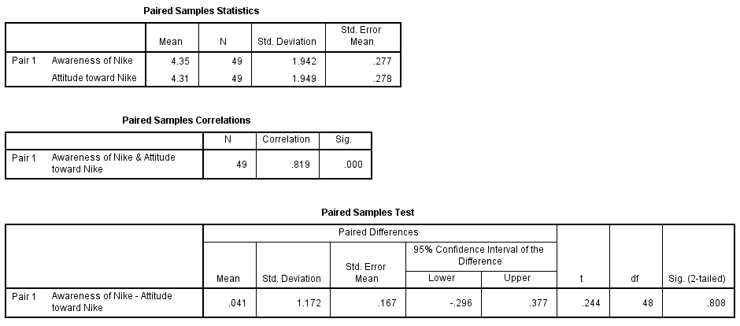
SPSS Windows: Paired Samples t Test
Results:
Means = 4.35 (Awareness) compared to 4.31 (Attitude).
P-value of the t-test = .808
There is no statistical difference between awareness of Nike and attitude towards Nike.
Choose your first TEST VARIABLE: “Awareness of Nike”
Choose your second TEST VARIABLE: “Attitude toward Nike”

Slide 62
5) Nonparametric Tests
Nonparametric tests are used when the independent variables are nonmetric.
(e.g. nominal or ordinal).
Like parametric tests, nonparametric tests are available for testing variables from one sample, two independent samples, or two related samples.

Slide 63
Nonparametric Tests One Sample
A chi-square test or binomial test can be performed on a single variable from one sample. In this context, the tests figure out whether a significant difference exists between our observed cases and some expected outcome.
For example, does our sample reflect the general population in regards to gender?
Ideally, we should have a population split of about 50% men and 50% women.
PLEASE NOTE: Nonparametric data is considered inferior and therefore rarely gets published.

Slide 64
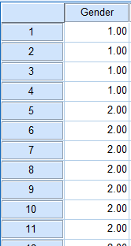
SPSS Windows: Binomial Test
Analyze → Nonparametric Tests → One Sample…
OR, depending on the version of SPSS
Analyze → Nonparametric Tests → Binomial …
Note: we only have two categories (men and women). We would use a chi-square test if we had more categories.

Slide 65
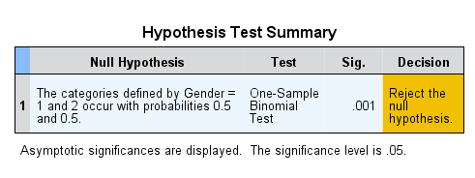
SPSS Windows: Binomial Test
Results:
Automatically tests a null hypothesis at .05
p-value of the binomial test = .001
Null hypothesis rejected: each gender does not have a 50% chance of occurring.
In other words, our sample is not evenly split!

Slide 66
Questions??
Thank you!

Slide 67
SPSS Windows Appendix
To select these procedures click:
Analyze>Descriptive Statistics>Frequencies
Analyze>Descriptive Statistics>Descriptives
Analyze>Descriptive Statistics>Explore
The major cross-tabulation program is CROSSTABS.
This program will display the cross-classification tables and provide cell counts, row and column percentages, the chi-square test for significance, and all the measures of the strength of the association that have been discussed.
To select these procedures, click:
Analyze>Descriptive Statistics>Crosstabs

Slide 68
SPSS Windows Appendix
The major program for conducting parametric tests in SPSS is COMPARE MEANS. This program can be used to conduct t tests on one sample or independent or paired samples. To select these procedures using SPSS for Windows, click:
Analyze>Compare Means>Means …
Analyze>Compare Means>One-Sample T Test …
Analyze>Compare Means>Independent-Samples T Test …
Analyze>Compare Means>Paired-Samples T Test …

Slide 69
SPSS Windows Appendix
The nonparametric tests discussed in this chapter can
be conducted using NONPARAMETRIC TESTS.
To select these procedures using SPSS for Windows,
click:
Analyze>Nonparametric Tests>One Sample …
Analyze>Nonparametric Tests>Binomial …
Analyze>Nonparametric Tests>Chi-Square …

