Slide 1
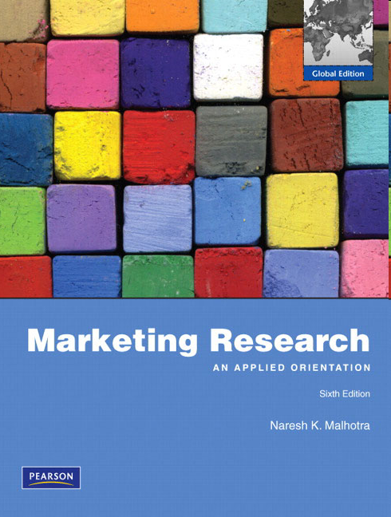
Chapter Fourteen
Correlation and Regression

Slide 2
1) Chapter Outline
1) Overview
2) Correlation
3) Regression Analysis

Slide 3
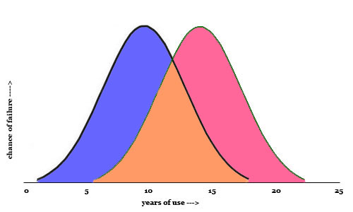
If variances are similar, t-tests are appropriate
Group A
Group B

Slide 4
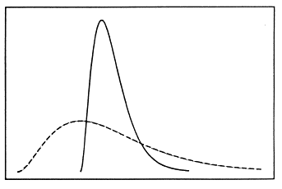
If variances are not similar, t-tests could be misleading
Correlation and regression analysis can help….
Group B
Group A

Slide 5
2) Correlation Coefficient
The correlation coefficient, r, summarizes the strength of association between two metric (interval or ratio scaled) variables, say X and Y.
In other words, you can have a correlation coefficient for Likert scale items, not dichotomous items.
It is an index used to determine whether a linear (straight-line) relationship exists between X and Y.
As it was originally proposed by Karl Pearson, it is known as the Pearson correlation coefficient.

Slide 6
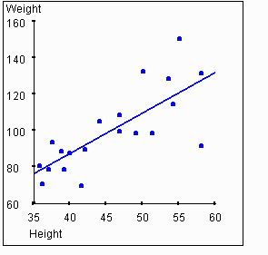
Linear relationships
For example:
How much does weight (Y) go up as height (X) goes up by one unit?
Height and weight are positively correlated.

Slide 7
Product Moment Correlation
R can be calculated from a sample of n observations:
n
S
(
X
i
-
X
)
(
Y
i
-
Y
)
r
=
i
=
1
S
n
X
X
2
S
n
Y
Y
2
(
i
-
)
(
i
-
)
i
=
1
i
=
1
D
i
v
i
s
i
o
= sum
n
n
o
f
t
h
e
n
u
m
e
r
a
t
o
r
a
n
d
d
e
n
o
m
i
n
a
t
o
r
b
y
(
-
1
)
g
i
v
e
s
X = average of all x’s
Y = average of all y’s
n
(
X
-
X
)
(
Y
-
Y
)
S
i
i
=
1
n
-
1
r
=
i
S
n
(
X
i
-
X
)
2
S
n
(
Y
i
-
Y
)
2
n
-
1
n
-
1
Don’t worry, we can do this in SPSS…
i
=
1
i
=
1
=
C
O
V
x
y
S
x
S
y

Slide 8
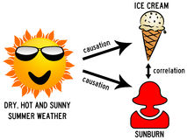
Product Moment Correlation
r varies between -1.0 and +1.0.
The correlation coefficient between two variables will be the same regardless of their underlying units of measurement.
For example, comparing a 5 point scale to a 7 point scale is okay.

Slide 9
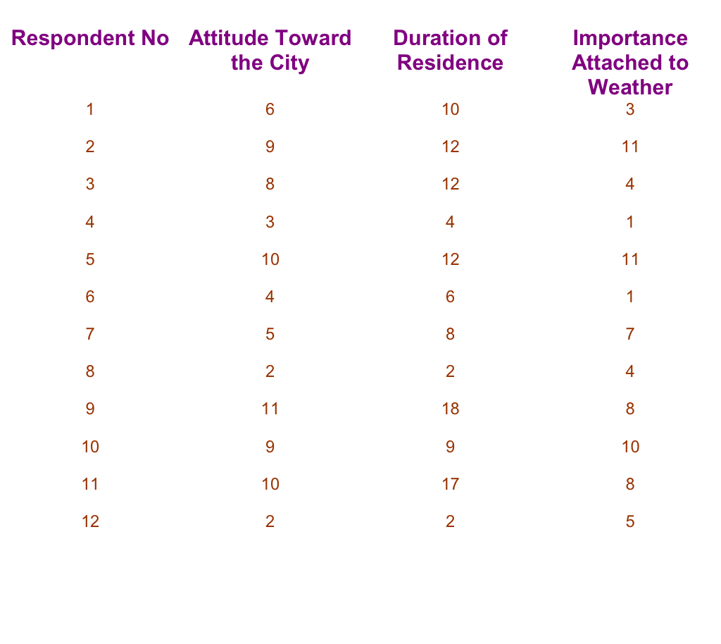
Explaining Attitude Toward the City of Residence

Slide 10
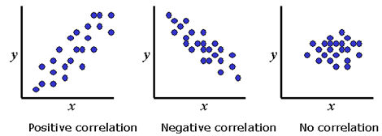
Interpretation of the Correlation Coefficient
The correlation coefficient ranges from −1 to 1.
A value of 1 implies that all data points lie on a line for which Y increases as X increases.
A value of −1 implies that all data points lie on a line for which Y decreases as X increases.
A value of 0 implies that there is no linear correlation between the variables.

Slide 11
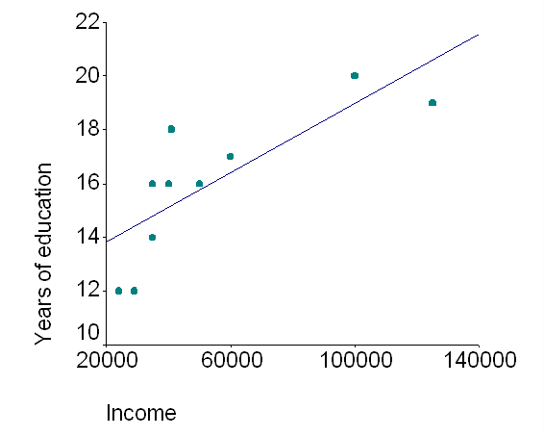
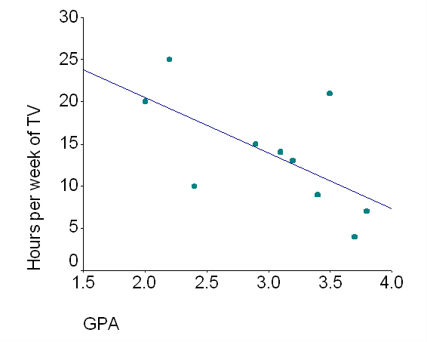
Positive and Negative Correlation

Slide 12
Interpretation of the Correlation Coefficient
As a rule of thumb, correlation values can be interpreted in the following manner:
Correlation | Negative | Positive
None | −0.09 to 0.0 | 0.0 to 0.09
Small | −0.3 to −0.1 | 0.1 to 0.3
Medium | −0.5 to −0.3 | 0.3 to 0.5
Strong | −1.0 to −0.5 | 0.5 to 1.0

Slide 13
SPSS Windows: Correlations
Select ANALYZE from the SPSS menu bar.
Click CORRELATE and then BIVARIATE.
Move “variable x” into the VARIABLES box. Then move “variable y” into the VARIABLES box.
Check PEARSON under CORRELATION COEFFICIENTS.
Check ONE-TAILED under TEST OF SIGNIFICANCE.
Check FLAG SIGNIFICANT CORRELATIONS.
Click OK.

Slide 14
SPSS Example: Correlation
Correlations
 |  | Age | InternetUsage | InternetShopping
Age | Pearson Correlation | 1 | -.740 | -.622
 | Sig. (1-tailed) |  | .000 | .002
 | N | 20 | 20 | 20
InternetUsage | Pearson Correlation | -.740 | 1 | .767
 | Sig. (1-tailed) | .000 |  | .000
 | N | 20 | 20 | 20
InternetShopping | Pearson Correlation | -.622 | .767 | 1
 | Sig. (1-tailed) | .002 | .000
 | N | 20 | 20 | 20

Slide 15
3) Regression Analysis
Regression analysis examines associative relationships between a metric dependent variable and one or more independent variables in the following ways:
Determines whether the independent variables explain a significant variation in the dependent variable: whether a relationship exists.
Determines how much of the variation in the dependent variable can be explained by the independent variables: strength of the relationship.
Determine the structure or form of the relationship: the mathematical equation relating the independent and dependent variables.
For example, does a change in age predict a change in Internet usage? Regression can answer this.

Slide 16
Conducting Bivariate Regression Analysis The Bivariate Regression Model
Bivariate regression model: The basic regression equation.
In the bivariate regression model, the general form of a
straight line is: Y = X
b
+
b
0
1
where
Y = dependent variable (e.g. Attitude Towards City)
X = independent (predictor) variable (e.g. Duration of Residence)
b
= intercept of the line
0
= slope of the line
The regression procedure adds an error term:
Y_{i} =
b
1
X_{i} + e_{i}
b
+
b
0
1

Slide 17
Plot of Attitude with Duration
Actual Responses – Attitude Towards City v. Duration of Residence
Is there a pattern? And which line is most accurate?
9
Attitude
6
3
2.25
4.5
6.75
9
11.25
13.5
15.75
18
Duration of Residence

Slide 18
Plot of Attitude with Duration
In order to determine the correct line, we use the Least-squares procedure (or OLS regression). Essentially, this finds a line that minimizes the distance from the line to all the points.
Least-squares minimizes the square of the vertical distances of all the points from the line.
Once we find the line, a formula can be derived:
Attitude = 1.0793 + 0.5897 (duration of residence)
This means that attitude towards city can be predicted by duration of residence.

Slide 19
SPSS Windows: Bivariate Regression
Select ANALYZE from the SPSS menu bar.
Click REGRESSION and then LINEAR.
Move “Variable y” into the DEPENDENT box.
Move “Variable x” into the INDEPENDENT(S) box.
Select ENTER in the METHOD box.
Click on STATISTICS and check ESTIMATES under REGRESSION COEFFICIENTS.
Check MODEL FIT.
Click CONTINUE.
Click OK.

Slide 20
SPSS Example: Bivariate Regression
If R square is above .3, you have a good model.
Model Summary
Model |  | R | R Square | Adjusted R Square | Std. Error of the Estimate
 | 1 | .767 | .588 | .565 | .93902
Under .05 = significant effect!
Positive effect!
Coefficientsa
Model |  | Unstandardized Coefficients |  | Standardized Coefficients | t | Sig.
 |  | B | Std. Error | Beta
1 | (Constant) | .122 | .577 |  | .211 | .835
 | InternetUsage | .853 | .168 | .767 | 5.071 | .000
DV = InternetShopping

Slide 21
Multiple Regression
The general form of the multiple regression model is as follows:
We will want to run multiple regression if we believe that multiple IVs will predict one DV.
Perhaps this is a more appropriate formula:
Attitude = 0.33732 + 0.48108 (Duration of residence) + 0.28865 (Importance of weather)
Y
=
b
+
b
X
+
b
X
+
b
X
+
.
.
.
+
b
X
+
e
e
0
1
1
2
2
3
3
k
k

Slide 22
SPSS Windows: Multiple Regression
Select ANALYZE from the SPSS menu bar.
Click REGRESSION and then LINEAR.
Move “Variable y” into the DEPENDENT box.
Move “Variable x₁, x₂, x₃…” into the INDEPENDENT(S) box.
Select ENTER in the METHOD box.
Click on STATISTICS and check ESTIMATES under REGRESSION COEFFICIENTS.
Check MODEL FIT.
Click CONTINUE.
Click OK.

Slide 23
SPSS Example: Multiple Regression
Model Summary
Model |  | R | R Square | Adjusted R Square | Std. Error of the Estimate
 | 1 | .771 | .595 | .547 | .95866
Coefficientsa
Model |  | Unstandardized Coefficients |  | Standardized Coefficients | t | Sig.
 |  | B | Std. Error | Beta
1 | (Constant) | .862 | 1.542 |  | .559 | .583
 | InternetUsage | .754 | .255 | .679 | 2.957 | .009
 | Age | -.011 | .021 | -.119 | -.520 | .610
DV = InternetShopping

Slide 24
SPSS Example: Correlation
Age and Internet Shopping are Correlated.
However, age does not cause Internet Shopping!

Slide 25
Questions??
Thank you!

