Slide 1
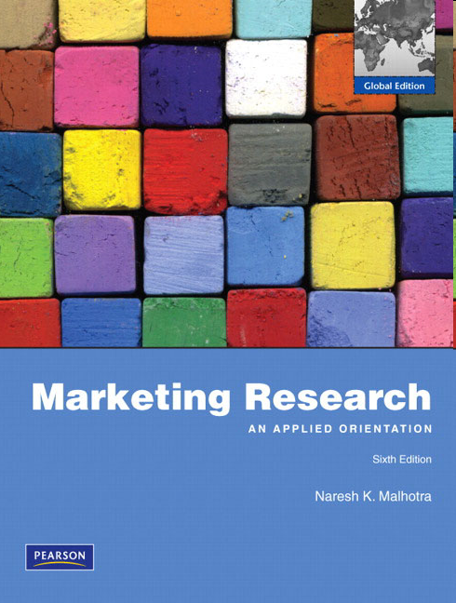
Chapter Two
Defining the Marketing Research Problem and Developing an Approach

Slide 2
Chapter Outline
1) The Process of Defining the Problem and Developing an Approach
2) Tasks involved in Problem Definition
i. Discussions with Decision Makers
ii. Interviews with Industry Experts
iii. Secondary Data Analysis
iv. Qualitative Research

Slide 3
Chapter Outline
3) Environmental Context of the Problem
4) Problem Definition
5) Components of an Approach
i. Objective / Theoretical Foundations
ii. Analytical Model
iii. Research Questions
iv. Hypothesis
v. Specification of Information Needed

Slide 4
1) Dr. Malhotra’s Case
Dr. Malhotra:
“One day I received a phone call from a research analyst who introduced himself as one of our alumni.
He was working for a restaurant chain in town and wanted help analyzing the data he had collected while conducting a marketing research study.”

Slide 5
1) Dr. Malhotra’s Case
“When we met, he presented me with a copy of the questionnaire and asked how he should analyze the data. My first question to him was:
What is the problem being addressed?”

Slide 6
1) Dr. Malhotra’s Case
“When he looked perplexed, I explained that data analysis is not an independent exercise.
Rather, the goal of data analysis is to PROVIDE INFORMATION RELATED TO THE PROBLEM COMPONENTS.”

Slide 7
1) Dr. Malhotra’s Case
“I was surprised to learn that he did not have a clear understanding of the marketing research problem and that a written definition did not exist. So before going any further, I had to define the marketing research problem.”
“Once that was done, I found that much of the data collected was not relevant to the problem. In this sense, the whole study was a waste of resources. A new study had to be designed and implemented to address the problem defined.”

Slide 8
1) The Problem Definition Process
Fig. 2.1
Pre-step 1: Tasks Involved
Discussion
Interviews
Secondary
Qualitative
with
with
Data
Research
Decision Maker(s)
Experts
Analysis
Pre-step 2: Environmental Context of the Problem
Step I: Problem Definition
Management Decision Problem
Marketing Research Problem
Step II: Approach to the Problem
Objective/
Analytical Model: Verbal, Graphical, Mathematical
Research
Specification
of
Information
Needed
Theoretical
Questions
Hypotheses
Foundations
Step III: Research Design

Slide 9
2) Pre-step 1: Tasks Involved (Discussion w/ DM)
The problem audit is a comprehensive examination of a marketing problem with the purpose of understanding its origin and nature. A discussion with the decision-maker (DM) includes:
1. History of the problem - The events that led to the decision that action is needed.
2. Alternatives - The alternative courses of action available to the DM.
3. Criteria - The criteria that will be used to evaluate the alternative courses of action.
4. Potential Actions - The potential actions that are likely to be suggested based on the research findings.
5. Information Needed - The information that is needed to answer the DM's questions.
6. Uses of Information - The manner in which the DM will use each item of information in making the decision.
7. Cultural Influence - The corporate culture as it relates to decision making.

Slide 10
2) Pre-step 1: Tasks Involved, continued
Conduct Interviews with Industry Experts
Survey experiences professionals; useful for new products.
Conduct Secondary Data Analysis
Secondary data: data collected for some other purpose other than the problem at hand; this data already exists.
Primary data: any data that originated by the researcher specifically to address the research problem (save this for later).
Conduct Qualitative Research
Qualitative research: an unstructured, exploratory research methodology based on small samples intended to provide insight and understanding of the problem setting.
Examples: focus groups, depth interviews.

Slide 11
3) Pre-step 2: Consider the Environmental Context of the Problem
Considering the following:
PAST INFORMATION AND FORECASTS
FIRM RESOURCES AND CONSTRAINTS
RESEARCH OBJECTIVES
BUYER BEHAVIOR
LEGAL ENVIRONMENT
ECONOMIC ENVIRONMENT
MARKETING AND TECHNOLOGICAL SKILLS OF THE FIRM

Slide 12
The Problem Definition Process (again)
Fig. 2.1
Pre-step 1: Tasks Involved
Discussion
Interviews
Secondary
Qualitative
with
with
Data
Research
Decision Maker(s)
Experts
Analysis
Pre-step 2: Environmental Context of the Problem
Step I: Problem Definition
Management Decision Problem
Marketing Research Problem
Step II: Approach to the Problem
Objective/
Analytical Model: Verbal, Graphical, Mathematical
Research
Specification
of
Information
Needed
Theoretical
Questions
Hypotheses
Foundations
Step III: Research Design

Slide 13
4) Step I: Problem Definition
Management Decision Problem Marketing Research Problem
Asks what the DM needs to do ←→ Asks what information is needed and how it should obtained
EXAMPLE
Should a new product be ←→ What are the consumer preferences
introduced? and purchase intentions for the
proposed new product?
Should the advertising ←→ How effective is the current
campaign be changed? advertising campaign?
Should the price of the ←→ How elastic is the demand?
brand be increased? How will a price change impact
sales and profits?

Slide 14
4) Definition of the Research Problem
Fig. 2.3
Marketing Research Problem
Broad Statement
Specific Components
For example….

Slide 15
4) Department Store Project Example
Broad Statement
Problem Definition:
In the department store project, the marketing research problem is to determine the relative strengths and weaknesses of Sears, vis-à-vis other major competitors, with respect to factors that influence store patronage. Specifically, research should provide information on the following questions:
1. What criteria do households use when selecting department stores? 2. How do households evaluate Sears and competing stores in terms of the choice criteria identified in question 1? 3. What is the demographic and psychological profile of the customers of Sears and competitors?
Specific Components

Slide 16
The Problem Definition Process (again)
Fig. 2.1
Pre-step 1: Tasks Involved
Discussion
Interviews
Secondary
Qualitative
with
with
Data
Research
Decision Maker(s)
Experts
Analysis
Pre-step 2: Environmental Context of the Problem
Step I: Problem Definition
Management Decision Problem
Marketing Research Problem
Step II: Approach to the Problem
Objective/
Analytical Model: Verbal, Graphical, Mathematical
Research
Specification
of
Information
Needed
Theoretical
Questions
Hypotheses
Foundations
Step III: Research Design

Slide 17
5) Step II: Approach to the Problem
Objective/Theoretical Foundations
Research Questions
Hypotheses
Analytical Models
Specification of the Information Needed

Slide 18
5) Objective/Theoretical Foundations
A theory is a conceptual scheme based on foundational statements that are assumed to be true.
Theory should be developed using objective, secondary evidence.
Theory should be relied upon when…
developing variables and hypotheses
operationalizing variables
choosing research procedures (e.g. survey, experiment, etc.)
selecting a sample
analyzing and interpreting data

Slide 19
5) Development of Research Questions and Hypotheses
Components of the
Marketing Research Problem
Objective/
Theoretical
Framework
Research Questions
Hypotheses
Analytical Model

Slide 20
5) Research Questions and Hypotheses
Research questions (RQs) are refined statements of the specific components of the problem.
Does preference for Sears lead to patronage?
What leads to preference for Sears?
A hypothesis (H) is an unproven statement or proposition about a factor or phenomenon that is of interest to the researcher. Often, a hypothesis is a possible answer to the research question.
H1: Positive evaluation of Sears leads to preference for Sears.
H2: Preference for Sears leads to patronage of Sears.

Slide 21
5) Analytical Models
An analytical model is a set of variables and their interrelationships designed to represent, in whole or in part, some real system or process.
The most common forms of analytical models are
verbal,
graphical, and
mathematical models.

Slide 22
5) Analytical Models, continued
In verbal models, the variables and their relationships are stated in prose form.
Example:
A consumer first becomes aware of a department store. That person then gains an understanding of the store by evaluating the store in terms of the factors comprising the choice criteria. Based on the evaluation and understanding, the consumer forms a degree of preference for the store. If preference is strong, the consumer will patronize the store.

Slide 23
5) Analytical Models, continued
Graphical models state the relationships in visual form.
Awareness
Understanding
Evaluation
Preference
Patronage

Slide 24
5) Analytical Models, continued
Mathematical models explicitly specify the relationships among variables, usually in equation form.
Y = Β₀ + Β₁X
where Β₀ is a constant (i.e. starting point), Β₁ is the regression coefficient, X is the value of the independent variable, and Y is the value of the dependent variable. In this case:
Patronage = Constant + Preference*X
Preference = Constant + Understanding*X1 + Evaluation*X2
Understanding = Constant + Awareness*X
Evaluation = Constant + Awareness*X

Slide 25
5) Specification of Information Needed
What information should be obtained in the marketing research project? Focus on:
each component of the problem,
the analytical framework/models,
the research questions, and
the hypotheses.
This exercise is carried out for the department store example on the next few slides…

Slide 26
Specification of Information Needed: Department Store Project Example
Component 1: What criteria do households use when selecting department stores?
The researcher identified the following factors as part of the choice criteria:
quality of merchandise,
variety and assortment of merchandise,
returns and adjustment policy,
service of store personnel,
prices,
convenience of location…

Slide 27
Department Store Project Example, cont’d.
Research Question: Is price the most important criteria when selecting a department store?
Hypothesis 1: Price is the most important criteria when selecting a department store.
Information needed:
Survey a few hundred department store customers.
The respondents should be asked to rate the importance of each factor as it influences their store selection.

Slide 28
Survey Example
Please rate the following stores on the below criteria (1 = worst, 10 =best).
 | Sears | JC Penney | Kohl’s | Bon-Ton
Quality of merchandise
Variety and assortment of merchandise
Returns and adjustment policy
Service of store personnel
Prices
Convenience of location

Slide 29
Questions??
Thank You!

