Slide 1
Chapter Four
Exploratory Research Design: Secondary Data

Slide 2
Chapter Outline
Primary Versus Secondary Data
Criteria for Evaluating Secondary Data
Classification of Secondary Data
Internal Secondary Data
External Secondary Data

Slide 3
1. Primary Vs. Secondary Data
Primary data are originated by a researcher for the specific purpose of addressing the problem at hand.
The collection of primary data involves all six steps of the marketing research process (Chapter 1).
Secondary data are data that have already been collected for purposes other than the problem at hand.
These data can be located quickly and inexpensively.
OpenView Partners (VC firm) explain: http://www.youtube.com/watch?v=h5RbuDxw4FQ

Slide 4
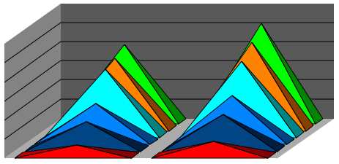
1. A Comparison of Primary & Secondary Data
Table 4.1
Primary Data Secondary Data
Collection purpose For the problem at hand For other problems
Collection process Very involved Rapid & easy
Collection cost High Relatively low
Collection time Long Short

Slide 5
1. Uses of Secondary Data
Uses of secondary data include:
Identifying the problem
Better defining the problem
Developing an approach to the problem
Formulating an appropriate research design
For example, identifying the key variables
Answering broad/speculative research questions

Slide 6
2. Criteria for Evaluating Secondary Data
Table 4.2
Criteria Remarks
Specifications & Methodology | What data collection methods were used? Data should be reliable, valid, & generalizable to the problem.
Error & Accuracy | Any errors in approach, research design, etc? Assess accuracy by comparing data from different sources.
Currency/ Time lag | How big is the time lag between collection and publication? Aim to use the most current data.
Objective | Why were the data collected? The more similar the objective to your study, the better.
Nature | How were variables defined, measured? Key variables must be consistently defined.
Dependability | Is the data dependable? Data should be obtained from an original, reputable source.

Slide 7
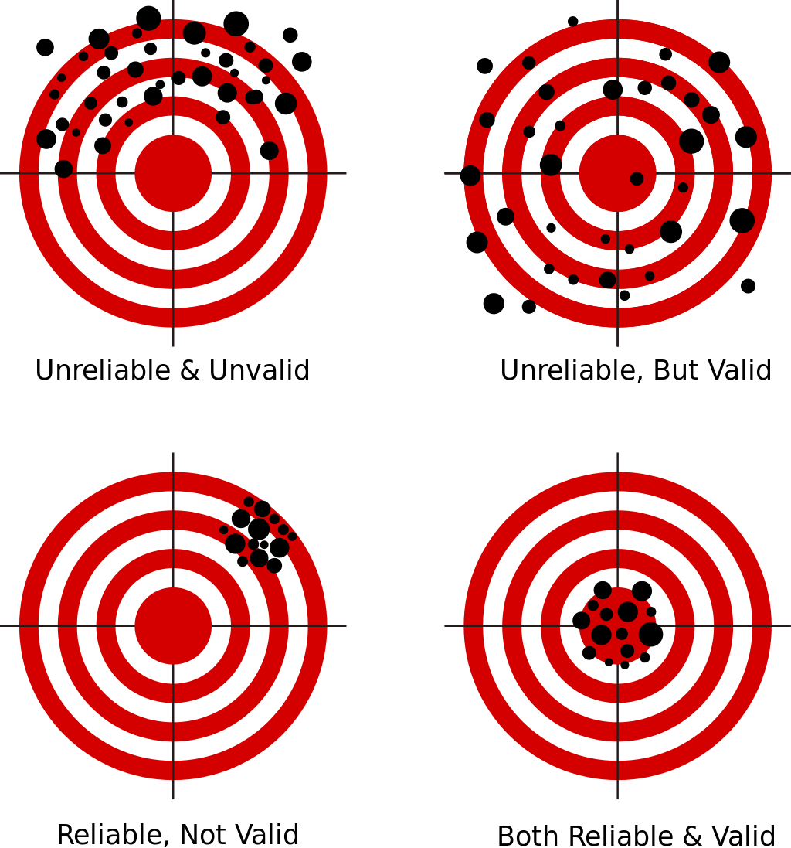
Reliability, validity, and generalizability
Reliability: the extent to which a measurement gives results that are consistent.
Validity: the degree to which an assessment measures what it is supposed to measure (accuracy).
Generalizability: the ability to extend a concept/finding to less-specific criteria.
For example, can findings about UML students be extended to other universities?

Slide 8
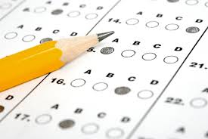
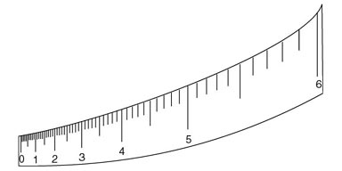
Reliability, validity, and generalizability
Valid, not reliable: SAT may be a valid indicator of cognitive ability, though it may not do so reliably.
Same individual may get
different results when taking
SAT for a second time.
Reliable, not valid: Any ruler would be reliable, but a warped rule would not be valid.
Consistent, inaccurate measurements.

Slide 9
Types of Validity
Construct Validity: the extent to which operationalizations of a construct actually measure what the theory says they do.
For example, to what extent is a questionnaire actually measuring "intelligence"?
Convergent Validity: the degree to which a measure (e.g. survey item) is correlated with other measures that it is theoretically predicted to correlate with.
Survey items should converge on a construct.
Discriminant Validity: the degree to which measurements that are supposed to be unrelated are, in fact, unrelated.

Slide 10
Convergent and Discriminant Validity
 | R1 | R2 | R3 | ITT1 | ITT2 | ITT3
Reputation1 | 1
Reputation2 | .878** | 1
Reputation3 | .789** | .801** | 1
Intent to Purchase1 | 0.201 | 0.151 | 0.123 | 1
Intent to Purchase2 | 0.173 | 0.142 | 0.091 | .901** | 1
Intent to Purchase3 | 0.312* | 0.192 | 0.211 | .855** | .823** | 1
Repuation = reputation of a brand, based on customer responses
Intent to Purchase = customers intention to purchase from that brand.
** = significant correlation

Slide 11
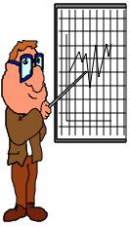
3. A Classification of Secondary Data
Fig. 4.1
Secondary Data
Internal
External
Ready to Use
Requires Further Processing
Published
Materials
Computerized Databases
Syndicated Services

Slide 12
4. Internal Secondary Data
Internal Secondary Data: In-house data collected for some other purpose other than the problem at hand (e.g. Database marketing).
Department Store Project Example
Before approaching the problem, sales were analyzed to obtain:
Sales by product line, major department (e.g., men's wear, house wares), geographical region, and time periods.
From this, hypotheses and models could be created.

Slide 13
5. External Secondary Data
External Secondary Data: Published Materials:
Publications, such as Standard and Poor’s, Moody’s, and Hoover’s provide company information.
Directories, such as the Encyclopedia of Associations, Fortune 500 Directory, are helpful for identifying firms that collect data.
Census data is useful for analyzing the bigger environment.
http://www.census.gov/
Ad Age Articles:
http://adage.com/article/adagestat/census-finds-1-3-million-fewer-nuclear-families/228057/
http://adage.com/article/adagestat/important-census-trends-marketers/226888/

Slide 14
Classification of Computerized Databases
External Secondary Data: Computerized Databases:
Bibliographic databases are composed of citations to articles
E.g. ABI/Inform
Numeric databases contain numerical and statistical information
E.g. Neilson Claritas (www.claritas.com)
Full-text databases contain the complete text of the source documents comprising the database
E.g. Lexis – Nexus, Google Scholar
Directory databases provide information on individuals, organizations, and services
EIS Industry Classifications

Slide 15
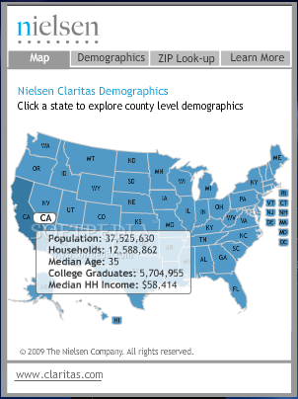
Useful Sources
Neilson Claritas: www.claritas.com
Google Scholar: Scholar.google.com

Slide 16
Syndicated Services
External Secondary Data: Syndicated Services:
Syndicated services are companies that collect and sell common pools of data of known commercial value designed to serve a number of clients.
Neilson Media Research is a syndicated service provider
Examples:
Syndicated Panel Surveys: measure the same group over time but possibly on different variables
Purchase Panels: Respondents record their purchases online.
Media Panels: TV viewing is recorded automatically
See Table 4.3 (p. 115) for more examples

Slide 17
Questions??
Thank you!

