Slide 1
Chapter Seven
Causal Research Design: Experimentation

Slide 2
Chapter Outline
1) Concept and Conditions for Causality
2) Definitions of Concepts and Symbols
3) Validity in Experimentation
4) Extraneous Variables
5) A Classification of Experimental Designs
Pre-experimental Designs
True Experimental Designs
Quasi Experimental Designs
Statistical Designs
6) Advantages and Disadvantages

Slide 3
1) Concept of Causality
Causality: When the occurrence of X increases the probability of the occurrence of Y.
Experiments are used to test for causality.
A statement such as "X causes Y" will have the following ordinary meaning and scientific meaning:
____________________________________________________
Ordinary Meaning Scientific Meaning
____________________________________________________
X must always lead to Y The occurrence of X makes the
(X is a deterministic occurrence of Y more probable
cause of Y). (X is a probabilistic cause of Y).
It is possible to prove We can never prove that X is a
that X is a cause of Y. cause of Y. At best, we can
infer that X is a cause of Y.

Slide 4
1) Conditions for Causality
Before inferring causality, the following conditions must be satisfied:
Concomitant variation is the extent to which a cause, X, and an effect, Y, occur together or vary together in the way predicted by the hypothesis under consideration.
The time order of occurrence condition states that the causing event must occur either before or simultaneously with the effect; it cannot occur afterwards.
The absence of other possible causal factors means that the factor or variable being investigated should be the only possible causal explanation.

Slide 5
1) Example of Concomitant Variation
Concomitant Variation between Purchase of Fashion Clothing and Education:
Purchase of Fashion Clothing, Y
High
Low
High
363 (73%)
137 (27%)
500 (100%)
Education, X
Low
322 (64%)
178 (36%)
500 (100%)
We can see an association between education level and the likelihood of purchasing of high-fashion clothing, but we cannot infer causality yet!

Slide 6
1) Purchase of Fashion Clothing By Income and Education
What about the effect of other possibly causal factors (e.g. income)??
These charts imply that income influences the purchase of high-fashion income, not education. Concomitant variation is not enough!
Low Income
High Income
Purchase
Purchase
High
Low
High
Low
High
122 (61%)
78 (39%)
200 (100%)
High
241 (80%)
59 (20%)
300
Education
171 (57%)
129 (43%)
Education
151 (76%)
49 (24%)
200
Low
300 (100%)
Low

Slide 7
2) Definitions and Concepts
Important definitions in experimentation:
Independent variables (treatments) are variables or alternatives that are manipulated and whose effects are measured and compared.
e.g., price levels, advertisements, discounts (coupons)
Dependent variables are the variables which measure the effect of the independent variables on the test units.
e.g., sales, intent to purchase, and market shares
Extraneous variables (confounding variables) are all variables other than the independent variables that affect the response of the test units.
e.g., store size, store location, and competitive effort
Test units are individuals or organizations whose response to the independent variables/treatments is being examined.
e.g., consumers or respondents

Slide 8
2) Experimental Design
An experimental design is a set of procedures specifying:
the test units and how these units are to be divided into groups,
what independent variables are to be manipulated (treatments),
what dependent variables are to be measured; and
how the extraneous variables are to be controlled.
Controlled variables are measured and considered as influential on the DV, they are not manipulated like the IV’s
Symbols used in experimental design:
X = exposure of a group of test units to a treatment of the IV
O = observation of the DV on a group of test units
E.g.: O₁ X O₂ (experimental group)
O₃ O₄ (control group)

Slide 9
2) Experimental Design: Example
Experimental Group
O₁ X O₂
Control Group
O₃ O₄

Slide 10
3) Validity in Experimentation
Experiments must draw valid internal conclusions and be generalizable (external validity):
Internal validity refers to whether the manipulation of the independent variables (treatments) actually caused the observed effects on the dependent variables.
Control of extraneous variables is a necessary.
External validity refers to whether the cause-and-effect relationships found in the experiment can be generalized.
To what other scenarios can the results be projected?

Slide 11
4) Extraneous Variables
Extraneous variables are threats to internal validity.
Threats to internal validity include:
History
Events outside of the study but occur at the same time (e.g. political change, natural disaster, recession).
Maturation
Subjects may change during the course of the experiment or even between measurements.
Testing effects
Repeatedly measuring the participants may lead to bias.
They may remember the correct answers or may be conditioned to know that they are being tested.

Slide 12
4) Extraneous Variables (threats to internal validity)
Threats to internal validity (continued):
Instrumentation
Changes in the measuring instrument.
Statistical regression
Test units with extreme scores move closer to the average score during the course of the experiment.
Selection bias
Improper assignment of test units to treatment conditions.
Differences between groups exist that may interact with the independent variable and thus be 'responsible' for the observed outcome.
Mortality
Loss of test units while the experiment is in progress.

Slide 13
4) Controlling Extraneous Variables
How do we deal with these threats to internal validity? Four options:
Randomization (R)
Randomly assign test units (respondents) to experimental/control groups.
Matching
Matching test units on a set of key background variables before assigning them to treatment groups.
Statistical control (weighting)
Measuring the extraneous variables and adjusting for their effects through statistical analysis.
Design control
The use of experiments designed to control specific extraneous variables, such as…

Slide 14
5) A Classification of Experimental Designs
Classifications include pre-experimental, true experimental, quasi-experimental and statistical:
Classifications based on how we control for extraneous factors?
1. Pre-experimental designs do not employ randomization procedures to control for extraneous factors.
The one-shot case study: X O₁
The one-group pretest-posttest design: O₁ X O₂
The static-group: X O₁ (experimental group)
O₂ (control group)
X = treatment/manipulation of the IV
O = observation of the DV

Slide 15
5) A Classification of Experimental Designs
2. True experimental design: the researcher can randomly assign test units to experimental groups and treatments to experimental groups.
The pretest-posttest control group design:
R O₁ X O₂ (experimental group)
R O₃ O₄ (control group)
The posttest-only control group design:
R X O₁ (experimental group)
R O₂ (control group)
The Solomon four-group design:
R O₁ X O₂
R X O₃
R O₄ O₅
R O₆
X = treatment/ manipulation of the IV
O = observation of the DV
R = randomization

Slide 16
5) A Classification of Experimental Designs
3. Quasi-experimental design: the researcher can not randomly assign test units, but can control extraneous factors in other ways (e.g. multiple observations).
Time series design:
O₁ O₂ O₃ O₄ X O₅ O₆ O₇ O₈
Multiple time series design:
O₁ O₂ O₃ O₄ X O₅ O₆ O₇ O₈
O₉ O₁₀ O₁₁ O₁₂ O₁₃ O₁₄ O₁₅ O₁₆
4. Statistical design: a series of basic experiments that allows for statistical control of extraneous factors.
Randomized block design: test units are blocked, or grouped, based on some external variable (e.g. age, education), ensuring that control and experimental groups match.
Factorial designs: allows research to measure multiple treatments and their interactions. (see slide 7-26)

Slide 17
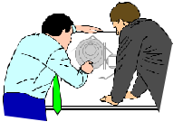
5) A Classification of Experimental Designs
Figure 7.1
Experimental Designs
Pre-experimental
True Experimental
Quasi Experimental
Statistical
One-Shot Case Study
One Group Pretest-Posttest
Static Group
Pretest-Posttest Control Group
Posttest: Only Control Group
Solomon Four-Group
Time Series
Multiple Time Series
Randomized Blocks
Factorial Design

Slide 18
5) Pre-experimental: One-Shot Case Study
X 0₁
A single group of test units is exposed to a treatment X.
A single measurement on the dependent variable is taken (0₁).
There is no random assignment of test units.
The one-shot case study is more appropriate for exploratory than for conclusive research.

Slide 19
5) Pre-experimental: One-Group Pretest-Posttest Design
0₁ X 0₂
A group of test units is measured twice.
There is no control group.
The treatment effect is computed as 0₂ – 0₁.
The validity of this conclusion is questionable since extraneous variables are largely uncontrolled.

Slide 20
5) Pre-experimental: Static Group Design
EG: X 0₁
CG: 0₂
A two-group experimental design.
The experimental group (EG) is exposed to the treatment, and the control group (CG) is not.
Measurements on both groups are made only after the treatment.
Test units are not assigned at random.
The treatment effect would be measured as 0₁ - 0₂.

Slide 21
5) True Experimental Designs: Pretest-Posttest Control Group Design
EG: R 0₁ X 0₂
CG: R 0₃ 0₄
Very commonly used design!
Test units are randomly assigned to either the experimental group or the control group.
A pretreatment measure is taken on each group.
0₁ and 0₃
The treatment effect (TE) is measured as: TE = (0₂ - 0₁) - (0₄ - 0₃).
Selection bias is eliminated by randomization.

Slide 22
5) True Experimental Designs: Posttest-Only Control Group Design
EG : R X 0₁
CG : R 0₂
The treatment effect is obtained by:
TE = 0₁ - 0₂
Very similar to that of the pretest-posttest control group design.
Effective randomization is crucial here!

Slide 23
5) Quasi-Experimental Designs: Time Series Design
0₁ 0₂ 0₃ 0₄ 0₅ X 0₆ 0₇ 0₈ 0₉ 0₁₀
There is no randomization of test units to treatments, but multiple observations help control for extraneous factors.
The timing of treatment presentation, as well as which test units are exposed to the treatment, may not be within the researcher's control.
E.g. When people are exposed to a television ad.

Slide 24
5) Quasi-Experimental Designs: Multiple Time Series Design
EG : 0₁ 0₂ 0₃ 0₄ 0₅ X 0₆ 0₇ 0₈ 0₉ 0₁₀
CG : 0_{A} 0_{B} 0_{C} 0_{D} 0_{E} 0_{F} 0_{G} 0_{H} 0_{I} 0_{J}
If the control group is carefully selected, this design can be an improvement over the simple time series experiment.
Can test the treatment effect twice: against the pretreatment measurements (0_{6 v.} 0₅) in the experimental group and against the control group (0_{6 v.} 0_{F})

Slide 25
5) Statistical Designs
Statistical designs consist of a series of basic experiments that allow for statistical control and analysis of external variables and offer the following advantages:
The effects of more than one independent variable can be measured.
Specific extraneous variables can be statistically controlled (because they are measured).
The most common statistical designs are the randomized block design and the factorial design.

Slide 26
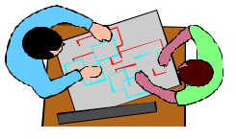
5) Statistical Designs: Randomized Block Design
The test units are blocked, or grouped, on the basis of the external variable (e.g. store patronage).
Treatment Groups Block Store Commercial Commercial Commercial
Number Patronage A B C
1 Heavy A B C
2 Medium A B C
3 Low A B C
4 None A B C
IVs = store patronage, commercial
DV = evaluation of commercial

Slide 27
5) Statistical Designs: Factorial Design
Is used to measure the effects of two or more independent variables at various levels.
A factorial design is used when the external variables are likely to interact.
Very popular method!

Slide 28
5) Factorial Design 2 (male/female) X 2 (high/low expertise) X 2 (high/ low similarity) X 3 (product type) = 24 treatments (in other words, 24 FB profiles)

Slide 29
5) Factorial Design 2 (male/female) X 2 (high/low expertise) X 2 (high/ low similarity) X 3 (product type) = 24 treatments (in other words, 24 FB profiles)
Purpose of study: Does reviewer expertise matter?
This design allows us to measure the impact of ‘expertise’ while controlling for gender, similarity, and product type
If Ashley posted a review of vitamins, would you listen to her??

Slide 30
6) Laboratory Versus Field Experiments
Table 7.7
Factor Laboratory Field
Environment Artificial Realistic
Control High Low Reactive Error High Low
Respondents guess the purpose? High Low
Internal Validity High Low
External Validity Low High
Time Short Long
Number of Units Small Large
Ease of Implementation High Low Cost Low High

Slide 31
6) Limitations of Experimentation
Experiments can be time consuming.
Particularly if the researcher is interested in measuring the long-term effects.
Experiments are often expensive.
The requirements of experimental group, control group, and multiple measurements significantly add to the cost of research.
Experiments can be difficult to administer.
It may be impossible to control for the effects of the extraneous variables, particularly in a field environment.

Slide 32
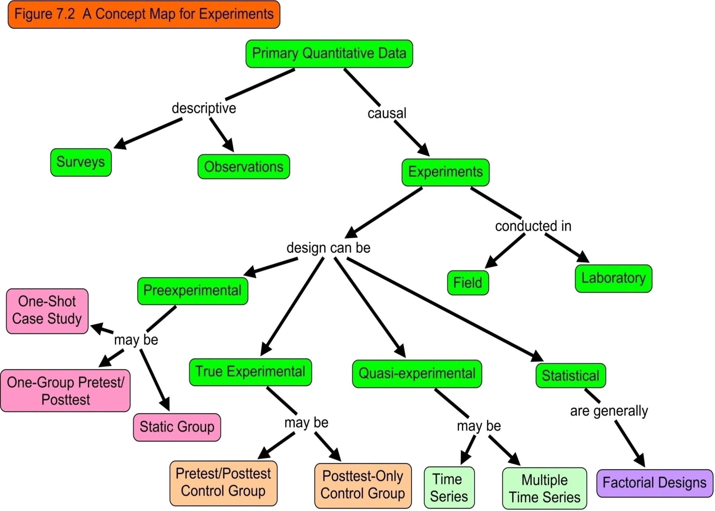

Slide 33
Questions??
Thanks!

