Slide 1
Chapter Eight
Measurement and Scaling:
Fundamentals and
Comparative Scaling

Slide 2
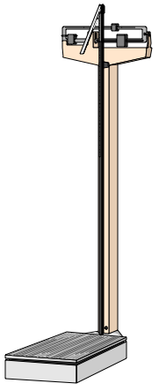
1) Chapter Outline
1) Overview
2) Measurement and Scaling
3) Scales Characteristics
4) Primary Scales of Measurement
5) A Comparison of Scaling Techniques
6) Comparative Scaling Techniques

Slide 3
2) Measurement and Scaling
Measurement means assigning numbers or other symbols to characteristics of objects according to certain pre-specified rules.
The rules for assigning numbers should be standardized, applied uniformly, and must not change over time.
Scaling = the process of measuring entities with respect to quantitative attributes.
= 1 = 2 = 3

Slide 4
3) Scale Characteristics
Scale characteristics: description, order, distance and origin
Description
By description, we mean the unique labels that are used to designate each value of the scale. All scales possess description.
E.g. Female = 1; Male = 2
Order
By order, we mean the relative sizes or positions of the descriptors. Order is denoted by descriptors such as greater than, less than, and equal to.

Slide 5
Scale Characteristics
Distance
The characteristic of distance means that absolute differences between the scale descriptors are known and may be expressed in units.
E.g. distance between intervals on a Likert scale.
Origin
The origin characteristic means that the scale has a unique or fixed beginning or true zero point. Not all scales have an origin.
E.g. income = $0

Slide 6
4) Primary Scales of Measurement
Scale
Nominal Numbers
Assigned
to Runners
Ordinal Rank Order
of Winners
Interval Performance
Rating on a
0 to 10 Scale
Ratio Time to Finish in Seconds
73
81
35
Third
place
Second
place
First
place
8.2
9.1
9.6
15.2
14.1
13.4

Slide 7
Primary Scales of Measurement: Nominal Scale
Nominal Scale
The numbers serve only as labels for identifying objects.
The numbers do not reflect the amount of the characteristic possessed by the objects.
The only permissible operation on the numbers in a nominal scale is counting.
Only a limited number of statistics, all of which are based on frequency counts, are permissible, e.g., percentages, and mode.

Slide 8
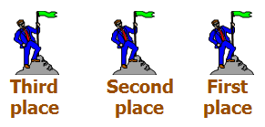
Primary Scales of Measurement Ordinal Scale
Ordinal Scale
A ranking scale in which numbers are assigned to objects to indicate the relative order.
Can determine whether an object has more or less of a characteristic than some other object, but not how much more or less.
In addition to the counting operation allowable for nominal scale data, ordinal scales permit the use of statistics based on centiles, e.g., percentile, quartile, median.

Slide 9
Primary Scales of Measurement Interval Scale
Interval Scale
Numerically equal distances on the scale represent equal values in the characteristic being measured.
It permits comparison of the differences between objects.
It is not meaningful to take ratios of scale values.
Statistical techniques that may be used include all of those that can be applied to nominal and ordinal data, and in addition the mean and standard deviation.

Slide 10
Primary Scales of Measurement Ratio Scale
Possesses all the properties of the nominal, ordinal, and interval scales.
It has an absolute zero point.
It is meaningful to compute ratios of scale values.
E.g. 4 is twice the value of 2.
All statistical techniques can be applied to ratio data.

Slide 11
Illustration of Primary Scales of Measurement
Nominal Ordinal Ratio
Scale Scale Scale
Preference $ spent last No. Store Rankings 3 months
1. Parisian
2. Macy’s
3. Kmart
4. Kohl’s
5. J.C. Penney
6. Neiman Marcus
7. Marshalls
8. Saks Fifth Avenue
9. Sears
10.Wal-Mart
Interval Scale
Preference Ratings
1-7
7 | 5 | $0
2 | 7 | $200
8 | 4 | $0
3 | 6 | $100
1 | 7 | $250
5 | 5 | $75
9 | 4 | $0
6 | 5 | $70
4 | 6 | $100
10 | 2 | $0

Slide 12
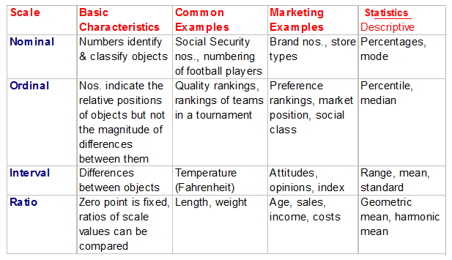
Primary Scales of Measurement

Slide 13
5) A Comparison of Scaling Techniques
Comparative scales involve the direct comparison of objects. Comparative scale data must be interpreted in relative terms and have only ordinal/rank order properties.
In noncomparative scales, each object is scaled independently of the others in the stimulus set. The resulting data are generally assumed to be interval or ratio scaled.

Slide 14
6) Comparative Scaling Techniques Paired Comparison Scaling
Paired Comparison Scaling:
A respondent is presented with two objects and asked to select one according to some criterion.
With n brands, [n(n - 1) /2] paired comparisons are required.
E.g. n=4; 6 comparisons required.
Under the assumption of transitivity, it is possible to convert paired comparison data to a rank order.
E.g. if A is preferred to B, and B is preferred to C, then A is preferred to C.

Slide 15
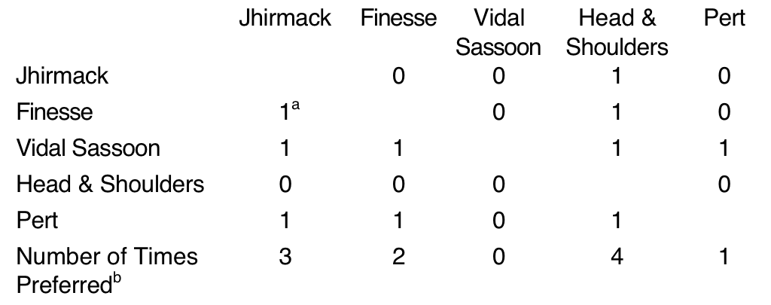
Obtaining Shampoo Preferences Using Paired Comparisons
Instructions: We are going to present you with ten pairs of shampoo brands. For each pair, please indicate which one of the two brands of shampoo you would prefer for personal use. Recording Form:
aA 1 in a particular box means that the brand in that column was preferred over the brand in the corresponding row. A 0 means that the row brand was preferred over the column brand. bThe number of times a brand was preferred is obtained by summing the 1s in each column.

Slide 16
Comparative Scaling Techniques Rank Order Scaling
Rank Order Scaling:
Respondents are presented with several objects simultaneously and asked to order or rank them according to some criterion.
However, it is possible that the respondent may dislike the brand ranked 1 in an absolute sense.

Slide 17
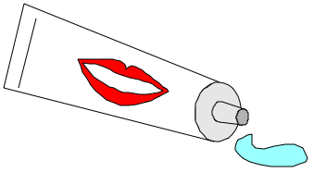
Preference for Toothpaste Brands Using Rank Order Scaling
Rank the following brands. No two brands should receive the same rank number.
Form
Brand Rank Order
1. Crest _________
2. Colgate _________
3. Aim _________
4. Gleem _________
5. Sensodyne _________
6. Ultra Brite _________
7. Close Up _________
8. Pepsodent _________
9. Plus White _________
10. Stripe _________

Slide 18
Comparative Scaling Techniques Constant Sum Scaling
Constant Sum Scaling:
Respondents allocate a constant sum of units, such as 100 points to attributes of a product to reflect their importance.
If an attribute is unimportant, the respondent assigns it zero points.
If an attribute is twice as important as some other attribute, it receives twice as many points.
The sum of all the points is 100. Hence, the name of the scale.

Slide 19
Importance of Bathing Soap Attributes Using a Constant Sum Scale
Instructions
On the next slide, there are eight attributes of bathing soaps.
Please allocate 100 points among the attributes so that your allocation reflects the relative importance you attach to each attribute.
The more points an attribute receives, the more important the attribute is.

Slide 20
Importance of Bathing Soap Attributes Using a Constant Sum Scale
Form
Average Responses of Three Segments Attribute Segment I Segment II Segment III
1. Mildness
2. Lather
3. Lasting Power
4. Price
5. Fragrance
6. Packaging
7. Moisturizing
8. Cleaning Power
8
2
4
2
4
17
3
9
7
53
17
9
9
0
19
7
5
9
5
3
20
13
60
15
Sum
100
100
100

Slide 21
Questions??
Thank you!

