Slide 1
Security Policy and Standards

Slide 2
Part I
1. Introduction
2. Policy
3. Enterprise Information Security Policy
4. Issue-Specific Security Policy (ISSP)
5. System-Specific Policy
6. Guidelines for Policy Management
7. Another Approach to Policy Development
8. SP 800-18 Guide for Developing

Slide 3
Introduction
This chapter focuses on information security policy:
What it is
How to write it
How to implement it
How to maintain it

Slide 4
Policy
Policy is an essential foundation of effective infosec program
The success of an information resources protection program depends on the policy generated, & on the attitude of management toward securing information on automated systems.

Slide 5
You, the policy maker, set the tone & the emphasis on how important a role infosec will have within your agency.
Your primary responsibility is to set the information resource security policy for the organization with the objectives of reduced risk, compliance with laws & regulations, & assurance of operational continuity, information integrity, & confidentiality.”

Slide 6
A quality infosec program begins & ends with policy
Policies are least expensive means of control & often the most difficult to implement
Basic rules to follow when shaping policy:
Never conflict with law
Stand up in court
Properly supported and administered
Contribute to the success of the organization
Involve end users of information systems

Slide 7
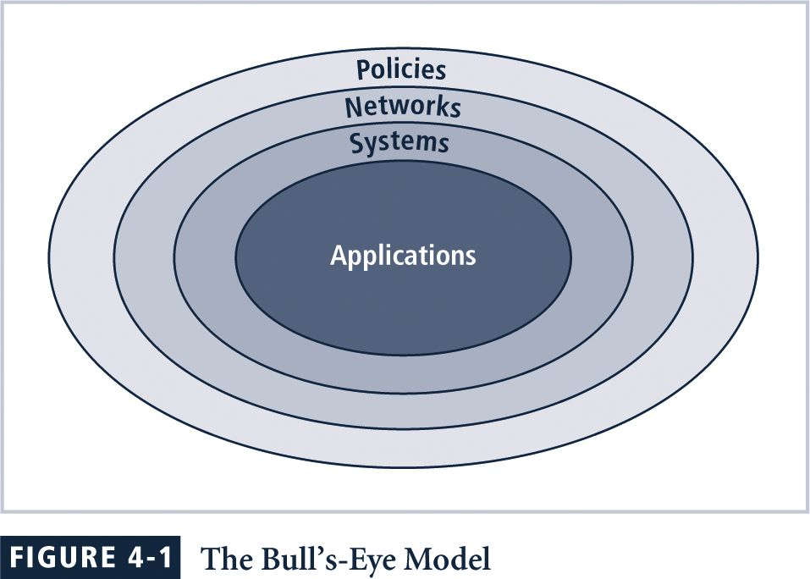
Focus on the systemic solutions, not specifics

Slide 8
Bulls-eye model layers
1. Policies: first layer of defense
2. Networks: threats first meet organization’s network
3. Systems: computers & manufacturing systems
4. Applications: all applications systems

Slide 9
Policies are important reference documents for internal audits & for resolution of legal disputes about management’s due diligence
Policy documents can act as a clear statement of management’s intent

Slide 10
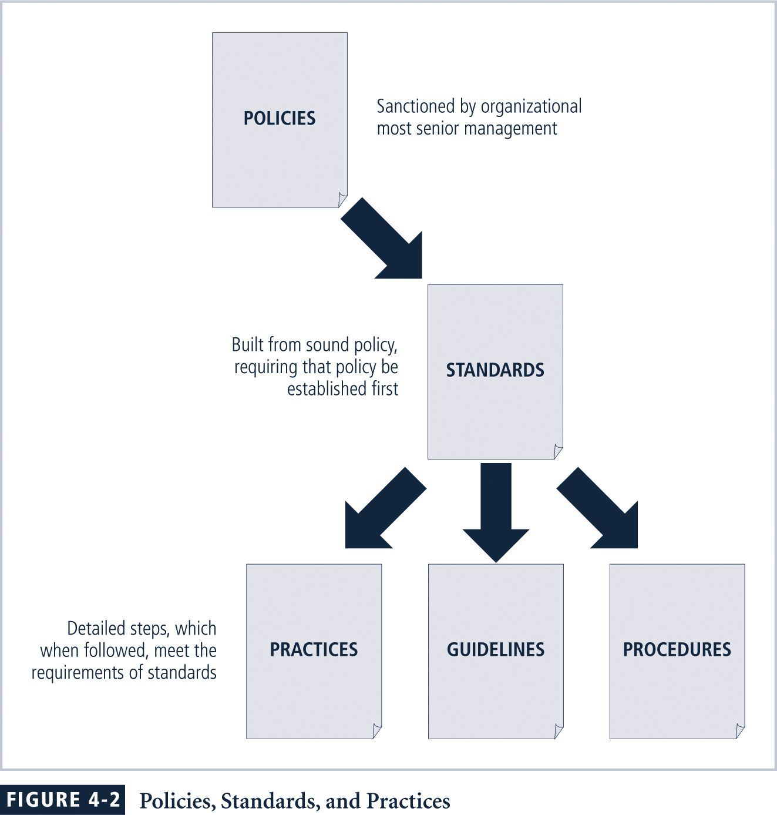

Slide 11
Policy: plan or course of action that influences & determines decisions
Standards: more detailed statement of what must be done to comply with policy
Practices, procedures & guidelines:explain how employees will comply with policy

Slide 12
For policies to be effective, they must be:
Properly disseminated
Read
Understood
Agreed-to

Slide 13
Policies require constant modification & maintenance
In order to produce a complete infosec policy, management must define 3 types of infosec policy:
Enterprise infosec program policy
Issue-specific infosec policies
Systems-specific infosec policies

Slide 14
Part I
1. Introduction
2. Policy
3. Enterprise Information Security Policy
4. Issue-Specific Security Policy (ISSP)
5. System-Specific Policy
6. Guidelines for Policy Management
7. Another Approach to Policy Development
8. SP 800-18 Guide for Developing

Slide 15
Enterprise InfoSec Policy (EISP)
Sets strategic direction, scope, & tone for organization’s security efforts
Assigns responsibilities for various areas of infosec
Guides development, implementation,& management requirements of infosec program

Slide 16
EISP documents should provide:
An overview of corporate philosophy on security
Information about infosec organization & infosec roles:
Responsibilities for security shared by all organization members
Responsibilities for security unique to each organizational role

Slide 17
Components of the EISP
Statement of Purpose: What the policy is for
Information Technology Security Elements: Defines infosec
Need for Information Technology Security: justifies importance of infosec in the organization
Information Technology Security Responsibilities & Roles: Defines organizational structure
References Information Technology standards & guidelines

Slide 18
Sample EISP
Protection Of Information: Information must be protected in a manner commensurate with its sensitivity, value, & criticality
Use Of Information: Company X information must be used only for business purposes expressly authorized by management
Information Handling, Access, & Usage: Information is a vital asset & all accesses to, uses of, & processing of Company X information must be consistent with policies & standards

Slide 19
Data & Program Damage Disclaimers: Company X disclaims any responsibility for loss or damage to data or software that results from its efforts to protect the confidentiality, integrity, & availability of the information handled by computers & communications systems
Legal Conflicts: Company X infosec policies were drafted to meet or exceed the protections found in existing laws & regulations, & any Company X infosec policy believed to be in conflict with existing laws or regulations must be promptly reported to infosec management

Slide 20
Exceptions To Policies: Exceptions to infosec policies exist in rare instances where a risk assessment examining the implications of being out of compliance has been performed, where a standard risk acceptance form has been prepared by the data owner or management, & where this form has been approved by both InfoSec management & Internal Audit management
Policy Non-Enforcement: Management's non-enforcement of any policy requirement does not constitute its consent

Slide 21
Violation Of Law: Company X management must seriously consider prosecution for all known violations of the law
Revocation Of Access Privileges: Company X reserves the right to revoke a user’s information technology privileges at any time
Industry-Specific InfoSec Standards: Company X information systems must employ industry-specific infosec standards

Slide 22
Use Of infosec Policies & Procedures: All Company X infosec documentation including, but not limited to, policies, standards, & procedures, must be classified as “Internal Use Only,” unless expressly created for external business processes or partners
Security Controls Enforceability: All information systems security controls must be enforceable prior to being adopted as a part of standard operating procedure

Slide 23
Thinking about the EISP (10 min):
Information Security Policy Documents
Review and Evaluation
Appropriate Use of Information Technology Resources
Identification of Risks from Third Party Access
Physical Security Area
Personnel Security Screening
Information Security Education and Training

Slide 24
Part I
1. Introduction
2. Policy
3. Enterprise Information Security Policy
4. Issue-Specific Security Policy (ISSP)
5. System-Specific Policy
6. Guidelines for Policy Management
7. Another Approach to Policy Development
8. SP 800-18 Guide for Developing

Slide 25
Issue-Specific Security Policy (ISSP)
Provides detailed, targeted guidance to instruct organization in secure use of tech systems
Begins with intro to fundamental technological philosophy of organization
Serves to protect employee & organization from inefficiency/ambiguity
Documents how technology-based system is controlled Identifies Processes & authorities that provide this control
Serves to indemnify organization against liability for inappropriate or illegal system use

Slide 26
ISSP should
Address specific technology-based systems
Require frequent updates
Contain an issue statement on the organization’s position on an issue

Slide 27
ISSP topics could include
email
use of Internet & World Wide Web
specific minimum configurations of computers to defend against malware
prohibitions against hacking or testing organization security controls
home use of company-owned computer equipment
use of personal equipment on company networks
use of telecommunications technologies
use of photocopy equipment

Slide 28
Components of the ISSP
Statement of Purpose:
Scope & Applicability
Definition of Technology Addressed
Responsibilities
Authorized Access & Usage of Equipment:
User Access
Fair & Responsible Use
Protection of Privacy
more ...

Slide 29
Prohibited Usage of Equipment:
Disruptive Use or Misuse
Criminal Use
Offensive or Harassing Materials
Copyrighted, Licensed, or other Intellectual Property
Other Restrictions
Systems Management:
Management of Stored Materials
Employer Monitoring
Virus Protection
Physical Security
Encryption
more ...

Slide 30
Violations of Policy:
Procedures for Reporting Violations
Penalties for Violations
Policy Review & Modification:
Scheduled Review of Policy & Procedures for Modification
Limitations of Liability:
Statements of Liability or Disclaimers

Slide 31
Common approaches to implementing ISSP
Number of independent ISSP documents
Single comprehensive ISSP document
Modular ISSP document that unifies policy creation & administration
Recommended approach is modular policy, which provides a balance between issue orientation & policy management

Slide 32
Discussion (10 min)
Guidelines on anti-virus process
Email-policy
Password
Third party connection agreement
Acceptable use policy

