Slide 1
ISO/IEC 27001:2005 Information Security Management System Certification Scheme

Slide 2
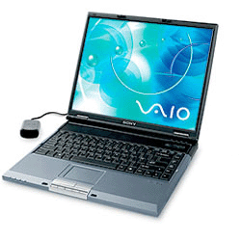
Presentation Outline
MSB in brief
Protecting Information
Information Security Management System – ISO/IEC 27001
How ISO/IEC 27000 works
The Certification Process
Major components of the ISMS
Benefits of Certification
MSB as your Certification Body
Notes:
TBT Agreement : Agreement on Technical Barriers to Trade
TBT Agreement ensures that technical standards as well as testing and certification procedures do not create unnecessary obstacles to trade.
WTO members should use international standards when available to meet their national regulations, except when it is impossible, then national standards apply

Slide 3
The Mauritius Standards Bureau
Parastatal body under aegis of the Ministry of Industry, Science & Research
We provide
Demand driven standardization services
Product & Management Systems Certifications
Conformity assessment services in:
Engineering (Mechanical, Civil, Electrical, NDT)
Chemical Technology, Food & Agriculture, Fibre Technology, Microbiology
Metrology (Mass,force,pressure, electrical measurements,Temperature)
Notes:
TBT Agreement : Agreement on Technical Barriers to Trade
TBT Agreement ensures that technical standards as well as testing and certification procedures do not create unnecessary obstacles to trade.
WTO members should use international standards when available to meet their national regulations, except when it is impossible, then national standards apply

Slide 4
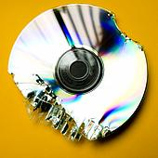
Protecting Information – a critical and essential business asset
High dependency on Information & Communications Technology
A successful business must have the right information at the right time in order to make well-informed decisions
All types of information, whether paper-based or on a computer disk, is at risk
Protection of information is a major challenge
PC/Network Failure,Hackers, Viruses/Spyware, Fraud, Unknown/Unsolicited contacts
What to do?What not to do?
Information Security Management System is the key.
Notes:
TBT Agreement : Agreement on Technical Barriers to Trade
TBT Agreement ensures that technical standards as well as testing and certification procedures do not create unnecessary obstacles to trade.
WTO members should use international standards when available to meet their national regulations, except when it is impossible, then national standards apply

Slide 5
Information Security Management System – ISO/IEC 27001
ISMS provides a framework to establish, implement, operate,monitor, review,maintain and improve the information security within an organization
Implement effective information security that really meets business requirements
Manage risks to suit the business activity
Manage incident handling activities
Build a security culture
Conform to the requirements of the Standard
Notes:
TBT Agreement : Agreement on Technical Barriers to Trade
TBT Agreement ensures that technical standards as well as testing and certification procedures do not create unnecessary obstacles to trade.
WTO members should use international standards when available to meet their national regulations, except when it is impossible, then national standards apply

Slide 6
How 27000 works
The standard comes in two parts :
ISO/IEC 27001:2005 – is a standard specification for an Information Security Management Systems (ISMS) which instructs you how to apply ISO/IEC 27002 and how to build, operate, maintain and improve an ISMS.
ISO/IEC 27002:2007 - is a standard code of practice and can be regarded as a comprehensive catalogue of good security things to do
Notes:
TBT Agreement : Agreement on Technical Barriers to Trade
TBT Agreement ensures that technical standards as well as testing and certification procedures do not create unnecessary obstacles to trade.
WTO members should use international standards when available to meet their national regulations, except when it is impossible, then national standards apply

Slide 7
The certification Process
Guidelines – ISO/IEC 27002:2007
Certification – ISO/IEC 27001:2005
Stage 1 : Documentation Review & evaluate client’s readiness
Stage 2 : Implementation audit & evaluate effectiveness of client’s systems
Lead Auditor’s recommendation to certify
Certificate issued by certification/registration body
Surveillance
Periodic review audits(6 monthly interval)
Triennial re-certification(after 3 years)
Notes:
TBT Agreement : Agreement on Technical Barriers to Trade
TBT Agreement ensures that technical standards as well as testing and certification procedures do not create unnecessary obstacles to trade.
WTO members should use international standards when available to meet their national regulations, except when it is impossible, then national standards apply

Slide 8
What is information?
An asset – essential to an organization’s business and needs to be protected.
Protection is vital in the increasingly interconnected business environment.
Interconnectivity leads to information being exposed to growing number and wider variety of threats and vulnerabilities.
Forms of information- printed, written, stored electronically, transmitted by post, email.

Slide 9
ISMS
With an ISMS we are not intending to make the system ‘hacker proof’ but develop a mechanism which can, to a large extent:
Anticipate potential problems
Prepare through proactive measures
Protect against considerable damages
Ensure recovery and restoration
‘Failure is not when you fall down, but when you fail to get up’

Slide 10
The Challenge…
Protection of information and information systems to meet business and legal requirements by
Provision and demonstration of secure environment to clients
Preventing loss of product knowledge to external
Preventing leak of confidential information
Ease of access to large mobile work force
Introduction of new technologies and tools
Disaster recovery & Business continuity
Managing legal compliance
Managing costs v/s risk

Slide 11
Information Security
Information Security is the protection of information from a wide range of threats in order to ensure business continuity, minimize business risk, maximize return on investments and business opportunities.
Information security is achieved by implementing a suitable set of controls, policies, processes, procedures, organizational structures and software and hardware functions – to ensure that the specific security and business objectives are met.

Slide 12
Why Information Security is needed?
Organizations and their information systems and networks are faced with security threats from a wide range of sources, including
Computer-assisted fraud
Sabotage
Vandalism
Fire or flood
Hacking
Denial of service attacks

Slide 13
Why Information security is needed?
Important to both public and private sector businesses
IS functions as an enabler e.g. to achieve e-government or e-business
IS that can be achieved through technical means is limited, and should be supported by appropriate management and procedures

Slide 14
Objectives of Information Security
Preservation of
Confidentiality: ensuring that information is available to only those authorised to have access
Integrity: Safeguarding the accuracy and completeness of information & processing methods
Availability: ensuring that information and vital services are available to authorised users when required.

Slide 15
What is an ISMS
ISMS provides a framework to establish, implement, operate,monitor, review,maintain and improve the information security within an organization
ISMS provides means to
Manage risks to suit the business activity
Manage incident handling activities
Build a security culture
Conform to the requirements of the Standard

Slide 16
Why ISMS ?
Information security that can be achieved through technical means is limited
Security also depends on people, policies, processes and procedures
Resources are limited
It is not a once off exercise, but an ongoing activity
All these can be addressed effectively and efficiently only through a proper ISMS

Slide 17
Who needs ISMS?
Every organisation which values information needs to protect it e.g.
Banks
Call centers
IT companies
Government & parastatal bodies
Manufacturing concerns
Hospitals
Insurance companies

Slide 18
Benefits of ISMS
Assurance through discipline of compliance
Risk management
Secure environment (protection of IPRs)
Minimize security breaches (continuity of business)
Increase trust & customer confidence & business opportunities

Slide 19
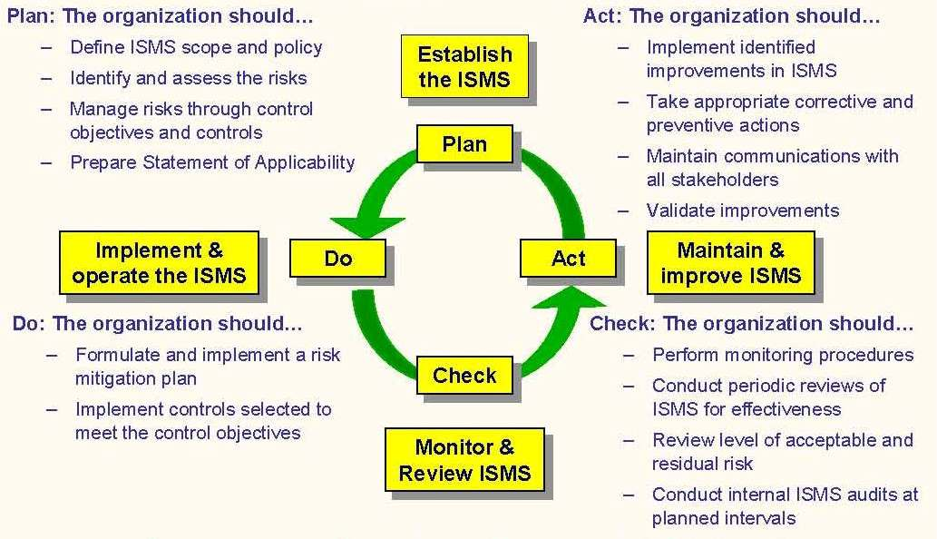
Major components of the ISMS
…the major steps towards achieving ISO 27001:2005 compliance
Notes:
-Process approach for information security mgt
-The Standard adopts the PDCA model to structure all the processes

Slide 20
Overview of MS ISO/IEC 27001:2005
Clause 1 : Scope
Specifies requirements for establishing, implementing,operating,monitoring,reviewing,maintaining and improving a documented ISMS within an organization.
Specifies requirements for the implementation of security controls that will protect information assets and give confidence to interested parties
Exclusions of controls are permitted only if they are found necessary to satisfy the risk acceptance criteria and should be justified.
Clause 2 : Normative references
ISO/IEC 27002:2007 – Code of practice for information security management : Provides control objectives and controls identified by a risk assessment
Clause 3 : Terms and conditions
A list of terms and definitions that apply to the purpose of the Standard
Notes:
TBT Agreement : Agreement on Technical Barriers to Trade
TBT Agreement ensures that technical standards as well as testing and certification procedures do not create unnecessary obstacles to trade.
WTO members should use international standards when available to meet their national regulations, except when it is impossible, then national standards apply

Slide 21
Overview of MS ISO/IEC 27001:2005
Clause 4 : Information security management system
4.1 General Requirements
Processes based on the PDCA model
4.2 Establishing and managing the ISMS
4.2.1 Establish the ISMS
Define the ISMS policy as per characteristics of the business
Define the risk assessment approach
Define scope & boundaries of the ISMS
Identify the risks
Analyse and evaluate the risks
Identify and evaluate options for the treatment of risks
Select control objectives and controls for the treatment of risks
Obtain management approval of the proposed residual risks
Obtain management authorization to implement and operate the ISMS
Prepare a Statement of Applicability(SOA)
Notes:
TBT Agreement : Agreement on Technical Barriers to Trade
TBT Agreement ensures that technical standards as well as testing and certification procedures do not create unnecessary obstacles to trade.
WTO members should use international standards when available to meet their national regulations, except when it is impossible, then national standards apply

Slide 22
Overview of MS ISO/IEC 27001:2005
Clause 4 : Information security management system
4.2 Establishing and managing the ISMS
4.2.2 Implement and operate the ISMS
Formulate & Implement the RTP
Implement controls
How to measure effectiveness of controls
Implement training and awareness
Manage resources
Implement procedures and controls capable of enabling prompt detection of security incidents
Notes:
TBT Agreement : Agreement on Technical Barriers to Trade
TBT Agreement ensures that technical standards as well as testing and certification procedures do not create unnecessary obstacles to trade.
WTO members should use international standards when available to meet their national regulations, except when it is impossible, then national standards apply

Slide 23
Overview of MS ISO/IEC 27001:2005
Clause 4 : Information security management system
4.2 Establishing and managing the ISMS
4.2.3 Monitor and review the ISMS
Execute monitoring and reviewing procedures to detect security incidents
Undertake regular reviews of effectiveness of the controls
Conduct internal audits
Review risk assessments regularly
4.2.4 Maintain and improve the ISMS
Apply lessons learnt from security experiences
Notes:
TBT Agreement : Agreement on Technical Barriers to Trade
TBT Agreement ensures that technical standards as well as testing and certification procedures do not create unnecessary obstacles to trade.
WTO members should use international standards when available to meet their national regulations, except when it is impossible, then national standards apply

Slide 24
Overview of MS ISO/IEC 27001:2005
Clause 4 : Information security management system
4.3 Documentation requirements
4.3.1 General
ISMS Scope, policy and objectives
Procedures and controls
Risk assessment methodology & report
Risk Treatment Plan
Statement of Applicability
4.3.2 Control of documents
4.3.3 Control of Records
Notes:
TBT Agreement : Agreement on Technical Barriers to Trade
TBT Agreement ensures that technical standards as well as testing and certification procedures do not create unnecessary obstacles to trade.
WTO members should use international standards when available to meet their national regulations, except when it is impossible, then national standards apply

Slide 25
Overview of MS ISO/IEC 27001:2005
Clause 5 : Management Responsibility
5.1 Management commitment
5.2 Resource Management
Clause 6 : Internal ISMS Audits
Organization shall conduct regular interval audits to determine if the control objectives, processes and procedures :
conform to the requirements of the standard
conform to the identified security requirements
are effectively implemented and maintained
perform as expected
Notes:
TBT Agreement : Agreement on Technical Barriers to Trade
TBT Agreement ensures that technical standards as well as testing and certification procedures do not create unnecessary obstacles to trade.
WTO members should use international standards when available to meet their national regulations, except when it is impossible, then national standards apply

Slide 26
Overview of MS ISO/IEC 27001:2005
Clause 7 : Management Review of the ISMS
Clause 8 : ISMS Improvement
8.1 Continual improvement
8.2 Corrective action
8.3 Preventive action
Notes:
TBT Agreement : Agreement on Technical Barriers to Trade
TBT Agreement ensures that technical standards as well as testing and certification procedures do not create unnecessary obstacles to trade.
WTO members should use international standards when available to meet their national regulations, except when it is impossible, then national standards apply

Slide 27
Benefits of Certification
A valuable framework for resolving security issues
Enhancement of client confidence & perception of your organisation
Enhancement of business partners’ confidence & perception of your organisation
Provides confidence that you have managed risk in your own security implementation
Enhancement of security awareness within an organisation
Assists in the development of best practice
Can often be a deciding differentiator between competing organisations
Notes:
TBT Agreement : Agreement on Technical Barriers to Trade
TBT Agreement ensures that technical standards as well as testing and certification procedures do not create unnecessary obstacles to trade.
WTO members should use international standards when available to meet their national regulations, except when it is impossible, then national standards apply

Slide 28
MSB as your National Certification Body
National responsibility to promote best practices and enhance competitiveness
MSB charges for its services at cost basis
Qualified and IRCA Registered auditors
Issuance of worldwide accredited certificates
Notes:
TBT Agreement : Agreement on Technical Barriers to Trade
TBT Agreement ensures that technical standards as well as testing and certification procedures do not create unnecessary obstacles to trade.
WTO members should use international standards when available to meet their national regulations, except when it is impossible, then national standards apply

Slide 29
Schedule of Fees for NISMS
Preliminary visit Free of charge
Application fee for certification Rs 8000
Assessment of Quality Manual Covered by application fee
Pre-assessment,if requested(per man-day) Rs 8000
Initial assessment (per man-day) Rs 8000
Continuing assessment(per man-day) Rs 8000
Certificate of Registration(3 years) Rs 16000
Cost of the standards
MS ISO/IEC 27001 : 2005 - Rs 1280
ISO/IEC 27002:2007 - Rs 2035
Notes:
TBT Agreement : Agreement on Technical Barriers to Trade
TBT Agreement ensures that technical standards as well as testing and certification procedures do not create unnecessary obstacles to trade.
WTO members should use international standards when available to meet their national regulations, except when it is impossible, then national standards apply

Slide 30
Thank you for your attention.

