Slide 1
Security Policy

Slide 2
Part I
1. Introduction
2. Policy
3. Enterprise Information Security Policy
4. Issue-Specific Security Policy (ISSP)
5. System-Specific Policy
6. Guidelines for Policy Management
7. Another Approach to Policy Development
8. SP 800-18 Guide for Developing

Slide 3
Systems-Specific Policies (SysSPs)
They may often be created to function as standards or procedures to be used when configuring or maintaining systems
SysSPs can be separated into:
  Management guidance
  Technical specifications
  Combined in a single policy document

Slide 4
Management Guidance SysSPs
Created by management to guide the implementation & configuration of technology
Applies to any technology that affects the confidentiality, integrity or availability of information
Informs technologists of management intent

Slide 5
Technical Specifications SysSPs
System administrators’ directions on implementing managerial policy
Each type of equipment has its own type of policies
Two general methods of implementing such technical controls:
  1. Access control lists
  2. Configuration rules

Slide 6
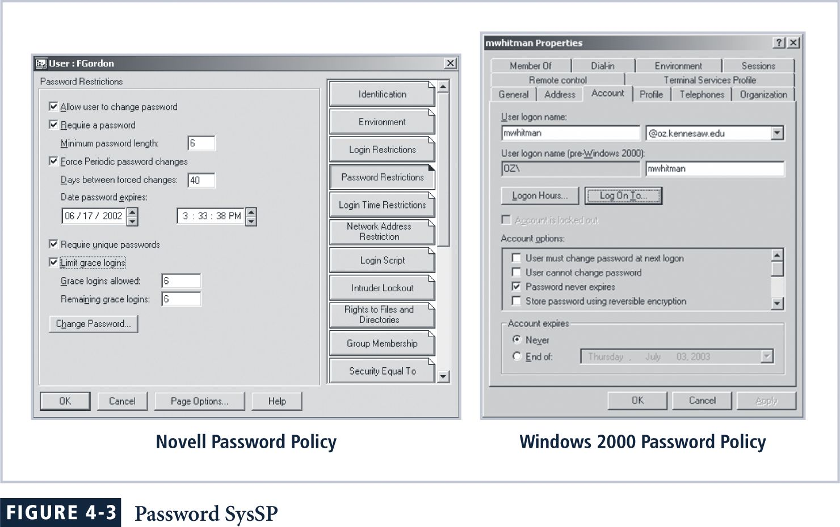

Slide 7
Access Control Lists
ACLs enable administrations to restrict access according to user, computer, time, duration, or even a particular file
more ...

Slide 8
Include user access lists, matrices, & capability tables that govern rights & privileges
Can control access to file storage systems, object brokers, or other network communications devices
Capability Table: similar method that specifies which subjects & objects users or groups can access
Specifications are frequently complex matrices, rather than simple lists or tables
Level of detail & specificity (often called granularity) may vary from system to system

Slide 9
ACLs regulate
Who can use the system
What authorized users can access
When authorized users can access the system
Where authorized users can access the system from
How authorized users can access the system
Restricting what users can access, e.g. printers, files, communications, & applications

Slide 10
ACL Administrators set user privileges
  Read
  Write
  Create
  Modify
  Delete
  Compare
  Copy

Slide 11
Configuration rules are specific configuration codes entered into security systems to guide execution of system when information is passing through it
Rule policies are more specific to system operation than ACLs & may or may not deal with users directly
Many security systems require specific configuration scripts telling systems what actions to perform on each set of information processed

Slide 12
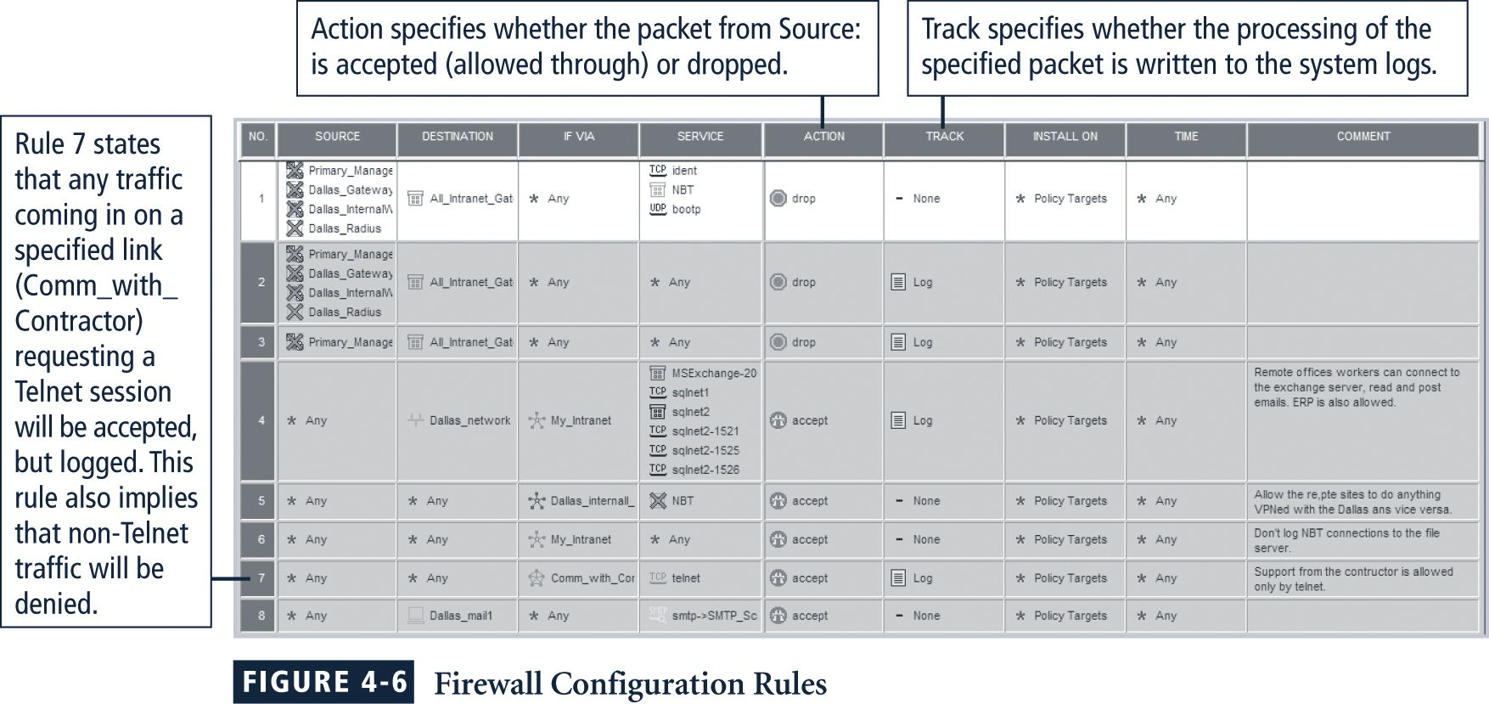

Slide 13
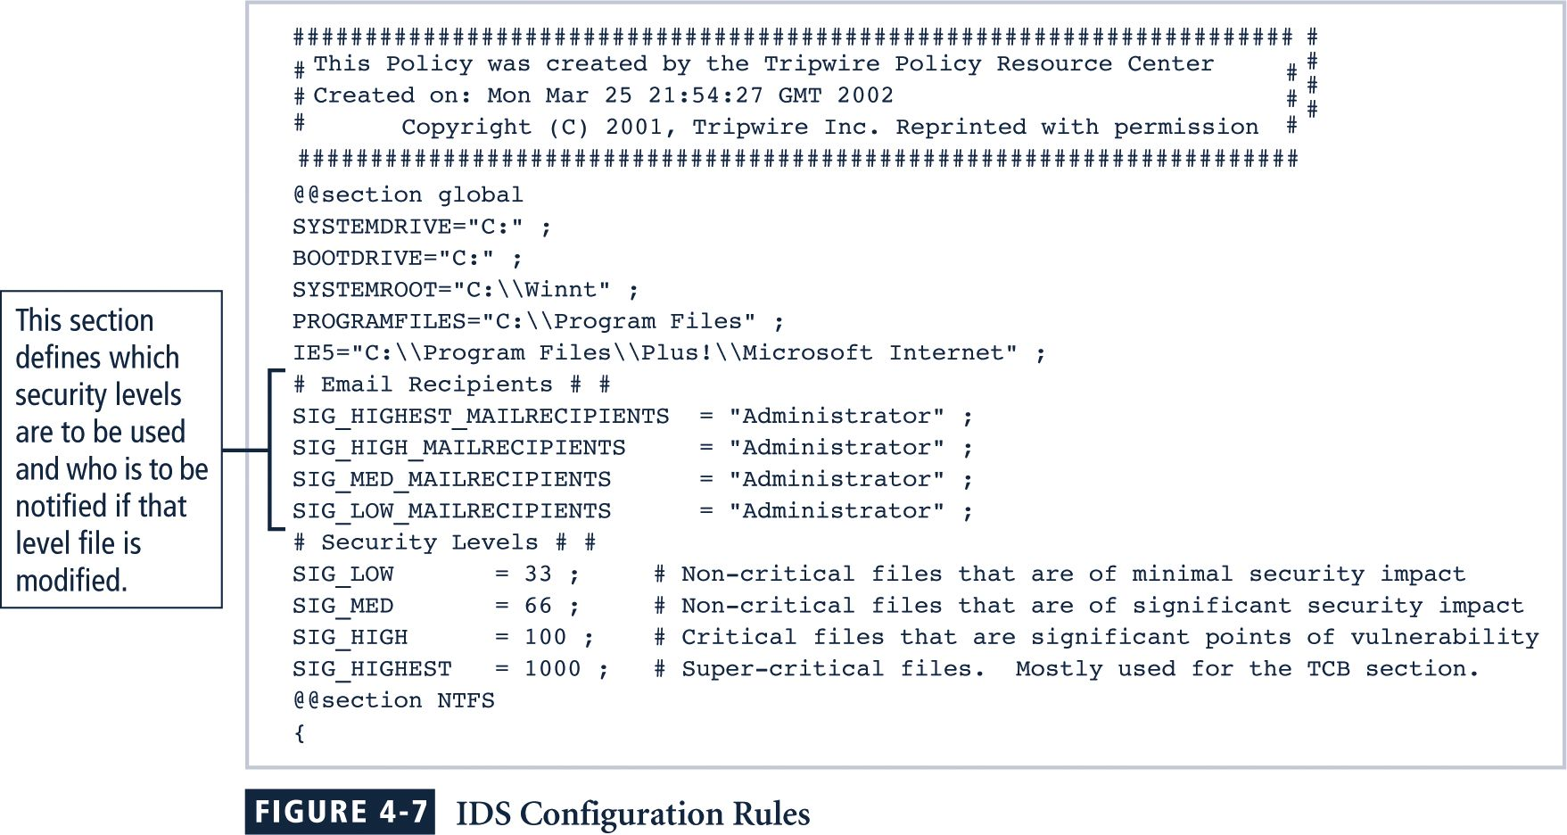

Slide 14
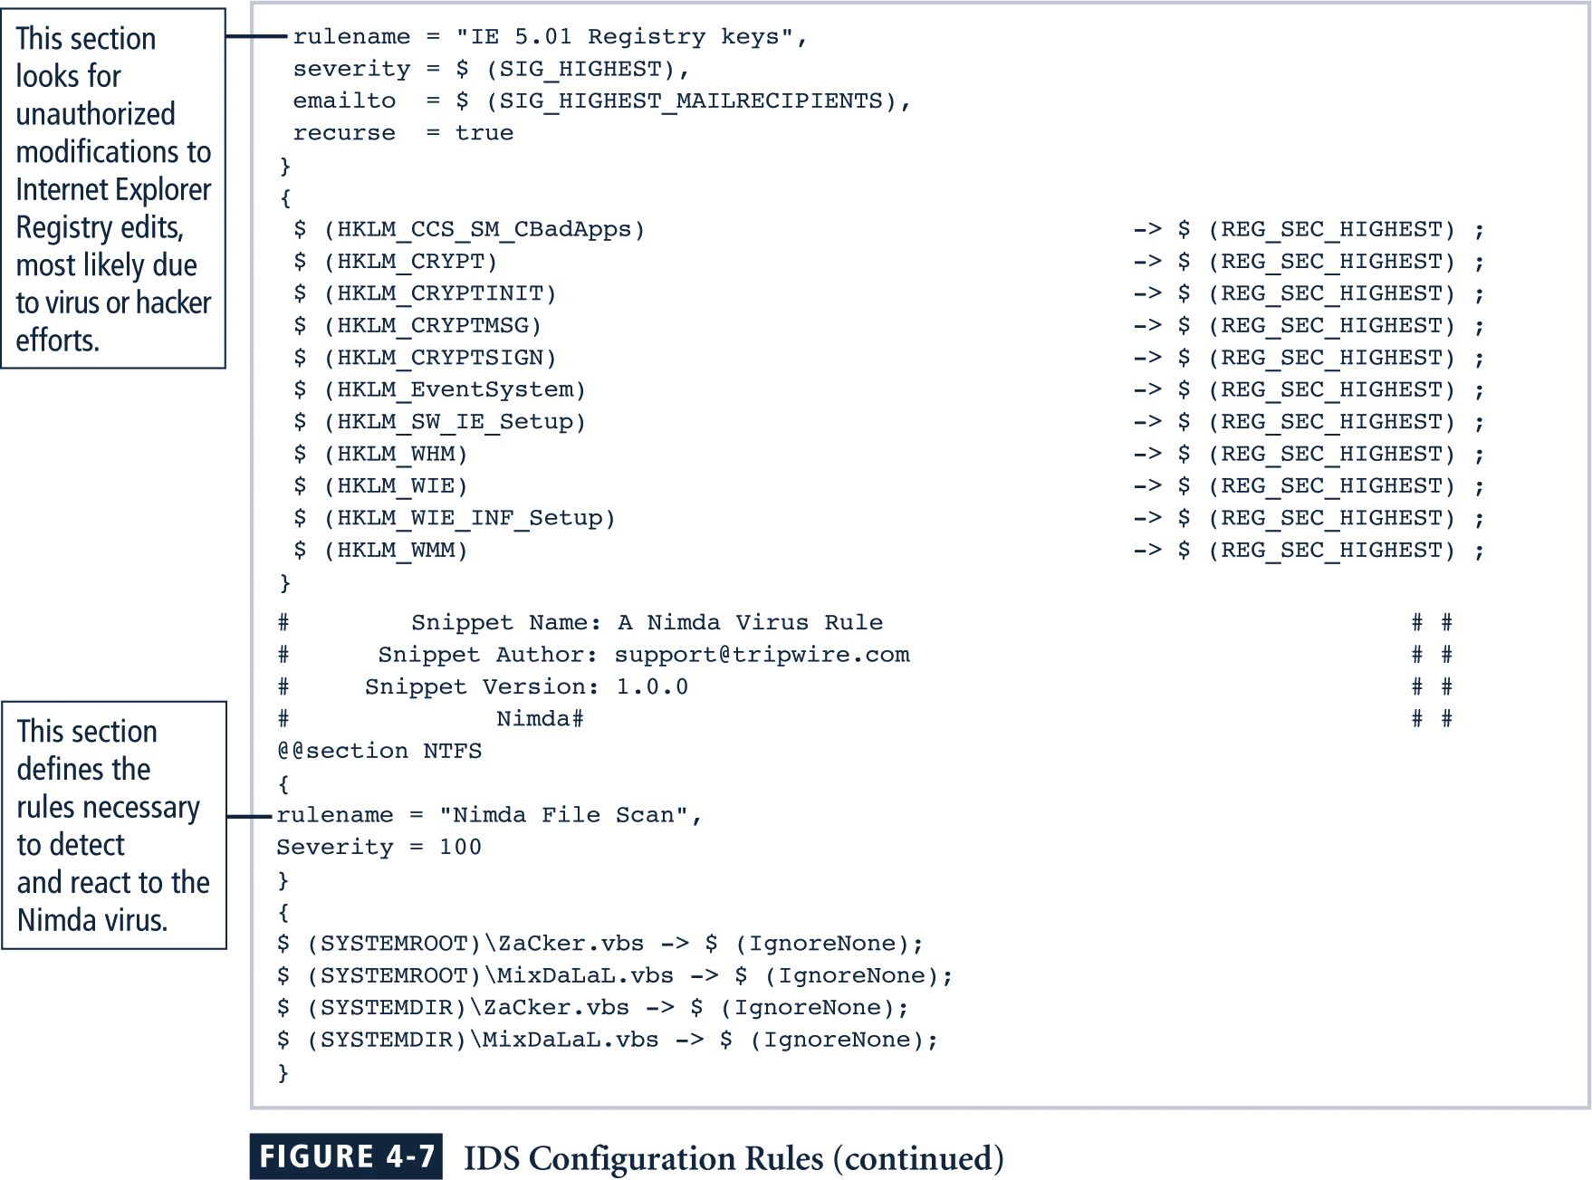

Slide 15
Combination SysSPs
Often organizations create a single document combining elements of both Management Guidance & Technical Specifications SysSPs
While this can be confusing, it is very practical
Care should be taken to articulate required actions carefully as procedures are presented

Slide 16
Part I
1. Introduction
2. Policy
3. Enterprise Information Security Policy
4. Issue-Specific Security Policy (ISSP)
5. System-Specific Policy
6. Guidelines for Policy Management
7. Another Approach to Policy Development
8. SP 800-18 Guide for Developing

Slide 17
Guidelines for Policy Development
Often useful to view policy development as a two-part project:
1. Design & develop policy (or redesign & rewrite outdated policy)
2. Establish management processes to perpetuate policy within organization
The former is an exercise in project management, while the latter requires adherence to good business practices

Slide 18
Policy development or re-development projects should be well planned, properly funded, & aggressively managed to ensure completion on time & within budget
When a policy development project is undertaken, the project can be guided by the SecSDLC process

Slide 19
1. Investigation Phase
The policy development team should:
  Obtain support from senior management, & active involvement of IT management, specifically CIO
  Clearly articulate goals of policy project
  Gain participation of correct individuals affected by recommended policies
  more ...

Slide 20
  Be composed from Legal, Human Resources & end-users
  Assign project champion with sufficient stature & prestige
  Acquire a capable project manager
  Develop detailed outline of & sound estimates for, the cost & scheduling of the project

Slide 21
2. Analysis Phase
Should include the following activities:
New or recent risk assessment or IT audit documenting the current infosec needs of the organization
Key reference materials, including any existing policies

Slide 22
3 & 4. Design phase
Should include:
  How policies will be distributed
  How verification of distribution will be accomplished
  Specifications for any automated tools
  Revisions to feasibility analysis reports based on improved costs & benefits as design is clarified

Slide 23
5. Implementation Phase
Write the policies!
Make certain policies are enforceable as written
Policy distribution is not always as straightforward
Effective policy:
  Is written at a reasonable reading level
  Attempts to minimize technical jargon & management terminology

Slide 24
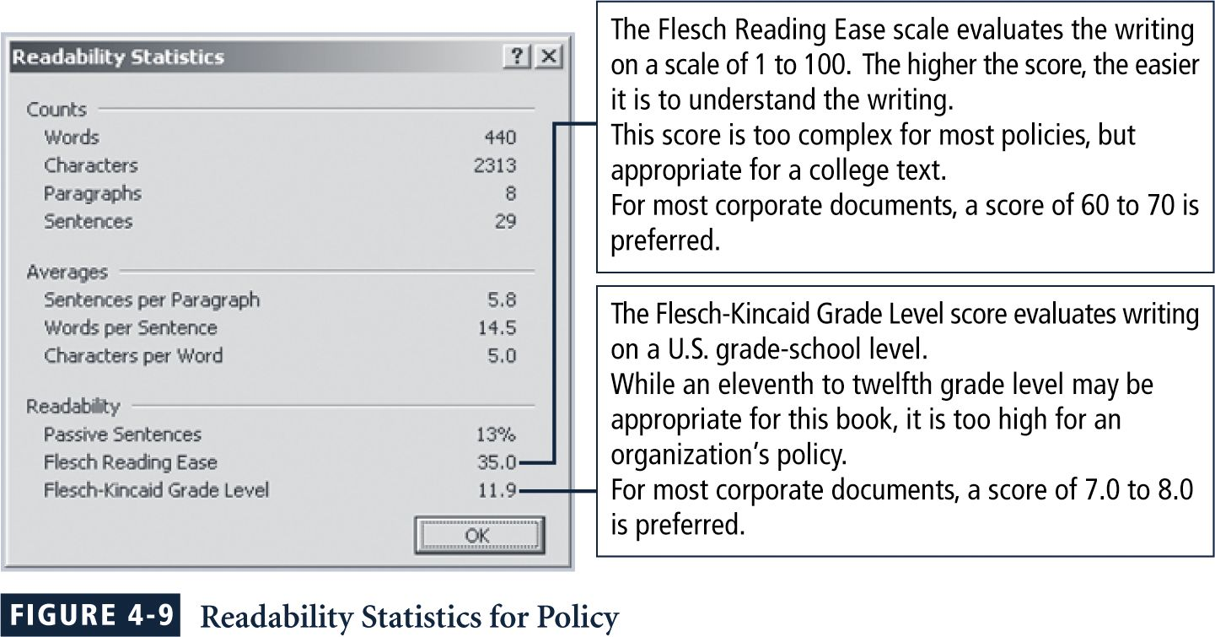
One way to measure readability

Slide 25
6. Maintenance Phase
Maintain & modify policy as needed to ensure that it remains effective as a tool to meet changing threats
Policy should have a built-in mechanism via which users can report problems with the policy, preferably anonymously
Periodic review should be built into the process

Slide 26
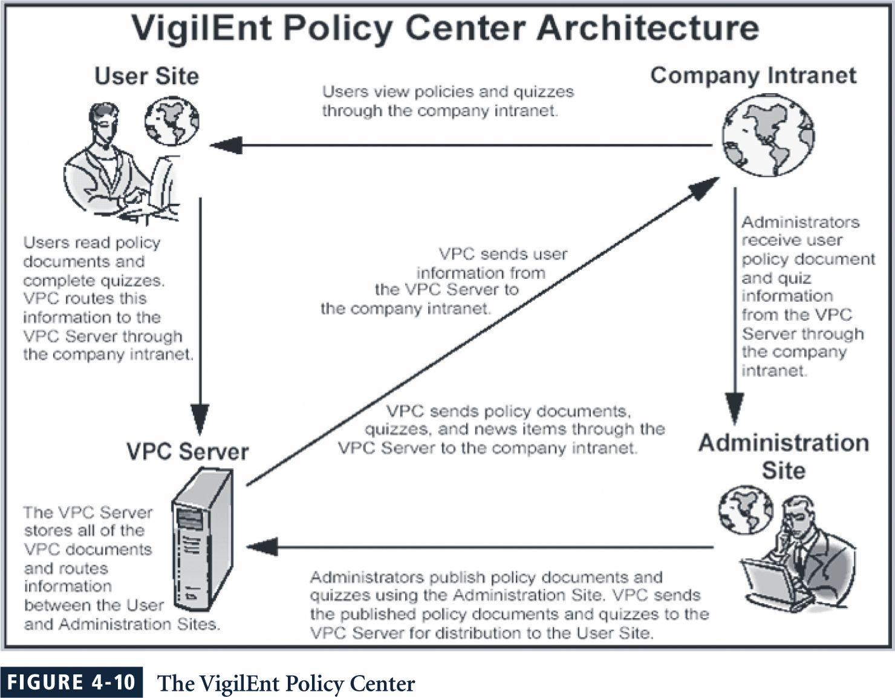

Slide 27
Part I
1. Introduction
2. Policy
3. Enterprise Information Security Policy
4. Issue-Specific Security Policy (ISSP)
5. System-Specific Policy
6. Guidelines for Policy Management
7. Another Approach to Policy Development
8. SP 800-18 Guide for Developing

Slide 28
The InfoSec Policy Made Easy Approach (ISPME)
Gathering Key Reference Materials
Defining A Framework For Policies
Preparing A Coverage Matrix
Making Critical Systems Design Decisions
Structuring Review, Approval, & Enforcement Processes

Slide 29
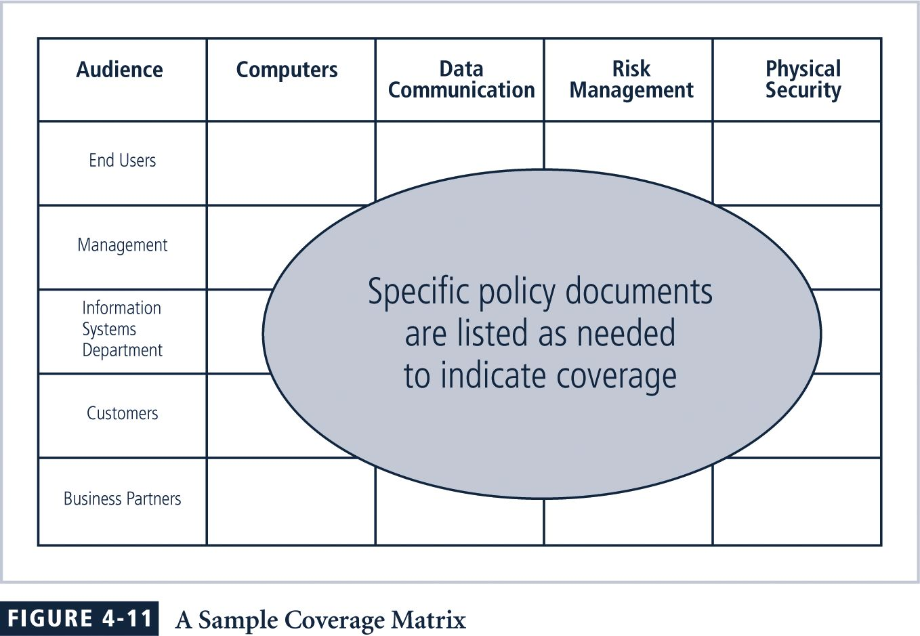

Slide 30
ISPME Checklist
Perform risk assessment or information technology audit to determine your org’s unique infosec needs
Clarify what “policy” means within your org so that you are not preparing a “standard,” “procedure,” or some other related material
Ensure that roles & responsibilities related to infosec are clarified, including responsibility for issuing & maintaining policies
more ...

Slide 31
Convince management that it is advisable to have documented infosec policies
Identify top management staff who will be approving final infosec document & all influential reviewers
Collect & read all existing internal infosec awareness material & make a list of the included bottom-line messages
Conduct a brief internal survey to gather ideas that stakeholders believe should be included in a new or updated infosec policy
more ...

Slide 32
Examine other policies issued by your organization, such as those from HR management, to identify prevailing format, style, tone, length, & cross-references
Identify audience to receive infosec policy materials & determine whether they will each get a separate document or a separate page on an intranet site
Determine extent to which audience is literate, computer knowledgeable, & receptive to security messages
more ...

Slide 33
Decide whether some other awareness efforts must take place before infosec policies are issued
Using ideas from the risk assessment, prepare a list of absolutely essential policy messages that must be communicated
If there is more than one audience, match the audiences with the bottom-line messages to be communicated through a coverage matrix.
more ...

Slide 34
Determine how the policy material will be disseminated, noting the constraints & implications of each medium of communication
Review compliance checking, disciplinary, & enforcement processes to ensure they all can work smoothly with new policy document
Determine whether number of messages is too large to be handled all at one time, & if so, identify different categories of material that will be issued at different times
more ...

Slide 35
Have an outline of topics to be included in the first document reviewed by several stakeholders
Based on comments from stakeholders, revise initial outline & prepare a first draft
Have first draft document reviewed by stakeholders for initial reactions, presentation suggestions, & implementation ideas
Revise draft in response to comments from stakeholders
more ...

Slide 36
Request top management approval on policy
Prepare extracts of policy document for selected purposes
Develop awareness plan that uses policy document as a source of ideas & requirements
Create working papers memo indicating disposition of all comments received from reviewers, even if no changes were made
more ...

Slide 37
Write memo about project, what you learned, & what needs to be fixed so that next version of policy document can be prepared more efficiently, better received by readers, & more responsive to unique circumstances facing your organization
Prepare list of next steps that will be required to implement requirements specified in policy document

Slide 38
ISPME Next Steps
Post Polices To Intranet Or Equivalent
Develop A Self-Assessment Questionnaire
Develop Revised User ID Issuance Form
Develop Agreement To Comply With InfoSec Policies Form
Develop Tests To Determine If Workers Understand Policies
Assign InfoSec Coordinators
Train InfoSec Coordinators
more ...

Slide 39
Prepare & Deliver A Basic InfoSec Training Course
Develop Application Specific InfoSec Policies
Develop A Conceptual Hierarchy Of InfoSec Requirements
Assign Information Ownership & Custodianship
Establish An infosec Management Committee
Develop An infosec Architecture Document

Slide 40
A Final Note on Policy
Lest you believe that the only reason to have policies is to avoid litigation, it is important to emphasize the preventative nature of policy
Policies exist first & foremost to inform employees of what is & is not acceptable behaviour in the organization
Policy seeks to improve employee productivity, & prevent potentially embarrassing situations

Slide 41
Summary
Why Policy?
Enterprise InfoSec Policy
Issue-Specific Security Policy
System-Specific Policy
Guidelines for Policy Development

Slide 42
Part II
Introduction
Security Standard Criteria and Product Security Evaluation Process
Computer Products Evaluation Standards
Major Evaluation Criteria

Slide 43
1 Introduction
Security Evaluation Process
Security Standards and Criteria
  The Orange Book
  U.S. Federal Criteria
  Information Technology Security Evaluation Criteria (ITSEC)
  The Trusted Network Interpretation (TNI): The Red Book
  Common Criteria (CC)

Slide 44
2 Security Standards, Criteria and Evaluation Process
Purpose
Criteria
Process
Structure
Outcome/benefit

Slide 45
2.1 Purpose of Evaluation
Certification
Accreditation
Evaluation
Potential market benefit

Slide 46
2.2 Criteria
Defines several degrees of rigor acceptable at each testing level of security
Defines the formal requirements the product need to meet at each Assurance level
Assurance levels are based on Trusted Computer System Evaluation (TCSEC)

Slide 47
2.3 Process of Evaluation
Two evaluation directions:
  Product-oriented
  Process-oriented
6-steps
  Proposal review
  Technical assessment
  Advice
  Intensive preliminary technical review
  Evaluation
  Rating maintenance phase

Slide 48
2.4 Structure of Evaluation
Functionality – what and how much the product can do
Effectiveness – whether the product meets the effectiveness threshold
Assurance – give buyer assurance and guarantee

Slide 49
2.5 Outcome/Benefits
A great product
  For evaluator, cut down the evaluation cost without cutting the value of evaluation
  For buyer, result in good product to enhance the security
Evaluation of a computer product can be done using either a standard or a criteria

Slide 50
3 Computer Products Evaluation Standards
American National Standards Institute (ANSI)
British Standards Institute (BSI)
Institute of Electrical and Electronic Engineers Standards Association (IEEE-SA)
International Information System Security Certification Consortium (ISC)2
International Organization for Standardization (ISO)
National Institute of Standards and Technology (NIST)
National Security Agency (NSA)
International Architecture Board (IAB)
Organization for the Advancement of Structured Information Standards (OASIS)
Underwriters Laboratories
Worldwide Web Consortium (W3C)

Slide 51
4 Major Evaluation Criteria
The Orange Book
U.S. Federal Criteria
Information Technology Security Evaluation Criteria (ITSEC)
The Trusted Network Interpretation (TNI): The Red Book
Common Criteria (CC)

Slide 52
The Orange Book
Three Objectives
  A yardstick for user
  Guidance for manufacturer
  Basis for security requirements
Two requirements
  Specific security feature requirements
  Assurance requirements

Slide 53
The Orange Book
Four Assurance Levels
  Class D – Minimal Protection
  Class C
    C1: Discretionary Security Protection (DSP)
    C2: Controlled Access Protection (CAP)
  Class B
    B1: Labeled Security Protection
    B2: Structured Protection
    B3: Security Domain
  Class A1: Verified Protection

Slide 54
Questions
Does evaluation mean security?
One advantage of process-oriented security evaluation is that it is cheap. Find other reasons why it is popular. Why, despite its popularity, is it reliable?
Why is the product rated as B2/B3/A1 better than that rated C2/B1, or is it?
How do I know if a product is evaluated?
How do I get my product evaluated?

