Slide 1
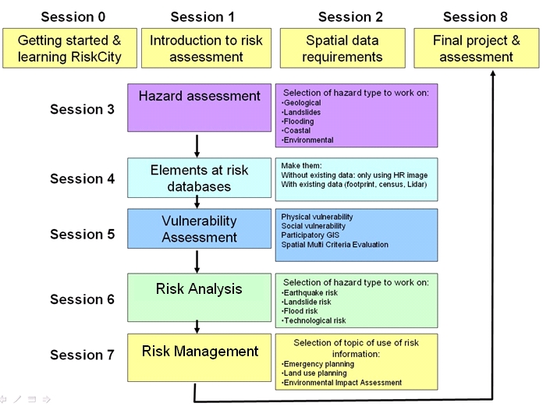
Vulnerability assessment

Slide 2
Objectives
Understand the types of vulnerability: physical, social, economic and environmental;
Understand the complexity in approaches used for vulnerability and the varying ways in which it is defined;
Indicate the ways in which vulnerability can be expressed.
Outline the main approaches used for flood, earthquake and landslide vulnerability assessment

Slide 3
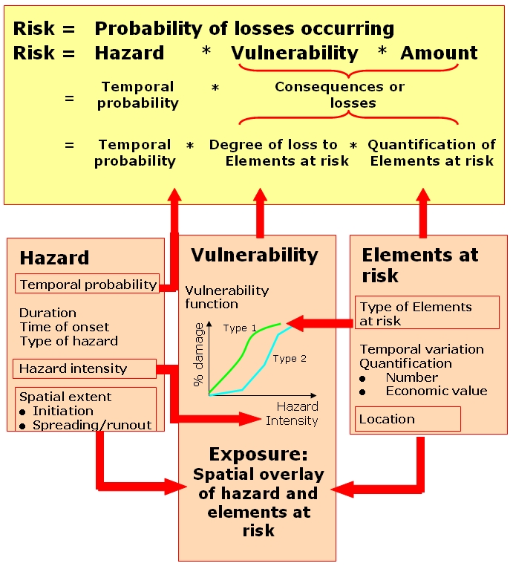
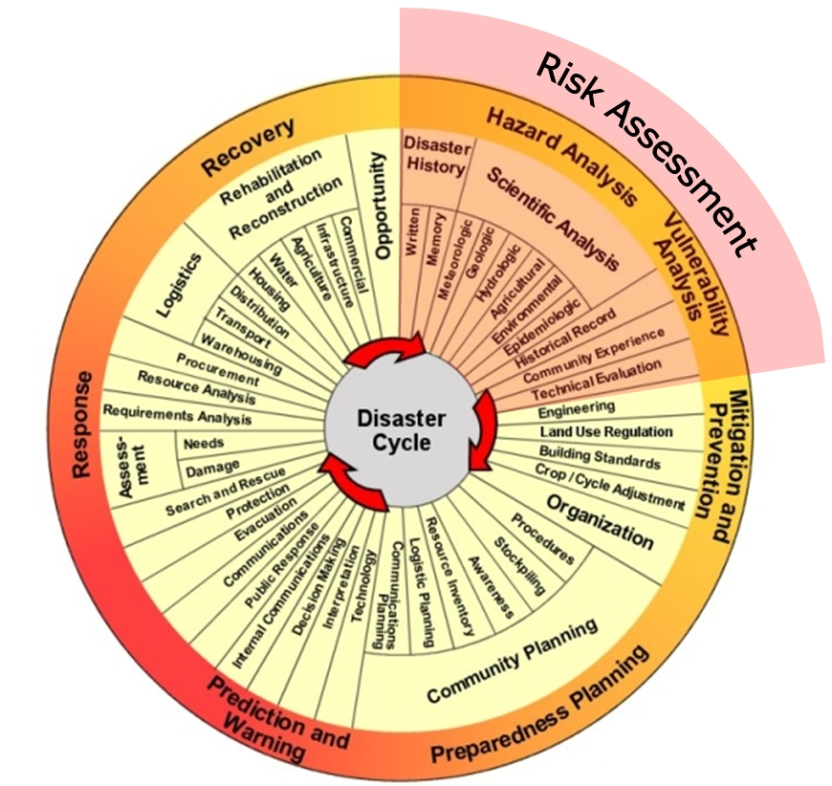
Small repetition: vulnerability and risk
Figure 1.11: The “traditional” disaster cycle and the role of risk assessment.

Slide 4
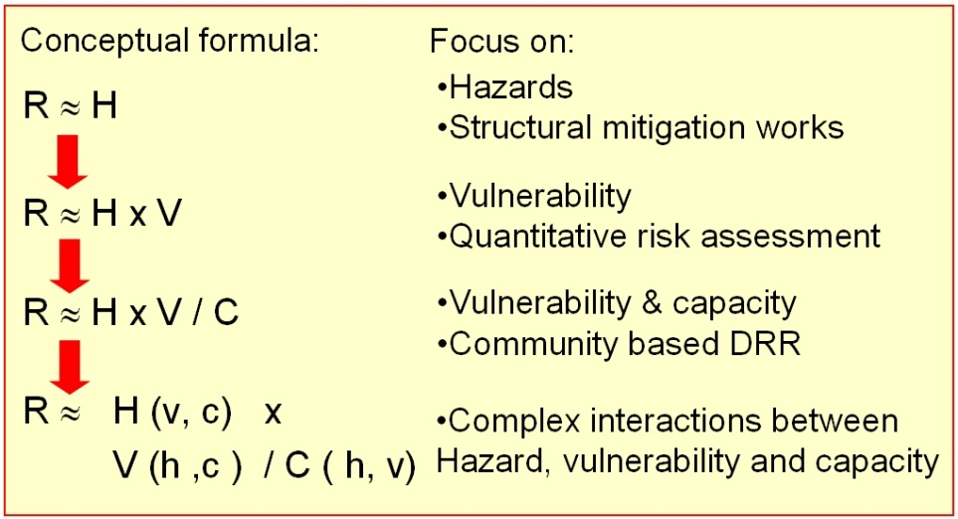
Defining vulnerability-1
The concept of vulnerability originated from the social sciences in response to the pure hazard oriented perception of disaster risk in the 1970s.
“The degree of loss to a given element at risk or set of elements at risk resulting from the occurrence of a natural phenomenon of a given magnitude and expressed on a scale from 0 (no damage) to 1 (total damage)” ( UNDRO, 1991)
Since that time different disciplines are working with the concept of vulnerability and the concept of vulnerability has broadened

Slide 5
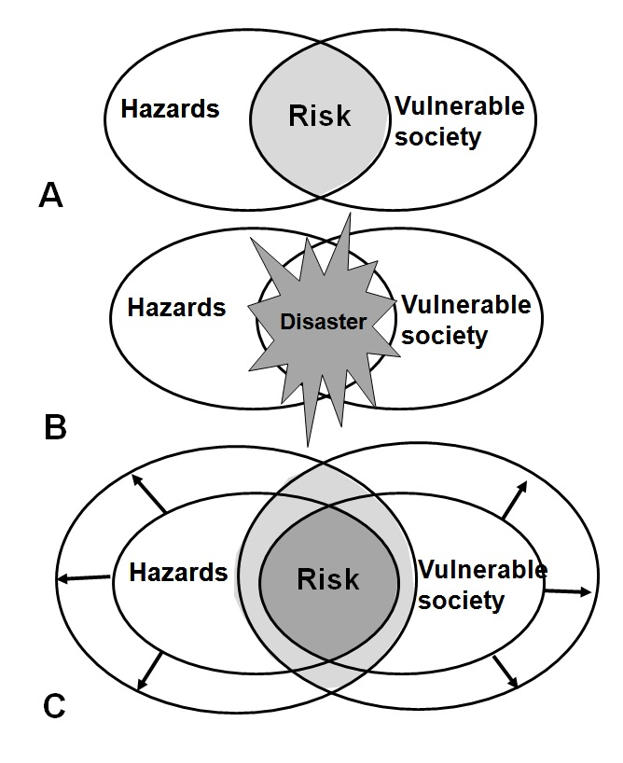
Disaster management spiral

Slide 6
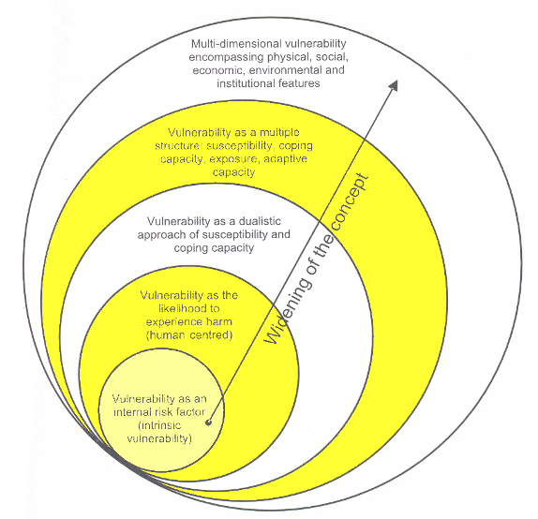
Widening concept of vulnerability.
Multiple definitions and different conceptual frameworks of vulnerability exist, because several distinct groups have different views on vulnerability.
Source:(Birkmann 2005)

Slide 7
Definitions of vulnerability-1.
“The degree of loss to a given element at risk or set of elements at risk resulting from the occurrence of a natural phenomenon of a given magnitude and expressed on a scale from 0 (no damage) to 1 (total damage)” ( UNDRO, 1991)
“Exposure to risk and an inability to avoid or absorb potential harm ( Pelling, 2003). In this context, he defines physical vulnerability as the vulnerability of the physical environment; social vulnerability as experienced by people and their social, economic, and political systems; and human vulnerability as the combination of physical and social vulnerability” (in Vilagrán de León, 2006)
“The characteristics of a person or group in terms of their capacity to anticipate, cope with, resist and recover from impacts of a hazard” (Blaikie, Cannon et al. 1994).
“The conditions determined by physical, social, economic and environmental factors or processes, which increase the susceptibility of a community to the impact of hazards “(UN-ISDR)

Slide 8
Definitions of vulnerability-2.
The potential to suffer harm or loss, related to the capacity to anticipate a hazard, cope with it, resist it and recover from its impact. Both vulnerability and its antithesis, resilience, are determined by physical, environmental, social, economic, political, cultural and institutional factors” (Provention Consortium, 2007)
Vulnerability = (Exposure ) + (Resistance ) + Resilience
Exposure: at risk property and population;
Resistance: Measures taken to prevent, avoid or reduce loss;
Resilience: Ability to recover prior state or achieve desired post-disaster state.

Slide 9
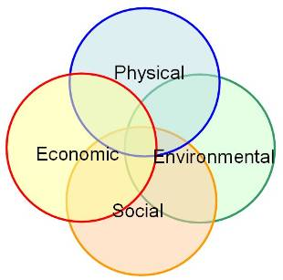
Characteristics of vulnerability.
Vulnerability is:
multi-dimensional (e.g. physical, social, economic, environmental, institutional, and human factors define vulnerability);
dynamic i.e. vulnerability changes over time;
scale-dependent ( vulnerability can be expressed at different scales from human to household to community to country resolution;
site-specific.
(Source: UN-ISDR).

Slide 10
Types of vulnerability-1
Physical Vulnerability: meaning the potential for physical impact on the built environment and population. The degree of loss to a given element at risk or set of elements at risk resulting from the occurrence of a natural phenomenon of a given magnitude and expressed on a scale from 0 (no damage) to 1 (total damage)”.
Vulnerability is analyzed per group of constructions ( i.e. structural types) having similar damage performance;
It is an intrinsic quality of a structure and it does not depend on location.
Economic vulnerability: the potential impacts of hazards on economic assets and processes (i.e. business interruption, secondary effects such as increased poverty and job loss) Vulnerability of different economic sectors,
Social vulnerability: the potential impacts of events on groups such as the poor, single parent households, pregnant or lactating women, the handicapped, children, and elderly; consider public awareness of risk, ability of groups to self-cope with catastrophes, and status of institutional structures designed to help them cope.
Environmental vulnerability: the potential impacts of events on the environment.

Slide 11
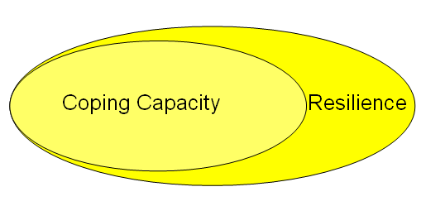
Coping capacity and resilience-1.
Capacity: A combination of all strength and resources available within a community or organization that can reduce the level of risk, or the effect of a disaster”.
Capacity may include physical, institutional, social or economic means as well as skilled personal or collective attributes such as leadership and management. Capacity may also be described as capability” (UN-ISDR, 2004)
Some examples of capacity are:
Permanent houses;
Ownership of land;
Adequate food and income sources;
Family and community support in times of crisis;
Local knowledge
Good leadership & management.

Slide 12
Coping capacity and resilience-2.
Resilience is the capacity of a system, community or society potentially exposed to hazards to adapt, by resisting or changing in order to reach and maintain an acceptable level of functioning and structure.
This is determined by the degree to which the social system is capable of organizing itself to increase its capacity for learning from past disasters for better future protection and to improve risk reduction measures.(UN-SDR 2004)
The strengthening of coping capacities usually builds resilience to withstand the effects of natural and human-induced hazards.
Resilience is a in general a more encompassing term than coping capacity.

Slide 13
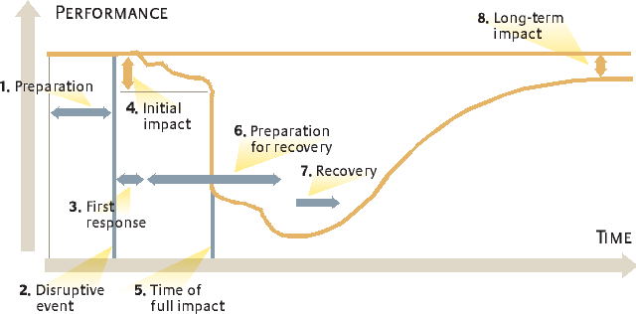
Resilience

Slide 14
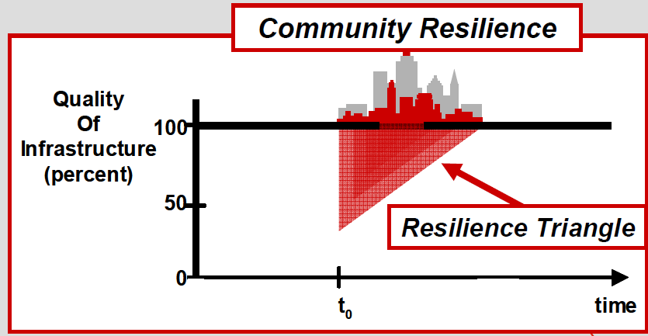
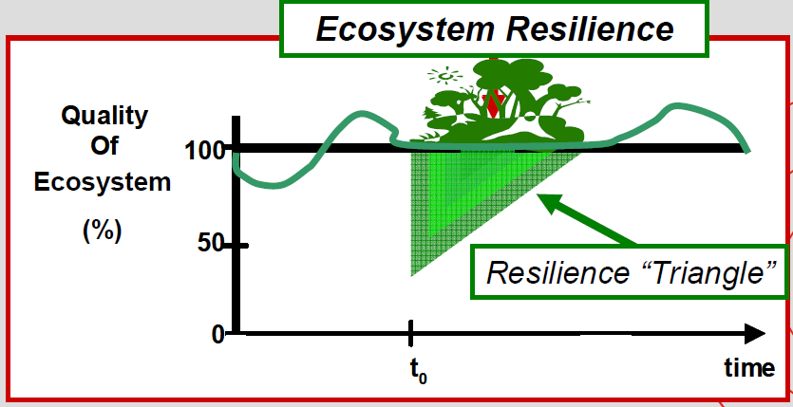
Resilience

Slide 15
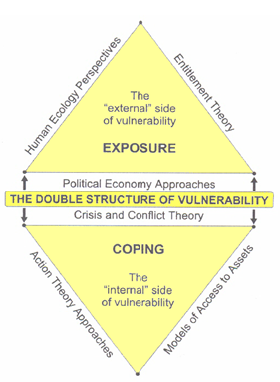
Conceptual frame-works of vulnerability: The Double Structure of Vulnerability
Vulnerability: external- and internal side;
External side relates to: exposure to risks and shocks
PEA:e.g. social inequalities, assets control by upper classes;
HEP: population dynamics and capacities to manage the environment
ET: relates vulnerability to the incapacity of people to obtain or manage assets via legitimate economic means
Internal side relates to :capacity to anticipate, cope with, resist and recover from the impact of a hazard
C&CTh: control of assets and resources, capacities to manage crisis situations and resolve conflicts ;
ATA: how people act as react freely or as a result of societal, economical or governmental constraints;
MAA: mitigation of vulnerability via access to assets.
Bohle’s conceptual Framework for vulnerability analysis.

Slide 16
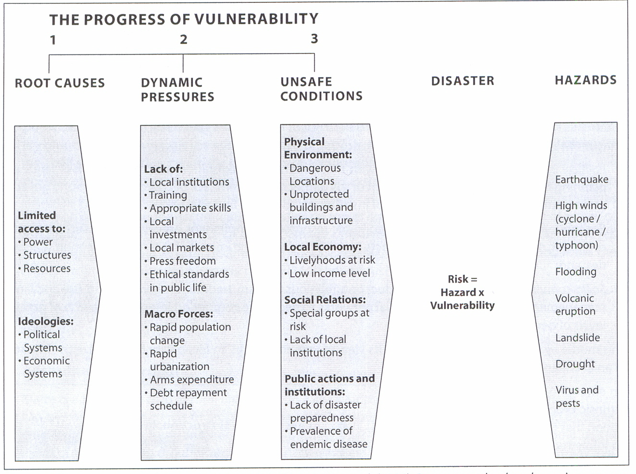
Conceptual frame-works of vulnerability: Pressure and Release (PAR) Model
Disasters are caused by opposing forces: progression of vulnerability, from root causes to dynamic pressures to unsafe conditions versus hazard event.
Figure 5.7 The PAR model ( Source: Blaikie, Cannon et al, 1994)

Slide 17
Conceptual frame-works of vulnerability: Pressure and Release (PAR) Model
Root causes are related to economic, demographic, and political processes as a function of economic structure, legal definitions of rights, gender relations, and other elements of the ideological order and reflect the distribution of power in a society (Blaikie, Cannon et al. 1994).
Dynamic pressures are processes and activities that ‘translate” the effects of root causes into the vulnerability of unsafe conditions
Unsafe conditions: are the specific form in which vulnerability of a population is expressed in time and space in conjunction with a hazard
Key characteristics of vulnerable groups in society are social class, caste, ethnicity, gender; disability; age and seniority.

Slide 18
Conceptual frame-works of vulnerability: Exposure, resistance and resilience model.
(Pelling, 2003)

Slide 19
MOVE project

Slide 20
Gender and vulnerability
a) Unequal gender relations arising from patriarchal structures can create new vulnerabilities or worsen existing ones for women and girls in disasters.
b) Men and women have different entitlements/access to resources and abilities to reduce their vulnerability through various coping and adaption practices
c) Men may be more mobile and have more opportunities to use large blocks of time on a single pursuit (e.g. livelihood activities) while women generally cannot because of their range of reproductive duties and thus are disadvantaged in postdisaster recovery
d) Women are a heterogeneous group and cannot be assumed to be equally vulnerable, everywhere and all of the time

Slide 21
Gender and vulnerability
e) Gender is a cross cutting issue which can qualify all vulnerability dimensions.
f) Gender should be understood as an inclusive term and not simply a binary (male, female) one. Groups defined/selfdefining as transgender or non heterosexual are particularly invisible and
under-researched; their marginalization leads to discriminatory practices in extreme events
g) Increasing amounts of research have identified post-disaster violence against women

Slide 22
Age and vulnerability
(a) Children are often at or near the top of any list of vulnerable groups (data on why: stage of physical, intellectual and emotional development; greater surface area: body mass ratio; general lack of power and agency; but examples of their exercise of agency and risk reduction actions and potential must also be acknowledged
In terms of risk groups, urban children in poverty face disproportionate risks from climate change. Children’s vulnerability comes from their state of rapid development; their relative inability to deal with deprivation, stress and extreme events; their physiological immaturity; and their limited life experience. While urban children generally fare better than rural children do, this is not the case for those living in extreme urban poverty. On the more positive side, children can also bevery resilient to stresses and shocks but require adequate support and protection.
(b) elderly people have been identified as at greater risk in heatwaves

Slide 23
Disability and vulnerability
People with disabilities may be vulnerable in disasters because of their impairments and because they are more likely to be living in poverty, and they may be institutionalised and dependent on others.
They are generally marginalized from disaster risk reduction planning or adaptation mechanisms.
Disasters also create disabilities.

Slide 24
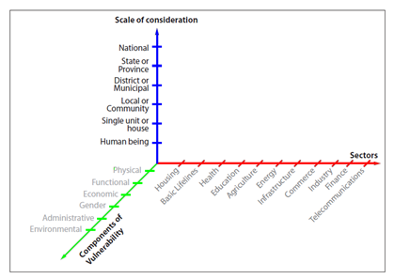
Holistic vulnerability and risk assessment: Example 1: Villagrán de León
These methods mostly use indicators for vulnerability and are based on expert opinion.
Example 1: Villagrán de León “ sectoral approach” having 3 dimensions of vulnerability, which each 6 “types of vulnerability.;
Hazard intensity is not further specified, the method is based on a very high magnitude event.

Slide 25
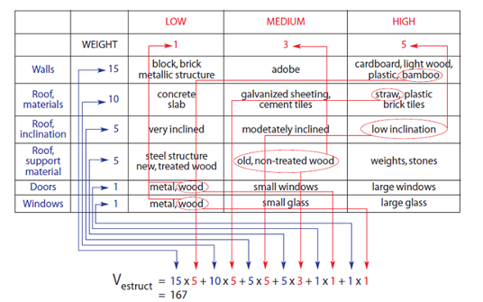
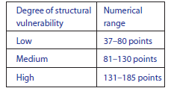
Holistic vulnerability and risk assessment: : Example 1: Villagrán de León
This sectoral approach, is proposed from a policy point of view, seems useful since it promotes the assigning of responsibilities for reducing vulnerabilities to those private or public institutions in charge of the sector!
The method uses matrices to calculate a vulnerability index, which is grouped in 3 classes (high, medium and low).
Matrix to asses the structural vulnerability index of a house in regarding volcanic eruptions.
3 subclasses are based on historic research of volcanic impacts on housing in Central America.

Slide 26
Holistic vulnerability and risk assessment: Example 2: GTZ
The GTZ framework is an expert-opinion index method, for defining physical/demographic, social, economic and environmental vulnerability at local level (community scale).
It uses the conceptual framework of Davidson
Risk= ∑ (hazard, exposure, vulnerabilities, capacity measures)
Each type of vulnerability is characterized by a number of indicators.
The model assigns 3 possible values ( low=1 , medium=2 or high=3) to the each of the indicators, and uses weights for the vulnerability index when calculating it for each type of hazard

Slide 27
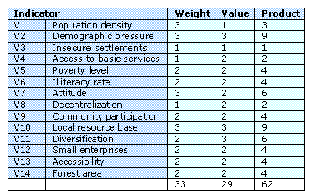
Holistic vulnerability and risk assessment: Example 2: GTZ
The model assigns 3 possible values ( low=1 , medium=2 or high=3) to the each of the indicators, and uses weights for the vulnerability index when calculating it for each type of hazard
The different indicators were weighted according to their importance for the specific hazard

Slide 28
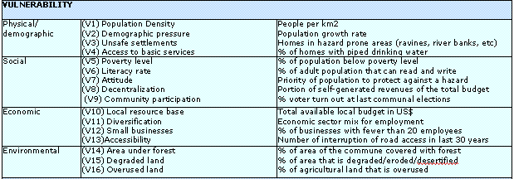
Holistic vulnerability and risk assessment: Example 2: GTZ
The whole concept of the community based disaster risk index:

Slide 29
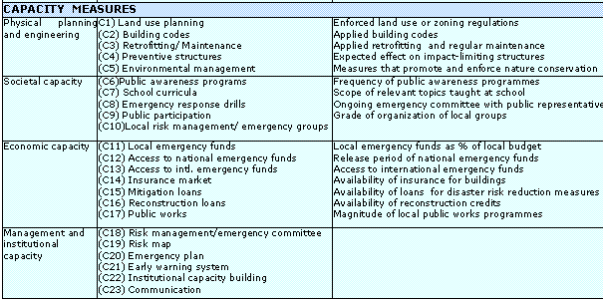
Holistic vulnerability and risk assessment: Example 2: GTZ
The whole concept of the community based disaster risk index:

Slide 30
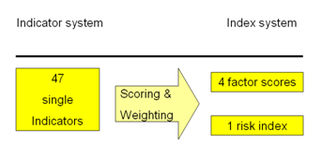
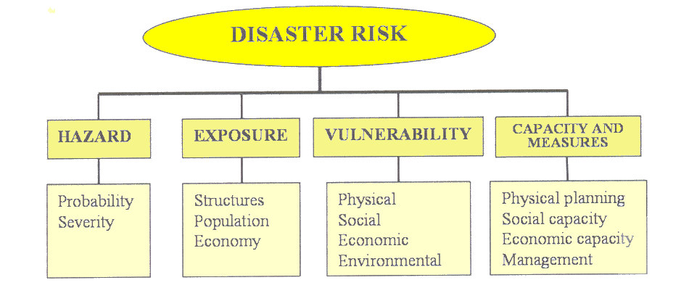
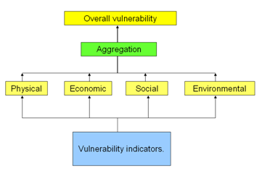
Holistic vulnerability and risk assessment: Example 2: GTZ
Hazard is scored on the basis of Probability and Intensity.
The 37 indicators are scored and weighted and one final risk index is produced. Depending on the scaled indicator values, the factor indices vary between 0 and 100.

Slide 31
Comprehensive community based risk assessment-2 Example 2: GTZ
Hazard is scored on the basis of Probability and Intensity.
The 37 indicators are scored and weighted and one final risk index is produced. Depending on the scaled indicator values, the factor indices vary between 0 and 100.

Slide 32
Overall vulnerability calculation.
The vulnerability indicators, defining the physical, economic, social and environmental vulnerability can be aggregated and combined into an overall vulnerability value.

Slide 33
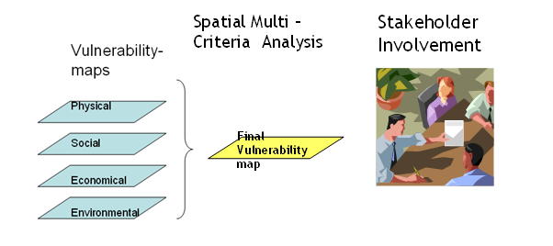
Overall vulnerability calculation.
One of the tools very suitable to combine and weigh the diffident vulnerability factors is the use of Spatial Multi Criteria Analysis.

Slide 34
Risk indices: Disaster Deficiency Index (O.D. Cardona)
The Disaster Deficit Index measures country risk from a macroeconomic and financial perspective according to possible catastrophic events. MCE loss = Maximum Considered Event
E is the economic value of all the property exposed;
V( ) is the vulnerability function, which relates the intensity of the event with the fraction of the value that is lost if an event of such intensity takes place;
I_{R} is the intensity of the event associated to the selected return period;
F_{S} is a factor that corrects intensities to account for local site effects; and
K is a factor that corrects for uncertainty in the vulnerability function
Economic resilience is a composite index which is made by combining 5 indicators:
Insurance and reassurance payments (F1p)
Reserve funds for disasters (F2p)
Aid and donations (F3p)
New taxes (F4p)
Budgetary reallocations (F5p)
External credit (F6p)
Internal credit (F7p)
A DDI greater than 1.0 reflects the country’s inability to cope with extreme disasters even by going into as much debt as possible. The greater the DDI, the greater the gap between losses and the country’s ability to face them

Slide 35
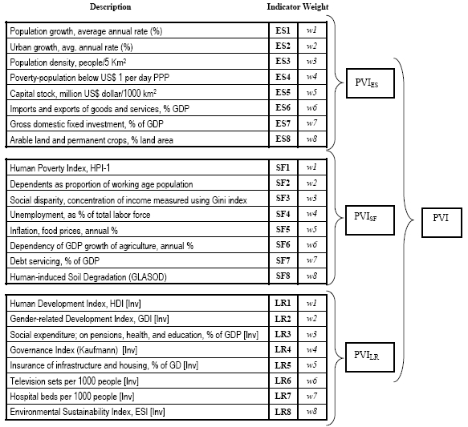
Risk indices: Disaster Deficiency Index (O.D. Cardona)
The Local Disaster Index
identifies the social and environmental risks resulting from more recurrent lower level events (which are often chronic at the local and subnational levels).
LDI_{k} = number of deaths K
LDI_{A}= number of people affected A
LDI_{L}= economic losses
Based on DesInventar database
The Prevalent Vulnerability Index
is made up of a series of indicators that characterize prevalent vulnerability conditions reflected in exposure in prone areas, socioeconomic weaknesses and lack of social resilience in general.

Slide 36
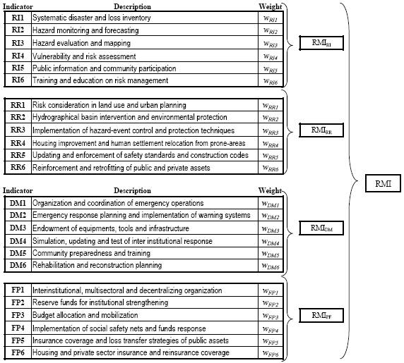
Risk indices: Disaster Deficiency Index (O.D. Cardona)
The Risk Management Index
brings together a group of indicators that measure a country’s risk management performance. These indicators reflect the organizational, development, capacity and institutional actions taken to reduce vulnerability and losses, to prepare for crisis and to recover efficiently from disasters.
RMI_{RI} = risk identification
RMI_{RR} = risk reduction
RMI_{DM} = disaster management
RMI_{FP} = governance and financial protection.

Slide 37
Objectives
Understand the types of vulnerability: physical, social, economic and environmental;
Understand the complexity in approaches used for vulnerability and the varying ways in which it is defined;
Indicate the ways in which vulnerability can be expressed.
Outline the main approaches used for flood, earthquake and landslide vulnerability assessment

Slide 38
Small repetition: vulnerability and risk
Figure 1.11: The “traditional” disaster cycle and the role of risk assessment.

Slide 39
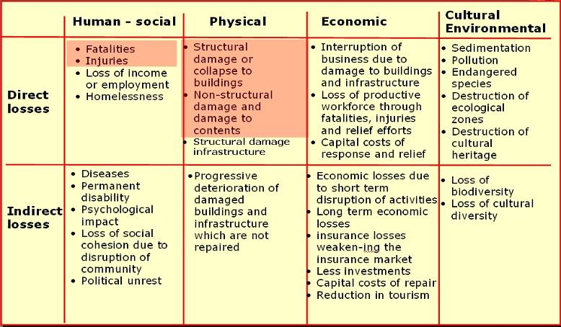
Types of losses.

Slide 40
Measuring vulnerability.
Different types of vulnerability: physical, social, economical, environmental;
Different levels of scale. Different levels of scale require often different methods. E.g. in the analytical models the data requirement increases with more complex methods;
Different hazard types. Not all methods of vulnerability quantification are used for the different hazard types.
Different hazard intensities and indicators for hazard intensity.
Flooding | Landslides | Earthquakes
Water depth Flow velocity Flow duration Wave height Time of onset Water-level ascend rate | Ground movement- displacements Velocity of ground movement Run-out distance Impact forces from rock falls | Mercalli intensity Peak ground acceleration Peak ground velocity Permanent ground displacement Spectral acceleration

Slide 41
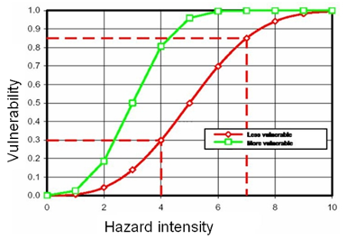
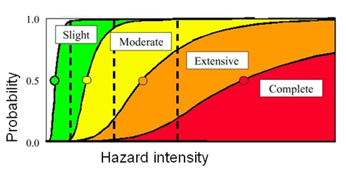
Expressing vulnerability
Vulnerability indices:
based on indicators of vulnerability; mostly no direct relation with the different hazard intensities. These are mostly used for expressing social, economic and environmental vulnerability;
Vulnerability table:
the relation between hazard intensity and degree of damage can also be given in a table.
Vulnerability curves:
that are constructed on the basis of the relation between hazard intensities and damage data
Relative curves: they show the percentage of property value as the damaged share of the total value to hazard intensity.
Absolute curves: show the absolute amount of damage depending on the hazard intensity; i.e. the value of the asset is already integrated in the damage function;
Fragility curves:
provide the probability for a particular group of elements at risk to be in or exceeding a certain damage state under a given hazard intensity.

Slide 42
Methods of Measuring physical vulnerability
Group | Method | Description
Empirical methods | Analysis of observed damage | Based on the collection and analysis of statistics of damage that occurred in recent and historic events. Relating vulnerability to different hazard intensities.
 | Expert opinion | Based on asking groups of expert on vulnerability to give their opinion e.g. on the percentage damage they expect for the different structural types having different intensities of hazard. In order to come to a good assessment of the vulnerability, many expert have to be asked and this is time consuming, and subjective in general. Re-assessments of vulnerability after building upgrading or repair are difficult to accommodate.
 | Score Assignment | Method using a questionnaire with different parameters to assess the potential damages in relation to different hazard levels. The score assignment method is easier to update e.g. if we think about earthquake vulnerability before and after application of retrofitting.
Analytical models | Simple Analytical models | Studying the behavior of buildings and structures based on engineering design criteria, analyzing e.g. seismic load and to derive the likelihood of failure, using computer based methods from geotechnical engineering. Using e.g. shake tables and wind tunnels, as well as computer simulation techniques;
 | Detailed Analytical methods | Using complex methods. It is time consuming, needs a lot of detailed data and will be used for assessment of individual structures
Source: ( Lang 2002. BRGM, 2005)

Slide 43
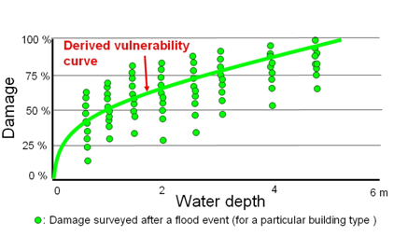
Observed data.
For events that are relatively frequent and widespread it is possible to collect information on the degree of physical damage to buildings or infrastructure after the event has occurred;
E.g for floods and earthquakes;
Large enough samples can e obtained in order to make a correlation between the intensity/magnitude of the hazard.

Slide 44
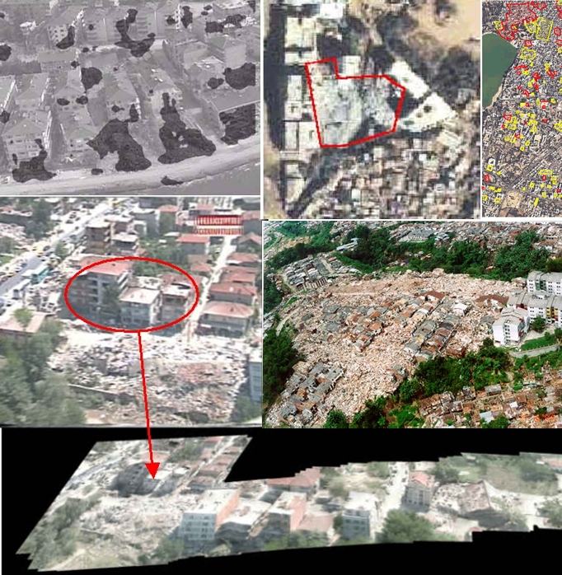
Damage assessment tools for empirical methods
Remote sensing;
Rapid monitoring using video cameras;
Participatory GIS approaches;
Existing data bases;
Expert opinion

Slide 45
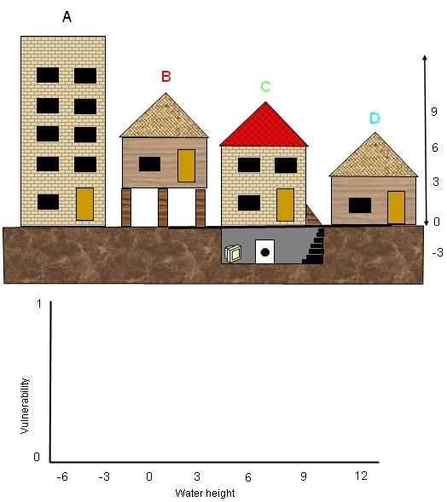
Exercise
Expert opinion
Task 5.6: Expert opinion in generating a vulnerability curve (duration 15 minutes)
In the figure above there are 4 different buildings, each with different characteristics. Imagine the flood will take place in the area, and the waterlevel is rising slowly but constantly. How would the four buildings be affected?
Draw 4 approximate vulnerability curves in the graph.

Slide 46
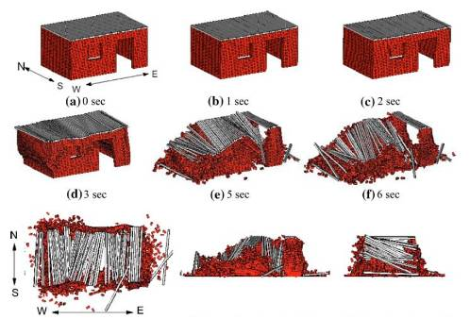
Analytical Methods
Analytical method study the behavior of buildings and structures based on engineering design criteria, analyzing e.g. seismic load and to derive the likelihood of failure, using computer based methods from geotechnical engineering.
Using e.g. shake tables and wind tunnels, as well as computer simulation techniques.
E.g. shake table: Adobe house ( earth brick) http://www.youtube.com/watch?v=AL7Kh31tB2M&NR=1
Computer simulation techniques: modeled collapse of masonry structures during an earthquake which has been analyzed using a three-dimensional distinct element method.
It is a numerical analysis technique, in which positions of elements are calculated by solving equations of motion step by step. Both individual and group behavior can be simulated

Slide 47
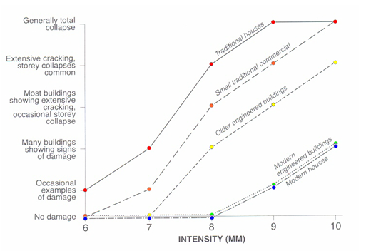
Earthquake vulnerability curves-1.
Constructed based on the effects of the 1995 earthquake in Kobe in 1995. The relation between the damage and the earthquake intensity is expressed in the Modified Mercalli Scale

Slide 48
Earthquake vulnerability curves-2 RADIUS

Slide 49
Earthquake vulnerability table.

Slide 50
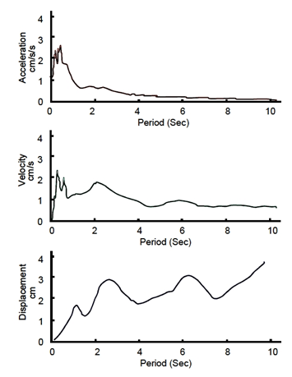
Earthquake vulnerability.
Different buildings can respond in different manners to the same earthquake ground motion;
Conversely, a given building will act differently during different earthquakes.
A response spectrum is a graph that plots the maximum response values of acceleration, velocity and displacement against period and frequency.
HAZUS-EQ loss estimation makes use of the response spectra. The site-dependent response spectrum of the ground motion is employed as a demand spectrum in the method.
Response spectrum.

Slide 51
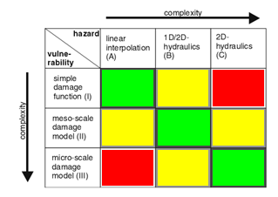
Flood vulnerability
Flood damage functions describe the relationship between hydraulic parameters and the relative damage or damage factor of the element at risk.
Factor to be considered:
· flood depth (m)
· flow velocity (m/s)
· critical flow velocity (m/s)
· water-level ascend rate (m/hour)
Scale levels: micro, meso regional) and macro.
Relation:Relevant food model with the relavant damage function scale level in figure.
(Source: Apel et al, 2009.)
Match
Mismatch

Slide 52
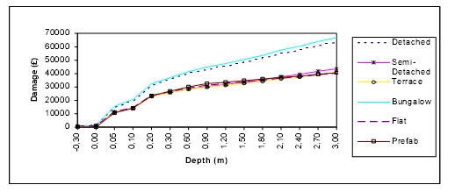
Flood example 1: UK Flood data base and damage functionsentre FHRC from Middlesex University.
Derivation of damage curves from synthetic damage data;
Main variables: depth of flood water within the buildings and the depth and extent of floodwater on the floodplain.
Velocity is assumed to cause in rare cases structural failure.
The data base has 100 residential and more than ten non residential property types.
Costs relate to restoration to pre-flood conditions, but do not always allow for full replacement.
Absolute damage functions are used.

Slide 53
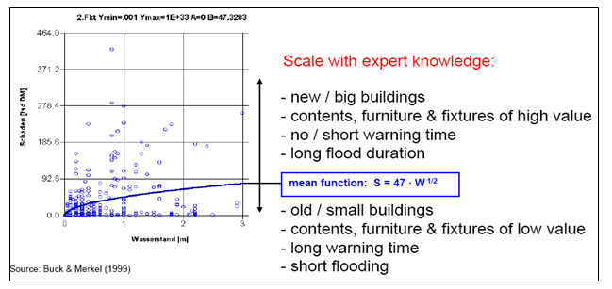
Flood example 2: HOWAS data base from Germany

Slide 54
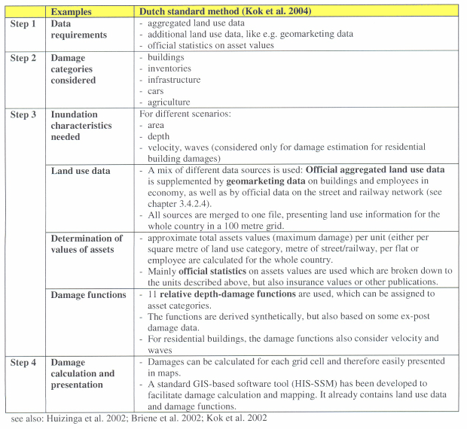
Flood example 3: Damage functions of the Dutch-2 Standard Method-2

Slide 55
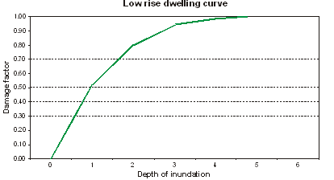
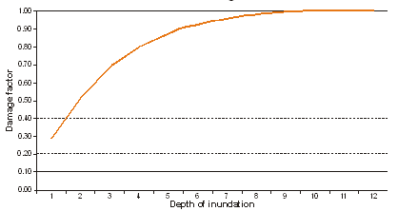
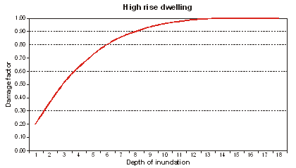
Flood example 3: Damage functions of the Dutch Standard Method-3

Slide 56
Landslide vulnerability assessment-1
Mass movement vulnerability depends on:
velocity,
magnitude and intensity of the mass movement;
type of mass movement;
Landslide runout distance.
Difficult to define since:
Lack of useful hazard intensity scales:wide variety of processes (fall, slide, flow, creep, spread) that may occur under different conditions and with different velocities;
No common agreed intensity scales.
Lack of historical damage databases: often isolated features;
Often the vulnerability = 1
Resulting in the use of Expert Opinions.
Landslide vulnerability assessment is still in it infant stages, and needs to gain more attention in order to be able to make quantitative assessments of landslide risk.

Slide 57
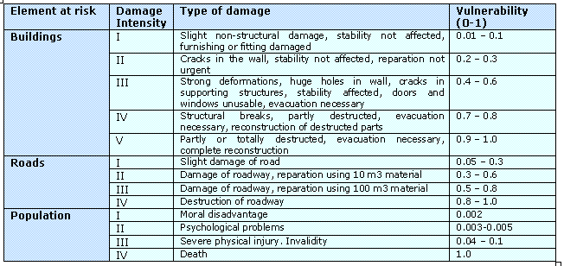
Landslide vulnerability assessment-2: expert opinions on landslides..
(Source: Glade 2003 – modified after Leone et al. 1996)

Slide 58
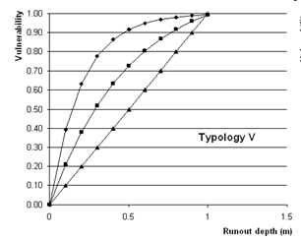
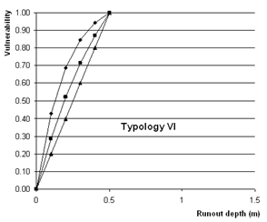
Landslide vulnerability assessment-2; expert opinions.
Historical debris flows and the evaluation of he thickness of the debris flow material in relation to the degree of loss. However, this didn’t give enough information, so the main input for the vulnerability curves came again from expert opinion

Slide 59
Landslide vulnerability assessment-3; expert opinions.
Rock fall vulnerability:
Particularly for rock-fall impact and debris flows these tools are very promising;
E.g. for the evaluation of the structural vulnerability of a building due to a rock impact, the probability of collapse can be analyzed by combining the probability of building collapse with the impact probability.
The impact of the rock blocks on the structural components of a building (columns) can be modeled and the stability of the structure after the impact can be analyzed.

Slide 60
Population vulnerability-1.
Population vulnerability:
physical vulnerability (direct) of the population (injury, casualties, and homelessness)
social vulnerability( indirect) and capacity.
Analyze the effect of the damage of the building on the population inside of the building;
The severity levels and the percentages of affected people should be combined with the temporal distribution patterns of the population;
Physical impact classified into different severity classes ( HAZUS)

Slide 61
Population vulnerability-2.
Linking of building damage from Earthquakes to severity classes. (HAZUS).

Slide 62
Population vulnerability-3.
NHEMATIC method: relating the percent of building damage to the fraction of the population affected in Earthquakes.

Slide 63
Population vulnerability-4.
Population vulnerability for landslides from the Hong Kong area; based on an extensive database of slope failures and associated injuries and casualties.

Slide 64
Population loss estimation

Slide 65
Pager

