Slide 1
Digital Rights Management:

Slide 2
This talk…
What is DRM?
Overview of MediaSnap DRM system
Other DRM systems
Conclusions

Slide 3
What is DRM?
“Remote control” problem
Digital book example
Digital music, video, documents, etc.
Privacy

Slide 4
Persistent Protection
Restrictions on use after delivery
No copying
Limited number of reads
Time limits
No forwarding
etc.

Slide 5
What to do?
The honor system (The Plant)
Give up (HIPAA, etc.)
Lame software-based DRM
Better software-based DRM
Tamper-resistant hardware http://www.cl.cam.ac.uk/%7Erja14/tcpa-faq.html

Slide 6
The hype
“Our solutions let enterprises control their confidential information at all times, even after the recipients receive it.” --- Authentica
“Seal confidential digital documents and protect you business against intellectual property theft indefinitely.” --- SealedMedia

Slide 7
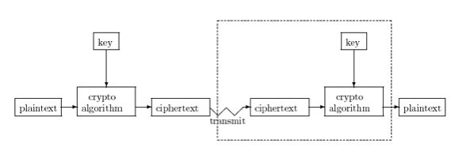
Is crypto the answer?

Slide 8
Current state of DRM
Security by obscurity (at best)
Secret designs (Kerckhoff’s Principle?)
Crypto is king
“Whoever thinks his problem can be solved using cryptography, doesn’t understand his problem and doesn’t understand cryptography.” --- Attributed by Roger Needham and Butler Lampson to each other

Slide 9
MediaSnap’s DRM system
Secure Document Server (SDS)
PDF plugin (or reader)
Security stuff…

Slide 10
Protecting a document
encrypt
Sender
persistent
protection
Recipient
SDS

Slide 11
Tethered mode
Sender
key
Recipient
SDS

Slide 12
Untethered mode
key
Sender
Recipient
SDS

Slide 13
Security issues
Server (SDS)
Protect keys, authentication data, etc.
Apply persistent protection
Client (Reader/PDF plugin)
Protect keys, authenticate, etc.
Enforce persistent protection

Slide 14
Document reader security
Tamper-resistance
Obscurity

Slide 15
Tamper-resistance
Anti-debugger
Encrypted code

Slide 16
Obscurity
Key management
Authentication
Caching (keys, authentication, etc.)
Encryption and “scrambling”
Key parts (data and code)
Multiple keys

Slide 17
Other MediaSnap features
Module tamper checking (hashing)
Anti-screen capture
Watermarking
“Unique-ification”

Slide 18
Other possibilities
General code obfuscation
Code “fragilization” (guards)
OS issues

Slide 19
Make fun of DRM systems
Patently obvious
Crypto claims
Sillyness
“Respect” model
MS-DRM

Slide 20
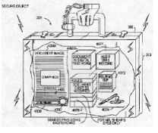
InterTrust
“…a company whose business model appears to rely entirely on legal filings against Microsoft.”

Slide 21
Crypto claims
Q: How does Atabok security compare to the competition?
A: The majority of service providers offer the ability to encrypt at 128-bits. Atabok encrypts your content with 256-bit encryption, which is exponentially more secure.

Slide 22
Sillyness
secretSeal’s five “radical innovations”
hieroglyphic passwords
variable-length encrypted keys
morphogenetic encryption algorithm
no encryption formula in software
the use of public keys

Slide 23
The respect model
Adobe eBooks --- “It is up to the implementors of PDF viewer applications to respect the intent of the document creator by restricting access to an encrypted PDF file according to passwords and permissions contained in the file.”

Slide 24
MS-DRM (version 2)
Weak proprietary block cipher (MultiSwap) used for hashing
No controlled execution
No obfuscation, etc.

Slide 25
Conclusions
Current DRM systems are weak
Ideal software-based DRM…
Individual content is non-trivial to attack
Overall system survives repeated attacks
Is this possible?

Slide 26
More info…
M. Stamp, Digital rights management: The technology behind the hype, Journal of Electronic Commerce Research, http://www.csulb.edu/web/journals/jecr/issues/20033/paper3.pdf
M. Stamp, Risks of digital rights management, Communications of the ACM, http://www.csl.sri.com/users/neumann/insiderisks.html#147
M. Stamp, Digital rights management: For better or for worse?, ExtremeTech, http://www.extremetech.com/article2/0,3973,1051610,00.asp

