Slide 1
PRESSURE ULCER
Pertemuan 10
Siti Anisah
Central Army Hospital
Gatot Soebroto, Jakarta

Slide 2
VISI DAN MISI UNIVERSITAS ESA UNGGUL

Slide 3
VISI DAN MISI PRODI KEPERAWATAN
Menjadikan pusat pendidikan Ners yang kompeten berbasis intelektualitas, kualitas, dan kewirausahaan dengna keunggulan di bidang nursing home care serta berdaya saing global pada tahun 2020.
Mengembangkan Program Pendidikan Ners dengna keunggulan nursing home care yang berwawasan global dan berbasis ilmu pengetahuan dan teknologi.
Mengembangkan ilmu pengetahuan dan teknologi di bidang keperawatan dengan keunggulan nursing home care melalui kegiatan penelitian/
Menerapkan dan mengembangkan ilmu keperawatan dengan keunggulan nursing home care melaui mengambdian kepada masyarakat.
Menyiapkan sumber daya manusia keperawatan dengan keunggulan nursinghome care yang berdaya saing global dan menciptakan calon pemimpin yang berkarakter bagi bangsa dan negara
Mengelola sarana dan prasarana yang menunjang program akademik dan profesi keperawatan dengan keunggulan nursinghome care
Berperan aktif dalam menerapkan dan mengembangkan ilmu keperawatan dengan keunggulan nursinghome care yang bermanfaat bagi organisasi profesi, bagi bangsa dan negara Indonesia serta segenap umat manusia

Slide 4
KEMAMPUAN AKHIR YANG DIHARAPKAN
Melakukan pengkajian pada pressure ulcer
Menjelaskan tipe luka
Melakukan asuhan keperawatan

Slide 5
Definition
Prescure ulcer is lession caused by local tissue necrotic when soft tissue are compressed between a bony prominence and an external surface (Catherine T. Milne, 2003).

Slide 6
Commonly referred to as pressure sores, bed sores, pressure damage, pressure injuries, and decubitus ulcers, are areas of localised damage to the skin, which can extend to underlying stuctures such as muscle and bone (Allman, 1995,1997).
Damage is believed to be caused by a combination of factors includes pressure, shear forces, friction and moisture (Allman, 1997)

Slide 7
PREVALENCE
United Kingdom 5.3 percent to 15.6 percent
Published Australian data reported 3.2 percent
USA reported varied 6.5 percent
Indonesia ??

Slide 8
Prevention and management
Financial (LOS at hospital)
Social
Pain, discomfort, loss of independence, decreased mobility

Slide 14
A variety of possible risk factors these can be directly related to patient pressure ulcers
appetite
diagnosis
smoking
neurological abnormality
anemia (Hb <12)
impaired nutritional intake
diarrhoea
temperature
decreased body weight (body loss)
hypotensive episode
change in condition of skin (hyperpigmentasion)

Slide 15
Extrinsic & Intrinsic Factors
Extrinsic factors
Shear
Friction
moisture
Intrinsic factor
Age
Nutrition
Body weight
Incontinence
Poor blood supply

Slide 16
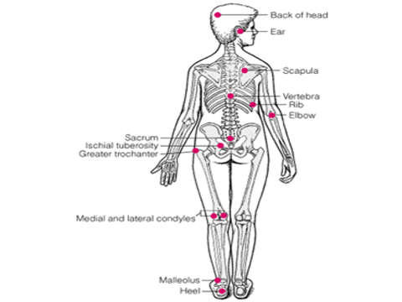

Slide 18
Wound Assessment
Cause of ulcers → immobilizied, weakness, unconscious ??
Site / location
Stage or grade
Exudates amount and type
Age
Local signs of infection

Slide 19
…..wound assessment
Wound appearance → 100 % black, red, or yellow ??
Wound edge → pink, black ?
Undermining / tracking → find that ?
Odor → mild, no odour
Size → length, width and depth

Slide 20
Mechanical loading and support surface
Positioning and repositioning
Eliminating shear and friction
Reducing heel pressure
Activity and mobilisation
Support surface

Slide 21
Positioning and repositioning
Needs may vary between individuals from one hourly to greater than two hourly.
Clock method of determining turning schedule
Pillows and foam wedges can be used when repositioning
Warning : foot placement

Slide 22
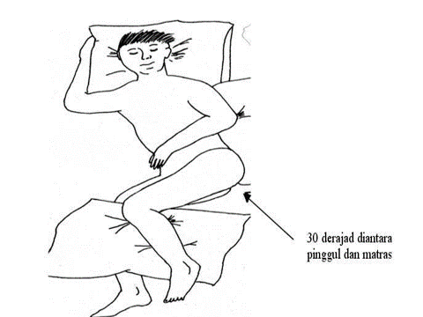

Slide 23
Eliminating shear and friction
Skin that is constantly exposed to friction should be protected with padding or protectitive
Massage over bonny prominences → increased oxygenation to the afffected tissue

Slide 24
Reducing heel pressure
To pressure as the calcaneum (heal bone)
Pillows or foam under full length of the lower leg → relieving pressure from the heels
Can be difficult if patient confused or agitated

Slide 25
Activity and mobilisation
Mobilisastion and activity alter pressure ulcers on weight bearing areas, relieving damaged tissue and improving circulation
The health care team should assess to need patient mobilization (walkers, handrails, cane, etc). Seat cushion to reduce pressure ulcers
Reffered to physitherapist or occupational therapist

Slide 26
Support surface
Constant low pressure
Conform closely to body contours redistributing body weight over a wider area
Foam or matresses, water beds, gel pads

Slide 27
Ideal support surface characteristic
Reduces/relieves pressure ulcers bony prominence
Controls pressure gradient in tissue
Provides stability
Controls temperature at interface
Controls moisture at skin
Low cost
durable

Slide 28
Risk Assessment Tools
The Norton Scale
→ The oldest risk assessment instrument.
→ Developed in 1961.
→ Sensory perception, moisture, activity and mobility, incontinence
→ Score ranking 5 – 20, scale 1 - 4

Slide 29
Gosnell’s Score
→ based – Norton Scale
→ original Norton Scale + skin appearance, medication, diet & fluid balance, and with detailed instruction
→ Score of 5 is the lower risk and a score of 20 is the highest risk

Slide 30
The Barden Scale
→ was developed in 1987
→ composed of six subscales that conceptually reflect degrees of sensory perception, moisture, activity, nutrition, and friction and shear.
→ score range 6 to 23

Slide 31
References
Australian Wound Management Associasion, Clinical Practice Guidelines. August 2001
Royal College of Nursing, The Management of Pressure Ulcers in Primary and Secondary Care. Sept 2005
Available at www.amwa.com.au/publications/2007
Morison, J. Morison, et al. (2004). Chronic Wound Care: A problem-based learning approach. Mosby
Sussman, Carrie; Bates Barbara. Wound Care : A Collaborative Practice Manual for Health Professionals. Third Edition. Lippincott William & Wilkins. 2007 page : 336-351

