Slide 1
MANAJEMEN LUKA BAKAR
Pertemuan 11
Siti Anisah
Central Army Hospital
Gatot Soebroto, Jakarta

Slide 2
VISI DAN MISI UNIVERSITAS ESA UNGGUL

Slide 3
VISI DAN MISI PRODI KEPERAWATAN
Menjadikan pusat pendidikan Ners yang kompeten berbasis intelektualitas, kualitas, dan kewirausahaan dengna keunggulan di bidang nursing home care serta berdaya saing global pada tahun 2020.
Mengembangkan Program Pendidikan Ners dengna keunggulan nursing home care yang berwawasan global dan berbasis ilmu pengetahuan dan teknologi.
Mengembangkan ilmu pengetahuan dan teknologi di bidang keperawatan dengan keunggulan nursing home care melalui kegiatan penelitian/
Menerapkan dan mengembangkan ilmu keperawatan dengan keunggulan nursing home care melaui mengambdian kepada masyarakat.
Menyiapkan sumber daya manusia keperawatan dengan keunggulan nursinghome care yang berdaya saing global dan menciptakan calon pemimpin yang berkarakter bagi bangsa dan negara
Mengelola sarana dan prasarana yang menunjang program akademik dan profesi keperawatan dengan keunggulan nursinghome care
Berperan aktif dalam menerapkan dan mengembangkan ilmu keperawatan dengan keunggulan nursinghome care yang bermanfaat bagi organisasi profesi, bagi bangsa dan negara Indonesia serta segenap umat manusia

Slide 4
KEMAMPUAN AKHIR YANG DIHARAPKAN
Melakukan pengkajian pada luka bakar
Menjelaskan tingkatan luka bakar
Melakukan asuhan keperawatan

Slide 6
At Emergency Room
Clear
Airway
Breathing
Circulation
Disability

Slide 16
Referral To Burn Unit
Burn Grade II – III > 20 % (adult), > 10% Children
Burn on Extremities, Face, Perineal, Joint
Burn due Chemical, Electrical
Burn with Inhalation Trauma or other trauma
Burn with comorbidities

Slide 17
Principles of Wound Care
Cardiopulmonary monitoring
Invasive catheters (vascular and urethral)
Not wet → high risk of systemic infection.
NO significant heat loss.
Heaters 27 degree Celcius
Warm water
Control the risks of bacterial cross-contamination
Interpersonal → caps, mask, gloves, and a gown.
Wound exposing and cleaning these separately

Slide 18
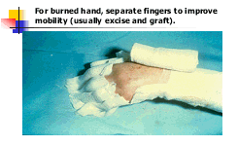
Stress management
Analgesia and sedation
Antipyretics → ibuprofen
NO impaired motion
Stiffness / muscle atrophy
exception: a new graft

Slide 19
Burn Wound Management

Slide 20
Wound Dressing Should Be....
Protect Damaged Skin
Isolate the wound
Splinting / allow early mobilization
Occlusive
Provide comfort

Slide 21
Topical Burn Dressing
Topical Antimicrobial Agent
Silversulfadiazine
Mafenide acetate
0.5 Silver Nitrat Solution
Acticoat
Topical Burn Ointment
MEBO

Slide 22
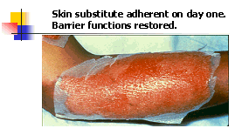
Sythetic and Biological Dressing
Human allograft
Human amnion
Biobrane
Transcyte
Opsite
Duoderm
Cellulose

Slide 23
Superficial Burn Treatment
Clean, remove small blisters
Apply grease gauze and soft gauze dressing (occlusion, absorbent dressing, changed daily).
Synthetic adhesive dressing → seals the wound and decreases pain.
On face, perineum → bacitracin / neomycin ointment
Cold water → decrease pain
Less than 15 % TBSA

Slide 24
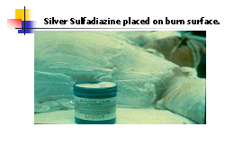
Superficial Burn Dressing
Water-soluble topical antibiotic
grossly contaminated
unsure if the wound is superficial or deep.
Prophylactic systemic antibiotics are not needed.
Closed Dressing
Dressing Change every 12 – 24 hours
Cleaned first
Pain management

Slide 25
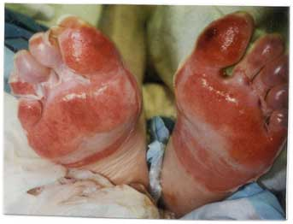
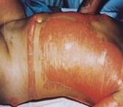
Partial Thickness Burn
6 yo – 60 yo (without Comorbidity)
grease gauze and occlusive dressing
Topical antibiotic (bacitracin) daily.
Extreme ages; with Comorbidity
contaminated wounds or perineal wounds
topical antibiotic
Silver sulfadiazine / silver dressing with closed dressing technique.
Temporary skin substitute
increase healing
decrease conversion.

Slide 26
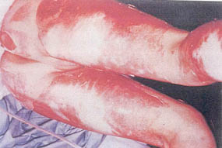
Full Thickness Burn
High risk of infection
Gentle wash, removing loose tissue, char.
Eschar penetrating antibodies, silver cream or dressing first choice, using closed dressing.
Early surgical excision and grafting.
Prophylactic parenteral antibiotics are not indicated.
Circumferential → escharotomy

Slide 27
Conclusion
Primary Survey
Wound assestment
Patient Referral
Principles of burn care
Wound care accordingly

Slide 28
What to do?
Release the vascular tension
In emergency room
Incision
Skin
Fascia
With / out local anasthesia
Using 10, 22 or 24 knife
Vascular evaluation
Capillary refill test
Wound treatment

