Slide 1
Diabetic Foot Ulcers
Pertemuan 8
TIM KEPERAWATAN LUKA

Slide 2
VISI DAN MISI UNIVERSITAS ESA UNGGUL

Slide 3
VISI DAN MISI PRODI KEPERAWATAN
Menjadikan pusat pendidikan Ners yang kompeten berbasis intelektualitas, kualitas, dan kewirausahaan dengna keunggulan di bidang nursing home care serta berdaya saing global pada tahun 2020.
Mengembangkan Program Pendidikan Ners dengna keunggulan nursing home care yang berwawasan global dan berbasis ilmu pengetahuan dan teknologi.
Mengembangkan ilmu pengetahuan dan teknologi di bidang keperawatan dengan keunggulan nursing home care melalui kegiatan penelitian/
Menerapkan dan mengembangkan ilmu keperawatan dengan keunggulan nursing home care melaui mengambdian kepada masyarakat.
Menyiapkan sumber daya manusia keperawatan dengan keunggulan nursinghome care yang berdaya saing global dan menciptakan calon pemimpin yang berkarakter bagi bangsa dan negara
Mengelola sarana dan prasarana yang menunjang program akademik dan profesi keperawatan dengan keunggulan nursinghome care
Berperan aktif dalam menerapkan dan mengembangkan ilmu keperawatan dengan keunggulan nursinghome care yang bermanfaat bagi organisasi profesi, bagi bangsa dan negara Indonesia serta segenap umat manusia

Slide 4
KEMAMPUAN AKHIR YANG DIHARAPKAN
Melakukan pengkajian pada luka diabetes
Menjelaskan analisa data
Melakukan pemeriksaan penunjang

Slide 5
Diabetic Foot Ulcers
Pemeriksaan & deteksi dini kaki diabetes
Kelainan biomekanik pada kaki diabetik
Management pada DFU

Slide 6
An early detection of diabetic foot Klasifikasi :
Klasifikasi The Meggitt Wagner
Grade 0-5
The PEDIS (perfusion, extent, depth, infection, sensation)

Slide 7
Meggitt-Wagner classification
Grade 0 = pre or post completely epitheliazed
Grade 1 = superficial not extending to the
subcutis
Grade 2 = ulcers of the skin, no osteomyelitis
Grade 3 = deep ulcers with osteomyelitis
Grade 4 = localized ganggrene of the toes
Grade 5 = foot with extensive gangrene

Slide 8
The PEDIS System
P = Perfusion = berdasarkan pemeriksaan ABI
E = Extent = size berdasarkan ukuran
D = Depth = superficial atau deep ulcers
I = Infection = ada tidaknya gejala infeksi
S = Sensation = ada tidaknya sensasi berdasarkan monofilamen test

Slide 9
Physical examination
The pin prick test – jarum/peniti
Temperature sensation – metakic rod
Examination of light touch – kapas
Examination of pressure perception – monofilamin 10 g
Vibration perception – garputala dan biothesiometer

Slide 10
Position sense (proprioception)
Deep tendon reflex
ABI (Angkle Brachial Pressure Index)

Slide 11
Pemeriksaan ABI
Pasien duduk / berbaring
Istrahat 5 – 10 menit
Pasang cuff pada cruris 10 cm
Probe Dopller 45-65 derajat
Hasil = TD sistolik tertinggi ATP
TD sistolik tertinggi A.brachialis
*ATP = Arteri Tibialis Posterior

Slide 12
Patogenesis Diabetic Foot Ulcers

Slide 13
Factors predispose diabetic patients to development of foot ulcers :
Peripheral neuropathy
Peripheral arterial disease
Infection
Pressure

Slide 14
Diabetic foot ulcer risk factor
Absence of protective to peripheral neuropathy
Vascular insufficiency
Structural deformities
Callus formation
Long duration diabetes
Long hystory of smoking
Poor glucose control
Impaired vision
Male gender
Ethnic background
Increased age
Poor footwear inadequately protecting skin from high pressures
Obesity

Slide 15
Doppler Ultrasound
Doppler is used to measure blood flow in both arteries and veins.
Ankle systolic pressure = ABPI
Brachial systolic pressure
ABPI (ankle brachial pressure index)
Normal > 0.9
Claudicant 0.5 – 0.9
Ischaemia < 0.5
Calcified > 1.2

Slide 17
DO’s
Be aware of foot conditions
Allert care providers immediately a problem is noted
Inspect feet after removing shoes
Wear white soacks if at risk for wounds
Daily foot hygiene and lubrication
Regulary toenail care
Be care with proper foorwear
Regulary check shoes to wear
Select appropriate activieties
Optimize body weight body mass index

Slide 18
Don’t
Walks barefoot
Lise dry heat on the feet
Soak fell in hot water
Use chemicals or sharps objects to remove calluses
Trim ingrown, embedded toenail edges
Use nail polish
Wear new shoes without frequent checks
Wear soaks with constricting bends
Wear inappropriate shoes
Smoke tobacco

Slide 19
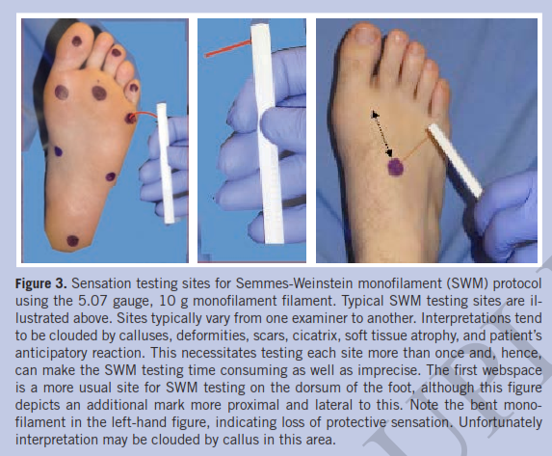
Semmes Weisntein Monofilament Test
WOUNDS 2014; 26(8); 221-231. From Long Beach Memorial Medical Center, Long Beach, CA

Slide 20
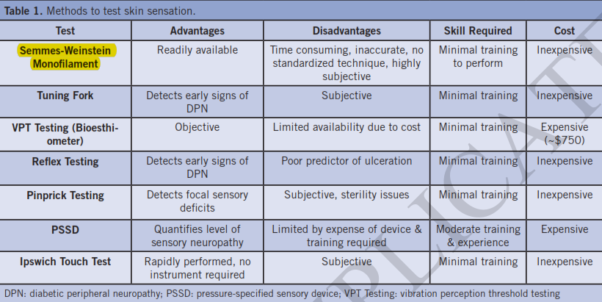
Advantages and Disavantages SMW

Slide 21
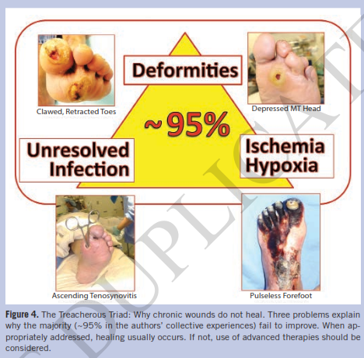

Slide 22
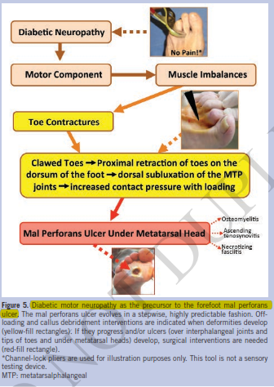

Slide 23
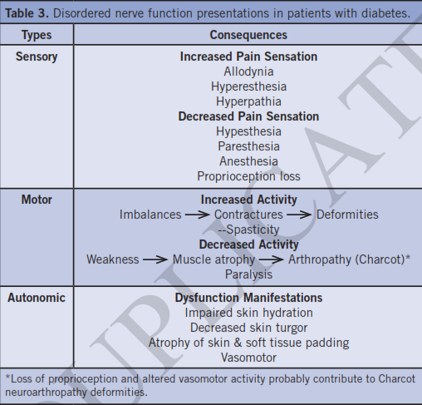

Slide 24
