Slide 1
Do and Don’t DMT2

Slide 2
DO’s
Be aware of foot conditions
Allert care providers immediately a problem is noted
Inspect feet after removing shoes
Wear white soacks if at risk for wounds
Daily foot hygiene and lubrication
Regulary toenail care
Be care with proper foorwear
Regulary check shoes to wear
Select appropriate activieties
Optimize body weight body mass index

Slide 3
Don’t
Walks barefoot
Lise dry heat on the feet
Soak fell in hot water
Use chemicals or sharps objects to remove calluses
Trim ingrown, embedded toenail edges
Use nail polish
Wear new shoes without frequent checks
Wear soaks with constricting bends
Wear inappropriate shoes
Smoke tobacco

Slide 4
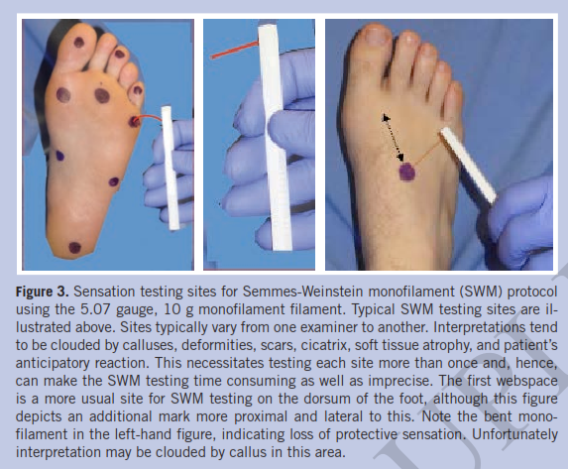
Semmes Weisntein Monofilament Test
WOUNDS 2014; 26(8); 221-231. From Long Beach Memorial Medical Center, Long Beach, CA

Slide 5
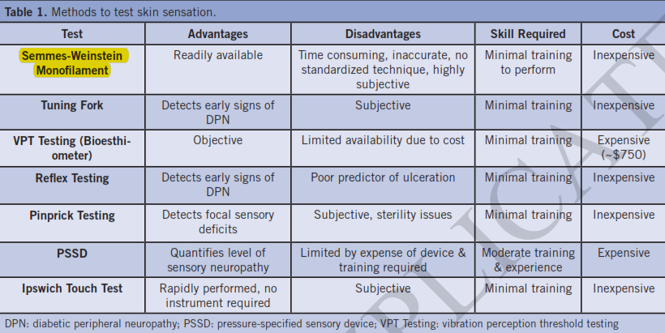
Advantages and Disavantages SMW

Slide 6
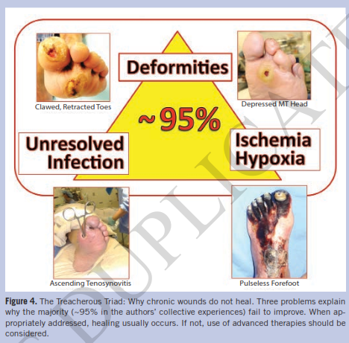

Slide 7
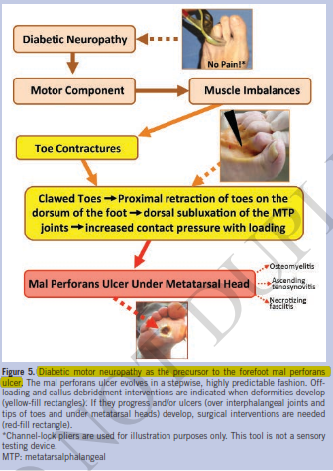

Slide 8
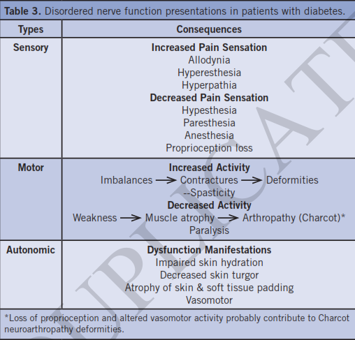

Slide 9
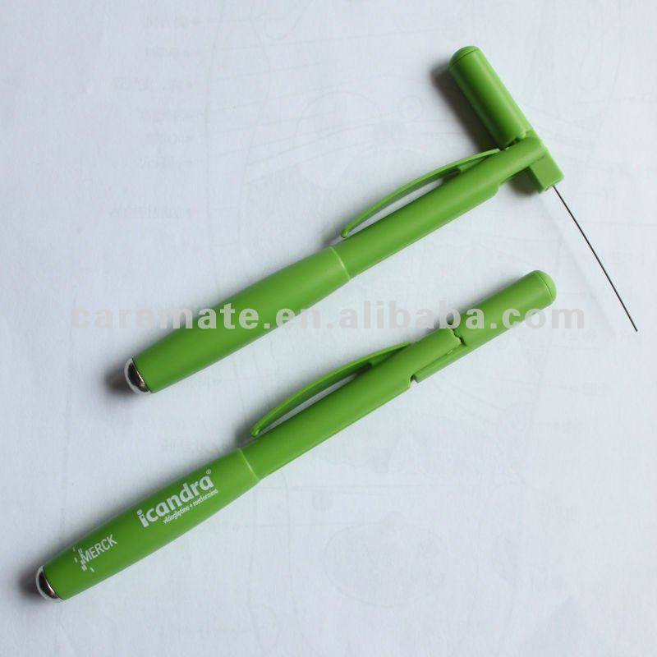
monofilament

Slide 10
