Slide 1
BASIC ENGLISH
WEEK 1: Course Outline
NURYANSYAH ADIJAYA, M.Pd.
PENDIDIKAN BAHASA INGGRIS, FKIP

Slide 2
VISI DAN MISI UNIVERSITAS ESA UNGGUL

Slide 3
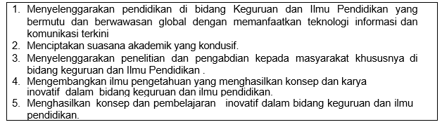
VISI FKIP
MISI FKIP

Slide 4
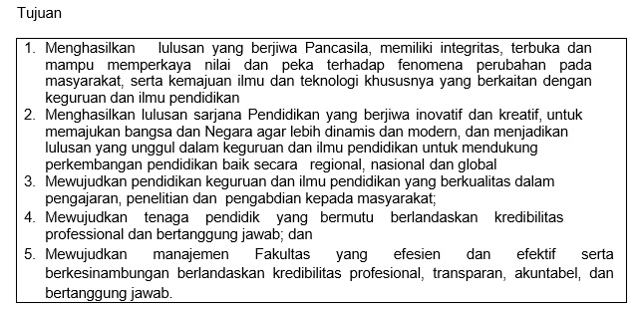
TUJUAN FKIP

Slide 7
TOPIC DISCUSSION BEFORE MID-TERM TEST
01. COURSE OUTLINE AND CLASS REGULATIONS
02. WHAT IS GRAMMAR
03. TENSES
04. CLASS OF WORDS
05. MODAL AUXILIARIES
06. SUBJECTS
07. PRONOUNS

Slide 8
TOPIC DISCUSSION AFTER MID-TERM TEST
08. PASSIVE VOICE
09. PASSIVE VOICE (CONTINUED)
10. DIRECT AND INDIRECT SPEECH
11. DIRECT AND INDIRECT SPEECH (CONTINUED)
12. CAUSATIVE FORM
13. CONDITIONAL IF
14. CONDITIONAL IF (CONTINUED)

Slide 9
Introduction
Welcome to the course of Basic Grammar, a two-credit core subject in Pedagogic English Department of Esa Unggul University. This study is designed to provide you with sufficient support and guidance in understanding the basic concepts of English Grammar in English language learning.

Slide 10
Course Description
This course aims at providing students to carefully practice on integrated points of usage in words, parts ofspeech, etc.

Slide 11
After completing course, you are expected to be able to
1.Identify the roles and relationships of words in a sentence.
Demonstrate mastery of grammar by constructing simple,compound,complex,andcompound/complex sentences

Slide 12
Scope and Approach
As reflected in the general objectives above, the scope of this course involve the basic knowledge of grammar and its components. The modes of teaching and learning activities in this course would be lectures, discussions and reflections, and individual/group presentations/reports.

Slide 13
Assessment
Attendance (10 %)
Assignment (20 %)
Mid-term test (30 %)
Final test (40%)

Slide 14
Course Policy
Students are not allowed to make lateness for more than 10 minutes
Students are assumed to have read the topic discussion before they come into the class
Bring the dictionary (digital or printed)
Submit assignment on time

Slide 15
References
Swan, Michael and Catherine. W. (2011). Oxford English Grammar Course: Intermediate. UK:OUP
Seaton Anne and Y.H. Mew. (2007) Basic English Grammar: book 1. USA: Saddleback Educational Publishing.
Seaton Anne and Y.H. Mew. (2007) Basic English Grammar: book 2. USA: Saddleback Educational Publishing.
Choy Penelope and Dorothy.G.C. (2011). Basic Grammar and Usage, (8th ed). Boston: Wardworth.

Slide 16
Personal reflection on learning English grammar
Why do you need to learn English grammar?
How important learning grammar in learning English?

