Slide 1
BASIC LISTENING
SESSION 1
NONI AGUSTINA, M.Pd.
PENDIDIKAN BAHASA INGGRIS, FKIP

Slide 2
VISI DAN MISI UNIVERSITAS ESA UNGGUL

Slide 3
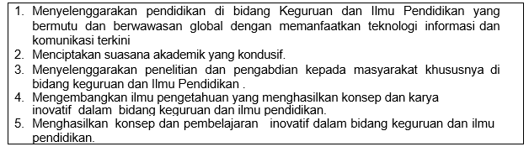
VISI FKIP
MISI FKIP

Slide 4
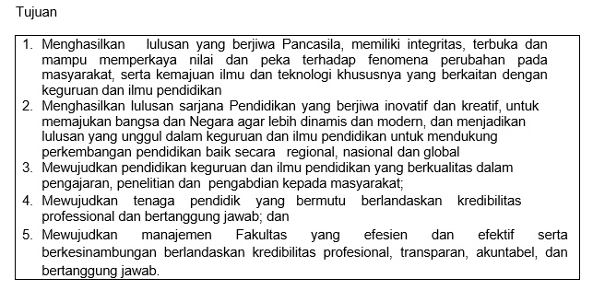
TUJUAN FKIP

Slide 7
Sessions before mid-term test
01. Language elements in the songs
02. Phonological details (sound)
03. Phonological details (stress and pattern)
04. Short dialogues
05. Public announcement
06. Public announcement
07. Instruction

Slide 8
Sessions after midterm test
08. Instruction
09. Long conversation
10. Long conversation
11. News
12. News
13. Making summary
14. Making summary

Slide 9
RULES OF THE GAMES
Try your best to speak English in the classroom
Come to the class on time
Bring the dictionary (digital or printed)
Submit assignment on time
Be honest

Slide 10
LEARNING OUTCOME
Students are able to recognize language elements in the songs.

Slide 11
WHY DO WE LISTEN IN LANGUAGE LEARNING?
Getting the language model through listening
What language model?
Pronunciation
Choice of words
Structure
Characteristic of language →arbitrary (there is no principles or reasons why particular words are chosen to convey meanings)
Father is a word to represent the meaning of your male parent and mother for a female parent.

Slide 12
WHAT LANGUAGE ELEMENTS CAN BE EXPLORED IN SONGS?
Meaning
Phrasal verbs: a phrase that consists of a verb with a preposition or adverb or both, the meaning of which is different from the meaning of its separate parts (Cambridge dictionary). Example: turn on
Idioms: a group of words in a fixed order that have a particular meaning that is different from the meanings of each word on its own
Literary phrase: phrase used in literary works

Slide 13
MADE YOUR MIND UP
I know you haven’t made your mind up yet.
Don’t try to guess the meaning by combining the meaning of each word (make, your, mind, up)
Find in dictionary the base form of made → make.
Find make your mind up.

Slide 14
DEFINITION IN MACMILLAN DICTIONARY
make up your mind
PHRASE
to make a decision
Come on, make up your mind!
make up your mind whether: I can’t make up my mind whether to go or not.
someone’s mind is made up: My mind’s made up. Nothing will makeme change it.
Synonyms and related words: To make a decision: decide, determine, arrive at...

Slide 15
BLACK AND BLUE
I’d go black and blue.
Don’t translate it directly black and blue
Pay attention the verb that comes before black and blue.
Black and blue comes with go

Slide 16
DEFINITION IN MACMILLAN DICTIONARY
black and blue
ADJECTIVE
covered in bruises (=dark marks on your skin where you have been injured but not cut)He’d been beaten black and blue by a gang of thugs.
Synonyms and related words: Injured, wounded or hurt: the injured, wounded, hurt...

Slide 17
STAND BY
I’ll stand by you.
Find stand by in dictionary

Slide 18
DEFINITION STAND BY IN MACMILLAN DICTIONARY
[INTRANSITIVE] [OFTEN PROGRESSIVE] to be ready to do something
A boat will be standing by in case of emergency.
Synonyms and related words
To be ready, or to get ready for something:stand by, brace, steel yourself...
2. [INTRANSITIVE] to not take action when you should
We can’t just stand by and watch her die.
Synonyms and related words
To not act, or to not do something: drop the ball, bother, abstain...

Slide 19
DEFINITION STAND BY IN MACMILLAN DICTIONARY
3.[TRANSITIVE] stand by someone to be loyal to someone who is in a difficult situation
We knew they would stand by us no matter what we’d done.
Synonyms and related words
To support an idea, plan or person:support, back, get behind...Explore Thesaurus
4. [TRANSITIVE] stand by something to continue to have a particular beliefor opinion, even though other people have doubts about it or disagree with you
The doctors are standing by their claim that they are not at fault.
Synonyms and related words
To support an idea, plan or person:support, back, get behind..

Slide 20
STAND BY: WHICH DEFINITION?
I’ll stand by you.
Notice that stand by was followed by you
Stand by you

Slide 21
NIGHT FALLS
When the night falls on you, you don't know what to do
Find night falls

Slide 22
DEFINITION IN MACMILLAN DICTIONARY
night falls - definition and synonyms
PHRASE LITERARY
Related words
darkness/night/dusk falls PHRASE
when night falls, it becomes dark
Night was falling by the time they arrived home.

Slide 23
SET APART
Song: the scientist
Tell you, I set you apart.
Find set apart

Slide 24
DEFINITION IN CAMBRIDGE DICTIONARY
set sth/sb apart
— phrasal verb with set / verb present participle setting, past tense and past participle set
​If a quality or characteristic sets someone or something apart, it shows him, her, or it to be different from, and usually better than,others of the same type:
What set her apart from the other candidates for the job was that she had a lot of original ideas.

Slide 25
DEFINITION IN MACMILLAN DICTIONARY
set someone/something apart to make someone or something different and special
set someone apart from someone/something: Graf’s natural athleticism set her apart from other tennis players.
Synonyms and related words
To be a feature or example of something: feature, enter into, characterize...
[OFTEN PASSIVE] to keep something separate in order to use it for a particular purpose
set apart for: Several acres of public land have been set apart for recreation.
Synonyms and related words
To keep something: set aside, collect, set apart...

