Slide 1
BASIC LISTENING
SESSION 14
Noni Agustina, M.Pd.
PENDIDIKAN BAHASA INGGRIS, FKIP

Slide 2
LEARNING OUTCOME
Students are able to do note-taking while listening to presentation.

Slide 3
Listen to the video at http://learnenglishteens.britishcouncil.org/skills/listening-skills-practice/taking-notes.
What should you do when do note taking?

Slide 4
Note taking
Learn to recognize that the speaker is making an important point by:
pausing
giving examples
repeating what has been said
increasing volume or changing pitch of voice
using body language (facial expression, gestures, posture, pace)
writing on the chalkboard
using direct statements (this is very important) or signal words

Slide 5
Note taking
Good lecture notes must:
present a neat, attractive appearance.
indicate the main points of the lecture.
show the relationship of the details to the main points.
include enough illustrative detail to enrich notes and content

Slide 6
Listening Practice
https://www.youtube.com/watch?v=Na8m4GPqA30
https://www.youtube.com/watch?v=-WLHr1_EVtQ
https://www.youtube.com/watch?v=5MgBikgcWnY

Slide 7
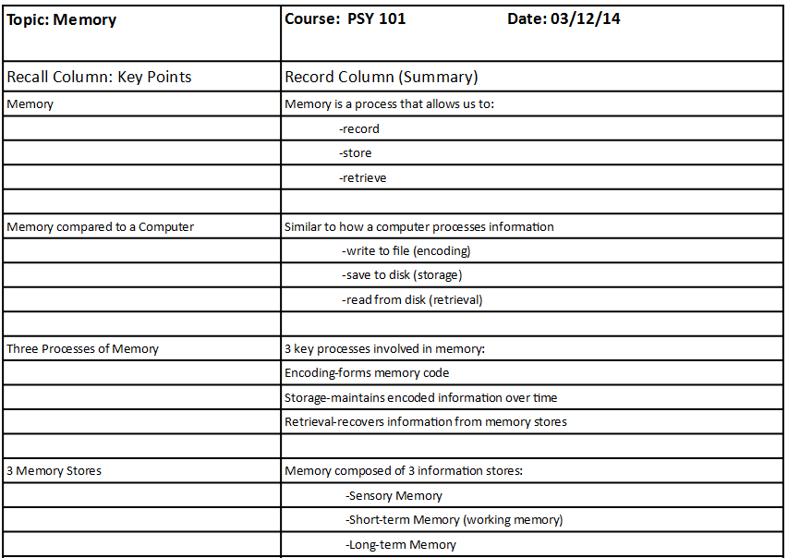
Sample of note taking

Slide 8
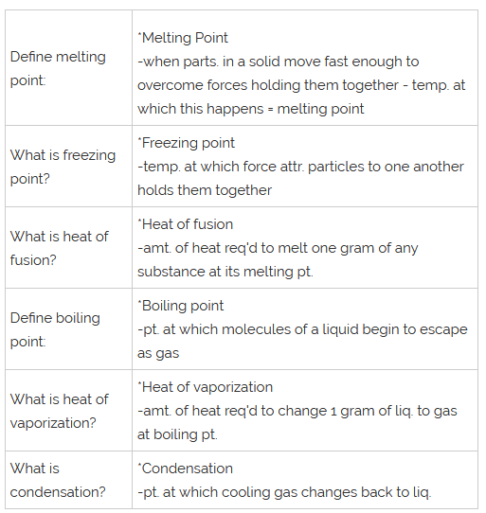
Sample of note taking

Slide 9
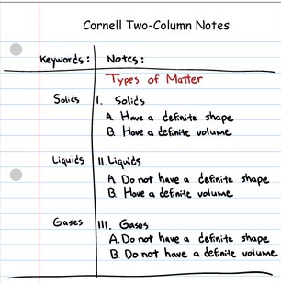
Sample of note taking

Slide 10
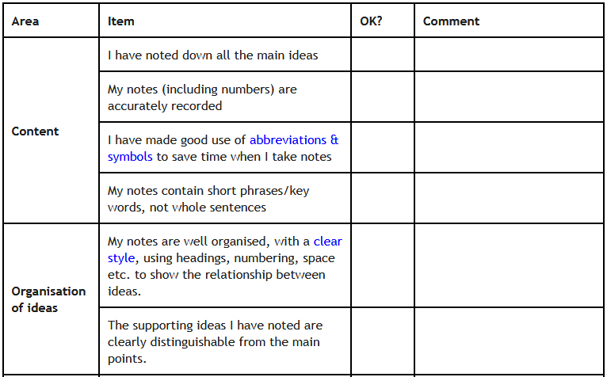
Listening Checklist

