Slide 1
BASIC READING
SESSION 1
Prayogo Hadi Sulistio, M.Pd
PENDIDIKAN BAHASA INGGRIS, FKIP

Slide 2
VISI DAN MISI UNIVERSITAS ESA UNGGUL

Slide 3
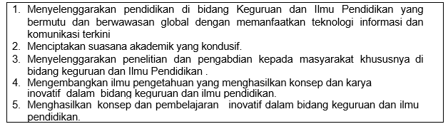
VISI FKIP
MISI FKIP

Slide 4
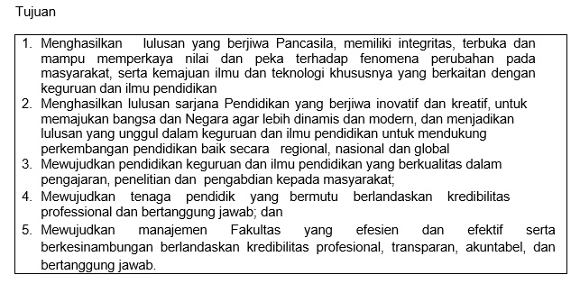
TUJUAN FKIP

Slide 7
Sessions before mideterm test
01. Introduction to Subject Matter
02. Effective reading strategies
03. Paragraph pattern
04. Main idea and supporting details
05. Implied main idea
06. Inference
07. Review

Slide 8
Sessions after midterm test
08. Context clues
09. Reference
10. Signal Words
11. Making prediction
12. Preview
13. Making summary
14. Review

Slide 9
RULES OF THE GAMES
Try your best to speak English in the classroom
Come to the class on time
Bring the dictionary (digital or printed)
Submit assignment on time

Slide 10
LEARNING OUTCOME
Students are able to recognize roles of reading in college.

Slide 11
Why Reading in College?
A fact of life that most students have problems with reading
Reading is one of the most important activities in which students have to engage
Better readers make more successful students

Slide 12
Why Reading in College?
A fact of life that most students have problems with reading
Reading is one of the most important activities in which students have to engage
Better readers make more successful students

Slide 13
Tricks for successful reading
Reading one word at a time in college is like sounding out letters or parts of words.
It TAKES TOO LONG
Instead . . .
Read in blocks: Read several words at once (a phrase, half a line, or a full line in textbooks with columns);

Slide 14
Tricks for successful reading
Think about how much effort it takes for your eyes to focus on EACH WORD AT A TIME!
Let’s play the focus game for a minute. Focus on something a long way away, now focus on something close up. Now look to your left and focus. Now to your right. Now close up again.
It took time for you to focus, right? That same process is occurring every time you FOCUS on a word if you read word-by-word. See??
It TAKES TOO LONG
Your eyes get TIRED
READ IN CLUMPS (clauses, phrases)
Let your eyes settle on several words at once (a phrase, half a line, or a full line in textbooks with columns). SEE the words, but don’t move your eyes or say them.

Slide 15
Tricks for successful reading
Take a sheet of paper and fold it in half
Place it under a line of text
If the text is in columns, put a dot on the piece of paper in the middle of the line
•
As you read,
move the piece of paper down the page so it is always under the line you are reading.
Look at the DOT
and SEE the words,
but do not SAY them

Slide 16
Here are the other tricks
Vocabulary - Wait until you've finished reading to look up unfamiliar words. (If you stop, you'll reduce your level of comprehension.)
Comprehension - to improve comprehension, repeat the main points of the chapter after closing the book. See how many specific details you can recall. The more you interact with your text, the more you'll recall. Recollection and comprehension require a vigorous approach.
Practice 1: Skimming & Scanning - find an interesting newspaper column or magazine article. Rapidly read the article, sampling just the first sentence or two of each paragraph and a few key words. Jot down all the facts you can remember. Then reread the article slowly, giving yourself a point for every item you can recall.

Slide 17
Thank you

