Slide 1
INTRODUCTION TO LINGUISTICS
SESSION 1
RIKA MUTIARA, S.Pd., M.Hum.
PENDIDIKAN BAHASA INGGRIS, FKIP

Slide 2
VISI DAN MISI UNIVERSITAS ESA UNGGUL

Slide 3
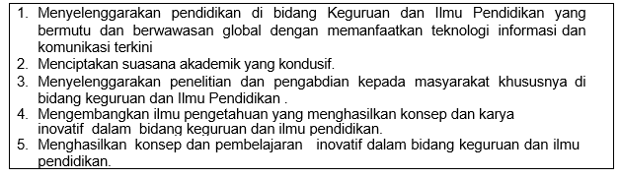
VISI FKIP
MISI FKIP

Slide 4
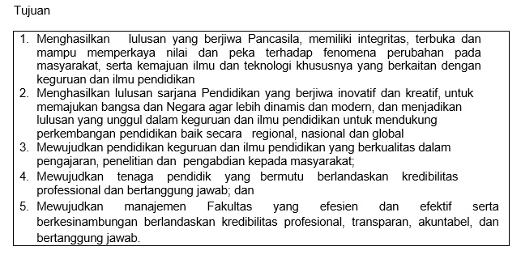
TUJUAN FKIP

Slide 7
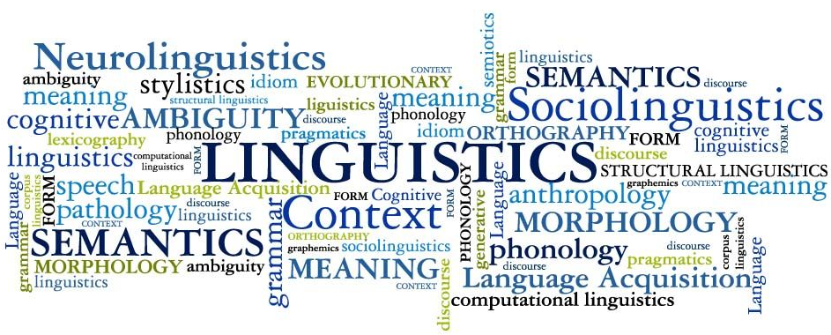
What is linguistics?
Linguistics is the scientific study of language. It encompasses all aspects of human language, seeking answers to fundamental questions about how language works (Linguistics Society of America).

Slide 8
Microlinguistics
Concern only on the language itself
Phonology
Morphology
Syntax
Semantics
Pragmatics

Slide 9
Microlinguistics
Phonology: how speech sounds function
Morphology: how words are formed
Syntax: how phrases, clauses, and sentences are formed
Semantics: how words form meaning
Pragmatics: how meaning is created by contexts

Slide 10
Macrolinguistics
Apply broader views such as
Psycholinguistics
Sociolinguistics
Neurolinguistics
Discourse Analysis
Computational linguistics
Historical linguistics

Slide 11
Macrolinguistics
Psycholinguistics: investigates and describes the psychological processes that make it possible for humans to master and use language
Sociolinguistics: how language use interacts with or is affected by social factors
Neurolinguistics: how and where our brains store our knowledge of the language, what happens in our brains as we acquire that knowledge, and what happens as we use it in our everyday lives

Slide 12
Macrolinguistics
Discourse analysis: how language is used in social contexts
Computational linguistics: how computer science are applied to linguistics
Historical linguistics: how languages change across time

Slide 13
Prescriptive grammar
How language should be used.
The “correct language”
Correcting people's use of the language to be standard language
Language class → teach people how to use language in a certain way
Example:
A: Thank you
B: You’re welcome/My pleasure

Slide 14
Descriptive grammar
How language is actually used
No right and wrong language

Slide 15
Prescriptive vs descriptive grammar
Bapak Yogo yang terhormat vs Yth. Bapak Yogo

Slide 16
What is language?
Language is a purely human and non-instinctive method of communicating ideas, emotions, and desires by means of system of a voluntary produced symbols (Sapir, 1921)
Language is a form of communicating by means of a system of symbols principally transmitted by vocal sounds (Hobbins, 1990)

Slide 17
Symbols in language
There is rarely an inherent association between a word and the object or concept that it denotes.
Examples:
Bawang merah, bawang putih
Kacang merah, kacang hijau, and kacang panjang

Slide 18
Characteristics of human language
Interchangeability: transmitting and receiving information.
Productivity: the ability to vary a message to reflect differences in circumstances concerned.
Cultural transmission: the ability to learn from others.

Slide 19
Functions of language
Phatic communion
Establish or maintain social relations
Example: How are you?
Emotive utterance
Expression of emotions
Examples: That’s fantastic; shit

Slide 20
Functions of language
Performative utterance
An utterance is an act in itself spoken by somebody with relevant authority.
Example: I declare the bridge open

