Slide 1
INTRODUCTION TO LINGUISTICS
SESSION 2
RIKA MUTIARA, S.Pd., M.Hum.
PENDIDIKAN BAHASA INGGRIS, FKIP

Slide 2
Morpheme
A morpheme is the smallest part of a word that has grammatical function or meaning
Examples:
may = {may}
shouted = {shout}+{-ed}
coughing = {cough}+{-ing}
unbeliever = {un-}+{believe}+{-er}

Slide 3
Free morpheme
A free morpheme: a morpheme that does not have to be attached to another morpheme.
Examples:
yesterday
school
saw

Slide 4
Bound morpheme
A bound morpheme: a morpheme that must be attached as a word part.
Examples:
un-
dis-
-ment
-able
pre-

Slide 5
Exercise: Free and bound morpheme
List the morphemes in each word below, and state whether each morpheme is free (F) or bound (B).
creating
unhealthy
seaward
waiter
wastage
reconsider
poetic
keys
modernize
incompletion

Slide 6
Derivational morpheme
Derivational morphemes are added to form and to create separate words:
Morpheme {-er} is a derivational morpheme whose addition turns a verb into a noun, usually meaning the person or thing that performs the action denoted by the verb.
Example: {paint}+{-er} → painter
Meaning: “someone who paints.”

Slide 7
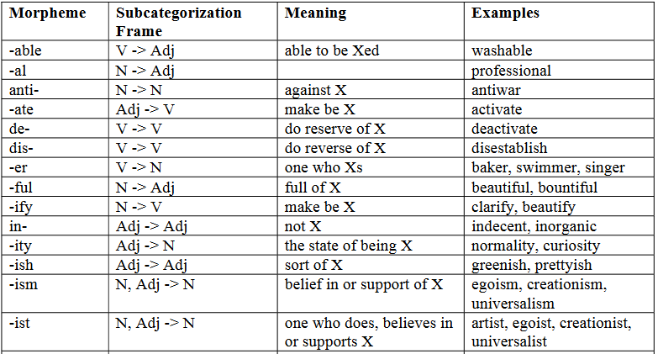
Common derivational morphemes chart

Slide 8
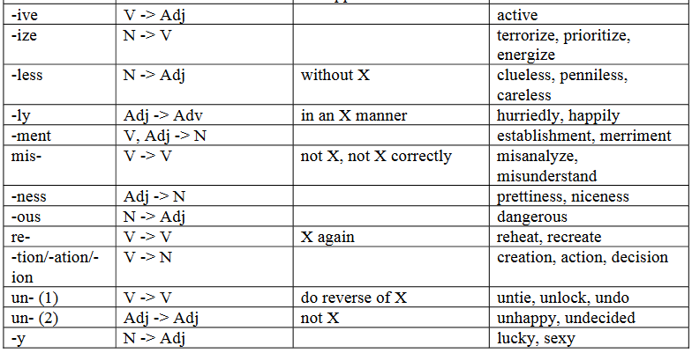
Common derivational morphemes chart

Slide 9
Inflectional morpheme
Inflectional morphemes do not create separate words.
They merely modify the word in which they occur in order to indicate grammatical properties such as plurality
Examples:
the {-s} of magazines
the {-ed} of barbecued

Slide 10
Be careful
The words district and discipline show that the sequence of letters d-i-s does not always constitute a morpheme. (Analogous examples are mission, missile, begin,and retrofit.)
List five more sequences of letters that are sometimes a morpheme and sometimes not.

Slide 11
Exercise: Derivational and inflectional morphemes
For each word below, indicate whether the word is morphologically simple (S), includes an inflectional morpheme (I), or includes a derivational morpheme (D).
rider
reader
colder
redder
silver
radish
lens
redness
legs
rotation

Slide 12
Root
A root morpheme is the basic form to which other morphemes are attached.
It provides the basic meaning of the word.
The morpheme {saw} is the root of sawers.

Slide 13
Base
Expressions to which affixes are attached are called bases
{move} + {-able}
{-able} is attached to {move}, move is the root.
{im-} + {moveable}
{im} is attached to moveable, not to {move} but moveable is not a root, it is a base.
While roots may be bases, bases are not always roots.

Slide 14
Allomorphs
Variants of a morpheme are called allomorphs.
Influenced by sound environment.
The allomorphs of plural and past tense.

Slide 15
Allomorphs

Slide 16
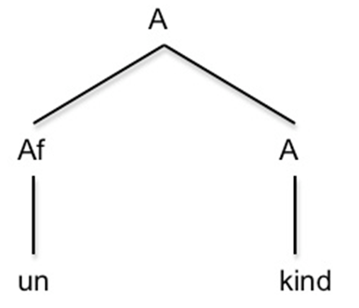
Word tree

Slide 17
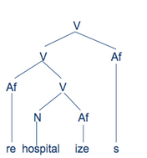
Word tree

Slide 18
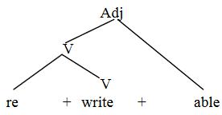
Word tree

Slide 19
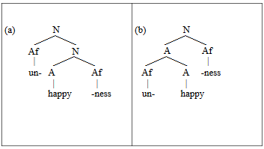
Word tree
Which one is correct?

Slide 20
Word tree
Why (a) is incorrect?
Because un- cannot be inflected to a noun (happiness).
Un- must be inflected to an adjective (unhappy).

Slide 21
Exercise: Word tree
Draw a word tree of the each word:
shipper
simply
disobey
jumping
resettled
digitizes
anticlimaxes
activity
unemployment
confrontational

Slide 22
Creating new words
Derivation: the process of creating separate but morphologically related words.
Compounding: combining two bound morphemes.
Coining: the creation of new words without reference to the existing morphological resources of the language.

Slide 23
Creating new words
Abbreviation: the shortening of existing words to create other words, usually informal versions of the originals.
Blending involves taking two or more words, removing parts of each, and joining the residues together to create a new word whose form and meaning are taken from the source words.
Borrowing involves copying a word that originally belonged in one language into another language.

Slide 24
Derivation
It involves a change in the position of the primary stress in a word.

Slide 25
Derivation
Only a feature of the final consonant changes, usually its voicing.

Slide 26
Derivation
It induces a change in a stressed vowel.

Slide 27
Derivation
The addition of a suffix triggers a change in the final consonant of the root.

Slide 28
English allows us to change a word’s part of speech without any change of form. As a result, identical forms may belong to different parts of speech.
Example:
This saw is dull.
Don’t saw the board.

Slide 29
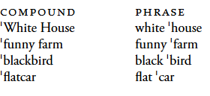
Compounding
Compounds are sometimes spelled as single words, as in sawmill, sawdust
Sometimes the parts are connected by a hyphen, as in jig-saw and sometimes they are spelled as two words, as in chain saw.
The main stress is on the first word

Slide 30
Compounding
The meaning of the compound may differ to a greater or lesser degree from that of the corresponding phrase.
A blackbird is a species of bird, regardless of its color; a black bird is a bird which is black, regardless of its species

Slide 31
Coining
Start out as brand names for everyday items.
Examples: aspirin, kleenex, aqua

Slide 32
Abbreviation
Prof for professor, doc for doctor.
We may use the first letter of each word in a phrase to create a new expression, an acronym, as in UN or US.

Slide 33
Blending
It involves taking two or more words, removing parts of each, and joining the residues together to create a new word whose form and meaning are taken from the source words.
smoke and fog → smog
motor and hotel → motel
worldwide web and seminar →webinar

Slide 34
Borrowing
Borrow words from other languages
Latin (homicide)
Greek (chorus)
French (mutton)
Spanish (ranch)
German (semester)
Scandinavian languages (law)

