Slide 1
INTRODUCTION TO LINGUISTICS
SESSION 3
RIKA MUTIARA, S.Pd., M.Hum.
PENDIDIKAN BAHASA INGGRIS, FKIP

Slide 2
What is syntax?
Syntax is a subfield of microlinguistics that concerns on phrase and clause structures.
Syntax discuses
Word order
Agreement
What modifies what

Slide 3
What is syntax?
Syntax is not about meaning.
A sentence can grammatically correct but nonsense
Colorless green ideas sleep furiously.
adj adj N V adv

Slide 4
Parts of speech
Open class
New words are added to the class over the time e.g. nouns, verbs, adjectives, and adverbs.
Closed class
It contains small number of words, new items are added very rarely.
e.g. determiners, pronouns, prepositions, conjunctions

Slide 5
Open class

Slide 6
Closed class: Determiners (Det)
Determiners come before nouns
articles (a, the)
quantifiers (many, any, all, several)
possessives (my, your, his, her)

Slide 7
Closed class: Auxiliary verbs (Aux)
Examples: will, may, must, shall, would, can, have
Aux is followed by a verb (V)
It will rain.
You must be quiet.
Is negated directly: not
He cannot swim.
She would not come.

Slide 8
Closed class: Pronouns (Pro)
Words that stand for a noun or a whole noun phrase.
Examples: I, you, he, she, it, we, they, me, him, her, us, them
Sub-categories of pronouns:
Subject pronouns
Object pronouns
Possessive pronouns
Reflexive pronouns
Examples:
I run.
*My run.
John likes my house.
*John likes I house.

Slide 9
Closed class: Preposition (Prep)
Prepositions stand before noun phrases (NP)
Examples: in, on, about, with, at, to, of, under

Slide 10
Closed class: Conjunctions (conj)
They connect two words, phrases, or clauses on the same level
Examples: and, or, but, . . .
They connect
N-N (women and men)
V-V (run or walk)
Adj-Adj (warm but rainy)
Clause-Clause (I will talk and he will write)

Slide 11
More than one word class
Some words belong to several categories:.
They have similar meaning:
She talks very much. vs. She is giving three talks.
It’s cold. vs. I got a cold.
They have completely different meanings.
I can’t bear the noise. vs. There is a bear in the wood.
tree barks vs. the dogs bark

Slide 12
Identify the class of words of the underlined words
a. It was a cold and dreary day.
b. I can't seem to get rid of my cold.
a. You must dry cilantro leaves before storing.
b. The dry heat of the desert proved to be deadly.
a. There has been some improvement in the past week.
b. In the past, there has not been much improvement.
a. That's a promise.
b. I promise to take you to the zoo tomorrow.
I forget where I put the book.
I booked the ticket for my trip to Manado.

Slide 13
Phrase/Constituent
A phrase is a group of words which “belong together” in a sentence.

Slide 14
Noun phrases
In English, a noun phrase is a determiner followed by a noun, or determiner followed by an adjective followed by a noun, or a single noun, or . . .
Examples:
NP→ Det N the cat
NP→ Det Adj N those noisy cats
NP→ Adj N noisy cats

Slide 15
Prepositional phrases
In English, preposition is usually followed by a noun phrase
Example
PP →P NP about those noisy cats

Slide 16
Clauses
A clause is a group of words that includes a subject and a verb.
A clause can be distinguished from a phrase, which does not contain a subject and a verb (e.g., in the afternoon, drinking from the bowl).

Slide 17
Clauses
In English, a clause consists of a subject (N or NP) followed by a verb which is sometimes followed by an object (N or NP), prepositional phrases etc.
Alphons slept. Subject + V
Alphons saw his dog. Subject + V + Object
NP V Alphons slept.
NP V NP Alphons saw his dog.
NP V PP Alphons asked for a beer.
NP V NP PP Alphons asked his dog for a beer.

Slide 18
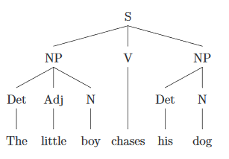
Phrase structure trees
Phrases are created from other phrases or words.
Sentence is the biggest phrase.

Slide 19
Constituency test
Sometimes, we get confused whether one is a phrase or not.
To check, we have constituency test.
A very useful constituency test is substitution.

Slide 20
Substitution
Replacing the string of words with another one which belongs to pronouns.
Mary helped the man in the green hat and Michael.
Mary helped them.

Slide 21
Substitution
If the substitution leaves the meaning roughly unchanged, then the constituency test has worked.
I read a book about Napoleon in Italy.
I read it in Italy.
I read it.

Slide 22
Ambiguity
More than one possible structure for the same string of words.
I saw a man with a telescope.(Who has the telescope, me or the man?)
We need more intelligent leaders.(need more or more intelligent?)

Slide 23
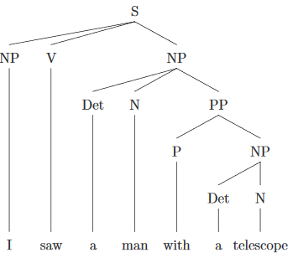
Ambiguity

Slide 24
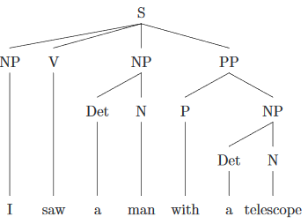
Ambiguity

Slide 25
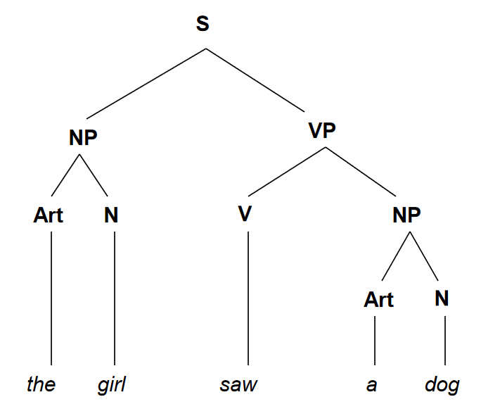
Tree diagram

Slide 26
Draw the tree diagrams
The man took the money.
The young lady cooked special dish.

Slide 27
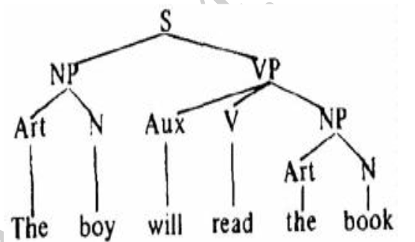
Tree diagram

Slide 28
Draw the tree diagrams
The old postman might deliver the letter.
Your order can arrive.

Slide 29
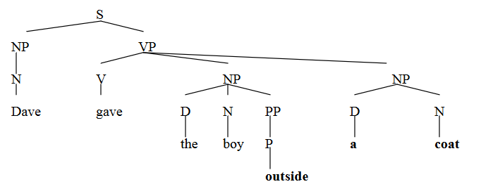
Tree diagram

Slide 30
Draw the tree diagram
The young lady gave the little boy some yummy pies.

