Slide 1
INTERMEDIATE GRAMMAR
SESSION 1
Prayogo Hadi Sulistio, M.Pd
PENDIDIKAN BAHASA INGGRIS, FKIP

Slide 2
VISI DAN MISI UNIVERSITAS ESA UNGGUL

Slide 3
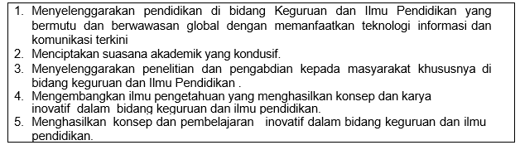
VISI FKIP
MISI FKIP

Slide 4
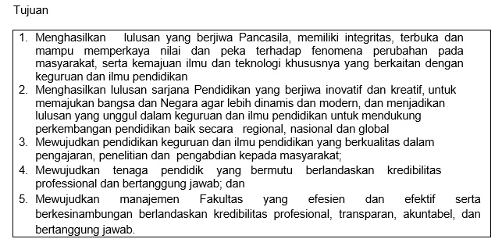
TUJUAN FKIP

Slide 7
Sessions before mideterm test
01. Introduction to Subject Matter
02. Articles in Grammar
03. Word Formation
04. Phrases Part I
05. Phrases Part II
06. Grammatical Structure of Sentence
07. Simple Sentence

Slide 8
Sessions after midterm test
08. Compound Sentence
09. Adverbial Clause
10. Noun Clause
11. Adjective cCause
12. Parallel Structure
13. Inversion
14. Review

Slide 9
RULES OF THE CLASS
Try your best to speak English in the classroom
Come to the class on time
Bring the dictionary (digital or printed)
Submit assignment on time

Slide 10
LEARNING OUTCOME
Deconstruct word formation, phrases, clauses, and parallel structure smaller parts.
Demonstrate mastery of grammar by constructing word formation, simple sentence, compound sentence, adjective clause, noun clause, adverbial clause, inversion, parallel structure in students’ writings.

Slide 11
Scoring System
Assignment 20%
Attendance 10%
Mid Term Test 30%
Final test 40%

Slide 12
References
Swan, Michael and Catherine. W. (2011). Oxford English Grammar Course: Intermediate. UK:OUP
Seaton Anne and Y.H. Mew (2007) Basic English Grammar: book 1. USA: Saddleback Educational Publishing.
Seaton Anne and Y.H. Mew (2007) Basic English Grammar: book 2. USA: Saddleback Educational Publishing.

Slide 13
Why is Grammar Important?
Grammar lays the groundwork for effective communication.
improper grammar can likewise affect the meaning and clarity of an intended message.

Slide 14
Why is Grammar Important?
Grammar makes written content more readable and in turn more interesting.
If it is necessary to repeatedly reword sentences while reading, the flow becomes disrupted and involvement in the story halted.

Slide 15
How is Grammar Useful in the Real World?
Grammar skills are useful in every aspect of life from education to leadership, and social life to employment opportunities.
They are equally important at home where children learn their grammatical patterns from their parents and family.
This puts the next generation at an immediate disadvantage if learning incorrectly.

Slide 16
How is Grammar Useful in the Real World?
Grammar skills are important to be an effective leader.
If continuing education is desired, grammatically correct papers will be expected from college professors.
Proper grammar is also essential for understanding English as a second language as well as for learning a new language, since all languages follow grammatical patterns.

Slide 17
Thank you

