Slide 1
BASIC WRITING
WEEK 1: Course Outline
NURYANSYAH ADIJAYA, M.Pd.
PENDIDIKAN BAHASA INGGRIS, FKIP

Slide 2
VISI DAN MISI UNIVERSITAS ESA UNGGUL

Slide 3
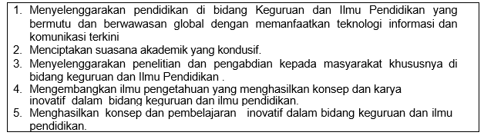
VISI FKIP
MISI FKIP

Slide 4
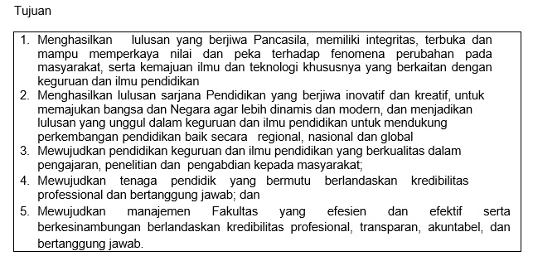
TUJUAN FKIP

Slide 7
TOPIC DISCUSSION BEFORE MID-TERM TEST
01. COURSE OUTLINE AND CLASS REGULATIONS
02. BASIC CONCEPT OF WRITING
03. OUTLINING
04. ORGANIZING
05. ORGANIZING PART 2
06. COHESION
07. COHESION PART 2

Slide 8
TOPIC DISCUSSION AFTER MID-TERM TEST
08. FAMILY
09. HEALTHY FOOD (COMPOSITION)
10. HEALTHY FOOD (DISCUSSION)
11. REVISING
12. REVISING PART 2
13. PROOFREADING
14. PROOFREADING PART 2

Slide 9
Introduction
Welcome to the course of Basic Writing, a three-credit core subject in Pedagogic English Department of Esa Unggul University. This study is designed to help students understand basic concepts of writing; finding ideas, oulining, organizing, revising and proofreading. After taking this course, students are expected to be able write a paragraph or text comprehensively.

Slide 10
Course Description
This course is Basic Writing. The subject consists of 9 topic discussions that discussed into 14 meetings.

Slide 11
After completing course, you are expected to be able to
1. Understand basic concept and components of writing
2. Compose a paragraph and text
3. Correct mistakes on composition.

Slide 12
Scope and Approach
As reflected in the general objectives above, the scope of this course involve the basic knowledge of writing and its components. The modes of teaching and learning activities in this course would be lectures, discussions and reflections, and individual/group presentations/reports.

Slide 13
Assessment
Attendance (10 %)
Assignment (20 %)
Mid-term test (30 %)
Final test (40%)

Slide 14
Course Policy
Students are not allowed to make lateness for more than 10 minutes
Students are assumed to have read the topic discussion before they come into the class
Bring the dictionary (digital or printed)
Submit assignment on time

Slide 15
References
Anker, Susan.(2009). Real Writing with Reading . NY:
Bedford.
Brook Guy and Vanessa Jakeman.(2013).Complete IELTS. Cambridge: Cambridge University Press.
http://gen.lib.rus.ec/book/index.php?md5=687986FCA
187CF35C1612438B84F7C1A
http://gen.lib.rus.ec/book/index.php?md5=7373A067F
BE290DB27BD284C2C476FE0

Slide 16
Personal reflection on learning Basic English
How long can you memorize it? Writing makes it long lasting.

