Slide 1
ENGLISH PHONETICS AND PHONOLOGY
SESSION 1
RIKA MUTIARA, S.Pd., M.Hum.
PENDIDIKAN BAHASA INGGRIS, FKIP

Slide 2
VISI DAN MISI UNIVERSITAS ESA UNGGUL

Slide 3
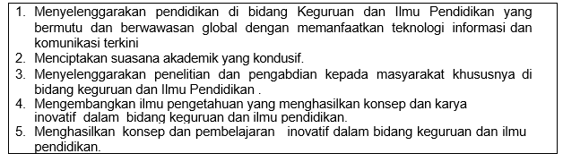
VISI FKIP
MISI FKIP

Slide 4
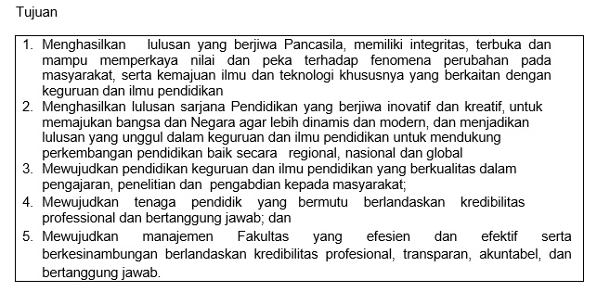
TUJUAN FKIP

Slide 5
Sessions before midterm test
01. Introduction to phonetics and articulators
02. Vowels, diphtongs, and triphtongs
03. Consonants
04. Consonants
05. The phoneme
06. Transcription practice
07. Phonology

Slide 6
Sessions after midterm test
08. Assimilation, disimilation, linking, elision
09. Syllables
10. Stress in simple words
11. Stress in complex words
12. Weak forms
13. Intonation and tone
14. Discourse functions of intonation

Slide 7
LEARNING OUTCOME
Students are able to identify general principles of phonetics (scope and branches) and articulators (positions).

Slide 8
REFERENCES
Katamba, F. (1989). An introduction to phonology. London: Longman.
Roach, P. 1991. English phonetics and phonology: A practical course. Cambridge: Cambridge University Press.

Slide 9
What is phonetics?
Phonetics is the study of the inventory of all speech sound which humans are capable of producing.
The term speech sound has been used advisedly since not all noises which we are capable of producing with our vocal apparatus are employed in speech.

Slide 10
Application
Phonetics as an interdisciplinary science has many applications.
In forensic investigations, it tries to work out whose voice is behind a recording phonetics.
In language teaching and learning, it helps to describe how words are pronounced.

Slide 11
Branches of phonetics
ACOUSTIC PHONETICS: the study of the physical properties such as frequency, intensity, and duration of speech sounds using laboratory instruments
AUDITORY PHONETICS: the study of speech perception
ARTICULATORY PHONETICS: the study of speech production

Slide 12
The articulators
The term VOCAL TRACT is used to refer to the air passages which the air enters on leaving the larynx.
The vocal tract has two parts: the ORAL TRACT, which is the air passage offered by the mouth and the NASAL TRACT, which is the air passage provided by the nose.
The parts of the oral tract such as the tongue and lips which can be used to form speech sounds are called ARTICULATORS.

Slide 13
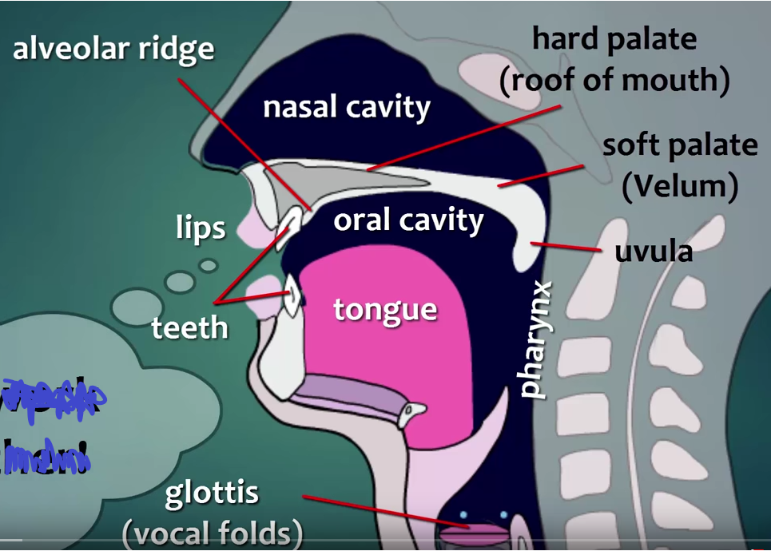
The articulators

Slide 14
Pharynx
Pharynx is a tube.
Its top end is divided into two (back of the mouth and the beginning of the way through the nasal cavity).

Slide 15
Soft palate (velum)
In speech often it is raised so that air cannot escape through the nose .
It can be touched by the tongue.
Sounds made with the tongue touches the lower side are called velar.

Slide 16
Hard palate
It is called roof of the mouth.
You can feel its smooth curved surface with your tongue.

Slide 17
Alveolar ridge
It is between the top front teeth and the hard palate.
Its surface is really much rougher than it feels.
Sounds made with the tongue touches it are called alveolar.

Slide 18
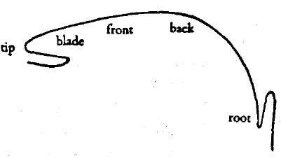
Tongue
It can be moved into many different places and different shapes.
Tongue is divided into some parts.

Slide 19
Teeth
They are divided into upper and lower.
The tongue is in control with the upper side teeth for many speech sounds.
Sounds made with the tongue touches the front teeth are called dental.

Slide 20
Lips
They can be pressed together (the sounds p, b).
They brought into contact with teeth (the sounds f and v)
They are rounded to produce the lip-shape (the sound u).
In lip to teeth contact, it is called labio dental.

Slide 21
Assignment
Draw the articulators and label the names of the articulators.
Next week, point the articulators one by one.

