Slide 1
ENGLISH PHONETICS AND PHONOLOGY
SESSION 2
RIKA MUTIARA, S.Pd., M.Hum.
PENDIDIKAN BAHASA INGGRIS, FKIP

Slide 2
Learning Outcomes
Students are able to explain the concepts of vowels, diphthongs, and triphtongs.
Students are able to differentiate the long and short vowels.
Students are able to pronounce the sounds correctly.

Slide 3
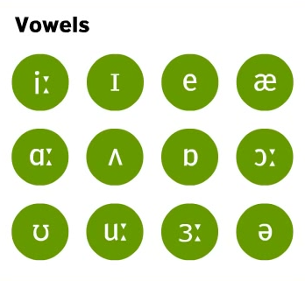
Vowel symbols
https://www.youtube.com/watch?v=W_e37xaNe3o

Slide 4
Parameters to describe vowels
Height: how high or low the tongue is.
Advancement: how far front or back the tongue is.
Roundedness
Tenseness

Slide 5
Height
HIGH: the highest point of the hump in the tongue close to the roof of the mouth
LOW: barely rising above the floor of the mouth
MID: the intermediate position
Practice to say: [i] and [ɑ]
Practice to say: [i] [ɜ] and [ɑ]

Slide 6
Advancement
Depending on the location of the highest point of the tongue, vowels may be regarded as FRONT, CENTRAL or BACK
Practice to say [i] and [u]

Slide 7
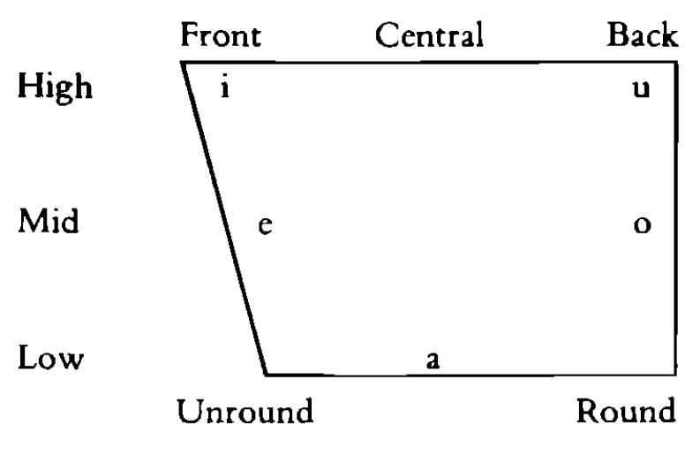
Vowels

Slide 8
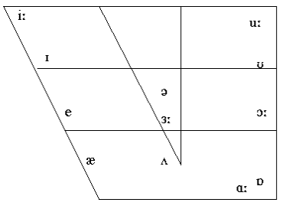
Vowels

Slide 9
Rounding
Rounded
Unrounded
Typically front vowels are unrounded and back vowels are rounded
Practice to say [i] and [u]

Slide 10
Tenseness
Tense and lax vowels
Your muscles tense (making effort) as in the case of /i:/,/u:/,/ɔ:/,/ɑ:/ etc or lax (not making too much effort) as in the case of the schwa sound,/ʌ/,/ɪ/
Tense vowels are longer than lax vowels of the same general high class
/i / is longer than /ɪ/
/u/ is longer than /ʊ/

Slide 11
Tenseness

Slide 12
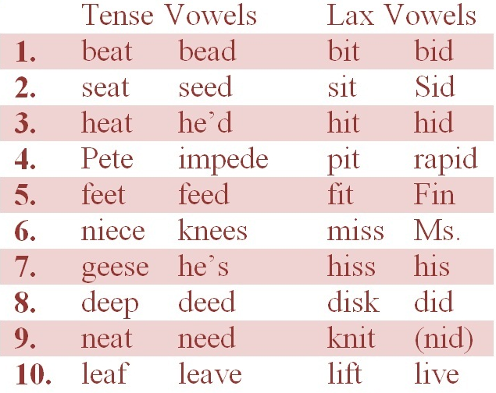
Tenseness

Slide 13
How to describe vowels
Height->advancement-> roundedness
Example: high back rounded

Slide 14
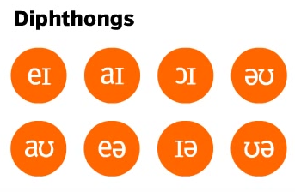
Diphtong
Diphtongs are sounds which consist of a movement or glide from one vowel to another.
The first part is much longer and stronger than the second part. The second part is shorter and quiter.

Slide 15
Diphtong
/eɪ/ play, shame, able, name, straight, bathe, ache, take
/ɔɪ/ oil, noise, lawyer, avoid, join, oyster, voice, toil
/aɪ/ eye, child, style, wild, pint, while, guy, climb
/əʊ/ phone, bone, comb, know, rose, over, poet, toe
/aʊ/ owl, shout, about, round, house, town, cow, loud
/ɪə/ ear, here, beard, pier, cheer, dear, earring, near
/eə/ air, fairy, stare, prayer, bear, there, where, swear

Slide 16
Diphtongs
/eɪ/ It takes a day to bathe your aches away.
/ɔɪ/ Avoid those boys and their noisy toys.
/aɪ/ That child’s style is silent but wild.
/əʊ/ Don’t row the boat so slowly.
/aʊ/ How about we have this row now?
/ɪə/ Here, here. Let’s cheer for more beer!
/eə/ Mary rarely shares her pears with Claire.

Slide 17
Triphtong
A triphtong is a glide from one vowel to another and then to a third. All are produced rapidly and without interruption.

Slide 18
Triphtong
eɪ + ə = eɪə, as in layer, player
aɪ + ə = aɪə, as in lire, fire
ɔɪ + ə = ɔɪə, as in loyal, royal
əʊ + ə = əuə, as in lower, mower
aʊ + ə = auə, as in power, hour

