Slide 1
ENGLISH PHONETICS AND PHONOLOGY
SESSION 3
RIKA MUTIARA, S.Pd., M.Hum.
PENDIDIKAN BAHASA INGGRIS, FKIP

Slide 2
Learning Outcomes
Students are able to explain the concepts of plossives, fricatives, and affricatives.
Students are able to pronounce the sounds correctly.

Slide 3
Consonants
Consonants involve constriction of airflow which vowels don’t have.
Parameters for consonants:
Place of articulation
Manner of articulation
Voicing

Slide 4
Place of articulation
This refers to the place in the vocal tract where the airstream is obstructed in the production of a consonant.
Bilabials: both lips come together
Labiodentals: upper teeth and lower lip come together
Interdental: tongue in between upper and lower teeth
Alveolar: tongue at or near the ridge behind the upper front teeth
(

Slide 5
Place of articulation
Alveo) palatal: the front of the tongue raised to the front hard palate
Velar: The back of the tongue raised to the velum
Uvular: The back of the tongue raised to uvula
Glottal: Made at the glottis

Slide 6
Manner of articulation
This refers to the way in which the airstream is interfered with in producing a consonant.
Plosive/stop
Fricate
Affricate
Nasal
Liquid
Glide

Slide 7
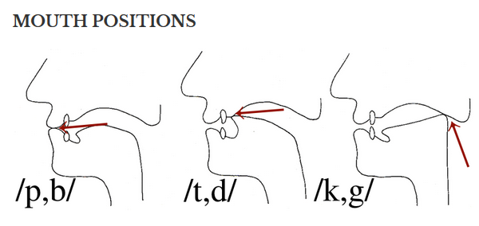
Plosive/stop
The articulators come together and completely cut off the flow of air momentarily, then they separate abruptly.

Slide 8
Fricate
The articulators are brought very close together leaving only a very narrow channel through which the air squeezes on its way out. The air is never fully blocked, it is constantly released.
Say fan van thin then sink zinc shrill genre

Slide 9
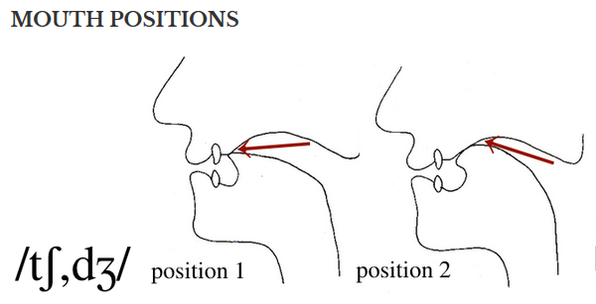
Affricate
Affricate: Articulators come together and completely cut off the flow of air, just as they do in a stop; then they separate gradually.

Slide 10
Voicing
What are the vocal folds doing?
Voiceless sound: air through open vocal folds.
Voiced sound: air through vibrating vocal folds
Say [ffffj and then [vvvv] with two fingers held firmly on your larynx.
You should be able to feel your fingers vibrating slightly when you say [vvvv] but not when you say [ffff].
Say [ssss] and [zzzz].

