Slide 1
ADVANCED LISTENING
SESSION 4
RIKA MUTIARA, S.Pd., M.Hum.
PENDIDIKAN BAHASA INGGRIS, FKIP

Slide 2
Learning Outcomes
Students are able to explain the concepts of nassals, sounds /l/, /r/, /j/, and /w/.
Students are able to pronounce the sounds correctly.

Slide 3
Nassals
The basic characteristic of nasals is the air escapes through the nose. The air does not pass through the mouth.
Soft palate must be lowered.
English has three nasal sounds: /m/,/n/,/ŋ/.

Slide 4
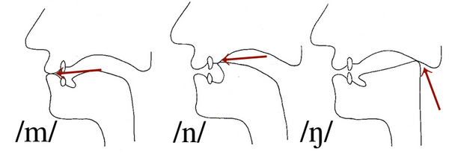
Nassals: Types of closure
Bilabial (two lips) → /m/
Alveolar (tongue blade against alveolar ridge → /n/
Velar (back of tongue against the soft palate) → /ŋ/

Slide 5
Lateral
Lateral sound is produced by allowing the air to escape around the sides of the tongue rather than over the middle of the tongue.
It is articulated with the tip the tongue at the alveolar ridge.
The lateral sound in English is only /l/.

Slide 6
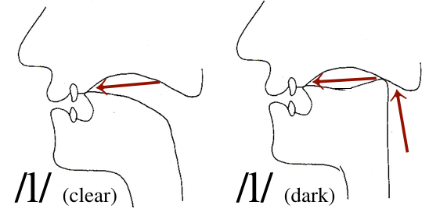
Lateral: Allophones
Light/Clear /l/ (before a vowel): law, leaf, holler, melon
Dark /l/ (at the end or before a consonant): all, feel, holding, mel
Dark /l/ also involves raising the back of the tongue towards the velum.

Slide 7
Approximants
They are vowel-like consonant sounds because we don’t block the airflow fully.
The articulators approach each other but do not get sufficiently close to each other to produce a ‘complete’ consonant such as plosive, nasal, or fricative.
Three approximants in English /j/, /w/, and /r/.

Slide 8
Approximants
The /j/ sound is similar in position to the vowel sound /i:/.
The /w/ sound is similar in position to the vowel sound /u:/, air is partly blocked at the back of the mouth and with the lips.
The /r/ sound involves moving your tongue close to the alveolar ridge (without touching it).

Slide 9
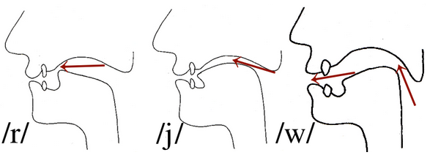
Approximants
Sound /j/ is a palatal.
Sound /w/ is a bilabial.
Sound /r/ is a palato alveolar.

