Slide 1
ENGLISH PHONETICS AND PHONOLOGY
SESSION 5
RIKA MUTIARA, S.Pd., M.Hum.
PENDIDIKAN BAHASA INGGRIS, FKIP

Slide 2
Learning Outcomes
Students are able to define the concept of phoneme and allophone.
Students are able to recognize the symbols and how to read them.

Slide 3
Phonemes
Definition: an abstract set of units as the basis of our speech (Roach, 1998)
A phoneme is conventionally represented by a letter symbol between slant lines (/…/).
There are many slightly different ways in which we make the sounds that represent these phonemes.
Sound b is voiceless. If b is pronounced as voice in bad, we still can understand the meaning of it.
Two different ways of making b means two realisations of the phoneme that does not change meaning.

Slide 4
Allophones
The phoneme is an abstraction. What actually occur are the allophones - to be precise PHONES i.e. sounds which can be grouped together as allophones of a particular phoneme.
Allophones are phonetic realizations of phonemes.
A phoneme consists of one or more allophones.

Slide 5
Allophones
Say the words: tea, too and eighth.
The alveolar allophone [t] in tea [ti] is made with the lips spread.
That in too [twu] is made with pursed or rounded lips (a little, raised 'w' is used to show lip rounding).
In [eit0] 'eighth' the allophone of /t/ is dental
All of them are labelled /t/.
In words, a phoneme may be realised by more than one speech sound and the selection of each variant is usually conditioned by the phonetic environment of the phoneme.

Slide 6
Allophones
Utter the following words slowly: car keys.
In car, the back of the tongue touches the part of the soft palate near the uvula
In key, it is the more front part of the soft palate near the hard palate that the tongue makes contact with.
The two varieties of 'k' are physically different. But they are not functionally different in English. They cannot be used to distinguish word meaning. Rather, they are allophones of the same /k/ phoneme and which one is used on a given occasion depends on what the neighbouring sounds happen to be.

Slide 7
Minimal pairs
The MINIMAL PAIR TEST (i.e. the method of determining that a single sound difference distinguishes the meanings of two words) is a key principle of phonemic analysis.
/mæt/ and /kæt/
/pɪn/ vs /bɪn/ vs /tɪn/ vs /dɪn/ vs /kɪn/

Slide 8
Phonemic transcription
It appears in most dictionaries and represent a very useful study tool as they provide a lot of information about the pronunciation of the word.
It is not based on the actual realisation for example aspirated sounds cannot be seen on it (https://www.youtube.com/watch?v=6PSdlctYBsw).

Slide 9
Symbols

Slide 10
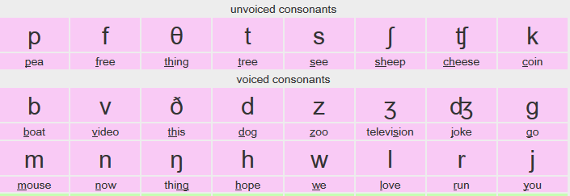
Symbols

Slide 11
Phonemic transcription
Because of some varieties of English such as American English, British English, Australian English, phonemic transcription may vary.

Slide 12
Read
/'ɔ:təm/
/'fɜ:nɪtʃə/
/'aɪlənd/
/mə'ʃi:n/
/'ðəʊ/
/'brəʊʃə/
/'gɔ:dʒəs/
/ˌhaɪə'rɑ:kɪkəl/
/'peɪdʒ/
/'rʌʃə/

